Slide 1

Kubernetes
Node App

Slide 2
Container first

Slide 3
Dockerfile best practices
Use a .dockerignore file
Containers should be immutable & ephemeral
Minimize the number of layers / Consolidate instructions
Avoid installing unnecessary packages
Sort multi-line arguments
Build cache
Build every time
Dockerfile for Development Environment
Understand CMD and ENTRYPOINT

Slide 4
Dockerfile best practices
COPY vs. .dockerignore
COPY vs. ADD
CD, MKDIR vs WORKDIR

Slide 5

Containers

Slide 6
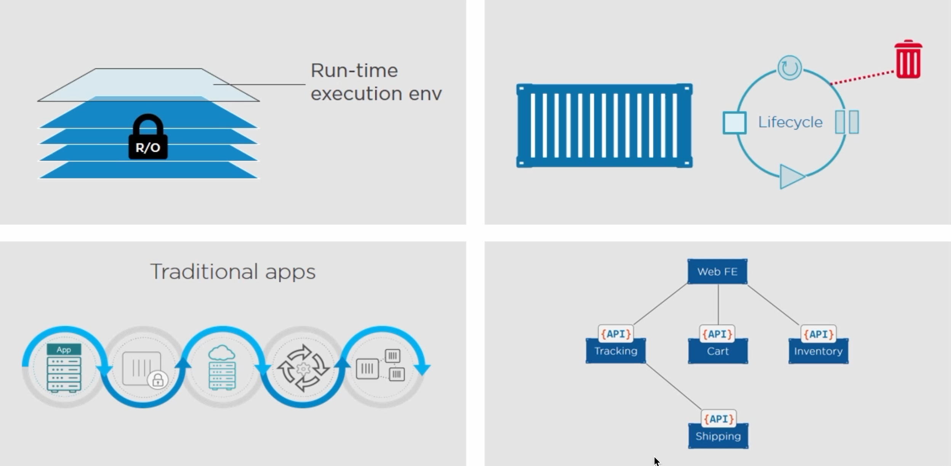
Containers

Slide 7
Logging

Slide 8
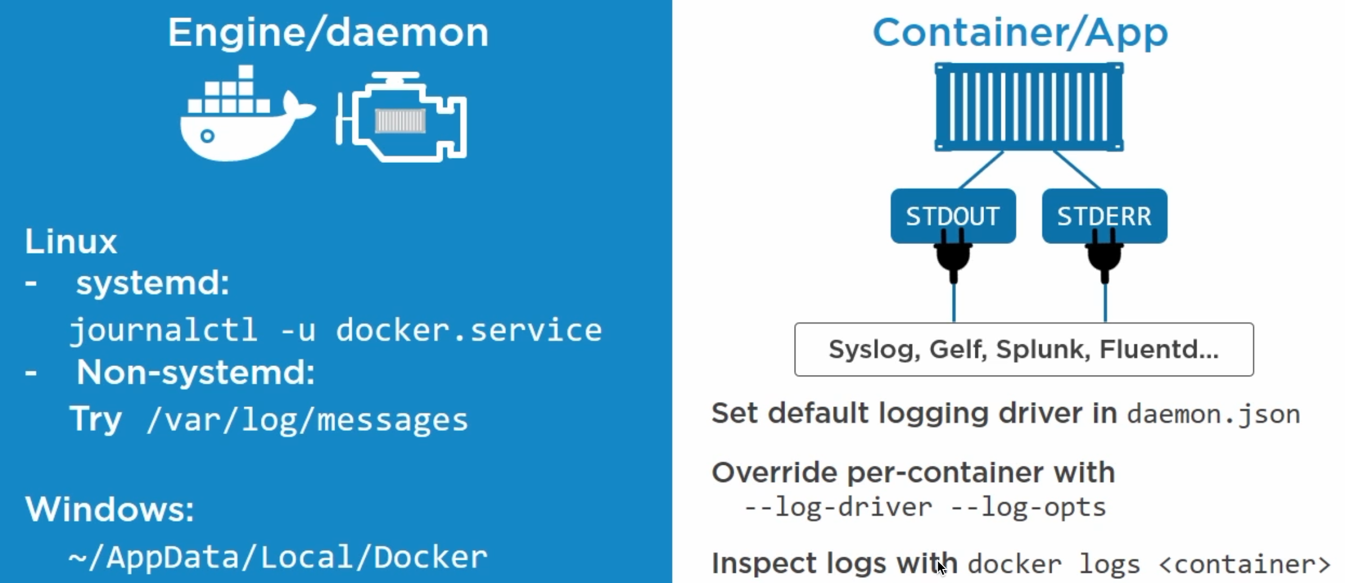
Logging

Slide 9
Graceful shutdown

Slide 10
docker stop
When you issue a docker stop command Docker will first ask nicely for the process to stop and if it doesn't comply within 10 seconds it will forcibly kill it. If you've ever issued a docker stop and had to wait 10 seconds for the command to return you've seen this in action
The docker stop command attempts to stop a running container first by sending a SIGTERM signal to the root process (PID 1) in the container. If the process hasn't exited within the timeout period a SIGKILL signal will be sent.
N-DEV-05503:.docker Nick$ docker stop e1 --time=30

Slide 11
docker kill
By default, the docker kill command doesn't give the container process an opportunity to exit gracefully -- it simply issues a SIGKILL to terminate the container. However, it does accept a --signal flag which will let you send something other than a SIGKILL to the container process.
For example, if you wanted to send a SIGINT (the equivalent of a Ctrl-C on the terminal) to the container "foo" you could use the following:
N-DEV-05503:.docker Nick$ docker kill e1 --signal=SIGINT

Slide 12
docker rm -f
The final option for stopping a running container is to use the --force or -f flag in conjunction with the docker rm command. Typically, docker rm is used to remove an already stopped container, but the use of the -f flag will cause it to the first issue a SIGKILL.
N-DEV-05503:.docker Nick$ docker rm af --force

Slide 13
Receiving signals
When you use docker stop or docker kill to signal a container, that signal is sent only to the container process running as PID 1.
N-DEV-05503:.docker Nick$ docker inspect -f '{{.State.ExitCode}}' 4dd

Slide 14
Kubernetes

Slide 15
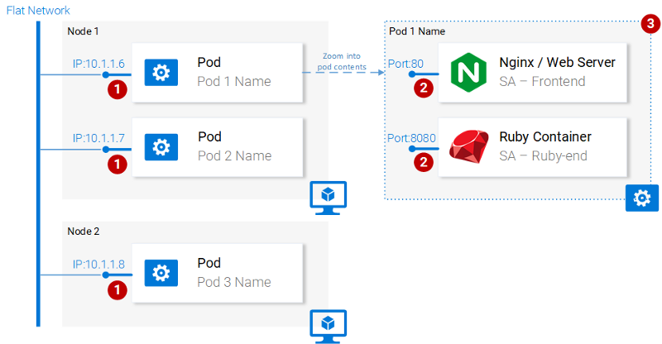
Pods

Slide 16
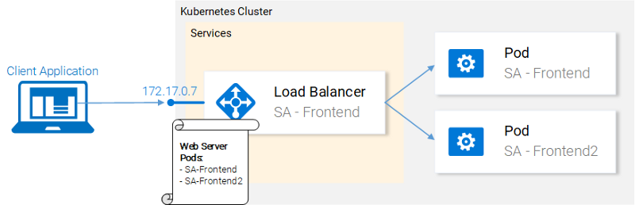
Services

Slide 17
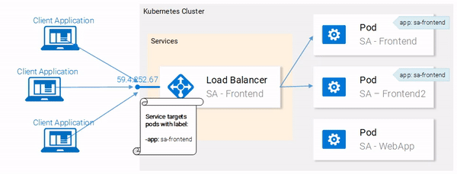
Cluster

Slide 18
Main Points
Dockerfile
Optimize docker image
Stateless
Do not ignore signals
HealthCheck
Liveness and Readiness Probe

Slide 19
Questions ?

Slide 20
Thanks for attention!

