Slide 1

React
Testing

Slide 2
component = ƒ(props, state)
Notes:
React построен на идее веб компонентов.
Компонент принимает данные на вход в виде props, и генерирует HTML.
Этот простой подход обеспечивает простое тестирование приложений.

Slide 3
The Plan
Test types
What we have to test and what we can not test.
Tools:
Test Frameworks
Assertion Libraries
Where to test
Jest
Helper libraries
React Test Utils
Enzyme
Test Redux/Flux

Slide 4




Kind of testing
What difference between Testing kinds

Slide 5
What is Unit testing?
What difference between Testing kinds

Slide 6

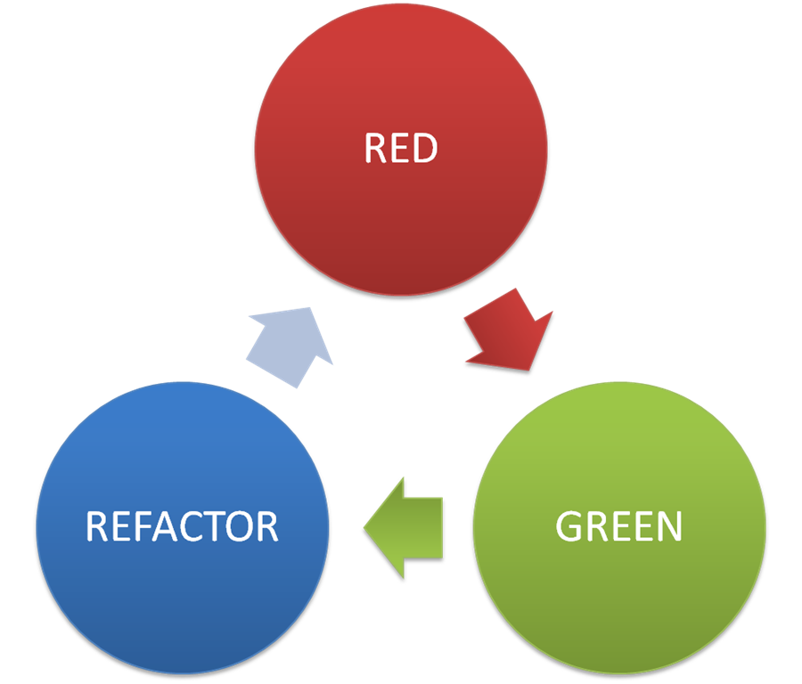
TDD
RED – Green – Refactor Pattern

Slide 7
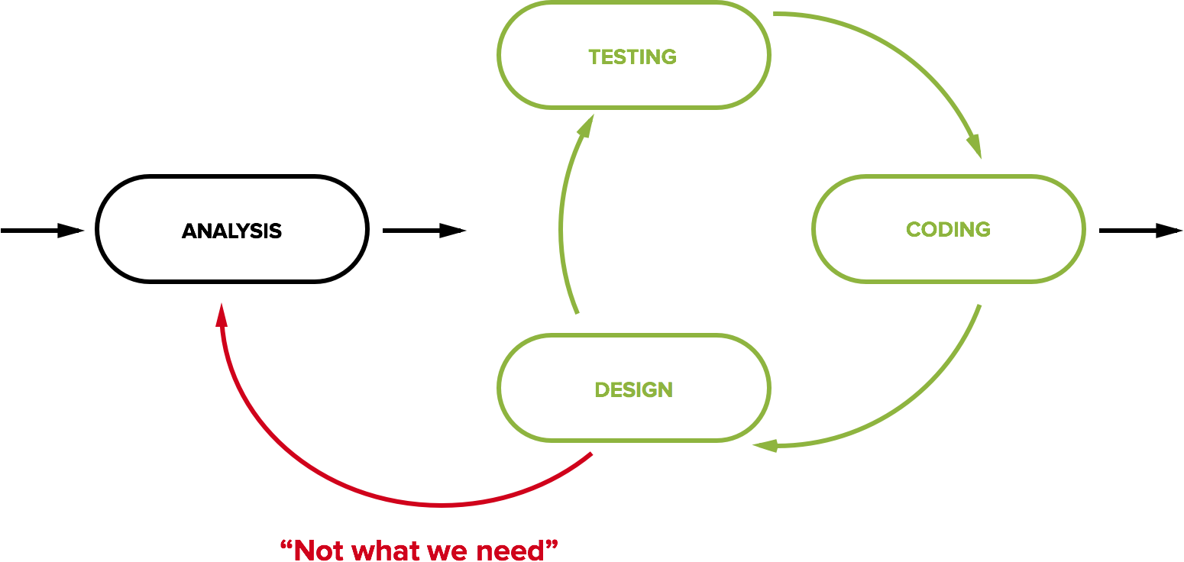
BDD
Behavior Driven development

Slide 8

Refactoring
Refactoring without unit tests calls ‘refucking’

Slide 9



JavaScript Unit Test
Javascript testing frameworks

Slide 10



What we test?
What we have to test?

Slide 11
Test Frameworks
Test Frameworks
Mocha
Jasmine
Jest
Tape
AVA
Assertion Libraries
Expect
Should
Assert
Chai
...
Notes:
-- framework-independent:
Mocha - Mature, most popular, highly configurable, large community
Jasmine - very similar to Mocha
-- related to React:
Jest - from Facebook, based on Jasmine, has some specific features for testing React. Interestingly, but it’s not the most popular for testing React.
--others:
Tape - the minimal, the simplest on the list
AVA - concurrent test run

Slide 12
Where to run tests?
Real browsers
Headless browser (PhantomJS)
JSDOM
Node Environment

Slide 13

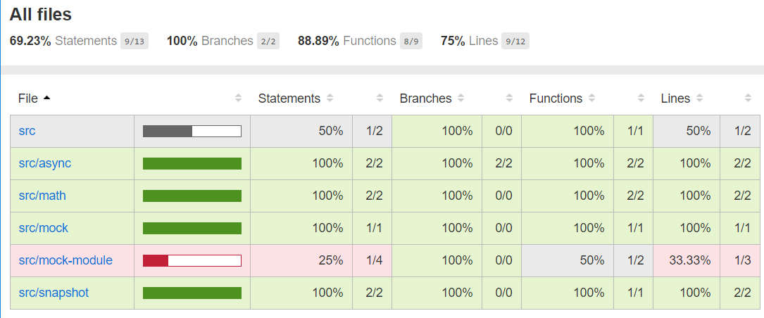
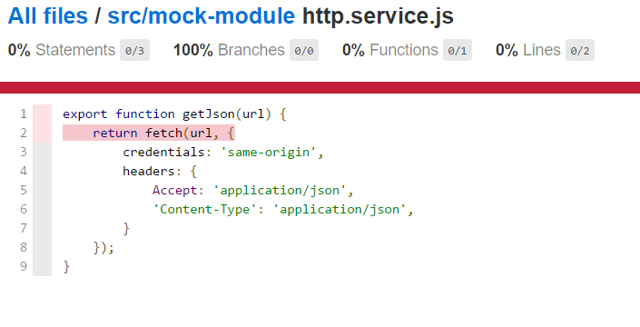
Jest. Coverage

Slide 14
Examples
Can be found here https://github.com/kitos/react-testing
Useful links
http://redux.js.org/docs/recipes/WritingTests.html
https://facebook.github.io/jest/#getting-started
http://airbnb.io/enzyme/index.html
https://facebook.github.io/react/docs/test-utils.html

