Slide 1

React
Training Camp - Lecture -9.
Testing React Apps

Slide 2
component = ƒ(props, state)
Notes:
React построен на идее веб компонентов.
Компонент принимает данные на вход в виде props, и генерирует HTML.
Этот простой подход обеспечивает простое тестирование приложений.

Slide 3
The Plan
Test types
What we have to test and what we can not test.
Tools:
Test Frameworks
Assertion Libraries
Where to test
Jest
Helper libraries
React Test Utils
Enzyme
Test Redux/Flux

Slide 4




Kind of testing
What difference between Testing kinds

Slide 5
What is Unit testing?
What difference between Testing kinds

Slide 6

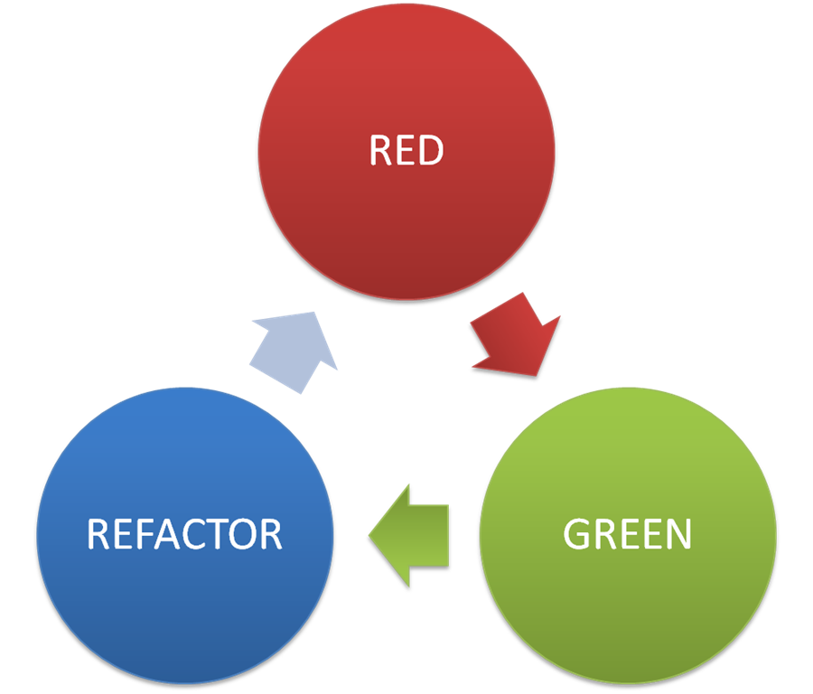
TDD
RED – Green – Refactor Pattern

Slide 7
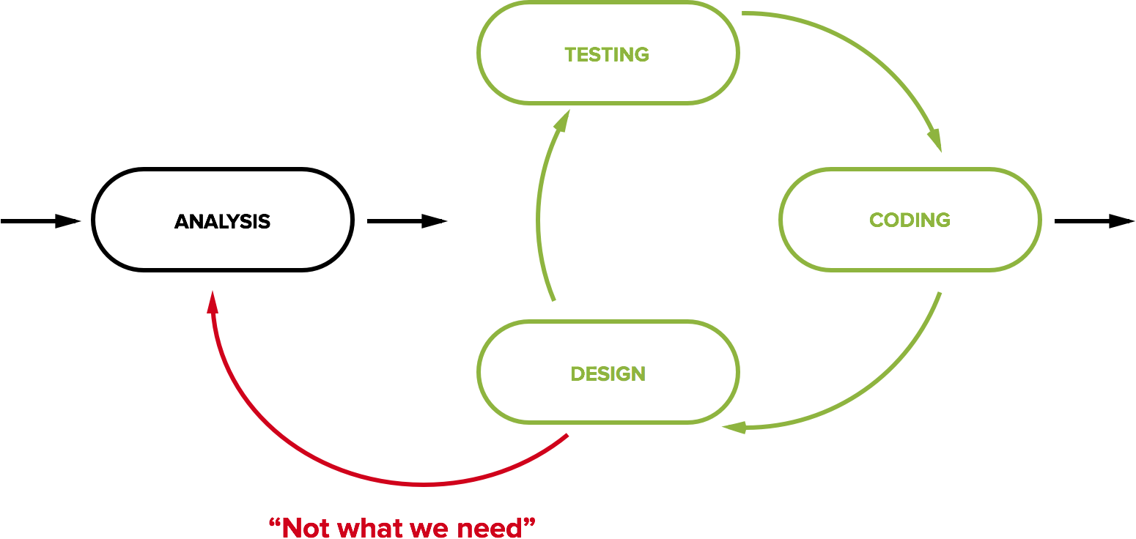
BDD
Behavior Driven development

Slide 8

Refactoring
Refactoring without unit tests calls ‘refucking’

Slide 9



JavaScript Unit Test
Javascript testing frameworks

Slide 10



What we test?
What we have to test?

Slide 11
Test Frameworks
Test Frameworks
Mocha
Jasmine
Jest
Tape
AVA
Assertion Libraries
Expect
Should
Assert
Chai
...
Notes:
-- framework-independent:
Mocha - Mature, most popular, highly configurable, large community
Jasmine - very similar to Mocha
-- related to React:
Jest - from Facebook, based on Jasmine, has some specific features for testing React. Interestingly, but it’s not the most popular for testing React.
--others:
Tape - the minimal, the simplest on the list
AVA - concurrent test run

Slide 12
Where to run tests?
Real browsers
Headless browser (PhantomJS)
JSDOM
Node Environment

Slide 13

Jest
Jest is a bit different from most test runners. Facebook designed it to work well in the context of it's infrastructure:
Monorepo
Sandboxing
providesModule
Error messages are helpful and color coded. Stack traces point to the source of problems quickly
Integrated support for testing with promises and async/await
Jest runs previously failed tests first. Together with --bail it provides useful signal quickly
Integrated manual mocking library
Automatically find tests related to changed files to execute in your project with -o
Run tests in parallel processes to minimize test runtime
Notes:
Monorepo At Facebook we have a huge monorepo that contains all of our JavaScript code
Sandboxing Another feature of Jest that's important to Facebook is how it virtualizes the test environment and wraps require in order to sandbox code execution and isolate individual tests
providesModule If you've looked at any of our open source JavaScript projects before, you may have noticed that we use a @providesModule header to assign globally unique IDs to modules. This does require some custom tooling, but it allows us to reference modules without relative paths which has helped us move incredibly fast, has scaled well as our engineering organization has grown, and has fostered code sharing across the entire company

Slide 14
Jest. Describe, it
// math.test.js
import { increment, add } from './math';
describe('math.js', () => {
it('should increment',
() => expect(increment(1)).toBe(2));
it('should add',
() => expect(add(2, 3)).toBe(5));
});
// math.js
export function increment(n) {
return ++n;
}
export function add(a, b) {
return a + b;
}
Notes:
Nothing new here, if you’ve already worked with jasmine/mocha: describe (used to logically group tests) and it to wrap test.

Slide 15
Jest. Assertions
describe('math.js', () => {
it('should have add method',
() => expect(add).toBeDefined());
describe('nonExistingMethod', () => {
it('should not exists',
() => expect(nonExistingMethod).not.toBeDefined());
it('should throw',
() => expect(() => nonExistingMethod()).toThrow());
});
});

Slide 16
Jest. Mock, Spy
// mock.test.js
import { functionWithCallback } from './mock';
describe('mock', () => {
jest.useFakeTimers();
it('should execute callback', () => {
const cb = jest.fn();
functionWithCallback(cb);
jest.runAllTimers();
expect(cb).toHaveBeenCalled();
expect(setTimeout.mock.calls[0][1]).toBe(1000);
});
});
// mock.js
export function functionWithCallback(cb) {
setTimeout(cb, 1000);
}

Slide 17
Jest. Async / Promises
// async.test.js
import { ajaxGet } from './async';
describe('ajax', () => {
it('should return some data', () => {
return ajaxGet('/known-endpoint')
.then(data => expect(data).toBe('Some data'));
});
it('should return error on other endpoints', () => {
return ajaxGet('/other')
.catch(data => expect(data).toBe('Error!'));
});
});
// async.js
export function ajaxGet(url) {
return new Promise((resolve, reject) => {
url === '/known-endpoint'
? resolve('Some data')
: reject('Error!');
});
}
Notes:
Usually our code has not just timeouts, but it has some async ajax call.

Slide 18
Jest. Mock modules
// http.service.js
export function getJson(url) {
return fetch(url, {
credentials: 'same-origin',
headers: {
Accept: 'application/json',
'Content-Type': 'application/json',
}
});
}
// user.service.js
import { getJson } from './http.service';
export function getUser(id) {
return getJson(`/users/${id}`);
}

Slide 19
Jest. Mock modules
describe('user.service', () => {
const getJsonMock = jest.fn()
.mockReturnValue(Promise.resolve('User'));
jest.mock('./http.service', () => ({
getJson: getJsonMock
}));
const getUser = require('./user.service').getUser;
it('should request user by /user/:id', () => {
return getUser(1).then(
() => expect(getJsonMock).toHaveBeenCalledWith('/users/1'));
});
});
Notes:
Angular implemented DI to make it more testable. With jest you can easily mock modules also!

Slide 20
Jest. Lifecycle method
afterEach(function () {
jest.resetAllMocks();
jest.clearAllTimers();
});

Slide 21
Jest. React Snapshot Testing
// my-component.js
import React from 'react';
const MyComponent = ({ title, children }) => (
<section>
<header>{title}</header>
<p>{children}</p>
</section>
);
export default MyComponent;
// my-component.test.js
import React from 'react';
import renderer from 'react-test-renderer';
import MyComponent from './my-component';
it('should be rendered correctly', () => {
const component = renderer.create(
<MyComponent title="some title">
some content
</MyComponent>
);
const tree = component.toJSON();
expect(tree).toMatchSnapshot();
});

Slide 22
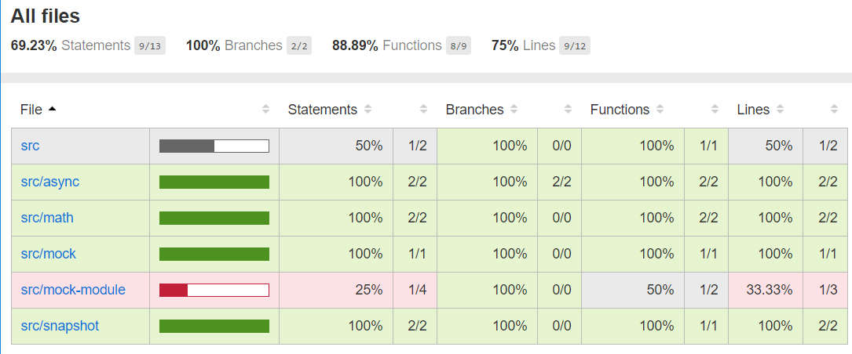
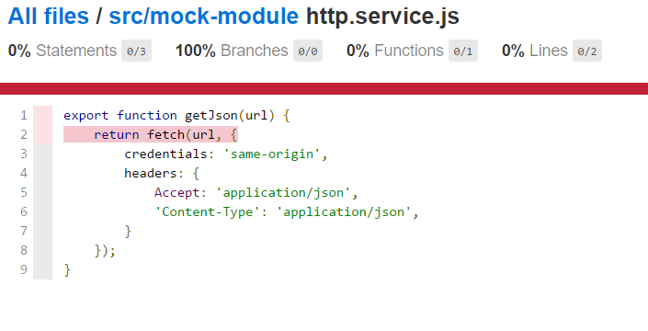
Jest. Coverage

Slide 23
questions

Slide 24
Helper Libraries
React Test Utils
Enzyme

Slide 25

React Test Utils
Rendering the component
Querying rendered components
Assertions on a component
Simulate events

Slide 26
React Test Utils
class CheckboxWithLabel extends React.Component {
...
render() {
return (
<label>
<input
type="checkbox"
checked={this.state.isChecked}
onChange={this.onChange}
/>
{this.state.isChecked ? this.props.labelOn : this.props.labelOff}
</label>
);
}
}
import React from 'react';
import ReactTestUtils from 'react-addons-test-utils';
import CheckboxWithLabel from './CheckboxWithLabel';
describe('CheckboxWithLabel', () => {
it('should display labelOff by default', () => {
//Arrange
const renderer = ReactTestUtils.createRenderer();
//Act
renderer.render(<CheckboxWithLabel labelOff="Off" labelOn="On" />);
const result = renderer.getRenderOutput();
//Assert
expect(result.type).toBe('label');
const label = result.props.children[1];
expect(label).toEqual('Off');
});
});

Slide 27
React Test Utils: Render Options
Shallow Render
Render component one level deep
No DOM required
Fast and simple
Does not support refs
Does not support event simulation
Component lifecycle limitations
Render into DOM
Render component and children
Requires DOM
Supports interactions

Slide 28
Shallow Rendering
function MyComponent() {
return (
<section>
<span className="heading">Title</span>
<Subcomponent foo="bar" />
</section>
);
}
function Subcomponent({foo}) {
return (
<section>{foo}</section>
);
}
test('Shallow render should render one level deep', () => {
//Arrange
const renderer = ReactTestUtils.createRenderer();
//Act
renderer.render(<MyComponent />);
const result = renderer.getRenderOutput();
//Assert
expect(result.type).toBe('section');
expect(result.props.children[0].type).toBe('span');
expect(result.props.children[1]).toEqual(<Subcomponent foo="bar" />);
});

Slide 29
renderIntoDocument
import React from 'react';
import ReactTestUtils from 'react-addons-test-utils';
import CheckboxWithLabel from '../components/CheckboxWithLabel';
describe('CheckboxWithLabel', () => {
it('should update label on change', () => {
//Arrange
const component = ReactTestUtils.renderIntoDocument(<CheckboxWithLabel labelOn="On" labelOff="Off" />);
const checkbox = ReactTestUtils.findRenderedDOMComponentWithTag(component, 'input');
const span = ReactTestUtils.findRenderedDOMComponentWithTag(component, 'span');
//Act
ReactTestUtils.Simulate.change(checkbox);
//Assert
expect(span.textContent).toBe('On');
});
});

Slide 30
React Test Utils API
shallowRenderer.render()
renderIntoDocument()
Simulate
isElement()
isElementOfType()
isDOMComponent()
isCompositeComponent()
isCompositeComponentWithType()
findAllInRenderedTree()
scryRenderedDOMComponentsWithClass()
findRenderedDOMComponentWithClass()
scryRenderedDOMComponentsWithTag()
findRenderedDOMComponentWithTag()
scryRenderedComponentsWithType()
findRenderedComponentWithType()

Slide 31
questions

Slide 32
Enzyme
React Test Utils
findAllInRenderedTree()
scryRenderedDOMComponentsWithClass
findRenderedDOMComponentWithClass()
scryRenderedDOMComponentsWithTag()
findRenderedDOMComponentWithTag()
scryRenderedComponentsWithType()
findRenderedComponentWithType()
Enzyme
find

Slide 33
Enzyme = RTU + Cheerio

Slide 34
Testing with Enzyme
import React from 'react';
import { shallow } from 'enzyme';
import CheckboxWithLabel from './CheckboxWithLabel';
describe('<CheckboxWithLabel />', () => {
it('should update label on change', () => {
//Arrange
const component = shallow(<CheckboxWithLabel labelOff="Off" labelOn="On" />);
expect(component.find('span').text()).toBe('Off');
//Act
const checkbox = component.find('input');
checkbox.simulate('change');
//Assert
expect(component.find('span').text()).toBe('On');
});
});

Slide 35
Enzyme Rendering
Shallow Rendering
import { shallow } from 'enzyme';
const wrapper = shallow(<MyComponent />);
// ...
Full Rendering
import { mount } from 'enzyme';
const wrapper = mount(<MyComponent />);
// ...
Static Rendering
import { render } from 'enzyme';
const wrapper = render(<MyComponent />);
// ...

Slide 36
Enzyme Wrapper APIs
.find(selector)
.hasClass(className)
.is(selector)
.children()
.parent()
.closest(selector)
...

Slide 37
Enzyme integrates with...
chai-enzyme with Mocha/Chai
jasmine-enzyme with Jasmine
jest-enzyme with Jest
...

Slide 38
questions

Slide 39

Redux testing. Actions creators
// action-creator.js
let id = 0;
export function addTodo(text) {
return {
type: 'add_todo',
payload: {
id: id++,
text
}
}
}
// action-creator.test.js
import { addTodo } from './action-creator';
describe('action-creators', () => {
it('should return todo with passed text and generated id', () => {
const text = 'write test';
const addTodoAction = addTodo(text);
expect(addTodoAction.type).toBe('add_todo');
expect(typeof addTodoAction.payload.id).toBe('number');
expect(addTodoAction.payload.text).toBe(text);
});
});

Slide 40
Redux testing. Reducers
Big example, go to IDE...

Slide 41
Examples
Can be found here https://github.com/kitos/react-testing
Useful links
http://redux.js.org/docs/recipes/WritingTests.html
https://facebook.github.io/jest/#getting-started
http://airbnb.io/enzyme/index.html
https://facebook.github.io/react/docs/test-utils.html

