Slide 1
Remove 6 → into 20 pages
Parties : Graph (base rapide + conv) – fem – deepsphere/nn (d’abord nn en général, slide formule cool, puis fcnn, puis deepsphere, la partie monomials) – modifications effectuées (algo itératif, cholesky triste car full matrix)
A la fin : résumé de ce que j’ai fait et appris

Slide 2
Using the FEM Laplacian in Deepsphere

Slide 3
Goal
Ability to use Convolutional Neural Networks on spherical data (weather/space maps...)
Have it be rotation-equivariant by design
Have it be efficient !

Slide 4
What has been done
Deepsphere uses a graph to approximate the sphere,
It uses a convolutional NN,
It uses the Graph Laplacian to approximate the sphere’s Laplace-Beltrami operator.
Explanation next slide !

Slide 5
Without approximations
The sphere is a manifold, with a defined “Laplace-Beltrami operator” : Δ.
We want to do convolutions.
These are easy in Fourier space.
Fourier transform = a decomposition relative to Δ’s eigenfunctions.

Slide 6
Graph approximation
Let’s approximate the sphere with a graph,
Sample nodes on the sphere with HEALPix,
Define weighted edges somehow* → Graph!
We can define a Laplace Operator for it!
* For the HKGL :

Slide 7
Graph approximation
The (discrete) Graph Laplacian L :
Matrix representation of Δ,
Graph sparsely connected ⇒ L sparse,
Graph undirected ⇒ L symmetric.

Slide 8
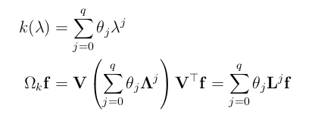
Graph convolutions
L is eigendecomposable :
Define Fourier Transform :
Define “a filter” :
Define convolution :
(Finally, use polynomial filters for efficiency)
Cheat :

Slide 9
Graph Laplacian’s problems
How to get convergence of L’s eigenvectors to the real Δ’s eigenfunctions?
HKGL converges if the graph...
  fully connected (⇒not sparse)
  nodes equi-area-sampled* (⇒not easy) & filter width t well-tuned.
* It still ~works if the sampling is regular enough

Slide 10
FEM approximation
Approximate sphere with a triangulation T
Discretize signals on that
Turns out that FEM filtering ≅ Graph filtering
FEM Laplacian still converges with more irregular samplings !

Slide 11

FEM explanation (see board)
We want Δ’s eigenfunctions, find f :
Insert test function ν + integrate by parts :
(find f such that this holds for all ν in our function space)

Slide 12

FEM explanation (see board)
ν ∈ continuous piecewise-linear funcs on T
T has a basis :
Just prove for all bases :
with

Slide 13
FEM explanation (see board)
Define FEM Laplacian :
A and B as full as triangles share vertices
A and B symmetric
L not sparse, nor symmetric!
⇒ We will use tricks

Slide 14
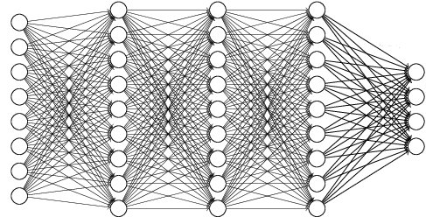
Neural network
Computes any function, given enough nodes
Can be “trained” by descending gradients
This one is fully connected ⇒ heavyweight

Slide 15
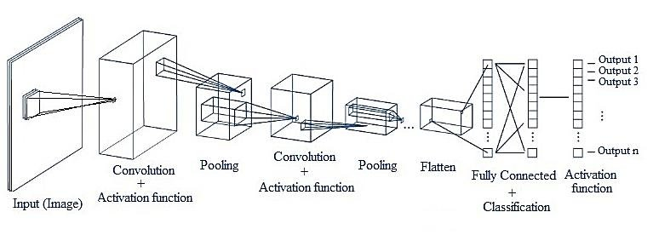
Convolutional neural network
Translation-equivariant feature extraction
Less connected + shared parameters ⇒
lightweight

Slide 16

Deepsphere’s conv layers
Use polynomial filters :
Simpler convolution :
Compute powers of L iteratively :
Convolution : a full, but small K K matmul

Slide 17

Our FEM modifications
The FEM Laplacian isn’t sparse nor symmetric
Powers of L must be computed another way :
Solving can be optimized because B sparse!
But B is symmetric and positive-definite too!

Slide 18
Our FEM modifications
B can be Cholesky-decomposed :
C lower-triangular + about as sparse as B
Sadly, tf has no “sparse_cholesky_solve“
This limits us to B and chol(B) being full…

Slide 19
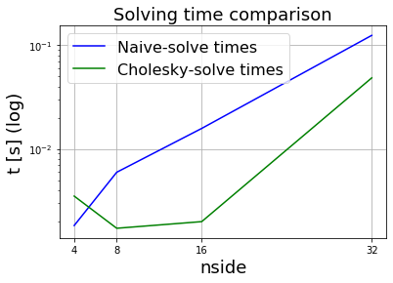
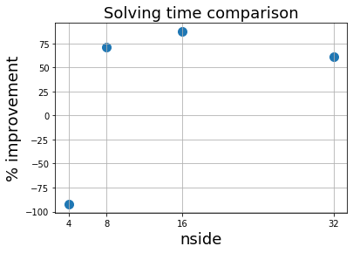
Our FEM modifications
nside ≤ 32 since the full B outgrows 2GB…
Unexpected green rise… Low memory ? (4GB)

