Slide 1

welcome
to
Phishing Awareness Training
SUBMITTED BY
MALU G

Slide 2
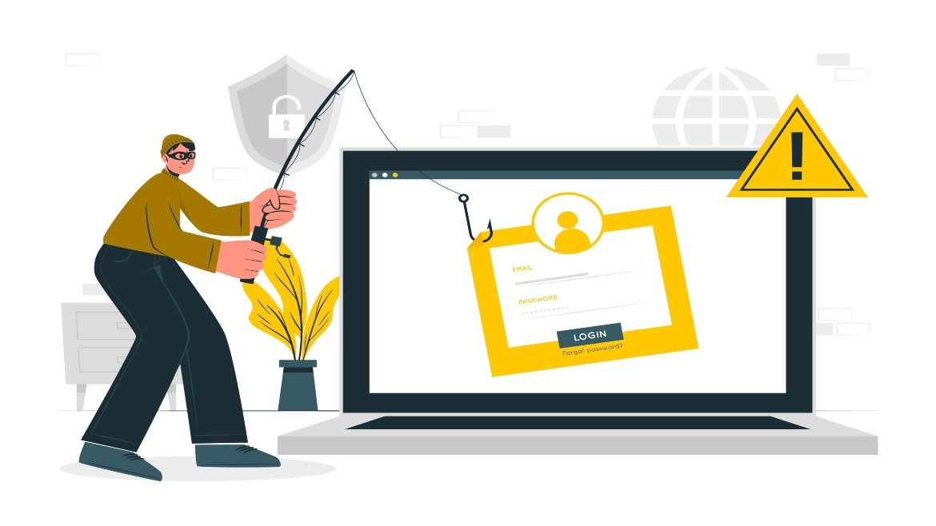
INTRODUCTION OF Phishing

Slide 3
1
TABLE OF CONTENTS
1. Introduction to Phishing
2. Types of Phishing Attacks
3.Recognizing Phishing Emails
4. Recognizing Phishing Websites
5. Social Engineering Tactics
6. How to Avoid Phishing Attacks
7. Interactive Quiz
8. Resources for Further Learning
9. Conclusion
2
5
3
4

Slide 4
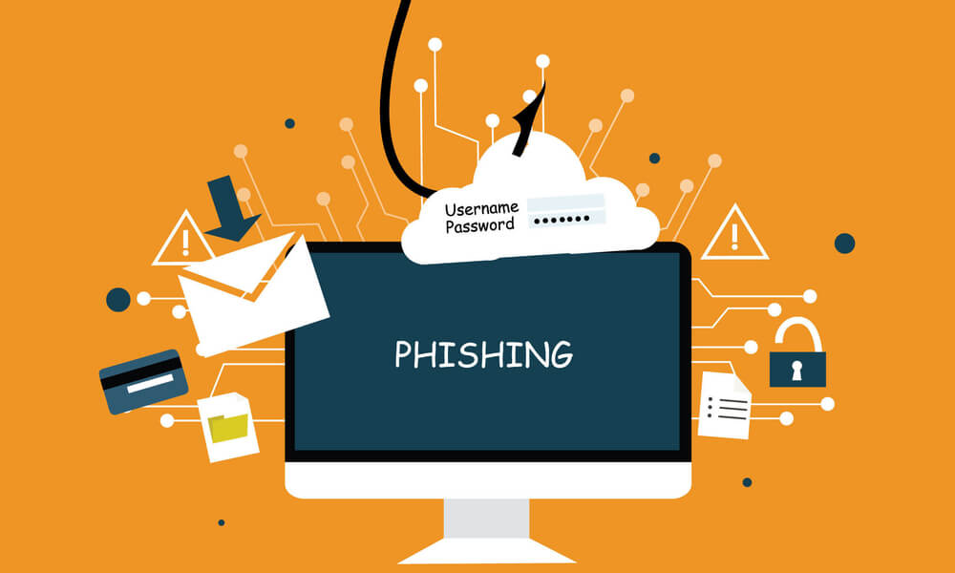
What is PHISHING
**What is Phishing?**
- Phishing is a form of cyber attack aimed at tricking individuals into providing sensitive information such as usernames, passwords, or financial details.
**Why is it Important?**
- Phishing attacks are among the most common cybersecurity threats, leading to significant data breaches and financial losses.
**Statistics:**
- In 2023, 75% of organizations reported experiencing phishing attacks, with an average cost of $1.6 million per incident.

Slide 5
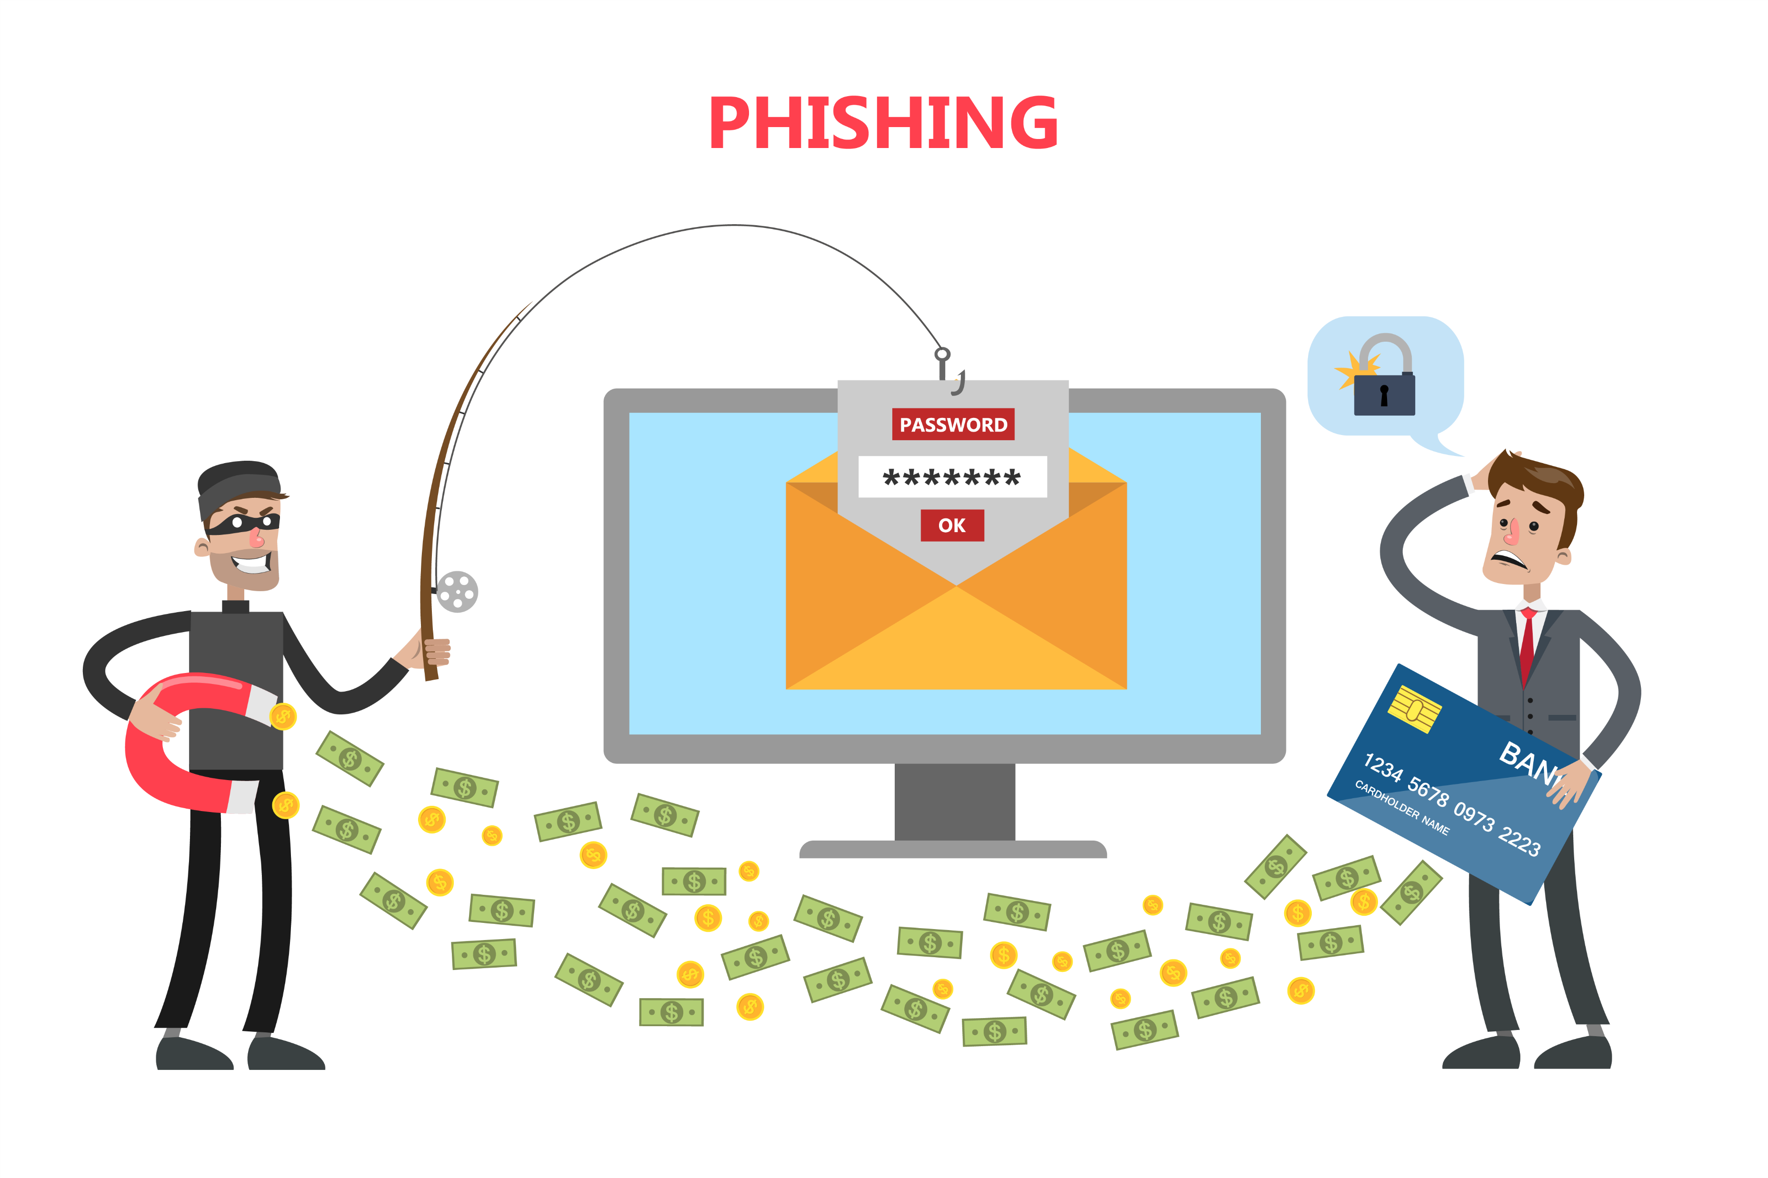
Types of Phishing Attacks
**1. Email Phishing:**
- Fraudulent emails that appear to come from legitimate sources.
**2. Spear Phishing:**
- Targeted emails aimed at specific individuals or organizations, often using personal information.
**3. Whaling:**
- High-level phishing attacks directed at senior executives, often designed to steal sensitive corporate data.
**4. Vishing (Voice Phishing):**
- Phishing conducted via phone calls, where attackers impersonate trusted entities.
**5. Smishing (SMS Phishing):**
- Phishing attempts via text messages, often with malicious links or urgent requests.

Slide 6
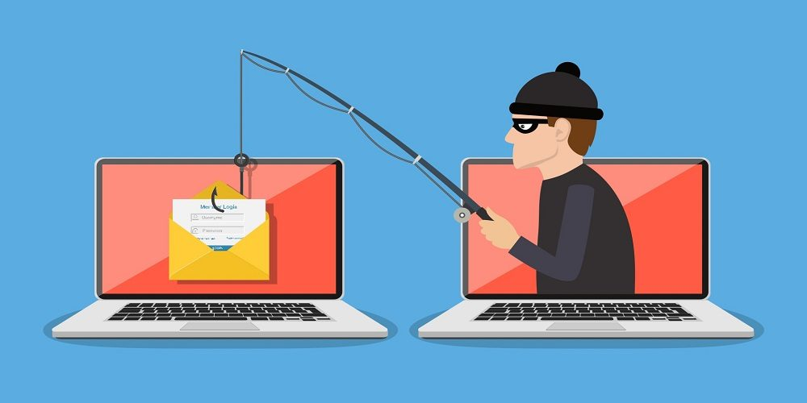
Recognizing Phishing Emails
Key Signs of Phishing Emails
Suspicious Sender Addresses
Check the email domain for typos or strange names..
Generic Greetings
Phishing emails often use non-specific greetings (e.g., "Dear Customer")
Urgent Language
Messages that create a sense of urgency or fear (e.g., "Your account will be locked!

Slide 7
Recognizing Phishing Emails
Key Signs of Phishing Emails
Poor Spelling and Grammar
Many phishing emails contain noticeable errors.
Unusual Attachments or Links
Be cautious of unexpected attachments and hover over links to check URLs before clicking

Slide 8
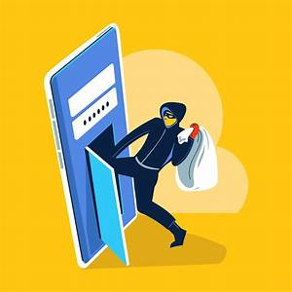
Recognizing Phishing Websites
Common Indicators of Phishing Websites
Check the URL
Look for misspellings or unfamiliar domains.
HTTPS and Padlock Icon
Ensure the site uses HTTPS; however, this alone does not guarantee safety.

Slide 9
Recognizing Phishing Websites
Common Indicators of Phishing Websites
Pop-Ups
Be wary of unexpected pop-ups asking for personal information.
Verify Through Official Sources
If in doubt, go directly to the official website by typing the URL into your browser

Slide 10
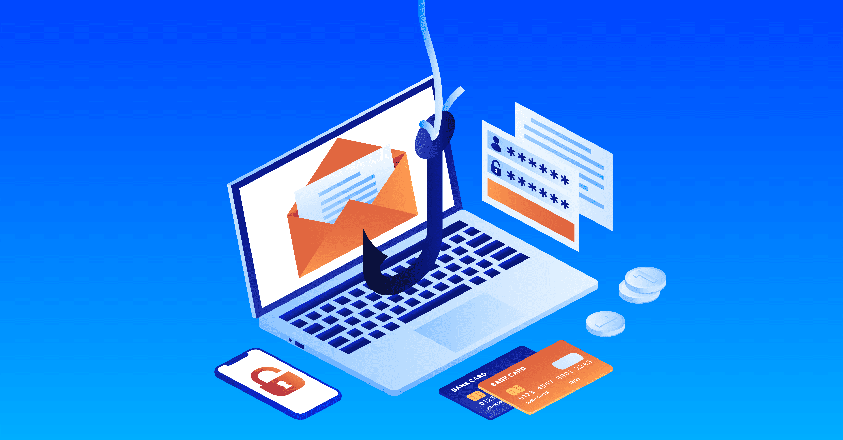
Social Engineering Tactics
What is Social Engineering
Manipulation techniques used to trick individuals into divulging confidential information.
Common Techniques
*Impersonation*
Attackers may pose as trusted figures (e.g., IT personnel).
*Creating Urgency*
Messages that pressure you to act quickly, such as “Immediate action required!”.

Slide 11
Social Engineering Tactics
Rewards or Incentives
Offers of free gifts or financial rewards to entice individuals into providing information.

Slide 12
How to Avoid Phishing Attacks
Best Practices to Stay Safe
Verify the Sender
Always check the sender's email address before clicking links or downloading attachments.
Enable Multi-Factor Authentication (MFA)
Add an extra layer of security to your accounts.
Report Suspicious Emails
Inform your IT department about any suspicious emails.
Keep Software Updated
Regularly update your operating system and security software to protect against vulnerabilities.

Slide 13
Interactive Quiz
Quiz: Identify Phishing
1. Review the sample email on the next slide.
2. Is it a phishing attempt? Why or why not?
Actions to Take
If you receive a suspicious email, what should you do?
A. Click the link
B. Delete it and report it
C. Reply to ask if it’s legitimate

Slide 14
Resources for Further Learning
Recommended Resources
- Anti-Phishing Working Group
[apwg.org](https://apwg.org/)
-Cybersecurity & Infrastructure Security Agency (CISA)
[cisa.gov](https://www.cisa.gov/)
-Online Courses
Platforms like Coursera, Udemy, and LinkedIn Learning offer courses on cybersecurity awareness

Slide 15
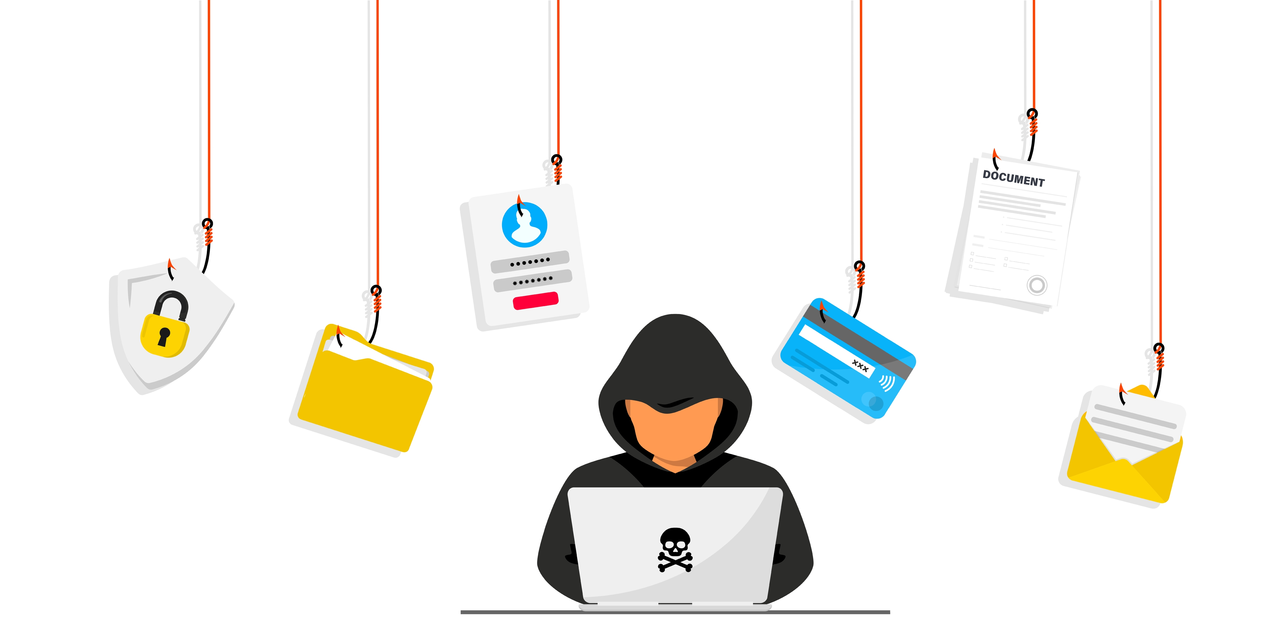
CONCLUSION
Phishing is a type of cyber attack that uses deceptive tactics to trick individuals into providing sensitive information, such as usernames, passwords, credit card numbers, and other personal data. Attackers often impersonate legitimate organizations or trusted figures to gain the victim's trust.
Attackers gather information about their targets, such as email addresses or names, to make their attempts more convincing.
Phishing can lead to severe consequences, including:
Financial Loss
Identity Theft
Data Breaches
Reputation Damage

Slide 16
CONCLUSION
Key Takeaways
- Stay informed about phishing tactics and best practices.
- Always be vigilant and verify suspicious communications.
- Encourage a culture of reporting and awareness in your organization.
Questions
- Open the floor for any questions or experiences participants would like to share.

