Slide 1
Investigating Hit and Runs
Malu Dee
February 15, 2017

Slide 2
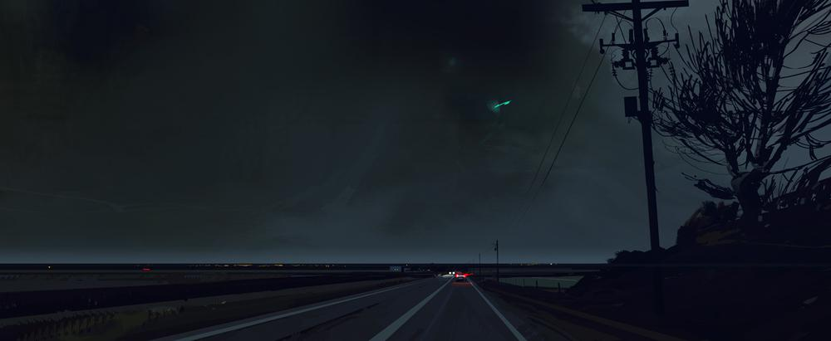
`
Can we classify drivers who leave the scene of a fatal accident?
About 5% of recorded fatal traffic accidents in 2015 were hit and runs
Difficult to catch and convict drivers who leave the scene of an accident
Examined data from National Highway Traffic Safety Administration for 2015

Slide 3
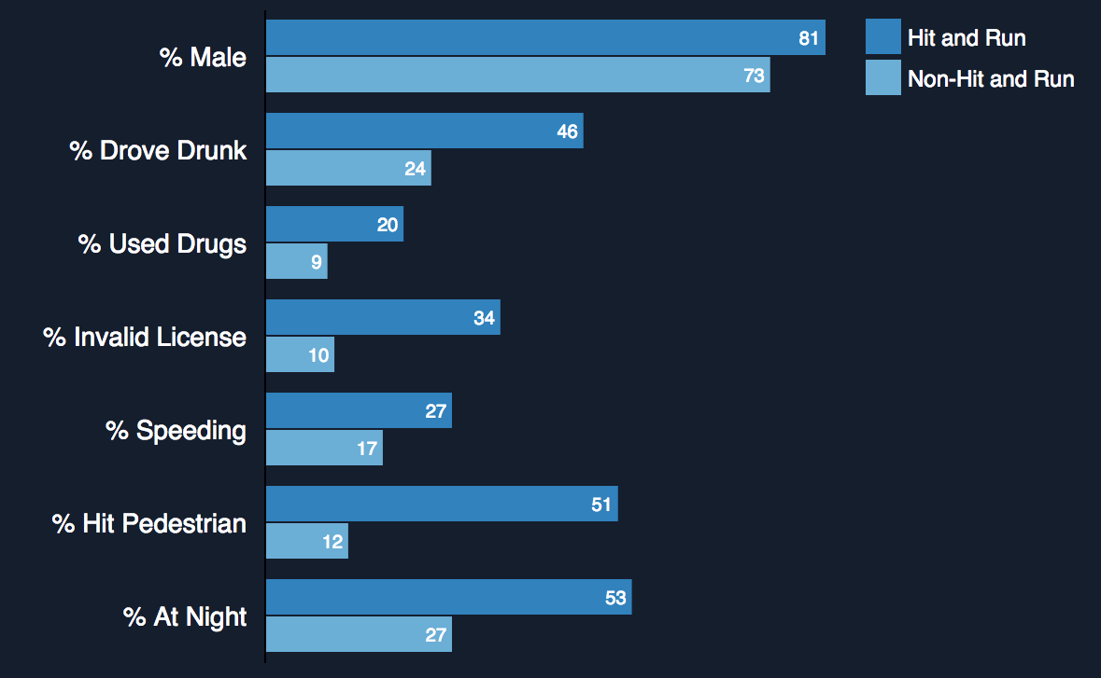
Hit and Runs vs. Other Fatal Accidents

Slide 4
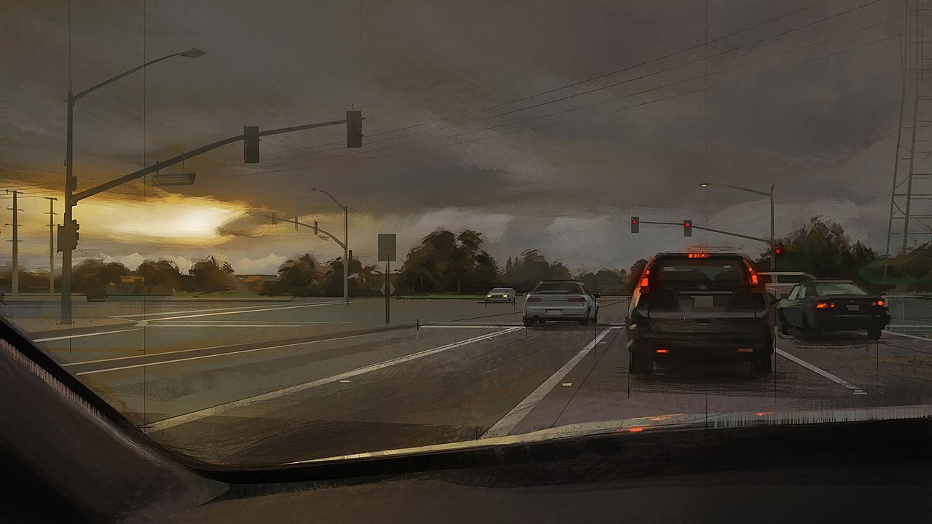
How can we find the drivers of fatal hit and runs?

Slide 5
Data Cleaning and Models
2015 Data – All Fatalities
Observations:
~ 34K
Features :
~ 100
Included:
Detailed vehicle information
Drivers, people involved
Weather, light conditions
Roads
Time of year/month/day
Limit to hit and runs
Data cleaning
Model selection
Simplify features
Drop select features

Slide 6
Facts: Traffic Fatalities
Was the driver drinking?
Was the driver male or female?
Logistic Regression scores (test data):
Accuracy : 0.78
Precision: 0.66
Recall: 0.87
Confusion Matrix:
Logistic Regression scores (test data):
Accuracy : 0.74
Precision: 0.67
Recall: 0.39
Confusion Matrix:
Predicted
Predicted
Not drinking
Drinking
Male
Female
48
4
59
19
Not drinking
Male
Actual
Actual
17
27
6
12
Drinking
Female

Slide 7
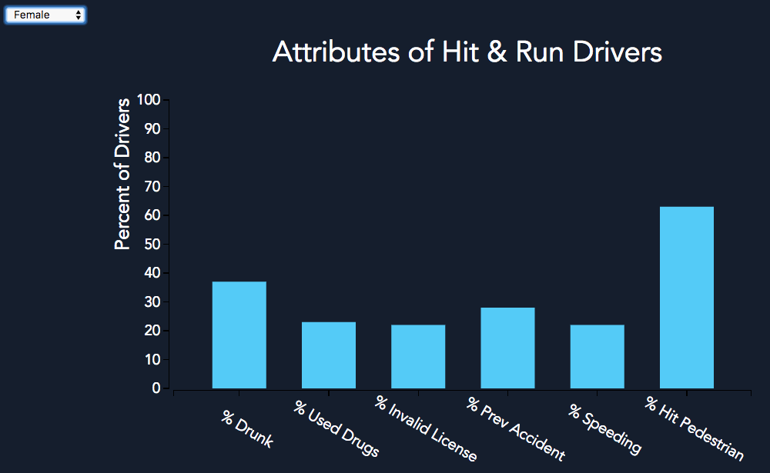
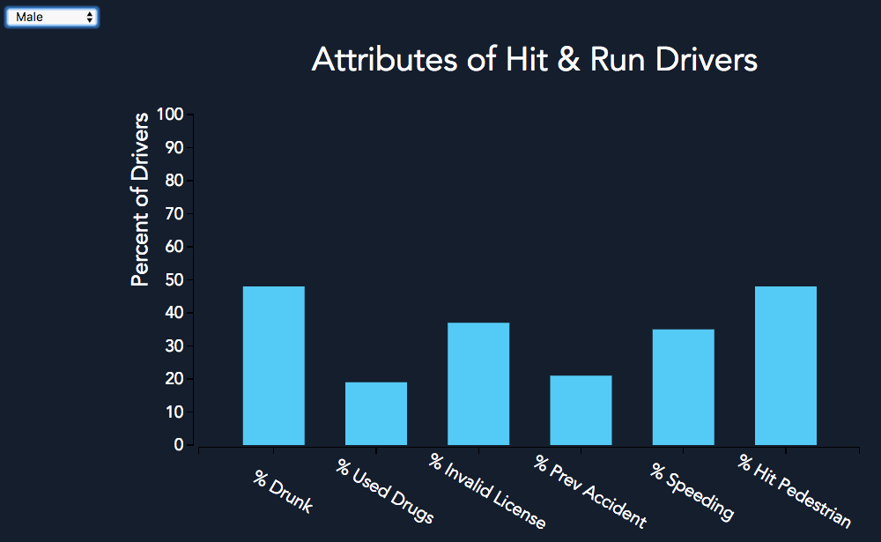
Comparing Hit & Run Drivers by Gender
Similar profiles of male and female hit and run drivers
Largest disparities:
Drinking (males, 48% vs females, 37%)
Hit pedestrian (males, 48% vs females, 63%)
Difficult for model to distinguish between males and females
Notes:
LiveSlide Site
http://0.0.0.0:8000/

Slide 8
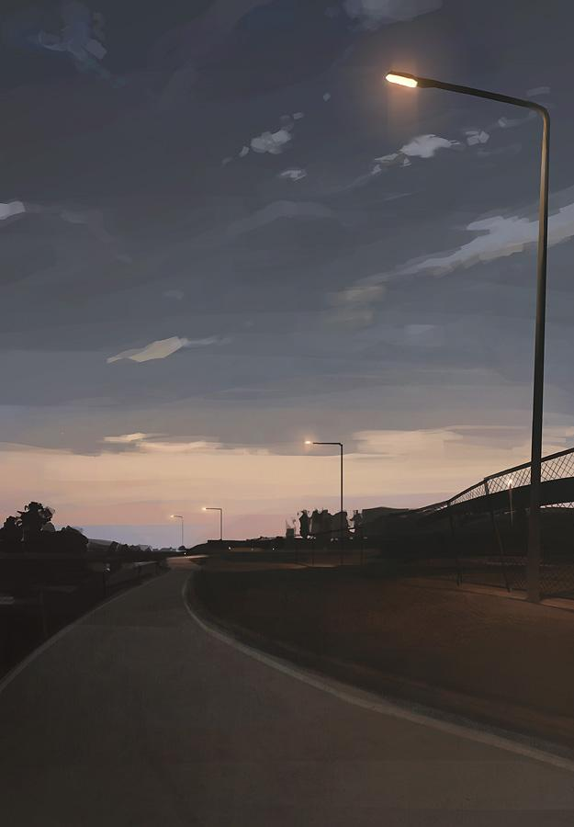
Next Steps...
Model improvement:
Use data from previous years
Larger sample size
Real world:
Hit and run alert systems
Cameras/witnesses for more complete information

Slide 9
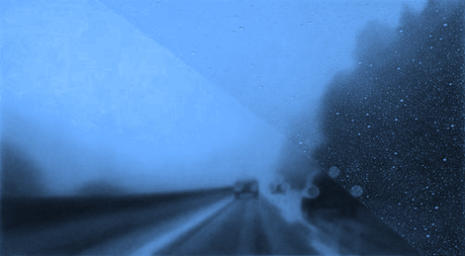
Questions?

Slide 10
Data Sources:
NHTSA (National Highway Traffic Safety Administration) 2015 Traffic Fatalities.
Link: https://www.transportation.gov/briefing-room/traffic-fatalities-sharply-2015

Slide 11
Image Sources:
Image 1: Landscape by Stuart Kim
Link: http://www.stuartkim.com/
Image 2: Harry Potter Concept Art by Alberto Mielgo
Link: http://www.albertomielgo.com/info/
Image 3:
“Dusk” by Luke Mancini
Link: http://conceptartworld.com/artists/luke-mancini/

