Slide 1

Data_Sharkleaner
A pandas project to clean a shark attack database (kaggle)

Slide 2
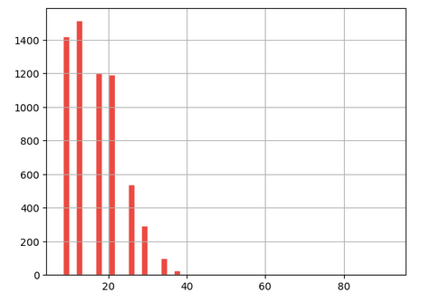
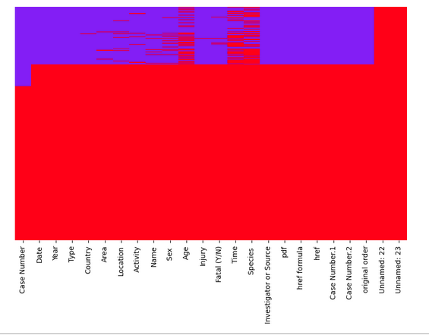
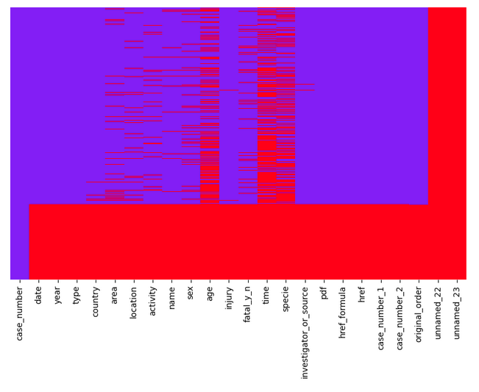
# INDEX:
1. Set working directory, load modules
2. Load raw data frame
3. Explore basic properties (shape, info..)
# 4. Cleaning steps
4.0 Rename columns if necessary
I replaced the column name "se" for "sex"
4.1 NA'S per row - drop rows with 100% of NA's
4.2 Check and drop duplicated rows
Histogram of % NA per row
25,723 rows
and 24 columns
Drop rows with 100% of NAS’
Drop rows with >40% of NAS’
17,020 rows
with 100% NA values
2,394 rows

Slide 3
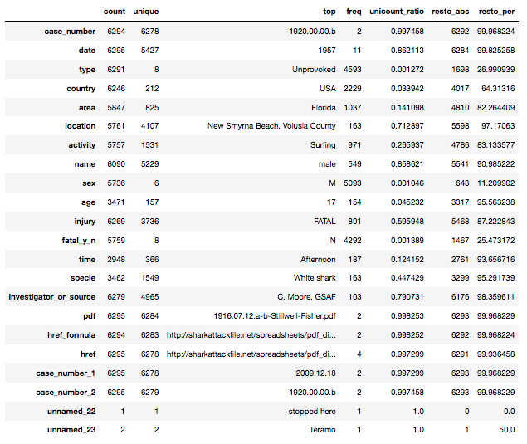
## Investigate the columns by their unique_count/freq ratio
Top rows: indicate there are MANY LEVELS with very LOW FREQ:
'case_number' should be an identifier and not present duplicated values!!!
That behavior is expected for 'case_number' and 'date' data types
According to wikipedia, there only exists 195 countries in the world but this column contains 212 unique values!!!! Check in the next cell bellow.
Same suspicion wiht "species" or "activity"
Bottom rows: indicate there is ONE LEVEL with EXCESIVE FREQ:
"unnamed_22" and "unnamed_23" should be deleted in a real job task
"case_number_1" and "case_number_2" should also be deleted cause they seem copies of "case_number"
For the moment, I will also ignore "href" and "href_formula" cause they seems uninformative links
df["resto_abs"] = (df["count”] - df["freq"])
df["resto_per"] = (df["resto_abs"]*100) / df["count"]

Slide 4
### Investigate the relationship between:
"case_number", "case_number_1", "case_number_2" and "original_order”
### 4.4 Correct "date" column
* 4.4.1 Remove "Reported”
* 4.4.2 Transform to "uncertain" the cells including the following keywords:
"Before" or "No date", " or ", "A.D”
* 4.4.3 Clean terms as Ca.
* 4.4.4 Drop "uncertain" values
* 4.4.5 Keep it on-hold and continue cleaning other columns
### 4.5 Correct "type" column
* 4.5.1 Unify the following keywords:
Boating == Boat == Boatomg
* 4.5.2 Transform to uncertain's the cells including the following keywords:
Questionable, Invalid
* 4.5.3 Drop uncertain values
* 4.5.4 Keep it on-hold and continue cleaning other columns

Slide 5
### 4.6 Correct "country" column
* 4.6.1 Clean when the name start with spaces
* 4.6.2 Transform to uncertain cells including "/", "?"
* 4.6.3 Drop records referring to countries mentioned less than 20 times since
these could noy be statistically compared against anything
* 4.6.4 Drop "uncertain" and "nan" values
* 4.6.5 Keep it on-hold and continue cleaning other columns
### 4.7 Correct "age" column
* 4.7.1 Drop NAN's
* 4.7.2 Transform to "uncertain" the cells including NON DIGIT"
* 4.7.3 Drop "uncertain" values
Keep it on-hold and continue cleaning other columns
### 4.8 Correct "fatal_y_n" column
* 4.8.1 Transform to "UNKNOWN" the cells = " N", "M" and "2017"
* 4.8.2 Drop "UNKNOWN" values
Keep it on-hold and continue cleaning other columns
AT THIS POINT,
I HAVE A RELATIVELY CLEAN DATAFRAME WITH:
2,869 rows and 24 columns!!

Slide 6
AT THIS POINT,
I HAVE A RELATIVELY CLEAN DATAFRAME WITH:
2,869 rows and 24 columns!!
FROM NOW ON I HAVE MODIFIED VALUES WITHOUT DROPING CELLS
### 4.9 Clean misspelled SEX column
### 4.10 Clean long ACTIVITY descriptions (i.e., > word by cell)
### 4.11 Clean "time" column
### 4.12 Clean "injury" column to keep only the top 5 types of lessions
### 4.13 Transform redundant columns into constant NA columns
### 4.14 Change NANs to zeroes those columns that I would prefer to cast as numeric
### 4.15 Downcast the dataframe to decrease memory use
### 4.16 Save this file as first task ---> data/sharks_clean1.csv

Slide 7
### 5 Data Analysis
Previous to the analysis itself:
* I will filter only the relevant columns
* Transform sex and fatal_y_n to "binary" (0/1) columns
* To define a simple analysis with enough statistical power, I will focus on columns with few levels with high frequency
* get_dummy variables from categorical columns
Exemplary analyses:
a) Top 20 deadliest countries
b1) Correlation between quantitative and/or binary variables
b2) Correlation between dummy variables

Slide 8
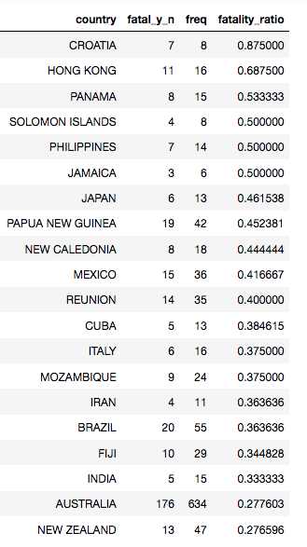
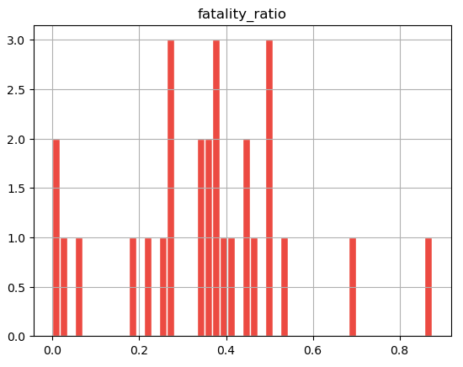
Top 20 deadliest countries
Countries with highest
fatality ratio
CAUTION! The fatality ratio might excessively high in countries with low sample size
However, it serves as example

Slide 9
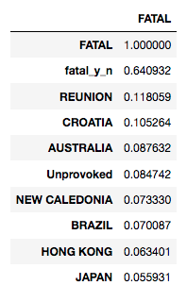
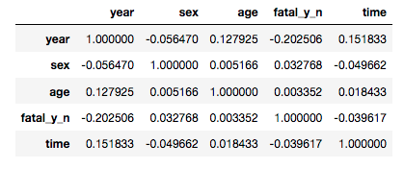
Correlation
Between quantitative and/or binary variables
I don't find any relevant correlation between quantitative and/or binary variables.
Correlation between dummy variables
These kind of analyses make no sense, we should perform other kind of stat test
In a completely cleaned dataframe,
injuries == FATAL should perfectly correlate with fatal_y_n ==Yes.
However, this correlation table indicates we could have further cleaning to make ...

