Slide 1
EBM-Projekt: Machine-Learning
Gruppe 2 Alexander Siewert(4595839) Nepomuk Bense(4616209) Sascha BOLLmann(4595095)

Slide 2
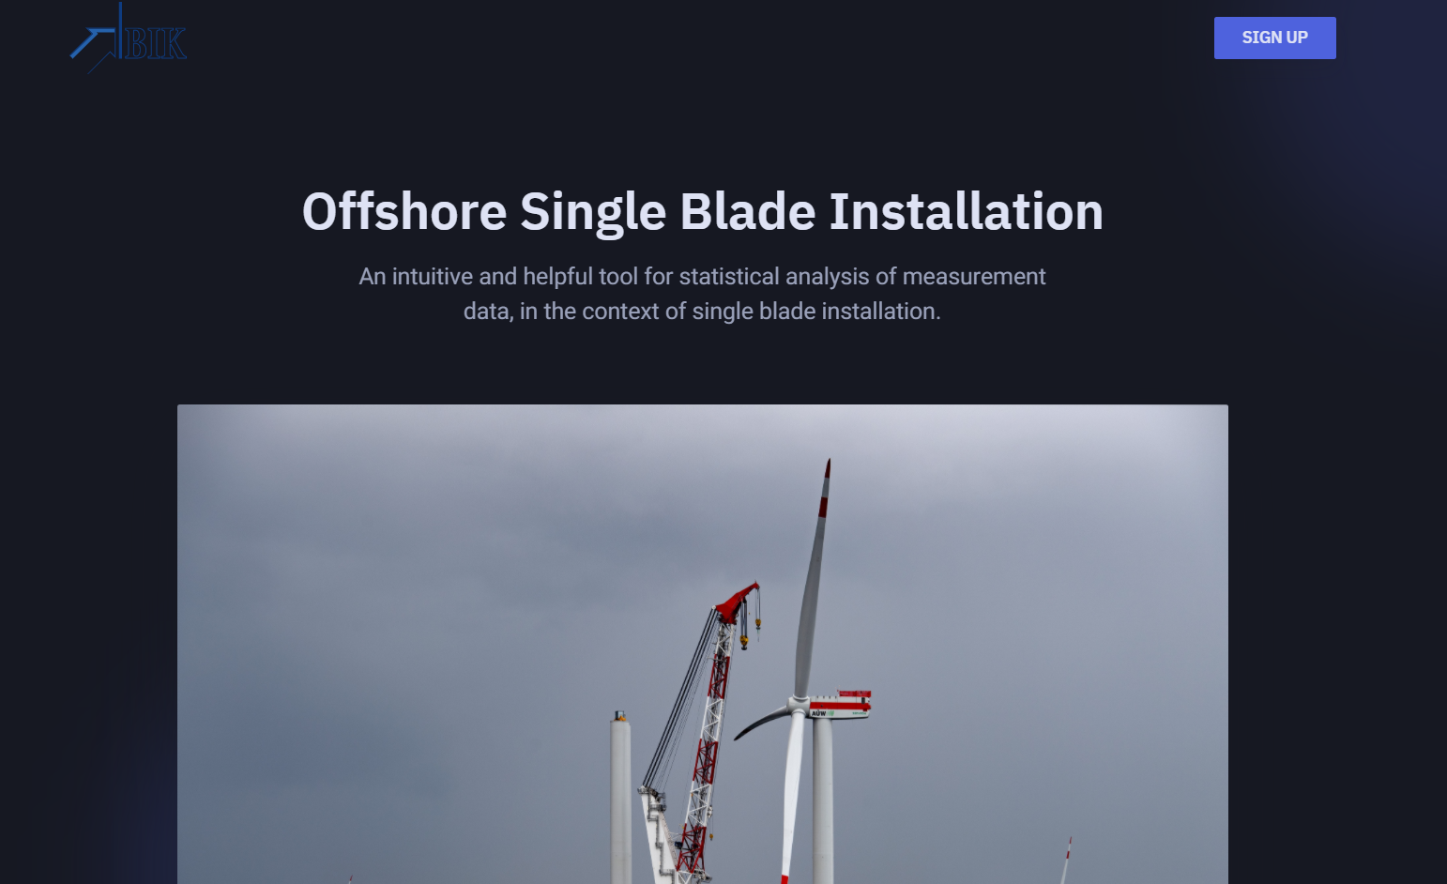
Bisheriger Fortschritt
Front-End Entwicklung der Oberfläche

Slide 3
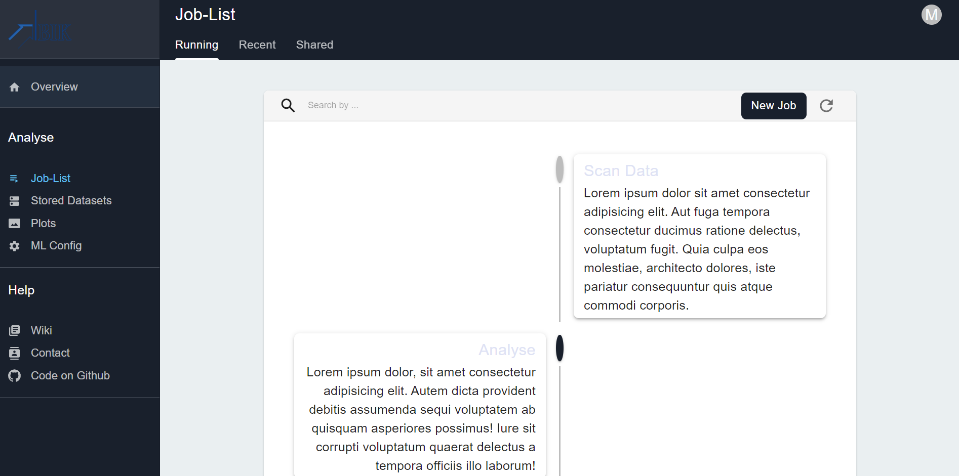
Bisheriger Fortschritt

Slide 4
# 'epoch', 'runtime', 'latitude', 'longitude', 'elevation', 'rot_x', 'rot_y', 'rot_z', 'acc_x', 'acc_y', 'acc_z', 'mag_x', 'mag_y', 'mag_z', 'roll', 'pitch', 'yaw‘
# 'epoch', 'Tp', 'Dirp', 'Sprp', 'Tz', 'Hm0', 'TI', 'T1', 'Tc', 'Tdw2', 'Tdw1', 'Tpc', 'nu', 'eps', 'QP', 'Ss', 'TRef', 'TSea', 'Bat', 'Percentage', 'Hmax', 'Tmax', 'H(1/10)', 'T(1/10)', 'H(1/3)', 'T(1/3)', 'Hav', 'Tav', 'Eps', '#Waves'

Slide 5
DataSets

Slide 6
Methods
Unsupervised Learning
ERA5-Daten
Installationszeit Vorhersage
Suche nach Korrelation in den gesamten Messdaten
Clustering
Auswertung von Wetterdaten
Phänomene wie Eisheilige identifizieren
Supervised
NN

Slide 7

Oscillations of Offshore Wind Turbines undergoing Installation I: Raw Measurements
19,7Gb
Environment (wind, wave)
16 turbines
https://zenodo.org/record/4498779#.YIG75ugzaMo //OpenSource

Slide 8

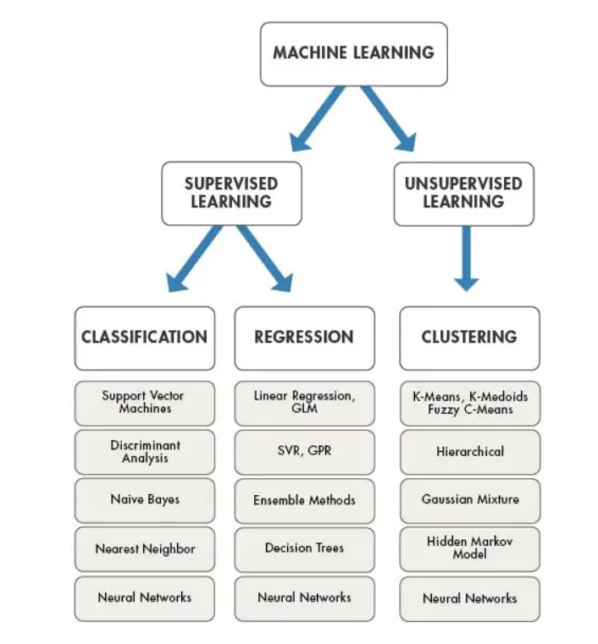

Slide 9
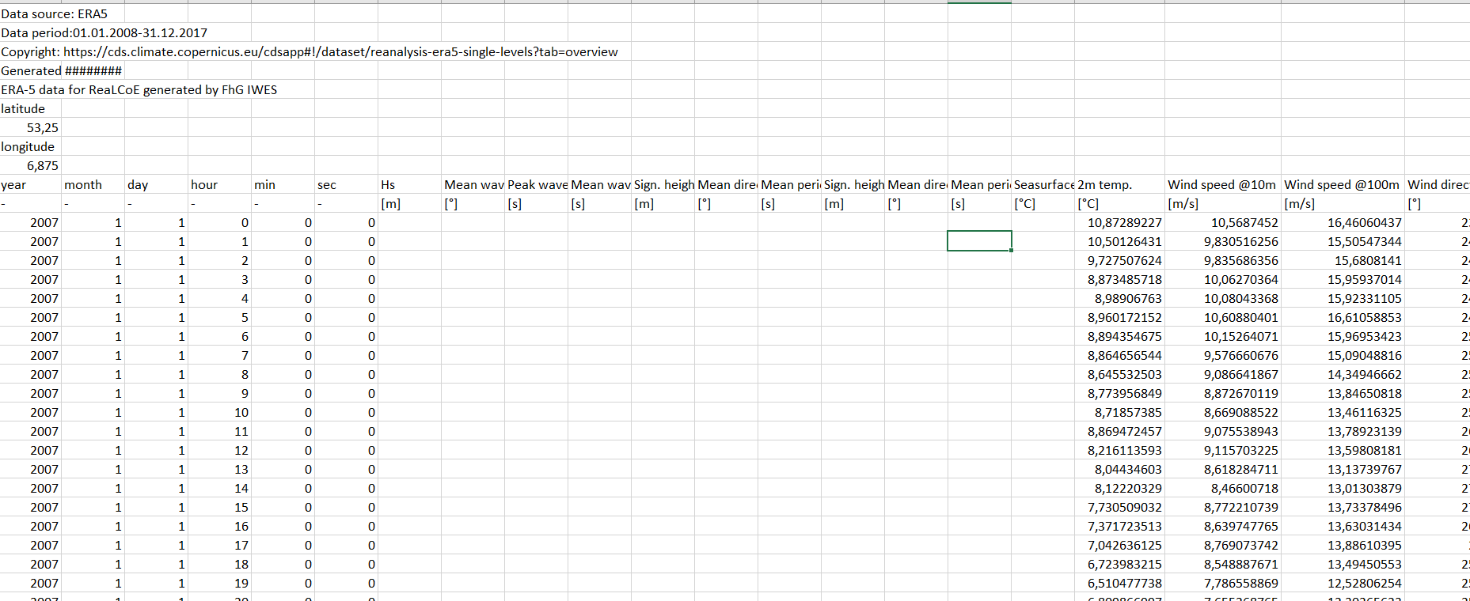
Era5

Slide 10
ERA5 Features
Timesstamp
2m Temperature
Wind(Direction)@10m
Wind(Direction)@100m
Size: 7,72gb

Slide 11

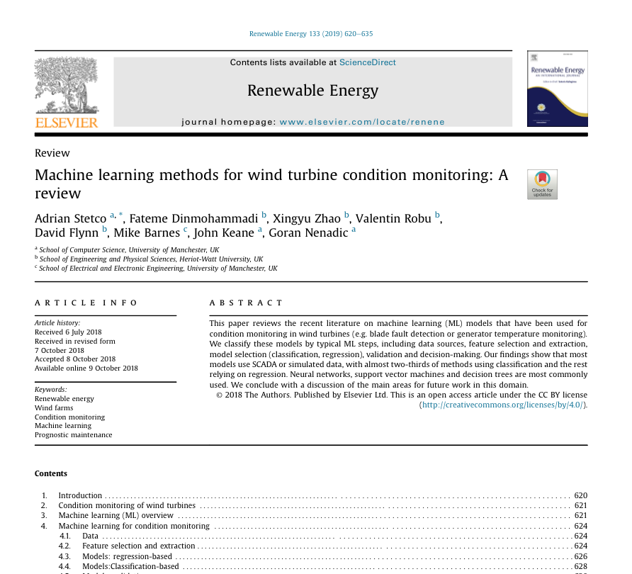
Literature

Slide 12
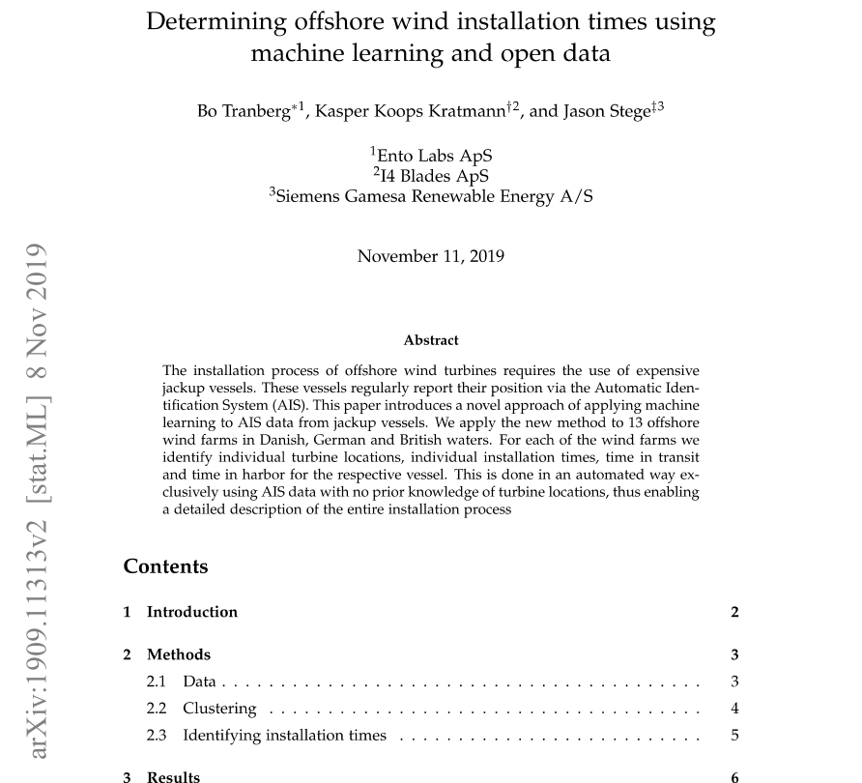
Literature

Slide 13
Installationsdauer Vorhersage
Über variablen Zeitraum
Eingabe von Wellenstärke, Windstärke, LIDAR usw. in unterschiedlichen Detailgraden

Slide 14

Tensorflow

Slide 15

Problem Overfitting

