Slide 1
Zwischenstand

Slide 2
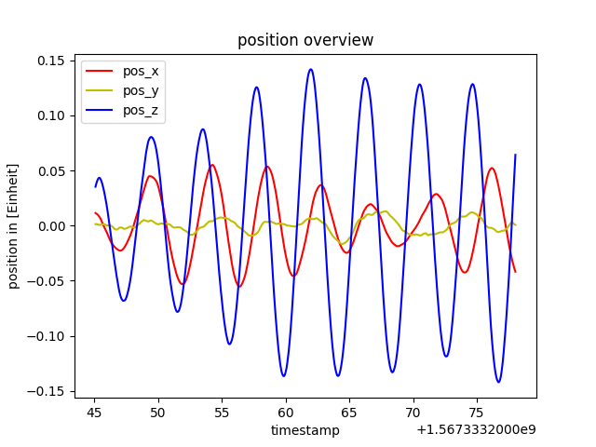

Slide 3
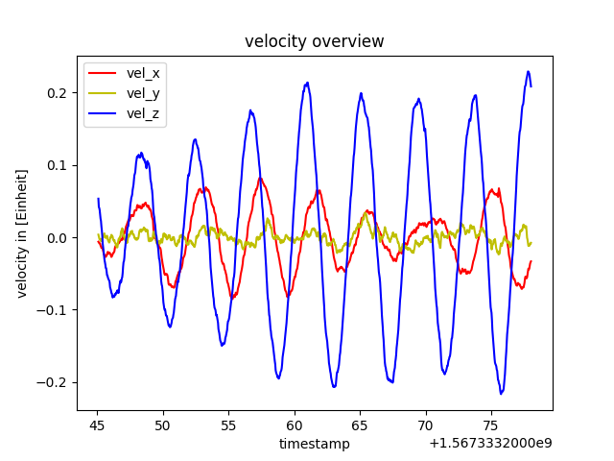

Slide 4
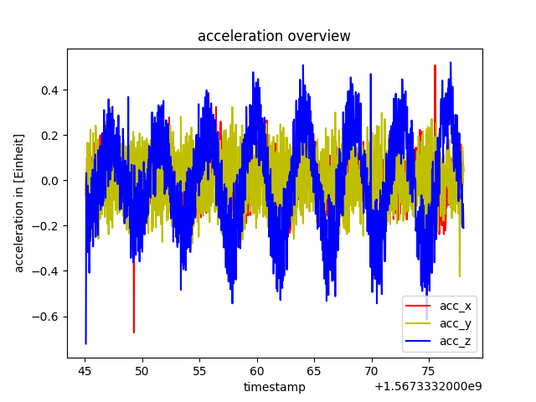

Slide 5
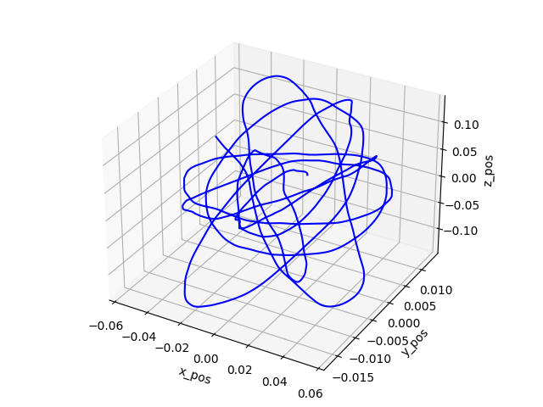
position

Slide 6
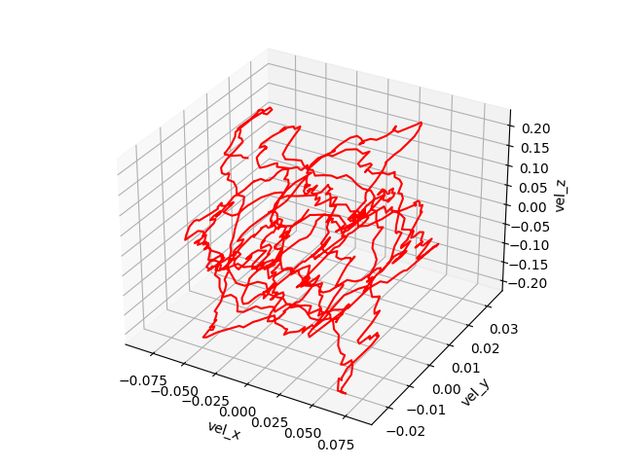
velocity

Slide 7
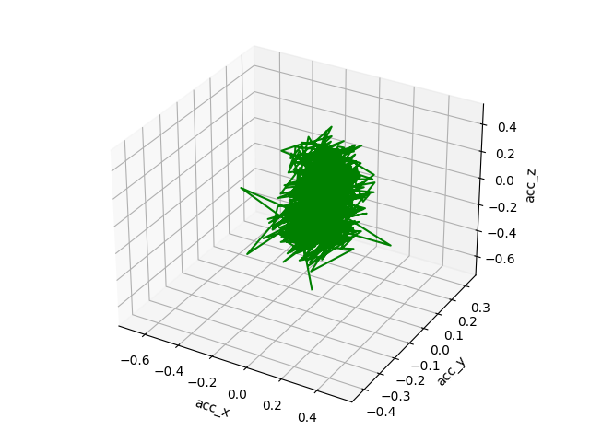
accerlation

Slide 8
timestamp
from datetime import datetime timestamp = 1545730073 dt_object = datetime.fromtimestamp(timestamp) print("dt_object =", dt_object)

Slide 9
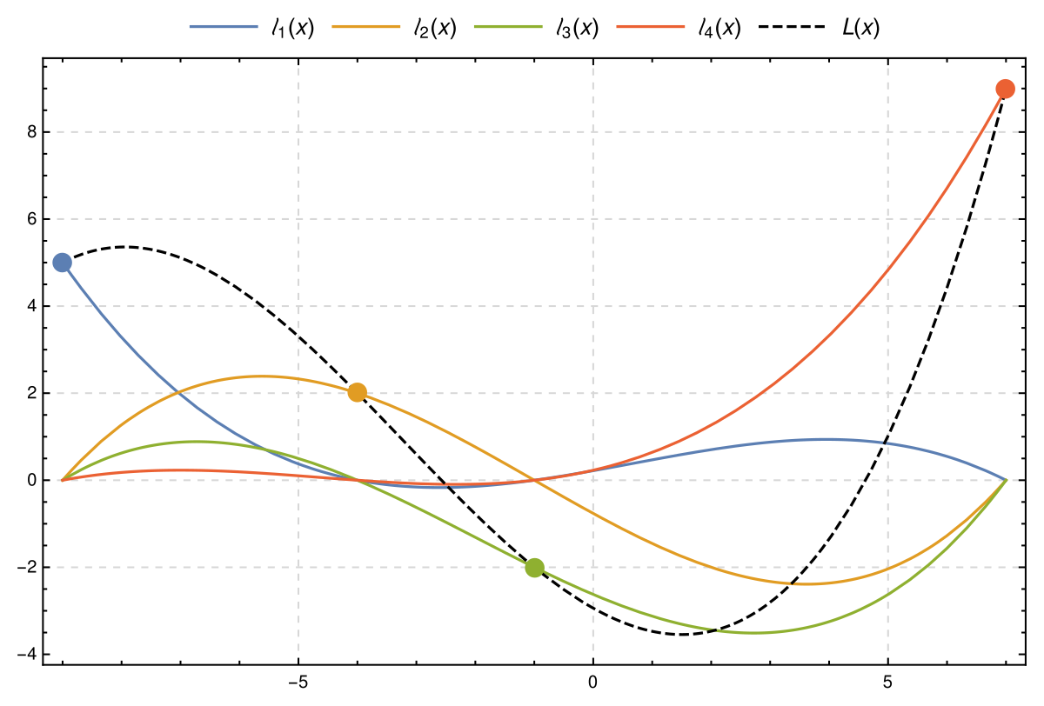
Lagrance Polynomsinterpolation

Slide 10
Data handling
GLOB

