Slide 1
EMBL Course:
Computing Skills For Reproducible Research: Software Carpentry
16 – 18 October 2019
Advanced Training Centre
Heidelberg, Germany
www.embl.org/events

Slide 2
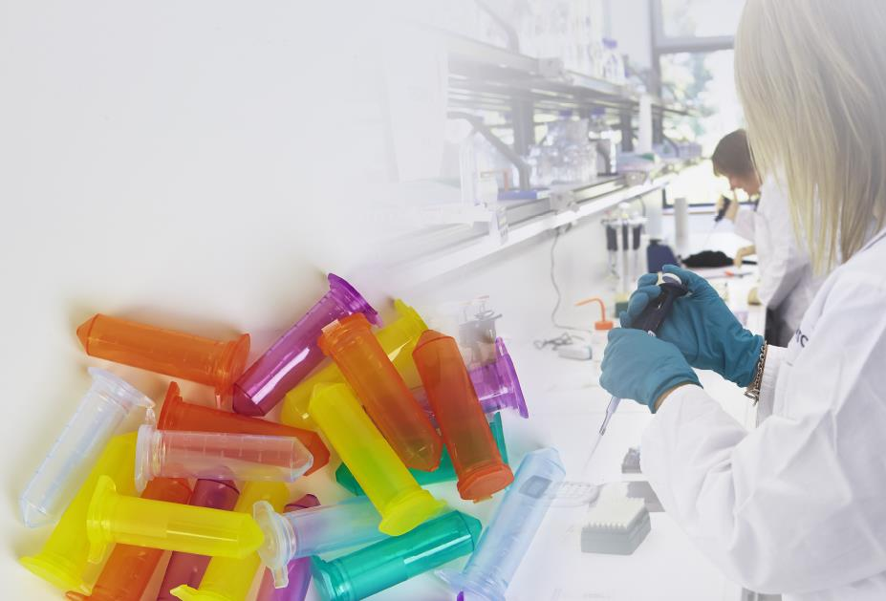

EMBL Scientific Visitor Programme
For selected Core facility visitors: Christian Boulin Fellowships
www.embl.de/training/visitor-programme
Notes:
<number>

Slide 3
The Logistics
www.embl.org/events
www.embl.org/events

Slide 4

You are here
Please use the designated areas when smoking
ATC Terrace
Roof Top Lounge Terrace
Toilets just around the corner
www.embl.org/events

Slide 5

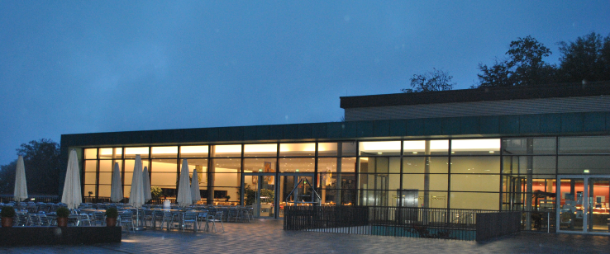
Food and Drinks
Coffee Breaks – Wednesday until Friday will be served outside the room Lunches – Wednesday until Friday will be served at EMBL Canteen (green building opposite the ATC)
Please wear your name badge at all times
Lunch is served at multiple stations so you don’t have to queue! Look for the reserved tables
www.embl.org/events

Slide 6


Social Programme and Networking
Group dinner will take place at Oskar Vinothek Restaurant from 19:00 onwards. Please check your menu choices at the information board outside the room.
Bus will departure from EMBL @17:30 to ISG Hotel & Neckarmunzplatz
Haspelgasse 5, 69117 Heidelberg http://www.oskar-hd.de/
A group photo will be taken on Thursday 17 @14:00
www.embl.org/events

Slide 7





General Information
WiFi – ATC Guest, no password
Tweeting? Use #EMBLsoftware
Please inform us if you do not wish to be photographed.
Please put your cell phone on silent during the talks.
Please be prompt for the bus departure times.
www.embl.org/events

Slide 8



Computer Lab Safety
Computer Login
login: training
pass: Tra1ning
Please turn off your PC before leaving the room
No food or drinks are allowed in the CTL.
www.embl.org/events

Slide 9
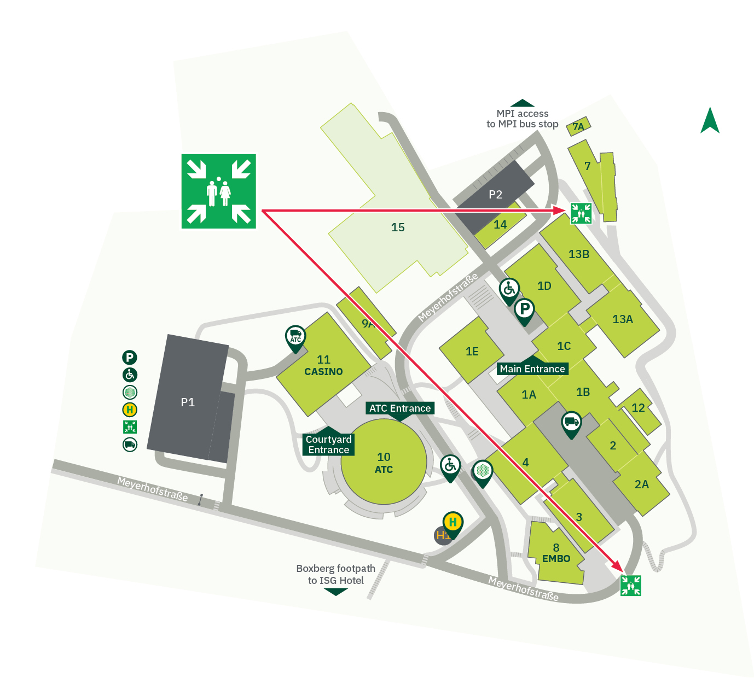
In Case of Emergency
If there is a fire alarm,
please evacuate the building and go to one of the meeting points
Do not use the lifts
Do not block the fire doors
Emergency Number - 222
www.embl.org/events

Slide 10
Information
Certificates of participation will be sent digitally at the end of the course, which you can easily add to LinkedIn.
Please fill out the feedback questionnaire
Slack will be used as a community building tool
Thank you for your attention and I wish you all an enjoyable and interesting course.
www.embl.org/events

