Slide 1
Biological workflows
Snakemake tutorial
EMBL 10/2017

Slide 2








-i 25
-p 5
> YB
ACGATA
CAGAG
GCGCCG
> YB
….(())...
(()).......(.
123.52
/bin/bash
.csv
YB, 12
ENO1, 24
GAPDH, 1
PKA2, 122
> EN
GACACA
GGGGGC
TACACA
>ENO
....((())))
().....(())..
243.42
2 weeks later ..
the following day
Can you just quickly add another
sequence!
Let’s change the parameter p to 4!
> AR
GGGGCC
CATAC
ACACAA

Slide 3
-i 25
-p 4
> YB
ACGATA
CAGAG
GCGCCG
> YB
….(())...
(()).......(.
123.52
/bin/bash
.csv
YB, 12
ENO1, 24
GAPDH, 1
PKA2, 122
> EN
GACACA
GGGGGC
TACACA
>ENO
....((())))
().....(())..
243.42
> AR
GGGGCC
CATAC
ACACAA
Logs
> AR
GGGGCC
CATAC
ACACAA
Management with scripts (Bash, Perl, Python, .. )

Slide 4

-i 25
-p 4
> YB
ACGATA
CAGAG
GCGCCG
> EN
GACACA
GGGGGC
TACACA
/bin/bash
.csv
> EN
GACACA
GGGGGC
TACACA
> YB
….(())...
(()).......(.
123.52
> EN
GACACA
GGGGGC
TACACA
>ENO
....((())))
().....(())..
243.42
> EN
GACACA
GGGGGC
TACACA
>ENO
....((())))
().....(())..
243.42
YB, 12
ENO1, 24
GAPDH, 1
PKA2, 122
> EN
GACACA
GGGGGC
TACACA
>ENO
....((())))
().....(())..
243.42
> EN
GACACA
GGGGGC
TACACA
>ENO
....((())))
().....(())..
243.42
> EN
GACACA
GGGGGC
TACACA
>ENO
....((())))
().....(())..
243.42
> EN
GACACA
GGGGGC
TACACA
>ENO
....((())))
().....(())..
243.42
> EN
GACACA
GGGGGC
TACACA
>ENO
....((())))
().....(())..
243.42
> EN
GACACA
GGGGGC
TACACA
>ENO
....((())))
().....(())..
243.42
> EN
GACACA
GGGGGC
TACACA
>ENO
....((())))
().....(())..
243.42
>ENO
....((())))
().....(())..
243.42
Logs
Cluster
Management with scripts
(Bash, Perl, Python, .. )

Slide 5
GNU Make
(Makefile)
rule based
file based
rule
A.txt
B.txt
2016-01-10
09:59:59
2016-01-10
10:00:00
B.txt: A.txt
cp $< $@
Disadvantages
readability
scalability
clean:
rm A.txt

Slide 6
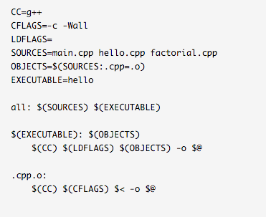
You got 30 seconds
to decrypt this tiny
script ..

Slide 7
Snakemake
rule
A.txt
B .txt
2016-01-10
09:59:59
2016-01-10
10:00:00
rule copy:
input:
“A.txt” output:
“B.txt”
shell:
“cp {input} {output}”
rule based
file based
scalable
scripting include
readable (python syntax)
no wrappers needed

Slide 8
Advanced
rule overlap:
input:
bed = “A.bed”,
bam = “B1.bam”
output:
“overlap.txt”
message:
“calculating overlaps between {input.bed} and {input.bam}”
log:
“overlap.log”
threads:
3 version:
shell(“customProgram –-version”)
resources:
gpu = 1
params:
“-s”
shell:
“customProgram {params} –t {threads} –abam {input.bam} \
–b {input.bed} > {output} 2> {log}”

Slide 9


-i 25
-p 4
> YB
….(())...
(()).......(.
123.52
> YB
ACGATA
CAGAG
GCGCCG
/bin/bash
>ENO
....((())))
().....(())..
243.42
.csv
YB, 12
ENO1, 24
GAPDH, 1
PKA2, 122
> EN
GACACA
GGGGGC
TACACA
> AR
GGGGCC
CATAC
ACACAA
> AR
GGGGCC
CATAC
ACACAA
Logs
rule create_csv
rule calculate_structure
rule create_graphics
Snakemake

Slide 10
Dependency management
> YB
ACGATA
CAGAG
GCGCCG
> YB
….(())...
(()).......(.
123.52
.csv
YB, 12
ENO1, 24
GAPDH, 1
PKA2, 122
> EN
GACACA
GGGGGC
TACACA
>ENO
....((())))
().....(())..
243.42
.csv
YB, 12
ENO1, 24
GAPDH, 1
PKA2, 122
> AR
GGGGCC
CATAC
ACACAA
> AR
GGGGCC
CATAC
ACACAA

Slide 11
Patterns
sample1_A.txt, sample1_B.txt,
sample1_C.txt, sample2_A.txt,
sample2_B.txt, sample2_C.txt
SAMPLES = “sample1 sample2”.split()
REP = “A B C”.split()
rule summarize:
input:
expand(“{samples}_{rep}.txt”, rep=REP, samples=SAMPLES)
output:
“summary.txt”
shell:
“python myscript.py {input} > {output}”

Slide 12
Wildcard rules
rule map:
input:
“{sample}.sam”
output:
“{sample}.bam”
shell:
“somecommand {input} {output}”

Slide 13
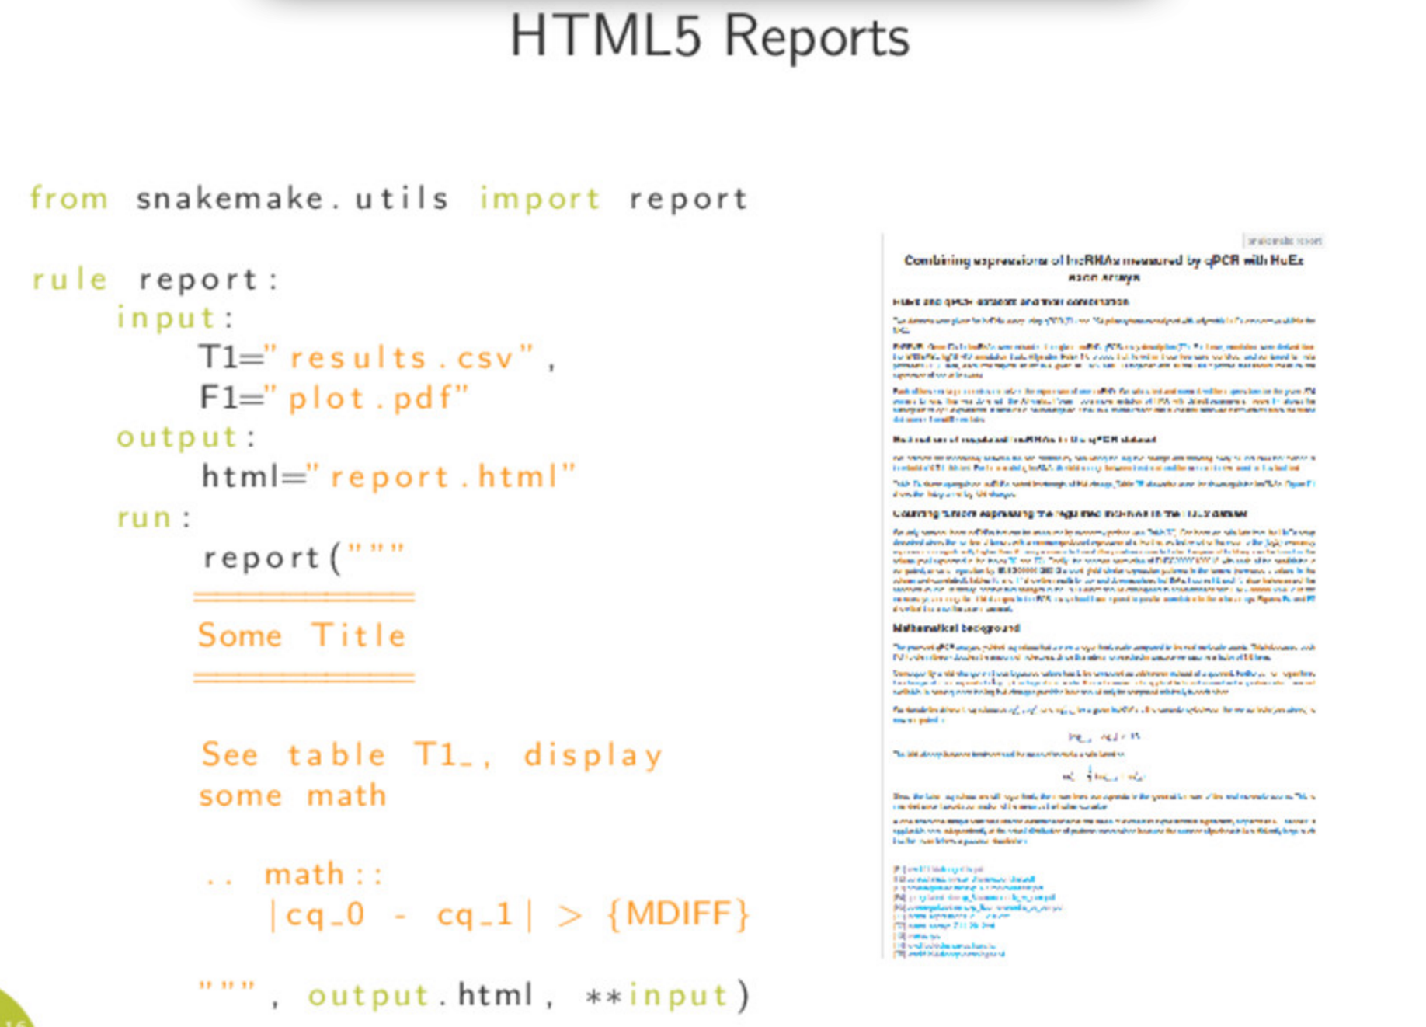
(from speakerdeck.com)

Slide 14
Usage / export to cluster
snakemake
snakemake –j 8
snakemake –j 20 –-cluster “bsub”

Slide 15
Thank you for listening. Let’s try it!

Slide 16
Get your files
> ssh schroedinger.embl.de
> sh /g/hentze/public/snakemake.sh
(or > git clone https://git.embl.de/schwarzl/snakemake-tutorial.git)
> cd snakemake-tutorial/00-start

Slide 17
First example
A.fasta
B.fasta
> A
GACACA
GGGGGC
TACACA
> B
CCCCCC
GGGGG
TTTTTT
Input files
A.fasta B.fasta
snakemake file
Snakefile
sum.txt
A 12
B 24
extract.txt
12
24

Slide 18
First rules
A.fasta
B.fasta
rule summarize:
> A
GACACA
GGGGGC
TACACA
> B
CCCCCC
GGGGG
TTTTTT
input:
“A.fasta”,
“B.fasta”
output:
“sum.txt”
sum.txt
shell:
“wc –c {input} > {output}”
20 A
66 B
rule extract:
input:
“sum.txt”
extract.txt
output:
“extract.txt”
20
66
shell:
“cut -f1 –d ‘ ‘ {input} > {output}”

Slide 19
Run the rules on its own
A.fasta
B.fasta
> A
GACACA
GGGGGC
TACACA
> B
CCCCCC
GGGGG
TTTTTT
> snakemake summarize
sum.txt
20 A
66 B
> snakemake extract
extract.txt
20
66
> rm sum.txt extract.txt

Slide 20
Add the default rule
A.fasta
B.fasta
Add the rule to the top of the Snakefile
> A
GACACA
GGGGGC
TACACA
> B
CCCCCC
GGGGG
TTTTTT
rule all:
input:
“extract.txt”
sum.txt
20 A
66 B
simply run
> snakemake
cleaning up
extract.txt
> rm sum.txt extract.txt
20
66

Slide 21
Add a clean rule
A.fasta
B.fasta
Snakefile
> A
GACACA
GGGGGC
TACACA
> B
CCCCCC
GGGGG
TTTTTT
rule clean:
shell:
“rm –f extract.txt sum.txt”
sum.txt
20 A
66 B
then run
> snakemake clean
extract.txt
20
66

Slide 22
Catchup
Folder 01-example/

Slide 23
Execute
> snakemake # executes rule ‘all’
> snakemake –n # dry run
> snakemake –p # print out the commands

Slide 24
Add a message
Snakefile
rule summarize:
input:
“A.fasta”,
“B.fasta”
output:
“extract.txt”
message:
“summarizing counts from {input} and creating {output}”
shell:
“wc –c {input} > {output}”

Slide 25
expand() – use variables for names
Snakefile
SAMPLES = “A B”.split()
rule summarize:
input:
expand(“{samples}.fasta”, samples=SAMPLES)
output:
“sum.txt”
message:
“summarizing counts from {input} and creating {output}”
shell:
“wc –c {input} > {output}”
> snakemake clean
> snakemake

Slide 26
Catchup
Folder 02-expand/

Slide 27
Add a temporary variable
A.fasta
B.fasta
> A
GACACA
GGGGGC
TACACA
> B
CCCCCC
GGGGG
TTTTTT
sum.txt
20 A
66 B
We do not really need to keep this!
extract.txt
20
66

Slide 28
Add a temporary
Snakefile
SAMPLES = “A B”.split()
rule summarize:
input:
expand(“{samples}.fasta”, samples=SAMPLES)
output:
temp(“sum.txt”)
message:
“extracting counts from {input} and creating {output}”
shell:
“wc –c {input} > {output}”
> snakemake clean
> snakemake

Slide 29
Dynamic read-in
Snakefile
SAMPLES, = glob_wildcards(“{samples}.fasta”)
rule summarize:
input:
expand(“{samples}.fasta”, samples=SAMPLES)
output:
temp(“sum.txt”)
message:
“extracting counts from {input} and creating {output}”
shell:
“wc –c {input} > {output}”
> snakemake clean
> snakemake

Slide 30
Add another file
Create a file C.fasta
> snakemake clean
> snakemake

Slide 31
Modify a file
A.fasta
B.fasta
> A
GACACA
GGGGGC
TACACA
> B
CCCCCC
GGGGG
TTTTTT
> touch B.fasta
sum.txt
20 A
66 B
> snakemake
extract.txt
20
66

Slide 32
Catchup
Folder 03-dynamic/

Slide 33
Add a log file
Snakefile
rule summarize:
input:
“{samples}.fasta”
output:
“sum.txt”
message:
“extracting counts from {input} and creating {output}”
log:
“sum.log”
shell:
“wc –c {input} > {output} 2> {log}”
> snakemake clean
> snakemake

Slide 34
Run it on the cluster
> snakemake --cluster ‘bsub –o /dev/null’

Slide 35
Local rules
Snakefile
localrules: all, extract
rule summarize:
input:
“{samples}.fasta”
output:
“extract.txt”
…

Slide 36
Catchup
Folder 04-cluster/

Slide 37
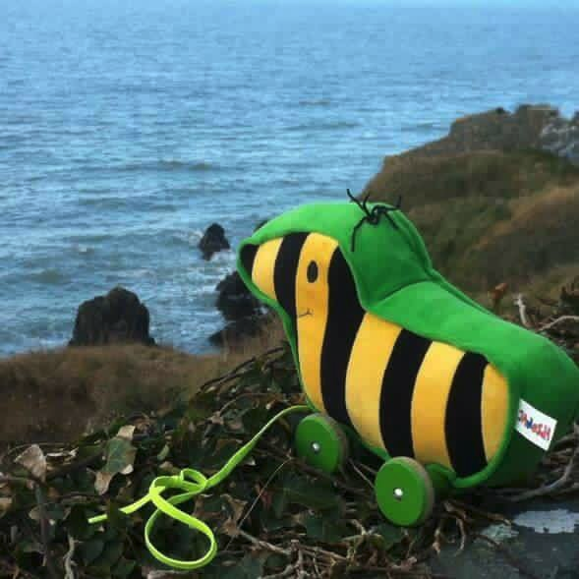
Last exercise!
Please use folder
05-foreach/

Slide 38
Understand what expand() does
Snakefile
SAMPLES = “A B”.split()
rule summarize:
input:
expand(“{samples}.fasta”, samples=SAMPLES)
output:
“sum.txt”
message:
“extracting counts from {input} and creating {output}”
shell:
“wc –c {input} > {output}”
> wc –c A.fasta B.fasta > extract.txt

Slide 39
Wildcard rules: for each
For every file do something
A.fasta
B.fasta
> A
GACACA
GGGGGC
TACACA
> B
CCCCCC
GGGGG
TTTTTT
A.sum
B.sum
20 A
20 B

Slide 40
Wildcard rules: for each
2 rules:
1) We require
A.sum B.sum
2) Wildcard rule
*fasta → *sum.txt
A.fasta
B.fasta
> A
GACACA
GGGGGC
TACACA
> B
CCCCCC
GGGGG
TTTTTT
A.sum
B.sum
20 A
20 B

Slide 41
1) We require A.sum B.sum
Snakefile
SAMPLES, = glob_wildcards(“{samples}.fasta”)
rule all:
input:
expand(“{samples}.sum”, samples = SAMPLES)

Slide 42
2) Wildcard rule
Snakefile
SAMPLES, = glob_wildcards(“{samples}.fasta”)
rule all:
input:
expand(“{samples}.sum”, samples = SAMPLES)
rule do_sum:
input:
“{sample}.fasta”
output:
“{sample}.sum”
shell:
“wc –c {input} > {output}”

Slide 43
Catchup
> snakemake
> snakemake clean
> snakemake –j 5
Folder 06-foreach-complete/

Slide 44

Snakemake is powerful…
Config files
Cluster config
Advanced Patterns
Mixing with python
Wrappers
Advanced reports
Visualization of execution
Workflow sharing
Sub workflows
Cloud connection
…

Slide 45
Discussing ups and downs of workflow management systems
Time to get things started
Distributable
Snakemake
Scalability / Flexibility

Slide 46
Thank you very much!

