Slide 1
Threats Groups
Targeting the Energy Sector
Voltzite
Emily Eubanks | malwaremily

Slide 2



VOLTZITE - Targets
NATIONS
United States of America
Non-continental U.S. Territories (i.e. Guam)
UK
Australia
INDUSTRIES
Energy
Telecommunication
Transportation Systems
Water and Wastewater Systems
Satellite Services
Emergency Management Services

Slide 3
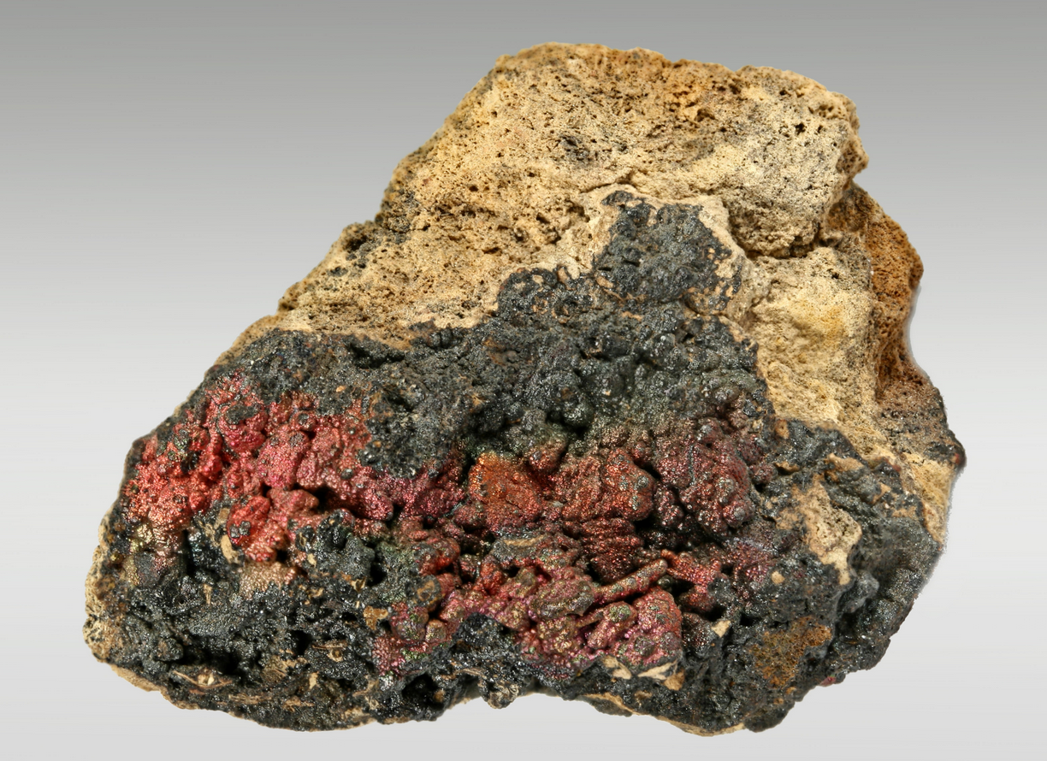
VOLTZITE - Targets
NATIONS
United States of America
Non-continental U.S. Territories (i.e. Guam)
UK
Australia
INDUSTRIES
Energy
Telecommunication
Transportation Systems
Water and Wastewater Systems
Satellite Services
Emergency Management Services

Slide 4
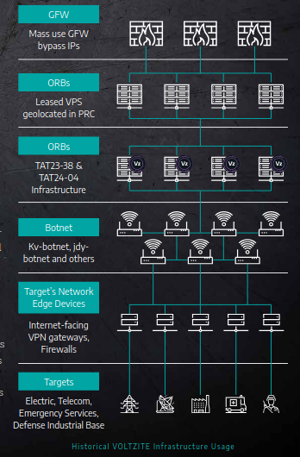
VOLTZITE - Infrastructure
CHARACTERISTICS
Named by Dragos (2023)
Extensive technical overlap with…
Volt Typhoon
UTA0178
Focus on stealing OT related data
network diagrams
OT equipment diagrams, documents
Data on SCADA systems, relays, switchgear
Graphical Information System (GIS) data
GIS data examples: siting new locations for solar, wind, geothermal generation, mapping transmission lines, etc.
Operational Relay Box (ORB) networks
Shares PRC affiliated threat actor infrastructure

Slide 5
VOLTZITE - Behaviors
PRECOMPROMISE
ORB network, compromised SOHO/VPS systems (kv-botnet, jdy-botnet)
Multi-hop proxies
enumerate internet-exposed servers
INITIAL ACCESS
Exploit known or zero-day vulnerabilities in public-facing network appliances
Fortinet
Ivanti (formerly PulseSecure)
NETGEAR
Citrix
Cisco
PRTG Network Monitor

Slide 6
VOLTZITE - Behaviors
POSTCOMPROMISE
Slow, steady, extensive reconnaissance to identify…
network topologies
security measures
typical user behaviors
key network and IT staff
Long-term persistence (i.e. 5+ years) with dedicated resources to maintain persistence and understand the target environment over time.
Valid Accounts
LOTL techniques (TTPs tailored to victim environment)

Slide 7
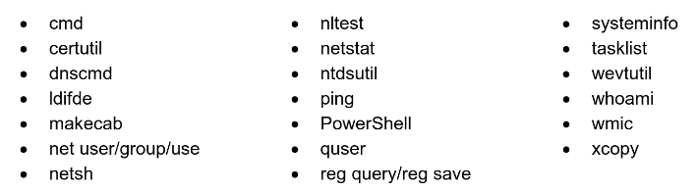
VOLTZITE - Behaviors (POSTCOMPROMISE cont’d)
DISCOVERY
`net start` used to list running services

Slide 8
VOLTZITE - Behaviors (POSTCOMPROMISE cont’d)
DEFENSE EVASION
PowerShell used to query WEL; extraction Security logs via .dat files
Targeted log deleted to evade detection (WEL, system).
Masquerade binaries (e.g. rar.exe → ronf.exe)
CREDENTIAL ACCESS
vssadmin to create shadow copy (cracks passwords offline)
ntdsutil to copy NTDS.dit and SYSTEM hive from volume shadow copy
Outdated comsvcs.dll downloaded to non-standard folder, LSASS dumped with MiniDump
Interacted with PuTTY application to enumerate stored sessions
Interact with browser artifacts to obtain stored passwords

Slide 9
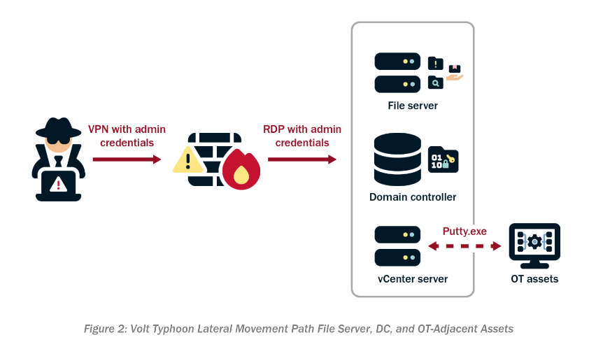
Source: CISA Joint Cybersecurity Advisory [1]

Slide 10
VOLTZITE - Behaviors (POSTCOMPROMISE cont’d)
COLLECTION & EXFILTRATION
WMIC used to create and use temporary directories
Renamed Winrar to compress exfil data
Exfiltration via SMB
NONNATIVE TOOLS
Magnet RAM Capture (MRC)
Fast Reverse Proxy (FRP) (obfuscated client files with UPX)
Mimikatz
Impacket
Existing tools found on victim endpoints (e.g. Advanced IP Scanner)

Slide 11
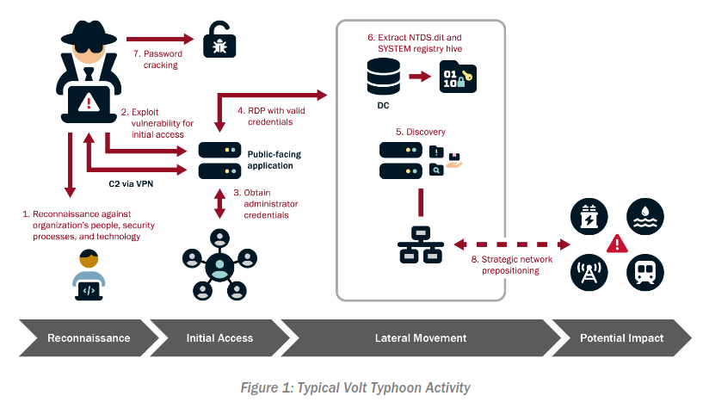
Source: CISA Joint Cybersecurity Advisory [1]

Slide 12
VOLTZITE - Examples
Voltizite threat actors have been observed…
Abstaining from using compromised credentials outside of normal working accounts
Obtaining credentials insecurely stored on public-facing network appliances
Testing access to domain-joint OT assets using OT vendor credentials, or leverage credentials cracked in NTDS.dit dump from shadow copy
After successful lateral movement to OT environment, minimal activity is observed beyond occasional discovery activity.
Extremely long dwell time, Dragos reports evidence of Voltzite extracting NTDS.dit from three DCs within a four year period in one compromise, another victim they extracted twice within a 9 month period.
Storing data in .log file detailing user activities, user PowerShell commands, keypresses, internet browsing activity; includes Timestamps.

Slide 13
VOLTZITE - Objective Theories
“Volt Typhoon actors are pre-positioning themselves on IT networks to enable lateral movement to OT assets to disrupt functions.” Source: CISA
Craft malicious OT-specific tooling to disrupt critical systems (Dragos)
Positioning to act in the event of geopolitical escalation and/or military conflict.

Slide 14
VOLTZITE - Objective Theories
Robert M. Lee (Dragos) discusses a 300+ day intrusion:
“It was very clear that the adversary, though contained to the enterprise IT network, was explicitly trying to get into the OT network there [...] I can confirm that they were stealing a lot of OT-specific data and insights, and SCADA-related information and GIS-related information, and things that would be useful in future disruptive attacks [...] It was clear that Voltzite was specifically thinking about key targets and how to take down power in the future, based on what they were stealing.”
Source: Dark Reading [4]

Slide 15
VOLTZITE - US FEDERAL RESPONSE ACTION
FBI announced it shut down a botnet of compromised network devices associated with PRC ORB network. [5]
“A December 2023 court-authorized operation has disrupted a botnet of hundreds of U.S.-based small office/home office (SOHO) routers hijacked by People’s Republic of China (PRC) state-sponsored hackers [...]
privately-owned SOHO routers infected with the “KV Botnet” malware to conceal the PRC origin of further hacking activities [...]
[...] the government extensively tested the operation on the relevant Cisco and NetGear routers. The operation did not impact the legitimate functions of, or collect content information from, hacked routers. Additionally, the court-authorized steps to disconnect the routers from the KV Botnet and prevent reinfection are temporary in nature. A router’s owner can reverse these mitigation steps by restarting the router. However, a restart that is not accompanied by mitigation steps similar to those the court order authorized will make the router vulnerable to reinfection.
The FBI is providing notice of the court-authorized operation to all owners or operators of SOHO routers that were infected with the KV Botnet malware and remotely accessed pursuant to the operation. For those victims whose contact information was not publicly available, the FBI has contacted providers (such as a victim’s internet service provider) and has asked those providers to provide notice to the victims.”

Slide 16


VOLTZITE - THaDE
Meticulous network monitoring for unusual communication
Subset of common discovery commands with administrative overlap
LOTL anomalies that deviate from baseline
Windows ESENT Application logs for evidence of NTDS.dit copy. (ESENT App ID 216,325,326,327)
vssadmin creating shadow copy
download DLL (comsvcs.dll) to non-standard folder
PowerShell queries against WEL saved to .dat file
WEL deletion via EID 1102
Native executables in non-standard folders
[?] Extract SYSTEM Registry Hive
[?] PTH Techniques
[?] FRP Reverse Proxy Tool
[?] csvde utility execution

Slide 17
VOLTZITE - MITIGATIONS
MFA, least priv, gMSAs & PAM+RBAC
Don’t leave your passwords laying around
Don’t let your users leave their passwords laying around
Configure group policy settings to prevent web browsers from saving passwords and disable autofill functions.
Regularly roll NTLM hashes of accounts that support token-based auth
Securely store sensitive data (like OT documentation)
Establish and continuously maintain a baseline of installed tools and software, account behavior, network traffic.
Audit security, access, application logging to ensure it aligns with expectation
Validate security controls

Slide 18
References
[1] Joint Cybersecurity Advisory ‘PRC State-Sponsored Actors Compromise and Maintain Persistent Access to U.S. Critical Infrastructure’. Published 2024 Feb 07. https://www.cisa.gov/sites/default/files/2024-03/aa24-038a_csa_prc_state_sponsored_actors_compromise_us_critical_infrastructure_3.pdf
[2] Dragos. 2025 OT/ICS Cybersecurity Report | Year in Review. Published 2025. https://hub.dragos.com/hubfs/312-Year-in-Review/2025/Dragos-2025-OT-Cybersecurity-Report-A-Year-in-Review.pdf?hsLang=en
[3] Mandiant (Michael Raggi). IOC Extinction? China-Nexus Cyber Espionage Actors Use ORB Networks to Raise Cost on Defenders. Published 2024 MAY 22. https://cloud.google.com/blog/topics/threat-intelligence/china-nexus-espionage-orb-networks
[4] Dark Reading. Web article. Published. https://www.darkreading.com/vulnerabilities-threats/volt-typhoon-hits-multiple-electric-cos-expands-cyber-activity
[5] U.S. Department of Justice. Press Release ‘U.S. Government Disrupts Botnet People’s Republic of China Used to Conceal Hacking of Critical Infrastructure’. Published 2024 JAN 31. https://www.justice.gov/archives/opa/pr/us-government-disrupts-botnet-peoples-republic-china-used-conceal-hacking-critical

