Slide 1


Lesson 1
Version Control Systems

Slide 2

Overview
What is version control system?
Types of version control systems
What is git?
How does git work?
What is snapshot?
What is commit?
What is repository?
What is branch?
What is HEAD?
What is master?
Making changes
Installing git on Windows
Web-based git repository hosting services
What is GitHub?
Setting up GitHub account
Homework: Clone course repository

Slide 3


What is version control system?
A system that keeps records of changes
Necessary for collaborative development
Allows you to know the date and the author of changes
Allows you to revert changes and return to previous state

Slide 4
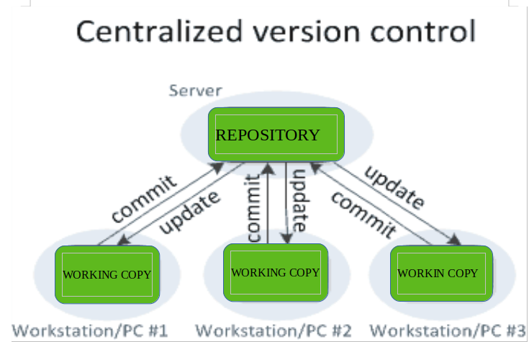
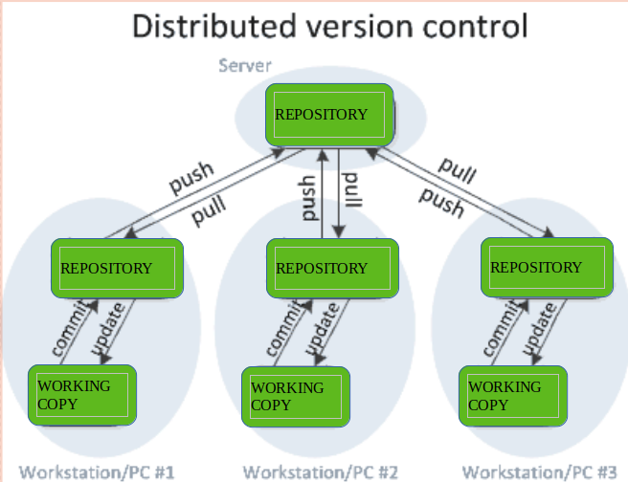
Types of version control systems
Local version control systems
local database
Centralized version control systems
single remote repository
Distributed version control systems
one remote repository and multiple local repositories
Image source: https://www.geeksforgeeks.org/version-control-systems

Slide 5
What is git?
A distributed version control system
Users keep the entire code and history on their PCs
Users can make changes offline
Users can synchronize between each other via a remote server – more later
Created by Linus Torvald (creator of Linux OS) in 2005
Currently the most used version control system

Slide 6
How does git work?
Key concepts of git
Snapshot
Commit
Repository
Branch
HEAD
master

Slide 7
What is snapshot?
Record that helps git track code history
Record that says how files looked at a given point in time
You can specify which file changes are included and which are not
Changing between any snapshots is possible and easy

Slide 8
What is commit?
The act of creating a snapshot
It contains these information
Information about file changes
Information about parent (the previous commit it originates from)
Information about its name (a hash code)
Information about commit message (a user message describing this commit)

Slide 9
What is repository?
A collection of all files and their history
Contains all commits and allows to switch between them
Can be cloned to local machines
git clone repository@address.git
Note: This will create a new folder which contains the project. This folder is often called “local directory”.
Commits from other team members can be downloaded by pulling
git pull
Commits from you can be uploaded by pushing
git push

Slide 10
What is branch?
All commits belongs to some branch
Branch itself is a bunch of commits linked together
The best-known way how to manage collaborative work

Slide 11

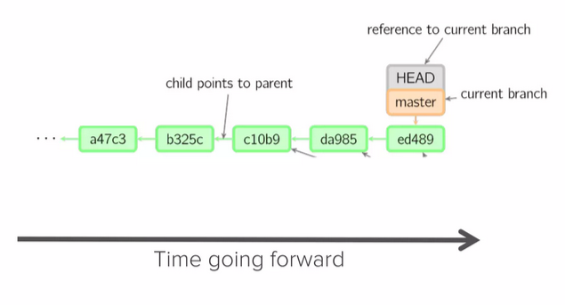
What is HEAD?
A reference to the most recent commit on a given branch (in most cases - can be changed to a different commit)
Image source: https://www.slideshare.net/slideshow/git-101-git-and-github-for-beginners

Slide 12
What is master?
The main branch in the project
Historically called master but due to recent culture changes it is now more often called main, dev, etc
Image source: https://www.slideshare.net/slideshow/git-101-git-and-github-for-beginners

Slide 13
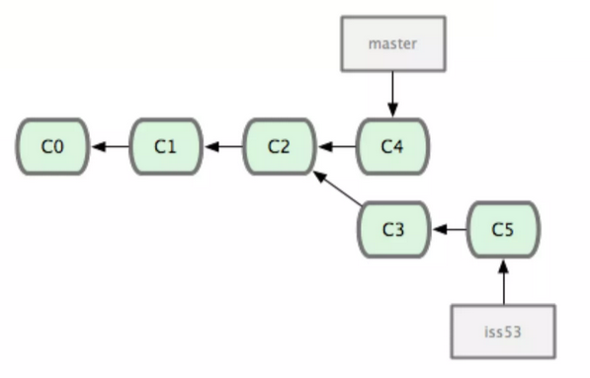
Making changes
When you want to make any changes to the project you make a new branch based on another branch (or commit – not that often)
Usually, the master branch is used for this purpose
However, the master branch will be used by others as well and it will also change in time
Once you are done with your work, you need to merge your branch back into its original branch
Image source: https://www.slideshare.net/slideshow/git-101-git-and-github-for-beginners

Slide 14
Making changes
Create a branch from the master branch in your local directory (on your PC)
git checkout master
git pull
git checkout –b YOUR_BRANCH_NAME
Make changes
Put changes into the staging environment (also called index)
git add .
Note: The “.” will add all files. You can specify files manually or use “-u” if you want to add only changed files.
Create a new commit
git commit –m “YOUR_COMMIT_MESSAGE”
Push commit to remote repository (also called origin)
git push
Create a merge (sometimes also called “pull”) request in the web-based UI – more on the next slides

Slide 15
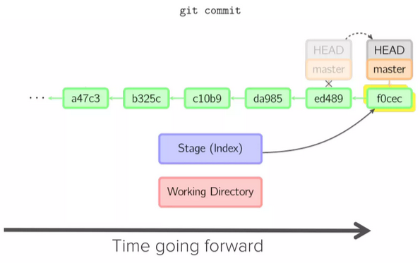
Making changes
Image source: https://www.slideshare.net/slideshow/git-101-git-and-github-for-beginners

Slide 16
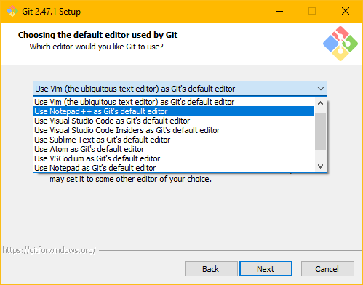
Installing git on Windows
Go to https://git-scm.com/downloads/win and download setup installer
Open it. You can continue with the default options most of the time (you can for example change the default editor to your favourite one)
Congratulations! You have successfully installed git

Slide 17
Web-based git repository hosting services
A server (PC) that hosts git repository is required for proper git functionality. You can host it locally by yourself on your PC and allow others to connect. However, it is more common to use a 3rd party provider which also takes care of backups and often offers convenient web UI for code reviews.
The most common providers are:
GitHub
GitLab
Bitbucket

Slide 18
What is GitHub?
The largest web-based git repository hosting service
Founded in 2008
Allows online collaboration from anywhere
Adds extra convenient functionalities:
UI
branch graph
pull requests
bug tracking
and more

Slide 19
Setting up GitHub account
Go to https://github.com/ and press “Sign up”
Follow the account creation process and then log-in
Click at your profile icon and select “Settings”
Click at “SSH and GPG keys”
Open terminal window on your machine an run
ssh-keygen -t ed25519 -C “email_you_used_for_github@example.com“
You can leave the passphrase empty or use some favourite word
This will generate new key to .ssh folder
Press “Windows + R“ and type
%USERPROFILE%
Press enter, new explorer window will open, navigate to the .ssh folder
Open file ending with “.pub” (your public key) with your favourite text editor
In GitHub click at “New SSH key” and copy the content of your public key there
Provide the key some title, ex: “My personal PC”
Click “Add SSH key”
Congratulations! You have successfully setup GitHub with your computer

Slide 20
End of lesson 1
Jakub Malý 2025

Slide 21
Homework: Clone course repository
Open https://github.com/malyjak/python-course-2025 in your web-browser
Get familiar with UI, feel free to explore all buttons
Clone the repository locally: git clone git@github.com:malyjak/python-course-2025.git
Check that the content of cloned directory match the one in the web-browser

