Slide 1
Standards-based Open Source Calendaring with Cosmo
  Brian Moseley
  ApacheCon US 2006

Slide 2
What is Cosmo?

Slide 3
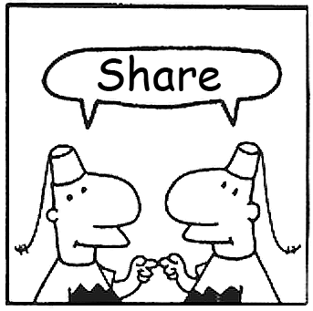
A Sharing Server
Notes:
Cosmo is a platform for sharing information with other people. It knows a little bit more about some kinds of information, like calendars and events, but it can store anything you want to put in it, and you can share whatever you put in with other anybody else, even people whom the server doesn’t already know about.
Each user gets a “home collection” where they can store calendars, tasks, contacts, media, or any other type of content. They can browse the contents of their home collection, subscribe to syndication feeds of their calendars, and grant or deny access to to items in the home collection.
More advanced sharing workflows are surfaced in the web UI and in Chandler, OSAF’s desktop PIM application, which has a very close knit relationship with Cosmo.

Slide 4
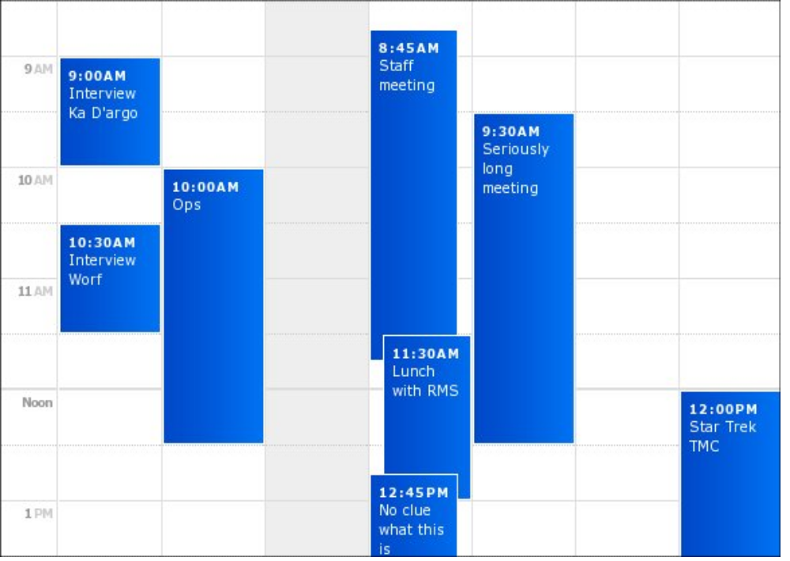
A PIM Application
Notes:
Cosmo has the beginnings of a really nice web interface for personal information management. The first area we’re concentrating on is calendaring, so there’s a nice little week view of your events, and a mini calendar which we’ve just integrated. There’s also a view for browsing everything that you’ve shared, sort of like the traditional web server directory index. Lots more is coming as we ramp up the interface part of the project, including innovative ways of triaging and organizing your info similar to those in Chandler.

Slide 5
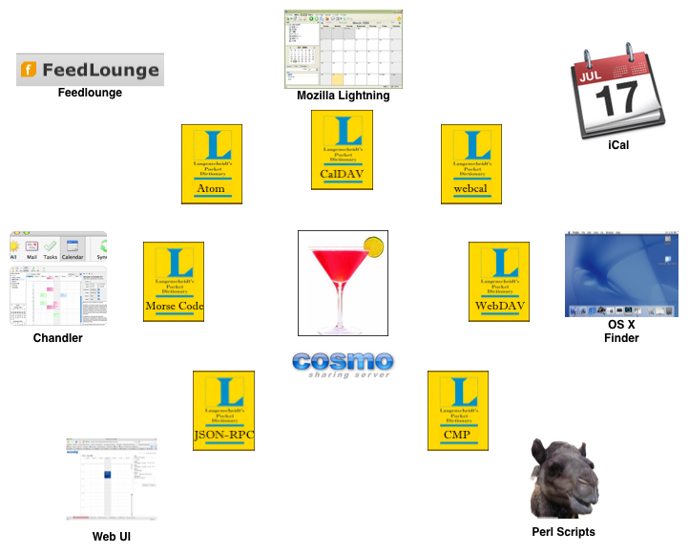
A Data Hub
Notes:
Because people have widely varying preferences for calendar programs, operating systems and scripting and programming environments, we’ve built Cosmo into a data hub that provides access to your information in a variety of ways - WebDAV, CalDAV, CardDAV, Atom Gdata, and even a couple custom protocols, which we’ll talk about later.

Slide 6
How do you use it?

Slide 7
Home Collection
It's where your stuff goes.
    Calendars
    Address books
    Collections of files
Think web server home directory.

Slide 8
Web UI
PIM today
    Calendars
PIM tomorrow
    Address books, Task lists, Dashboard, Stamping
Also
    Home collection browser
    Account management
    Server administration

Slide 9
External Applications
WebDAV
    Windows Network Place
    OS X WebFS
    cadaver
CalDAV
    Mozilla Sunbird
    Apple iCal (Leopard)
    OSAF Chandler
Atom
    NetNewsWire
    FeedDemon
    Firefox Live Bookmarks
    Bloglines
    Google Reader

Slide 10
Sharing
Universal access with tickets
    Read-only, read-write, free-busy
Sharing a calendar is fun and easy
    Sharer creates the calendar
    Sharer sends ticket URL to sharee
    Sharee subscribes to ticket URL
    Sharer and sharee collaborate. Woohoo!
Coming soon: ACLs
Notes:
Credential-based authentication: a user has an account on the server identified by a username and a password.
Ticket-based: a ticket is an opaque identifier that can be presented by any person or program to assert that his identity was s verified out of band - for example, if I grant a ticket on my calendar, I can give it to my friends and colleagues so that they can view or even update my calendar without having accounts on the server. Yes, this is quite insecure, but it’s good enough for some people.
When a request comes to Cosmo, it looks for user credentials (J2EE form inputs for Web Console, Basic for all others). If no credentials found, all protocol interfaces look for a ticket (tickets are not supported by the Web Console - YET). Any request that does not identified with a user or ticket is considered to be anonymous.
Role-based authorization: User accounts represent either regular users or administrators.
An administrator has full access to all user accounts and resources.
A regular user has full access to all resources in his home directory via WebDAV and can use Web Console and CMP to access account details, change password, and browse his home collection.
Ticket-based authz: a ticket allows read-only, read-write or freebusy-only access to the resource on which it is granted or any child resource thereof
CMP and the Web Console offer public access to account sign up and username and password reminder facilities.

Slide 11
Open source, standards-based, blah blah blah

Slide 12
WebDAV
“HTTP extensions for distributed authoring” (RFC 2518)
    Adds write capability to the read-only web
    Extends HTTP verb set
    Standardizes listings of directory contents
    Introduces resource annotation via properties
In Cosmo:
    Home collections are mountable as network shares
    Implemented extensions: tickets
    Extensions coming soon: access control lists, quotas
Notes:
-RFC 2518 specifies WebDAV as “HTTP extensions for distributed authoring”. Standard HTTP defines how to view resources on the web but not how resources are made available to the web – WebDAV bridges this gap. It makes the web read/write.
-Another area where HTTP lacks specificity is in discovering the contents of a web directory. Web servers typically provide HTML indexes of directory content, but the format of these indexes is not standard. WebDAV introduces the notion of the “collection” and provides standard mechanisms for creating collections – MKCOL – and getting information about the contents of a collection – PROPFIND.
-WebDAV also provides the ability to annotate collections and regular resources with simple key/value “properties”. Some properties defined by the protocol include creation date, last modification date, and media type. Implementation- and user-defined properties are also supported. WebDAV introduces the PROPFIND and PROPPATCH methods for reading and writing properties.
-Cosmo home collections are accessible with WebDAV. You can set up a Network Place in Windows or “connect to server” with OS X's Finder. This gives you the ability to drag and drop files from your desktop into Cosmo and vice versa.
-Various parties have written draft standards that extend WebDAV into various complementary areas. Cosmo already implements an extension that allows clients to grant and revoke tickets on collections and resources. Once ACLs are added to the security model, Cosmo will implement the WebDAV ACL draft. Similarly for quotas.

Slide 13
CalDAV
Extension of WebDAV that is aware of specific content types: event, task (Proposed-Standard)
    Works with existing data format: iCalendar (RFC 2445)
    Specifically typed collections: calendar
    Reports for general, time-based and free-busy queries
In Cosmo:
    Primary means of interoperability with calendar applications
    Task support on the horizon
    Free-busy tickets, but no ACLs yet
    Current through draft 9, and part of draft 15
Notes:
-CalDAV and CardDAV are extensions to WebDAV that add capabilities for working with specific content types, namely events, tasks, and contacts. They are heavily tied to the standard formats for these content types, iCalendar and vCard.
-These protocols introduce the notion of typed collections. Events and tasks are stored in specialized calendar collections. Contacts are similarly stored in addressbook collections. The protocols add MKCALENDAR and MKADBK methods for creating these collections and establish rules about their properties and contents.
-The protocols also define new reports for querying calendar and addressbook collections using the REPORT method, including content-specific notions such as time ranges and recurrence. For example, you can request the title, location, and start and end dates for all events occurring this month, including all instances of recurring events.
-Combined with WebDAV's PROPFIND, you can implement basic synchronization. If you know the etags of the events you've already put into a calendar collection at some point in the past, then you can PROPFIND for the etags of each of those events. If the server reports a different etag than the one you have stored for an event, then the event has been updated on the server. You can use a “multiget” REPORT to fetch the contents of all of the updated resources, apply whatever changes you have made locally, and then upload the results of the merge back into the server. CardDAV introduces an experimental synchronization report that aims to make this process even simpler.
-CalDAV is the primary mechanism for interoperability with clients such as Evolution, Sunbird, and Lightning. We expect that Apple iCal will support CalDAV pretty soon. No clients have yet implemented CardDAV, but we hope that this will change once they can test against Cosmo.
-Cosmo's CalDAV support is almost complete. We only have to incorporate the changes from the last few revisions of the draft. Today your CalDAV client can create a calendar collection inside your home collection, populate it with events, and use reports to query it. CardDAV support is currently in progress and is expected to land in the next month or two.

Slide 14
CardDAV
Extension of WebDAV that is aware of a specific content type: contact (Internet-Draft)
    Works with existing data format: vCard (RFC 2426)
    Specifically typed collections: address book
    Reports for queries and synchronization
    Expired, no existing client applications
In Cosmo:
    Experimental implementation, not yet in trunk
    No sync report or DeltaV

Slide 15
Atom
“Atom Syndication Format” (RFC 4287) and “Atom Publishing Protocol” (Internet-Draft)
    IETF standards for content syndication
    Lightweight alternative to WebDAV for read/write web
    Extremely useful for simple sharing notifications
    Supported by all major feed readers and web browsers and a growing number of mail applications
    Enables “Web 2.0” style integration
In Cosmo:
    Feeds for calendars and regular collections
    On the horizon: full bi-directional APP

Slide 16
Google Data APIs
Extensions of Atom and APP for many content types such as events, tasks, mail messages
    Adds simple query support
    Extends Atom format with custom XML for each content type
    Date-range queries for calendar feeds
    “Visibility” determines whether or not to include public or private events in a calendar feed
    “Projections” provide various filters on calendar feeds, including “attendees only” and free-busy
In Cosmo:
    Partial implementation in the next couple months

Slide 17
CalAtom
CalDAV over APP instead of WebDAV (informal proposal)
    Builds on several Atom concepts and extensions (feature discovery, paging)
    Adds calendar discovery and date-range search
    Encodes all calendar data in external xcal (XML representation of iCalendar) resources
    Re-uses HTTP verbs rather than defining new ones
In Cosmo:
    Tracking development of the proposal
    Possible partial implementation in 2006

Slide 18
JMX
Standard Java API for monitoring, management and control of Java components
    Core API and extensions provide in-JVM and remote access to metrics and control methods
    Java's answer to SNMP
    Built into the Java 1.5 platform
In Cosmo:
    Basic instrumentation providing most important metrics by Q1 2007

Slide 19
Paint me a picture

Slide 20
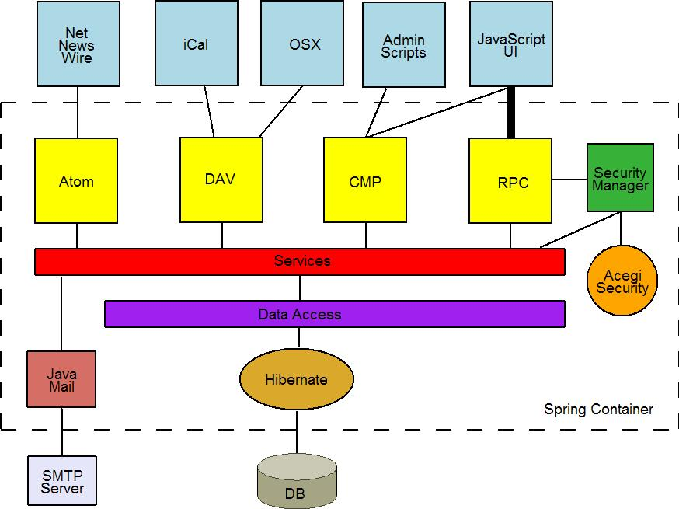
Architecture

Slide 21
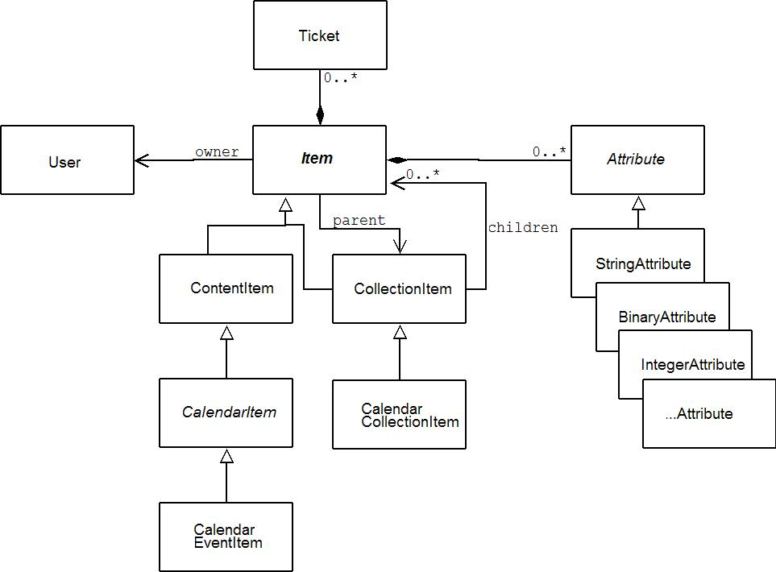
Object Model

Slide 22
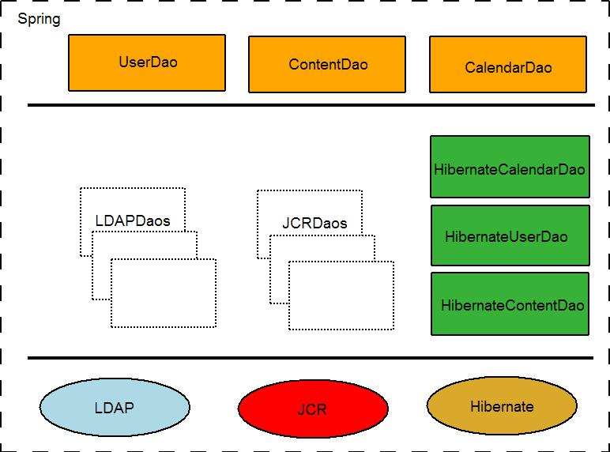
Data Access API
Spring-managed components that persist data to storage
Responsibilities:
  CRUD
  Queries (e.g. “find the first 20 users”, “find all events occurring this month”)
  Path resolution
Out of the box: Hibernate/JDBC
What about other storage systems?

Slide 23
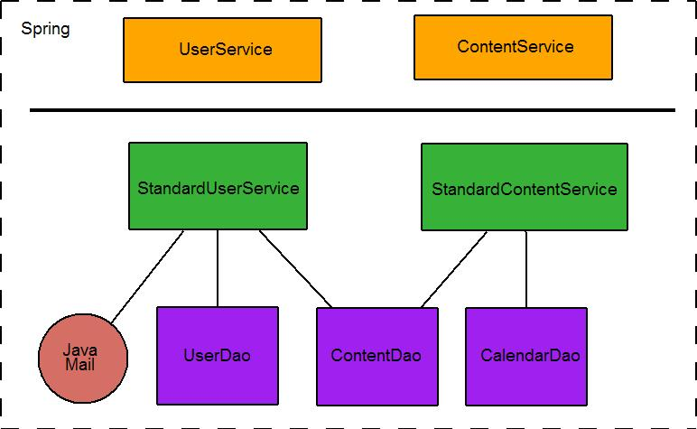
Service API
Spring-managed components that provide core logic for user management and content sharing
Implemented in terms of Data Access APIs and interfaces to external systems (e.g. JavaMail)
Properties:
  Stateless
  Transactional
  Security-aware (coming soon)

Slide 24
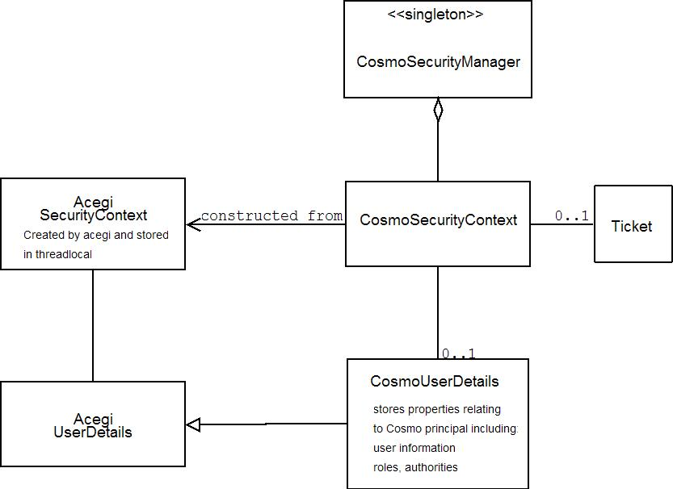
Security API
Facade for Acegi Security
  Thread local security context
  Filter-based authn & authz
  Any component can examine the current thread's security context at any time
    If ticket, what permissions?
    If user, admin or no?
  To come: access control lists, instance filtering in services

Slide 25
RPC API
RPC adapter for service APIs
    Developed initially for Web UI
    Simplified domain model that's easy to serialize for the wire
    Out of the box transport: JSON-RPC
Security is hard! Let's go shopping!
    Extra challenging when RPC client is a browser
    Currently no built-in security; relies on external security context (user logged into Web UI)
    Future: ticket and role based security for every remote call
Notes:
Another way to get data in and out of Cosmo is through RPC, or remote procedure calling.
This was initially designed with our WebUI (aka Scooby) in mind, but there’s nothing stopping anyone from writing another client that uses these method if you prefer working with an API over working with a protocol.
CosmoRPCService exposes a bunch of methods for getting calendar events indidually, over a date range, updating events, deleting events, etc.
The domain model is simpler than the full icalendar spec, to reflect the simpler domain model of the WebUI and the desktop ui (for example recurrence rules and timezones are way simpler right now)
Although the domain model is simplified, the routines on the server that convert back and forth between WebUI(Scooby?) domain objects and icalendar objects are very careful not to lose information when updating events on the server. In other words, even though the WebUI’s domain model has no notion of Alarms, updating an event that has an alarm won’t destroy that alarm
It doesn’t have any specific RPC protocol in mind
Right now the security for is very simple. After a user has logged in via an HTML form, they can execute any of the methods on their collections. In essence there is only one role, the user role.
We would also like to have people log in and perhaps register via RPC, but we’d need an anonymous role for that. We’d also like to execute administrative functions via RPC, but for that we’d need an admin role. So the plan is to wrap this service bean in a Acegi proxy bean which would properly test for security, using declaritive role-based security
Right now we have only exposed CosmoRPCService using JSON-RPC, but if there was enough demand for it, we could relatively easily expose the same methods over SOAP or XML-RPC for instance.

Slide 26

CMP
“Cosmo Management Protocol”
    Custom HTTP-based, RESTacular protocol for provisioning and reporting
      Administrators: CRUD users, resource usage reports
      End Users: sign up for an account, update account details, change password
    Easy to script with common tools
Real life client software:

Slide 27


Slide 28
Snarf (aka OSAF Server Bundle)
Goal: provide a functional server that takes the fewest possible steps to get running
    (1) Download, unpack, and run
    (2) ?
    (3) Profit!
Provides Tomcat and embedded Derby, but...
    Extremely simple to point at another database
    Just as simple to run behind a reverse HTTP proxy
    Not trivial (and not documented) to use another servlet engine

Slide 29
< insert demo here >

Slide 30
What's Next?
OSAF
    Anonymous sharing
    Complete bi-directional Atom with GData extensions
    More efficient synchronization with Projekt: Morse Code
    Month and day calendar views in the PIM
    Stamping
    Quotas
    Stateless web UI
    Database partitioning
    Scheduling (free-busy, CalDAV, iTIP)
    Item soup

Slide 31
What's Next?
Community
    Groups
    Access control lists
    Delegated authentication and user profile management with LDAP
    Identity management & single-signon
    Embedding Apache DS and James in Snarf
    Embedding Cosmo in other applications

Slide 32
For More Info
Find installation instructions, release notes, developer info, project wiki, mailing lists, IRC info at http://cosmo.osafoundation.org/
This presentation is found at http://svn.osafoundation.org/server/cosmo/trunk/src/docs/presentations/apachecon2006.ppt and also at http://us.apachecon.com/html/archive.html

Slide 33
Credits
Randy Letness, for most of the diagrams in this presentation, and for coding the entire object model and data access layer
Ted Leung, for keeping other people from bothering me when I'm trying to work
Blizzard Entertainment, for giving me something to do when I don't feel like working

Slide 34

Rock on!

