Slide 1
Evolution OF Random graph generators
Matthew Martin Aaron Pope

Slide 2
Why Genetic Programming?
Demonstrate the use of genetic programming (GP) with graph algorithms
Once implemented, a GP can be used to solve a variety of related problems

Slide 3
Why Random Graphs?
Random graphs can be used to generate test data for graph algorithms
Can also be used to simulate networks (computer, social, organizational, etc.)

Slide 4
Current Random Graph Models: Erdős–Rényi
Each possible edge has an independent probability of being included
Purely random model
Provides a poor simulation of real-world graphs, such as social networks

Slide 5
Current Random Graph Models: Random Geometric
Vertices placed randomly, edges exist between nearby vertices
Relates well to wireless sensor networks
Not practical for applications which are unaffected by physical locations

Slide 6
Current Random Graph Models: Scale-free
Vertex degree distributions follow a power law relation
Majority of edges are incident to a small portion of the vertex set
Often used for modeling computer and social networks

Slide 7
Room for Specialization
Graphs needed with a specific characteristic (topology motifs, sub-graph structure, etc.)
Method of construction is unclear or unimportant
When it’s easier to define your requirements than it is to construct your solution, evolve it!

Slide 8
An Example
You’ve designed a new graph partitioning algorithm and you want to test its limitations
Evolve a program which generates random graphs on which your algorithm performs poorly
Highlights the weaknesses of your algorithm

Slide 9
Our Solution
Genetic Programming
Post-order parse tree
Evolve edge selection phase

Slide 10
Random Graph Generating Algorithm
Select vertices for new vertex to connect to
Add vertex
Add edges
n times
End

Slide 11
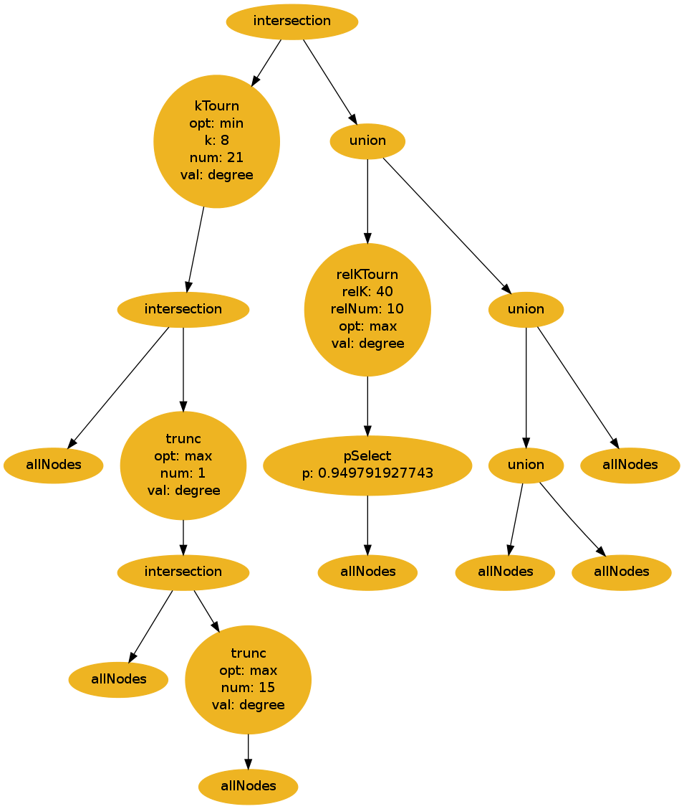
Parse Tree
Selects vertices for the new vertex to connect to
Sets of vertices
Root returns the set of vertices

Slide 12
Nodes: Selection Operations
Regular Selection
Relative Selection

Slide 13
Nodes: Regular Selection Operations
p-Select
k-Tournament Selection
Truncation Selection
Random Subset

Slide 14
Nodes: Relative Selection Operations
Relative k-Tournament Selection
Relative Truncation Selection
Relative Random Subset

Slide 15
Nodes: Set Operations
Union
Intersection
Difference
Symmetric Difference

Slide 16
Genetic Program
Generate Population
Generate Children
Evaluate Children
Evaluate Population
Parent Selection
Terminate
Check Termination
Survivor Selection

Slide 17

Random Graph Generating Algorithm Evaluation

Slide 18
Random Graph Generating Algorithm Evaluation

Slide 19
Testing
Maximize Edgecut of Partition
Minimize number of Edges
Minimize Edgecut of Partition
Maximize number of Edges
Maximize Average Eccentricity
Minimize number of Edges
Minimize Average Eccentricity
Minimize number of Edges

Slide 20
Testing
Trained Graph Size = 300
20 runs during evaluation
5 runs of GP on each problem

Slide 21
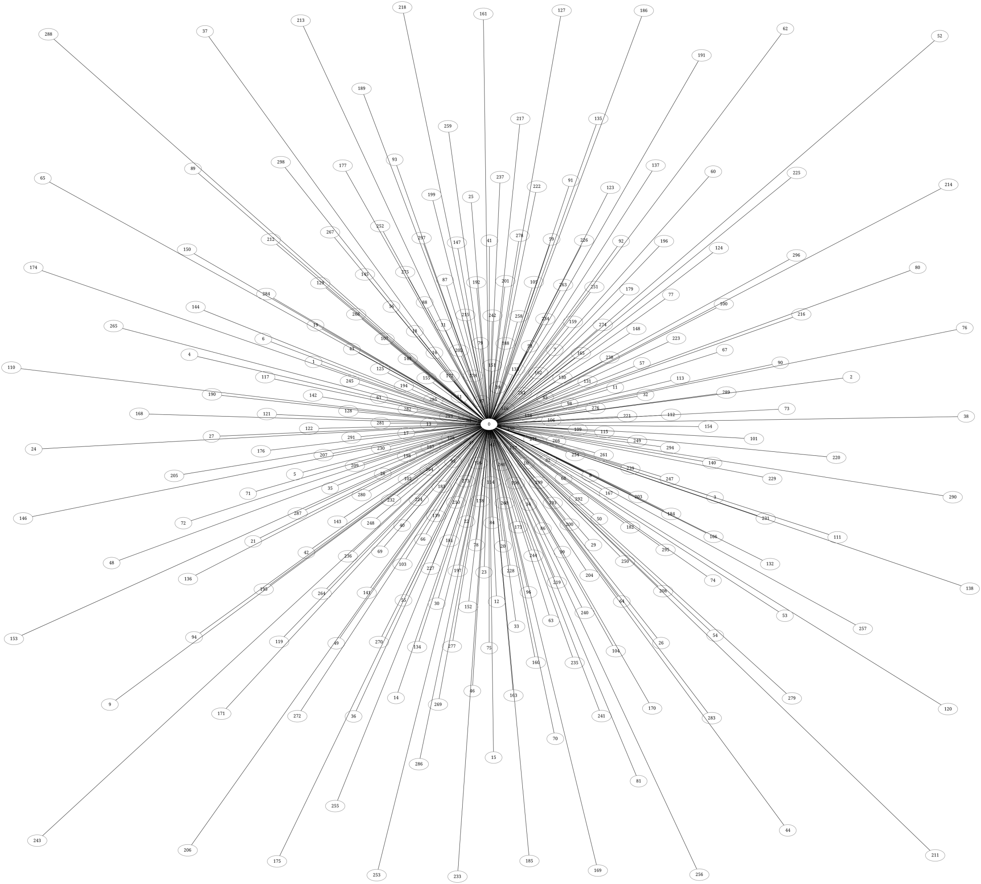
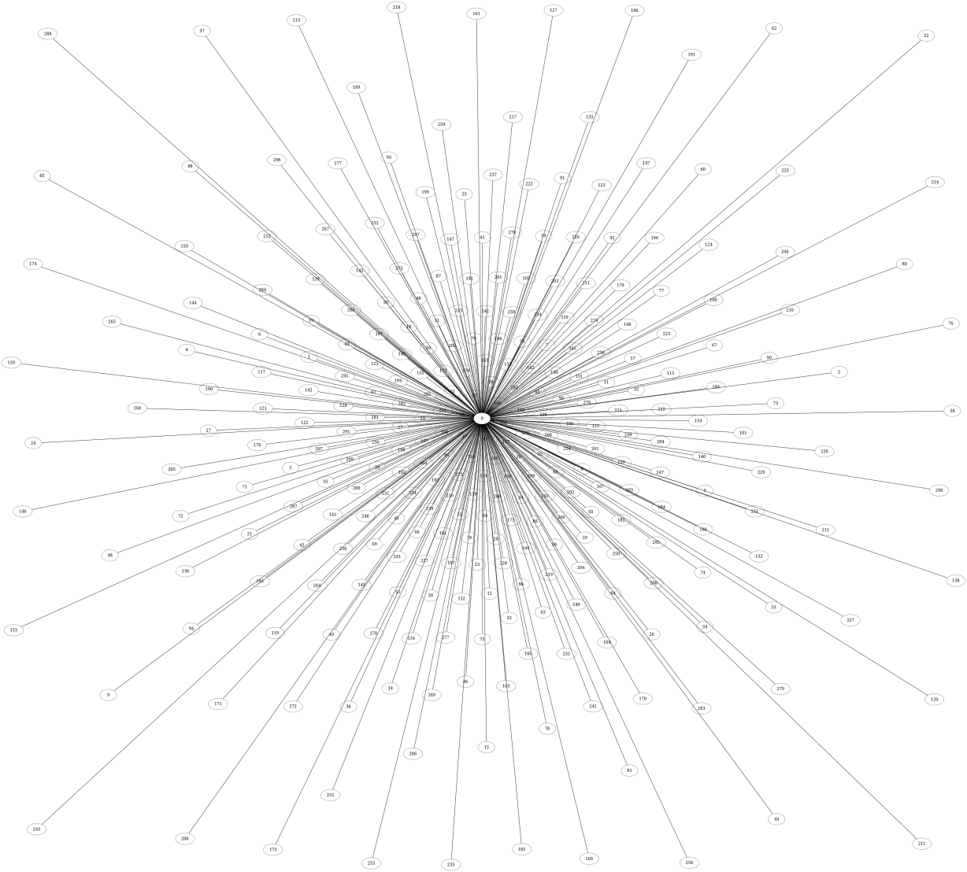
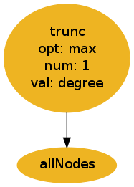
Results: Max Partition
Star Graph

Slide 22
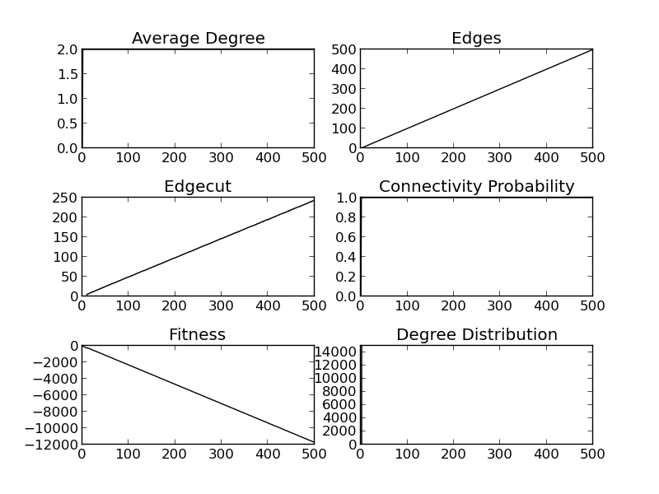
Results: Max Partition

Slide 23
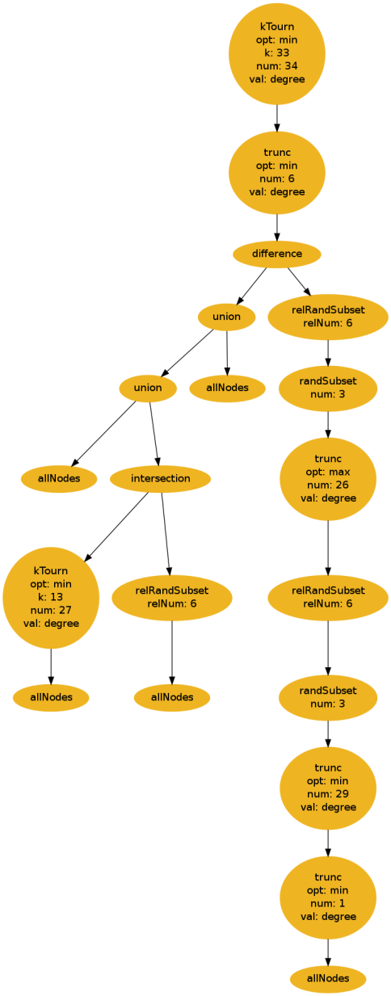
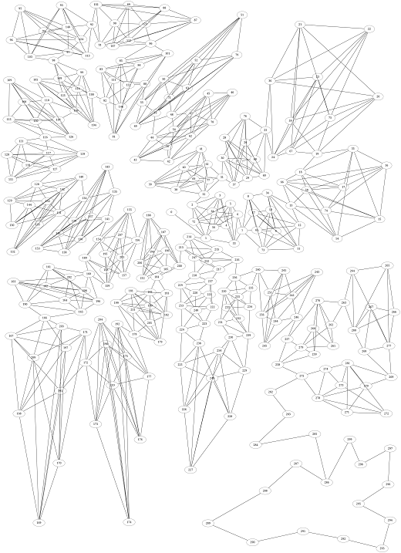
Results: Min Partition

Slide 24
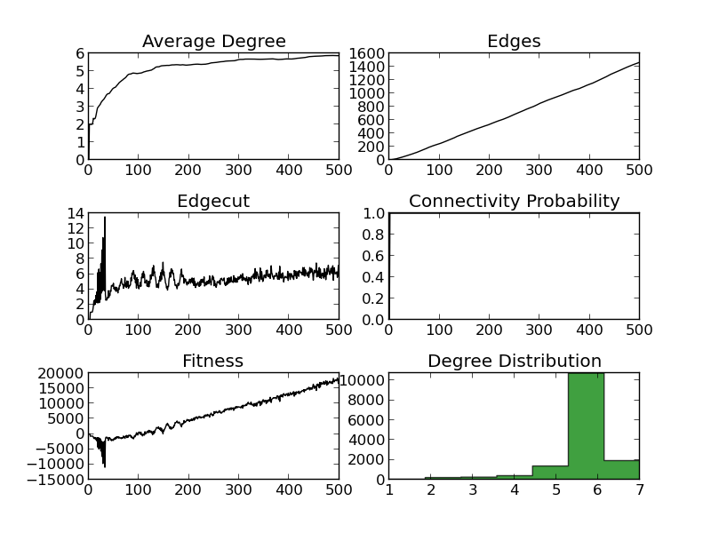
Results: Min Partition

Slide 25
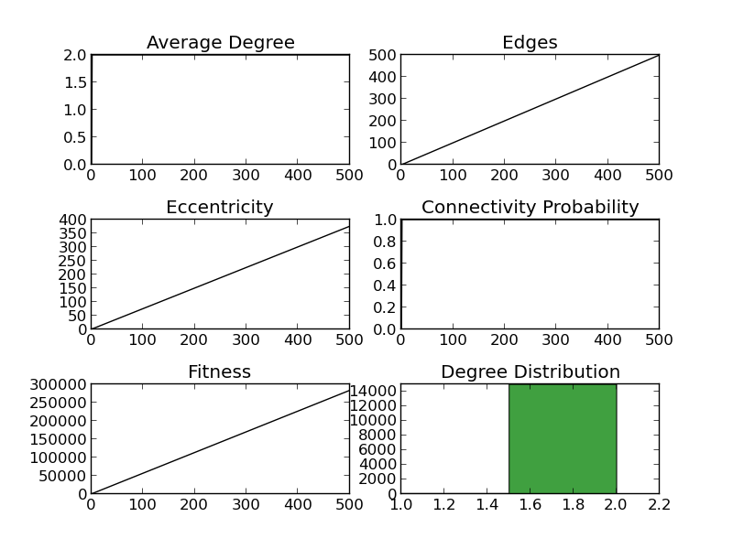
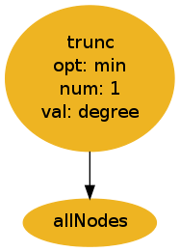
Results: Max Eccentricity
Path Graph

Slide 26
Results: Min Eccentricity
Star Graph

Slide 27
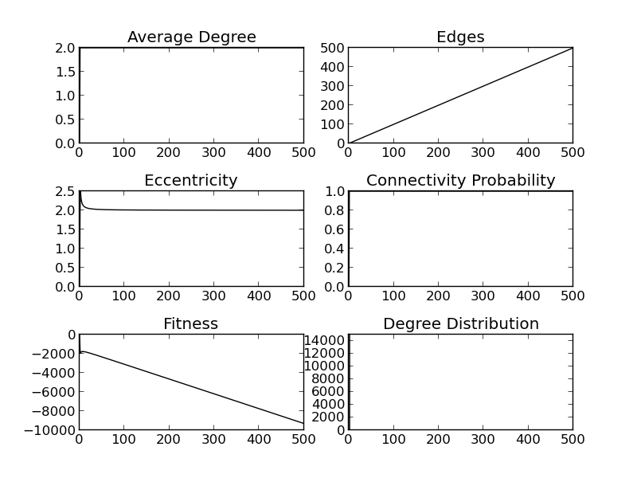
Results: Min Eccentricity

Slide 28
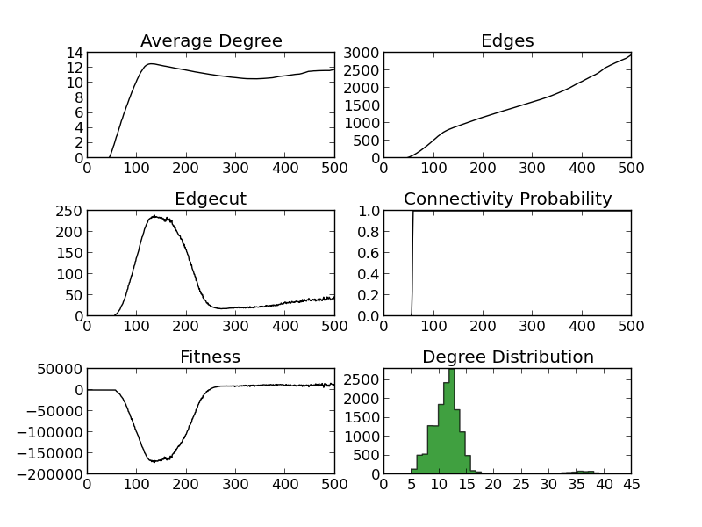
Drawbacks
Misleading

Slide 29
Conclusion
Using GP we can create custom Random Graph Generation Algorithms
Proof of Concept
Improvement need on evaluation during evolution

Slide 30
Future Work
Add capability to evolve Random Directed Graph Generating Algorithms
Use to create graphs that emulate program control flow graphs
Evolving other types of graph algorithms
Co-evolution of graph algorithms alongside Graph Generating Algorithms

