Slide 1
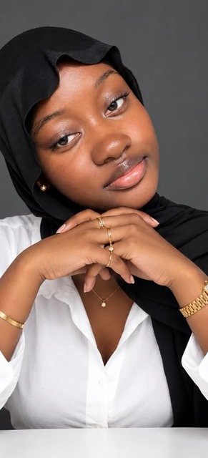
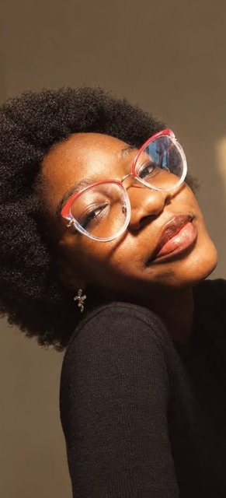
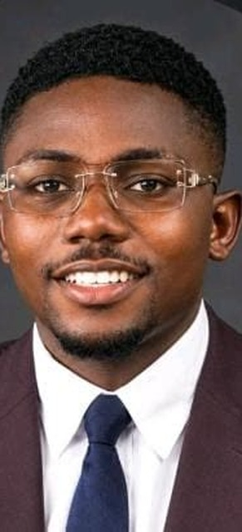
MSC
MSC
BETECHIFIED / ADVANCED CLASS PROJECT
TEAM MSC PRESENTS
Team MSC
Developer Portfolio
Website
BeTechified Week 11 Advanced Class Presentation
A collaborative, responsive showcase of our team, skills and work.
MAMA
AZIEGBE
JOHNSON
Mama S. Ceesay
Project Leader & Workflow Lead
PROJECT LEADER
UI/UX LEAD
FRONTEND
Aziegbe Favour Osetuohamen
Presentation Slides & UI/UX Lead
THREE PEOPLE · ONE TEAM
Johnson Victor
Frontend Developer
01 / 06

Slide 2
MSC
MSC
BETECHIFIED / WEEK 11
01 / WEB PAGE STRUCTURE
A clear structure. One connected experience.
Three core files keep the portfolio easy to understand, style and maintain.
index.html
HTML
01
PORTFOLIO SECTIONS
Semantic content and page sections
01
Home
Introduction
css/style.css
CSS
02
02
About & Skills
Our capabilities
Visual system, CSS Grid and responsive styling
js/script.js
03
Projects
Selected work
JS
03
Navigation, interactions and form validation
04
Contact
Interactive form
One page. A straightforward path from introduction to connection.
STRUCTURE / CONTENT / BEHAVIOR
TEAM MSC · DEVELOPER PORTFOLIO WEBSITE
02 / 06

Slide 3
MSC
MSC
BETECHIFIED / WEEK 11
02 / WEB PAGE RESPONSIVENESS
Designed to feel right on every screen.
Bootstrap 5 handles the responsive page grid; CSS Grid arranges flexible content.
MOBILE
COMPACT
TABLET
BALANCED
DESKTOP
EXPANDED
ONE
COLUMN
Designed for
the wider view.
Stacked sections
Flexible columns
Multi-column layout
Readable type and tap-friendly controls.
Cards gain breathing room as the screen grows.
CSS Grid uses wide screens without losing clarity.
MOBILE FIRST
Bootstrap breakpoints + CSS Grid = layouts that adapt as the viewport changes.
TEAM MSC · DEVELOPER PORTFOLIO WEBSITE
03 / 06

Slide 4
MSC
MSC
BETECHIFIED / WEEK 11
03 / FEATURES + BONUS TASK
Real projects. Practical interaction.
Three live projects demonstrate frontend work; the portfolio also validates contact input.
FITLIFE / GAMBIA
01
IDEAS / STORIES
02
MAMA S. CEESAY
03
FitLife Gambia
Medium Landing Page
Developer Portfolio
Fitness-centre website with programmes and membership information.
Editorial-inspired experience for discovering and sharing ideas.
Personal portfolio introducing the developer, skills and selected work.
LIVE DEMO ↗
GITHUB ↗
LIVE DEMO ↗
GITHUB ↗
LIVE DEMO ↗
GITHUB ↗
BONUS REQUIREMENT
JS
Interactive contact form
JavaScript checks name, email, subject and message; inline feedback guides users before their email is prepared.
TEAM MSC · DEVELOPER PORTFOLIO WEBSITE
04 / 06

Slide 5
MSC
MSC
04 / COLLABORATION
GITHUB WORKFLOW & DELIVERABLES
A shared workflow.
A site that ships.
LIVE ON GITHUB PAGES
OUR PROJECT
Team MSC
Developer Portfolio
Git and GitHub helped us coordinate tasks, share updates and publish the finished portfolio.
Explore the live website and source repository.
01
02
03
04
PLAN
BUILD
REVIEW
PUBLISH
Agree on tasks
Work in files
Share changes
GitHub Pages
mama124-max.github.io/
developer-portfolio/
MAMA · LEAD & WORKFLOW
AZIEGBE · UI/UX & SLIDES
JOHNSON · FRONTEND
OPEN GITHUB REPOSITORY ↗
05 / 06
TEAM MSC · DEVELOPER PORTFOLIO WEBSITE
05 / 06
TEAM MSC · DEVELOPER PORTFOLIO WEBSITE

Slide 6
MSC
MSC
BETECHIFIED / WEEK 11
05 / CONCLUSION + Q&A
Built together. Ready for what's next.
We strengthened our responsive design, validation, Git collaboration and presentation skills.
Q&A
Questions about the design, code, workflow or next steps?
10-MINUTE PRESENTATION GUIDE
A focused run of show
01
Team & project
0:45
LIVE PROJECT
02
Scope & structure
1:30
mama124-max.github.io/
developer-portfolio/ ↗
03
Responsive build
1:30
04
Features & projects
2:00
05
Workflow & live site
1:45
LEARNINGS
06
Summary & Q&A
2:30
Plan together · build responsively · validate · deliver on time
10 MIN TOTAL · 2½ MIN FOR QUESTIONS
THANK YOU · TEAM MSC · BETECHIFIED WEEK 11
TEAM MSC · DEVELOPER PORTFOLIO WEBSITE
06 / 06

