Slide 1
Deep Reinforcement Learning
Last Project of Intelligent System Course

Slide 2
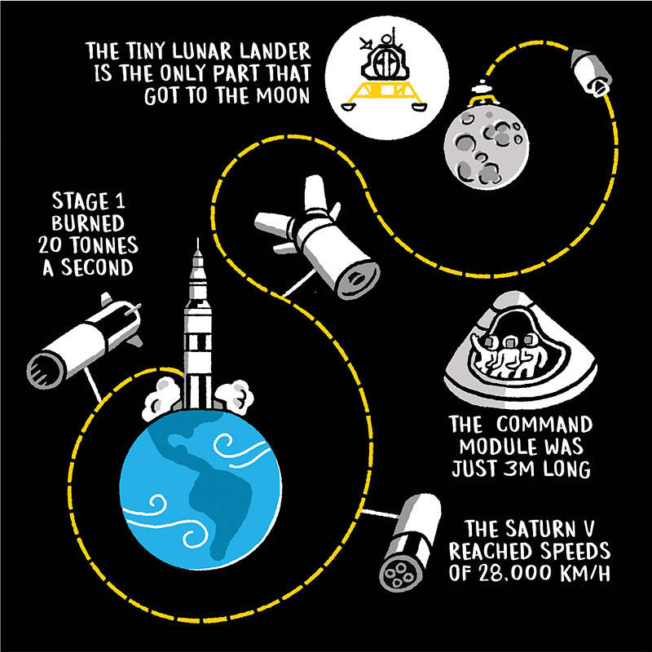
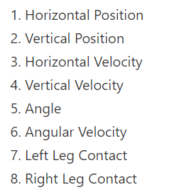
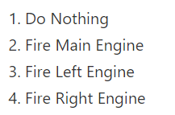
Lunar Lander environment
States:
Actions:

Slide 3
Rewards:
+100/-100 for coming to rest or crashing.
Ground contact for each leg is +10
Firing engine is -0.3 The benchmark for winning the game is 200 points.

Slide 4
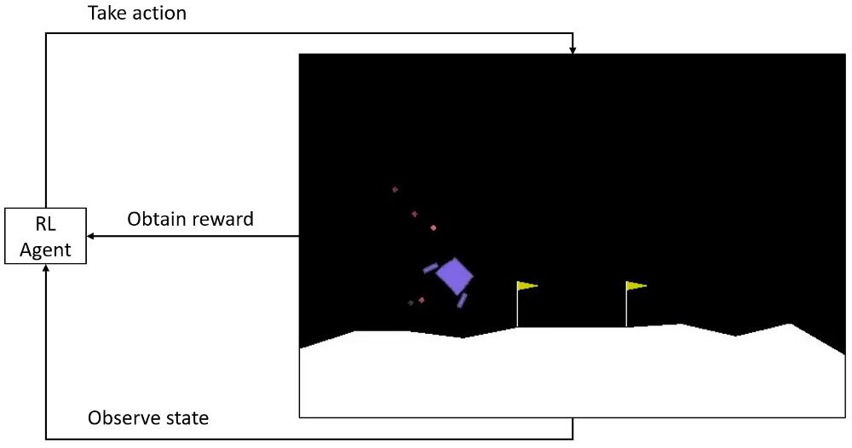
Slide Title
Saving Experience
make memory(deque format)
save in memory
take random samples in batch size

Slide 5
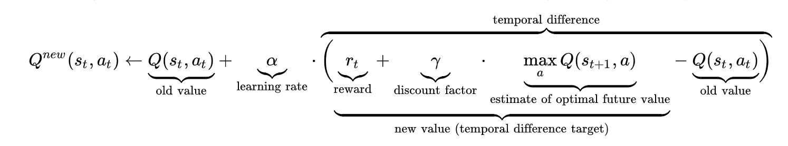
DQN
Algorithm

Slide 6
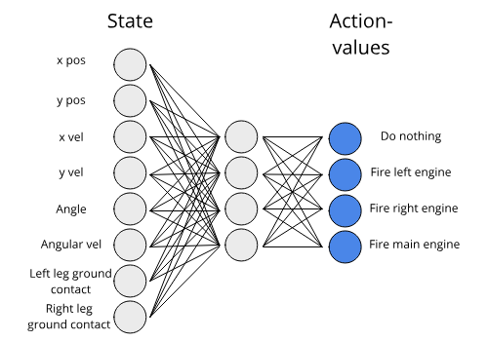
DQN Network
Network:
architecture
3 * Linear
( start : state_size,
end : action_size)
forward propagation
2 * ReLU + Linear

Slide 7
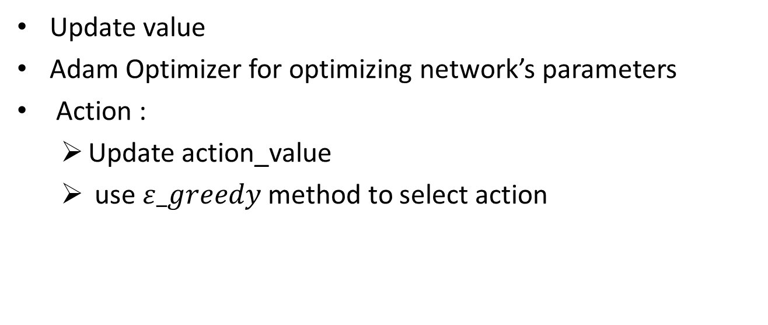
Agent
Update value
Adam Optimizer for optimizing network’s parameters
Action :
Update action_value
use $ε_greedy$ method to select action

Slide 8
Training
Select and perform action until done or truncated happens
Calculate cumulative rewards
Calculate recent cumulative rewards ( deque format)
Calculate regret:
Regret = mean(recent cumulative rewards) – current cumulative rewards

Slide 9
DDQN
Algorithm
Network
Value Network : DQN
Target Value Network :DQN

Slide 10
Agent
Update value
Adam Optimizer for optimizing network’s parameters
Action :
Update action_value
use $ε_greedy$ method to select action

Slide 11
Training
Same as DQN training

Slide 12
Presented by:
Mohammad Hoseini 810198529
Amirhosein Abdoli 810197541
Kiana Lotfi 810197574
Thank you for your consideration

