Slide 1
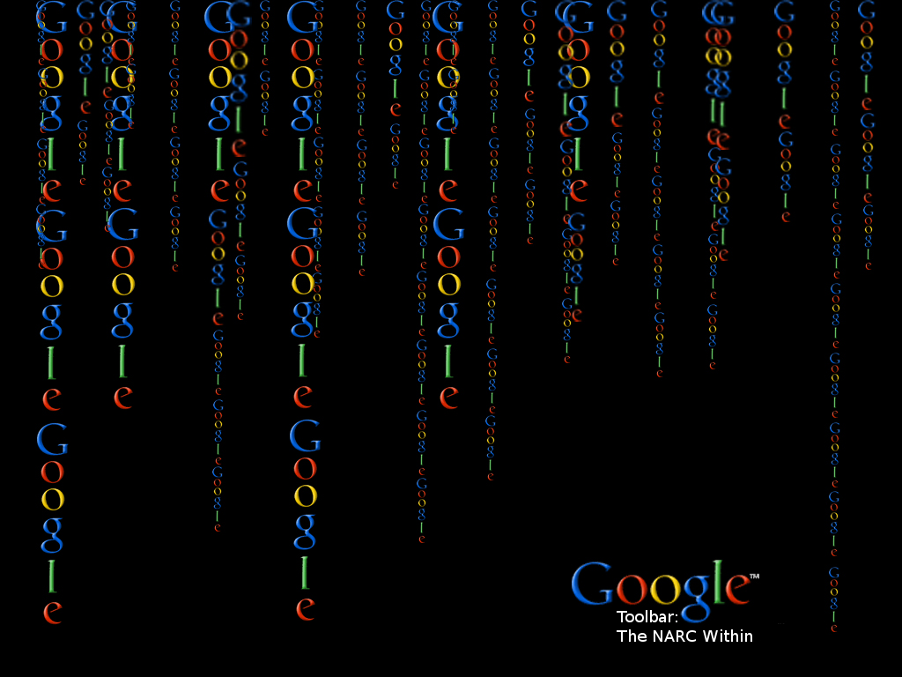

Slide 2
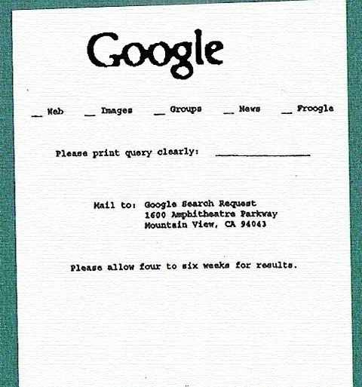
Google Toolbar:
The NARC Within
“The” Google
What would we do without them/it?

Slide 3
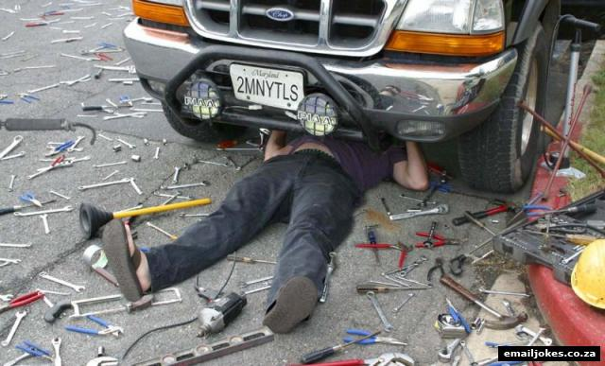
Google Toolbar:
The NARC Within
The problem:
Bookmarks are the geek tool?
URLs, URLs everywhere...
Home, work, on the go?

Slide 4
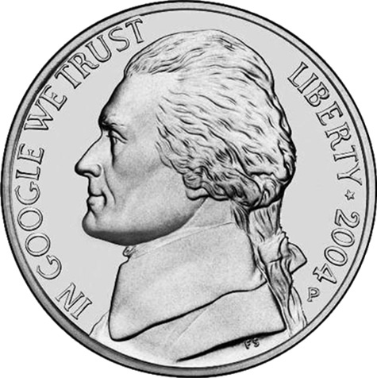
Google Toolbar:
The NARC Within
Google Toolbar is the Solution?

Slide 5

Google Toolbar:
The NARC Within
Or just a tease?

Slide 6
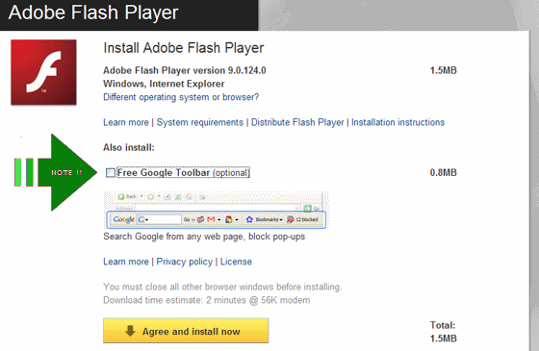
Google Toolbar:
The NARC Within
Of course it's good, it's free!

Slide 7

Google Toolbar:
The NARC Within
Installs easy..
Stores URLS..
Access them wherever, whenever you need it
No more lost URLS!
Happy!

Slide 8
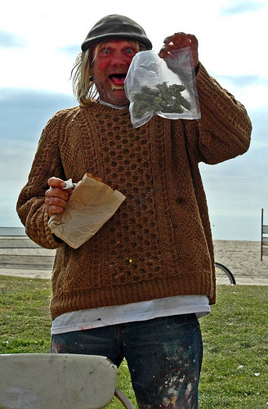
Google Toolbar:
The NARC Within
Time passes....
You bookmark your discoveries
Happy!

Slide 9
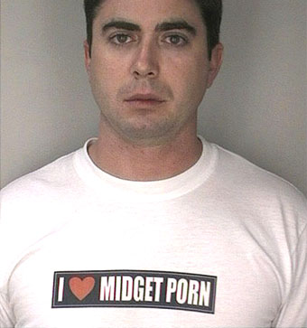
Google Toolbar:
The NARC Within
bookmark any pr0n?

Slide 10
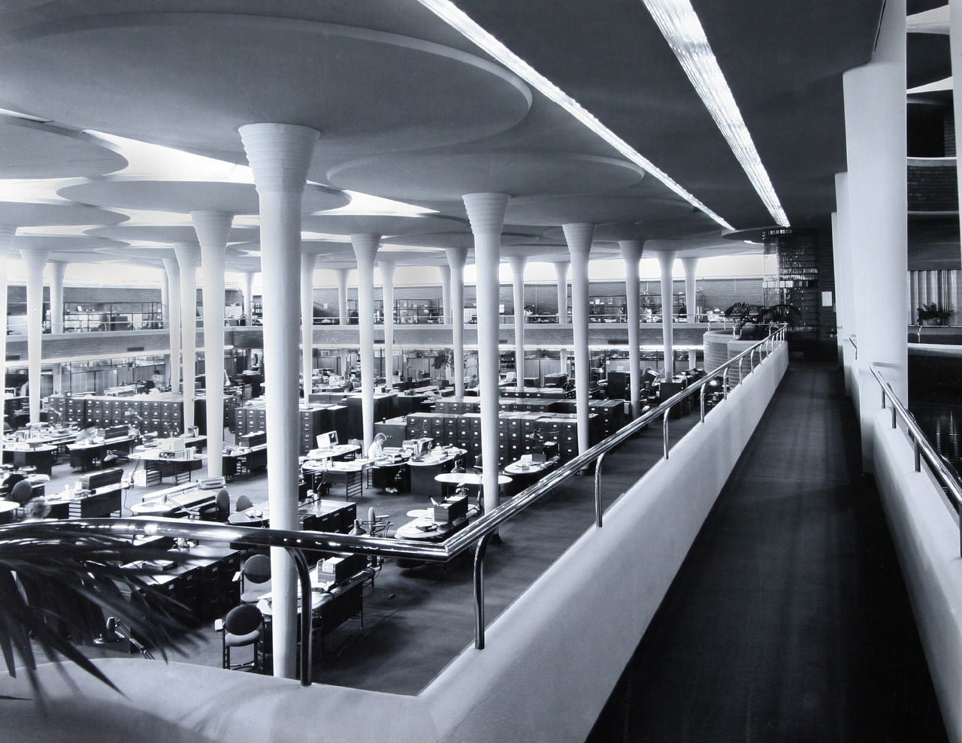
Google Toolbar:
The NARC Within
Next day at work...
You log in to google
and of course use the toolbar with all your
handy bookmarked
urls.

Slide 11
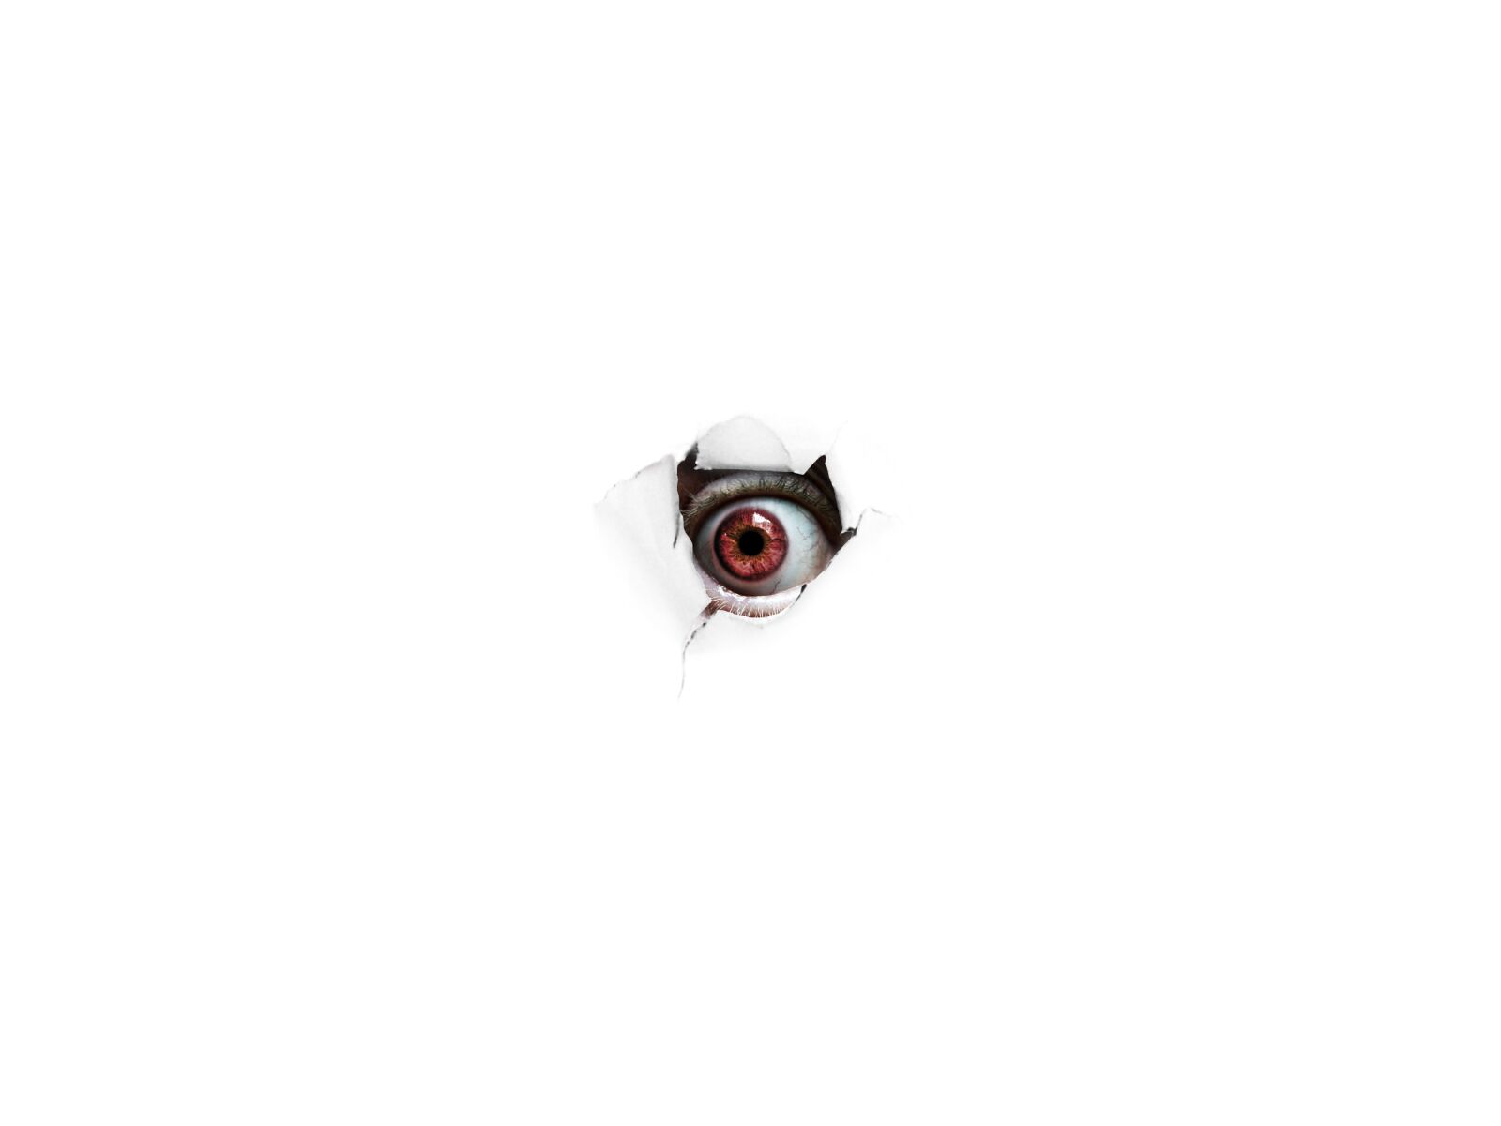
Corporate Security
You probably have a corporate security department?
They probably watch you?

Slide 12

Corporate Security
Maybe they watch you closely?
Web proxies?
Web filtering?
Web reporting?

Slide 13
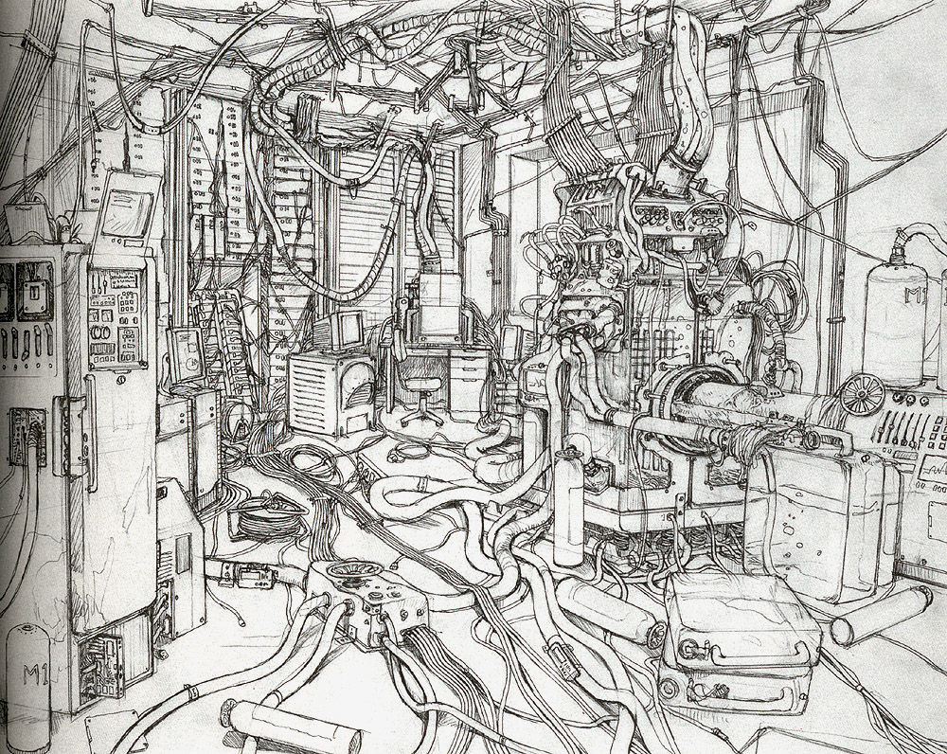
Toolbar Traffic
What happens when you access the toolbar?
Lets untangle...

Slide 14
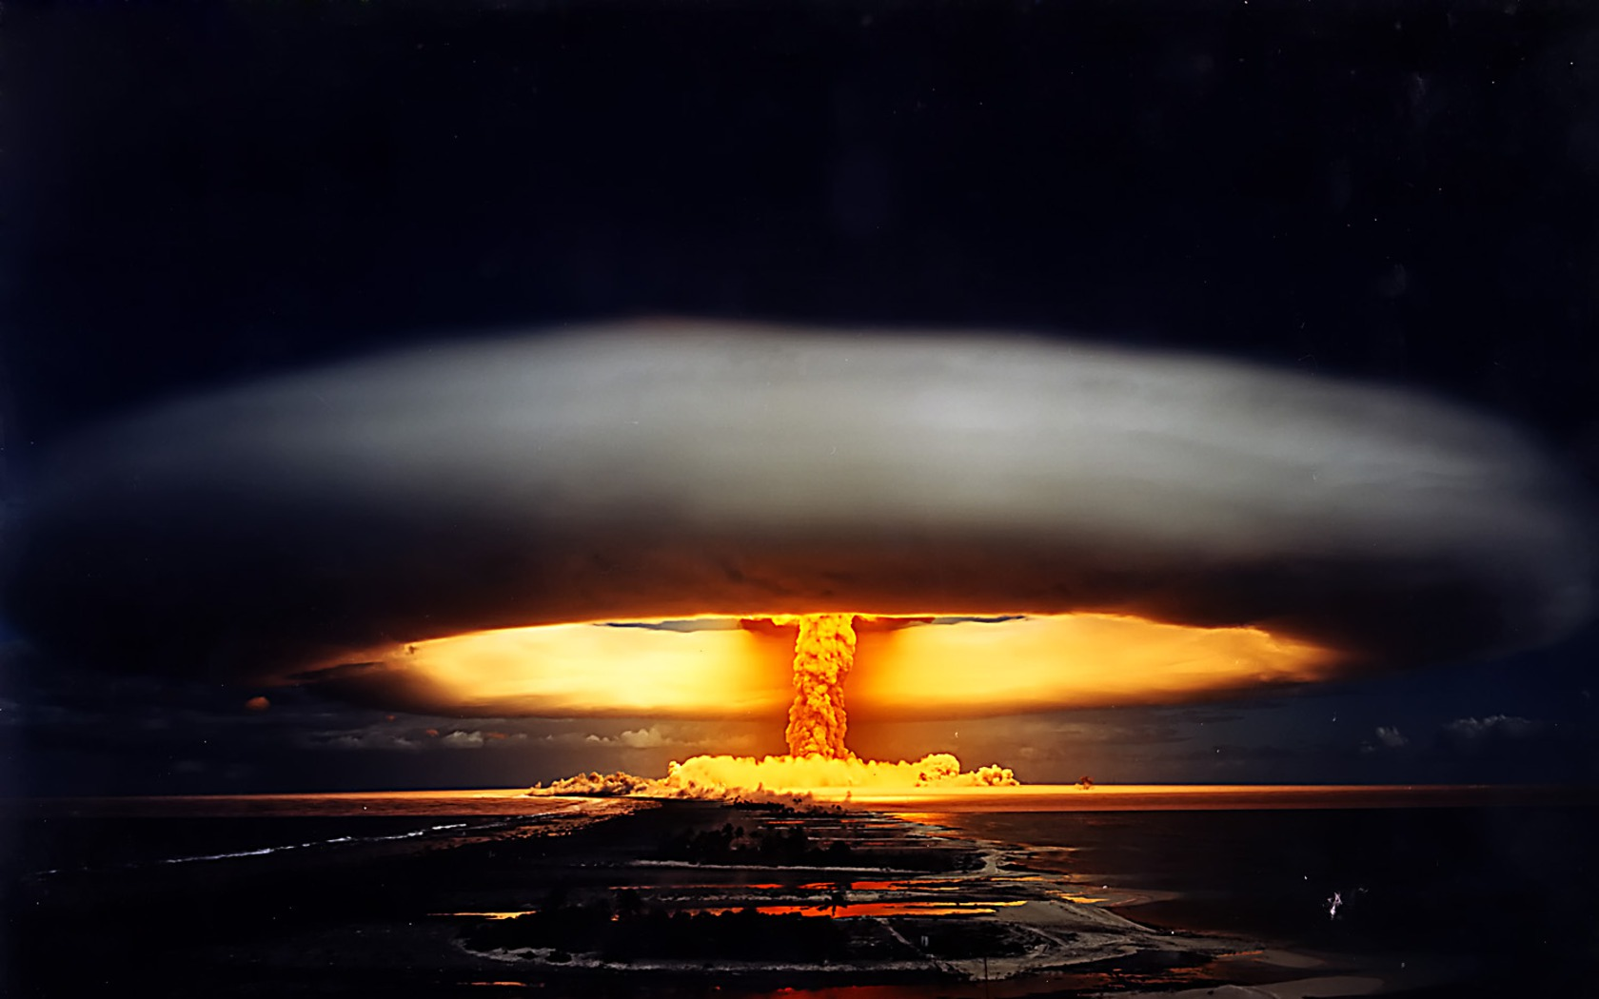
Demonstration

Slide 15
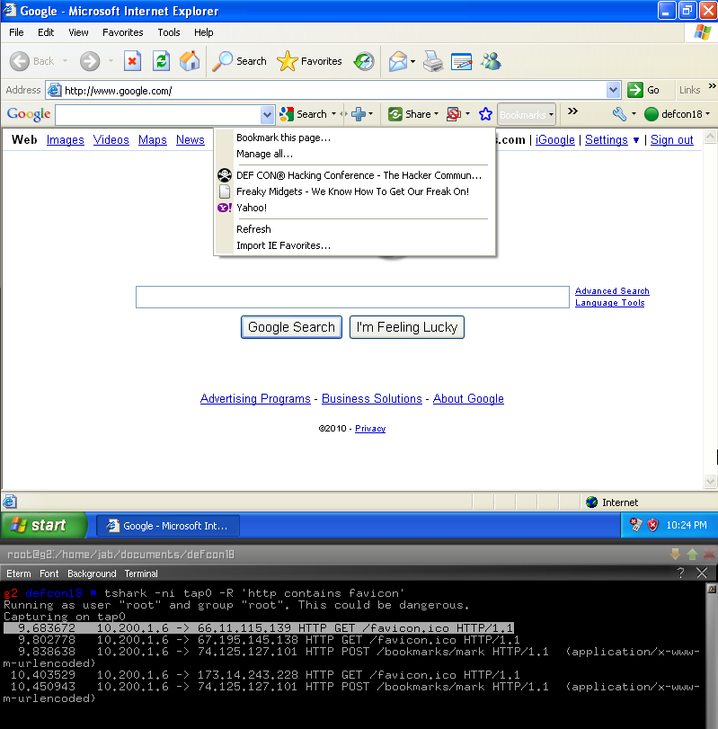
What we saw
For every url, google attempts a hit to the favicon.gif or favicon.ico url

Slide 16
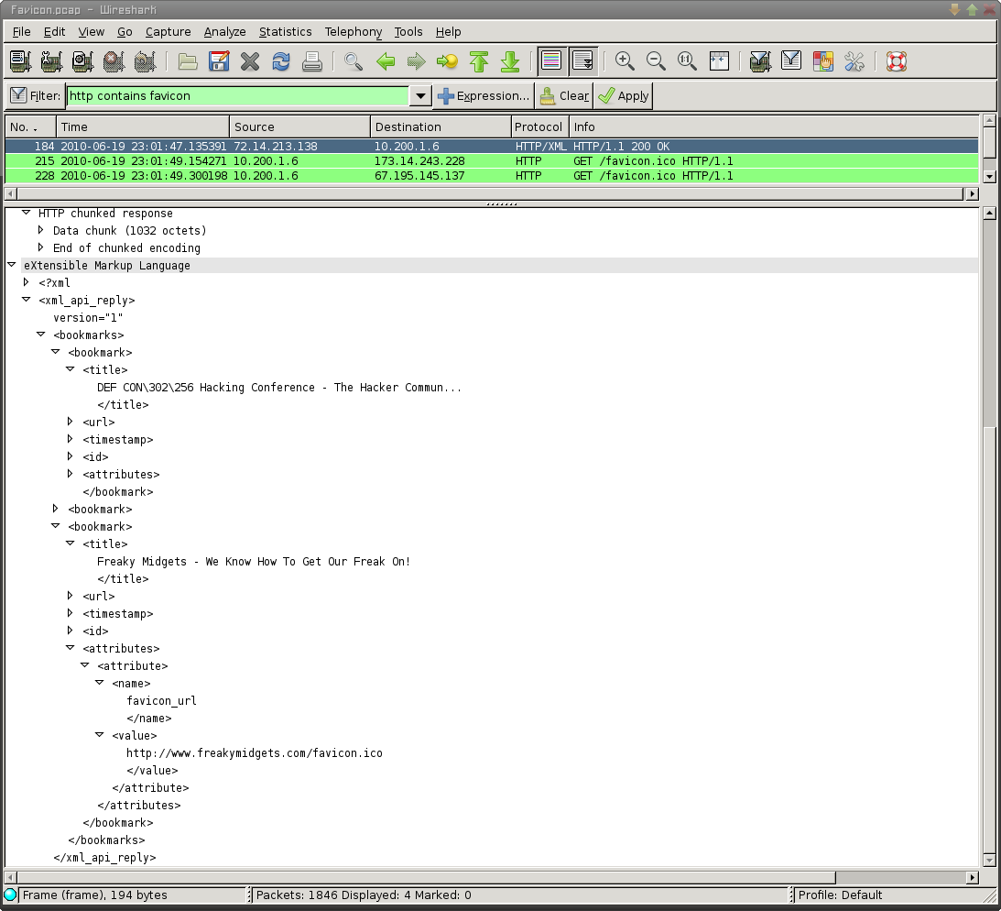
Why?
Check out
the XML structure

Slide 17

So?

Slide 18
Corporate Security
Remember they watch you?
Top 10 porn viewers now likely includes you?
Even though you didn't do anything.

Slide 19
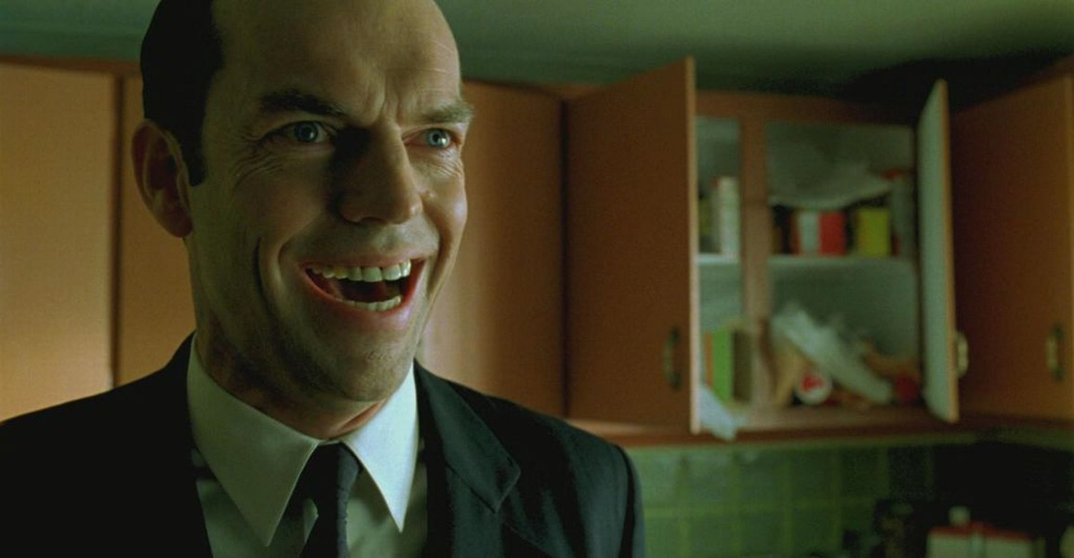
Forensics
When they investigate you what will they see?

Slide 20
Bluecoat
Bluecoat one liner to watch traffic in realtime:
wget --user=admin --password=supersecret --no-check-certificate -O - -q https://10.1.1.1:8082/Accesslog/tail-f//Access-Log
Pipe it through grep to narrow the target
| grep "10.2.2.2" | grep favicon

Slide 21
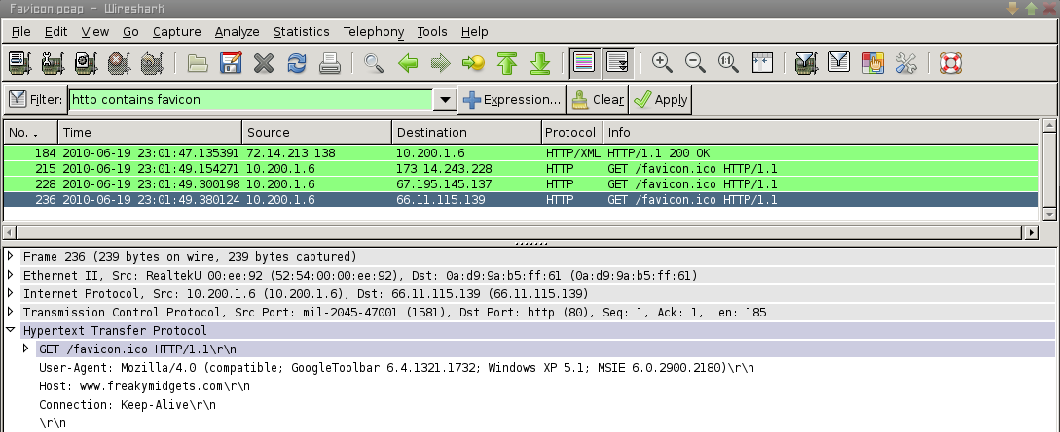
Forensics
index.dat files?
Nope..the toolbar generated the traffic, not IE.

Slide 22
Workarounds
Firefox Plugins to the rescue?:
Places pack from Andy Halford:
SyncPlaces:
https://addons.mozilla.org/en-US/firefox/addon/8426/
CheckPlaces:
https://addons.mozilla.org/en-US/firefox/addon/10897/
SortPlaces:
https://addons.mozilla.org/en-US/firefox/addon/9275/

Slide 23
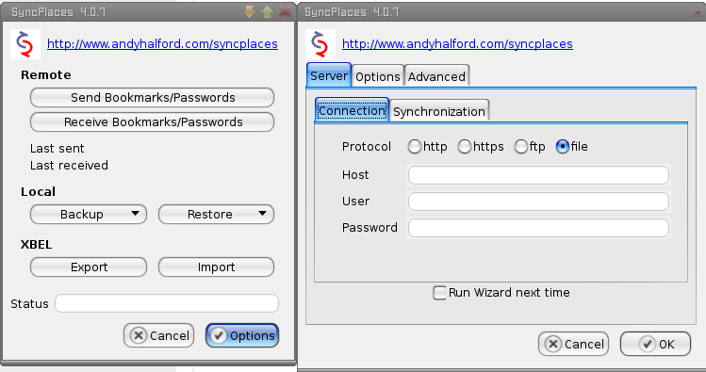
WebDav or file=rsync

Slide 24
favicon.ico?
Stored in the .json file generated by syncplaces:
{"iconData":[
{"uri":"http://s.com/","faviconuri":"http://s.com/favicon.ico",
"mimeType":{"value":"image/png"},"data":[137,80,78,71,13,10,26,10,0,0,0,13,73,72........

Slide 25
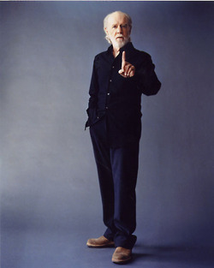
Not so fast...
Retrieve,import bookmarks via syncplaces also triggers firefox to attempt favicon hits just like google toolbar.

Slide 26
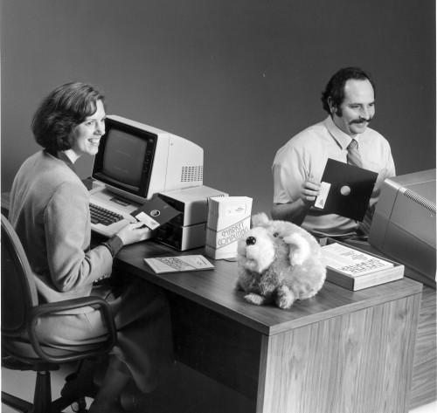
What to do?
Duh...
quit
looking
at porn!

Slide 27
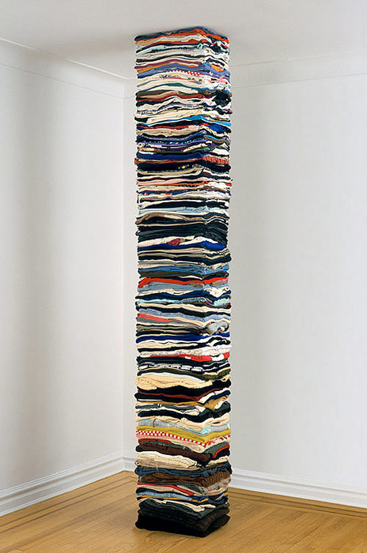
What else to do?
Or, write some code to straighten up the .json and remove bookmarks that you don't want ending up at work.

Slide 28
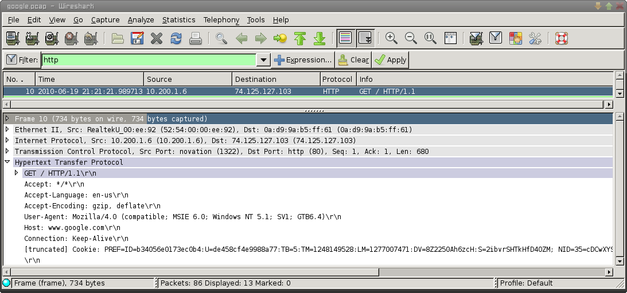
Toolbar p0wnage?
So what else can we do with this toolbar information?
Normal user agent:

Slide 29
Toolbar p0wnage?
Quite detailed client version info from google:

Slide 30
Profiling/Dating? (aka stalking)
IP/Bookmark tag cloud from coffee shop wifi?
http://tagcrowd.com/
http://www.wordle.net/create
Python/regex= new tool gtoolbarsnoop.py?
./gtoolbarsnoop.py --icons --titles -f eth0

Slide 31
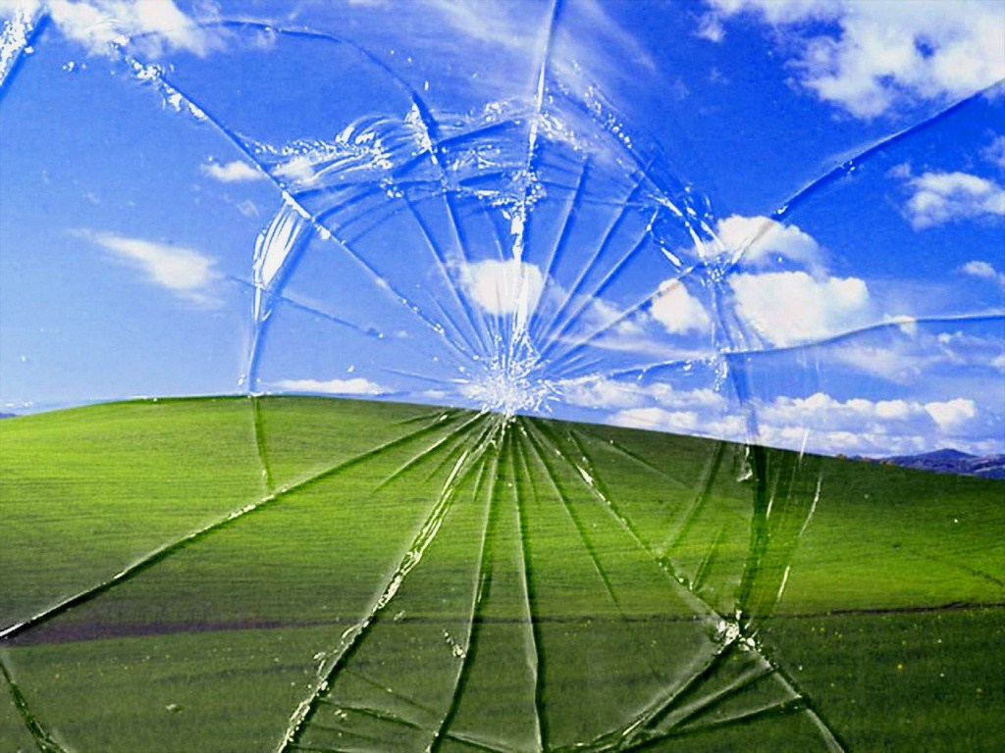
Demonstration

Slide 32
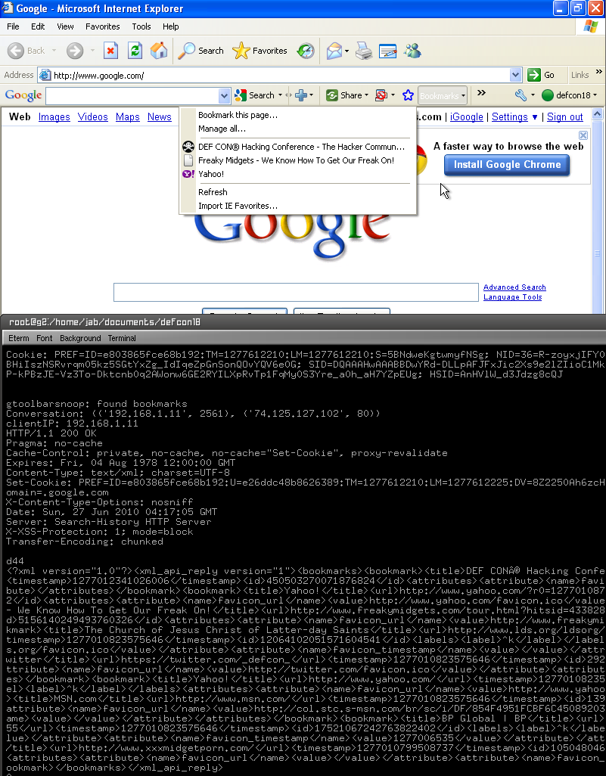
What else?
Deleted Bookmarks?!

Slide 33
Bookmark forensics
Allocated bookmark:
<bookmark>
<title>Yahoo!</title>
<url>http://www.yahoo.com/?r0=1277010878</url>
<timestamp>1277012340477390</timestamp>
<id>17266698985382022972</id>
<attributes>
<attribute>
<name>favicon_url</name>
<value>http://www.yahoo.com/favicon.ico</value>
</attribute>
</attributes>
</bookmark

Slide 34
Bookmark forensics
Deleted bookmark + favicon Timestamp!:
<bookmark>
<title>BP Global | BP</title>
<url>http://www.bp.com/bodycopyarticle.do?categoryId=1&amp;contentId=7052055</url>
<timestamp>1277010823575646</timestamp>
<id>17521067242763822402</id>
<labels>
<label>^k</label>
</labels>
<attributes>
<attribute>
<name>favicon_url</name>
<value/>
</attribute>
<attribute>
<name>favicon_timestamp</name>
<value>1277006535</value>
</attribute>
</attributes>
</bookmark>

Slide 35

Shocking

Slide 36
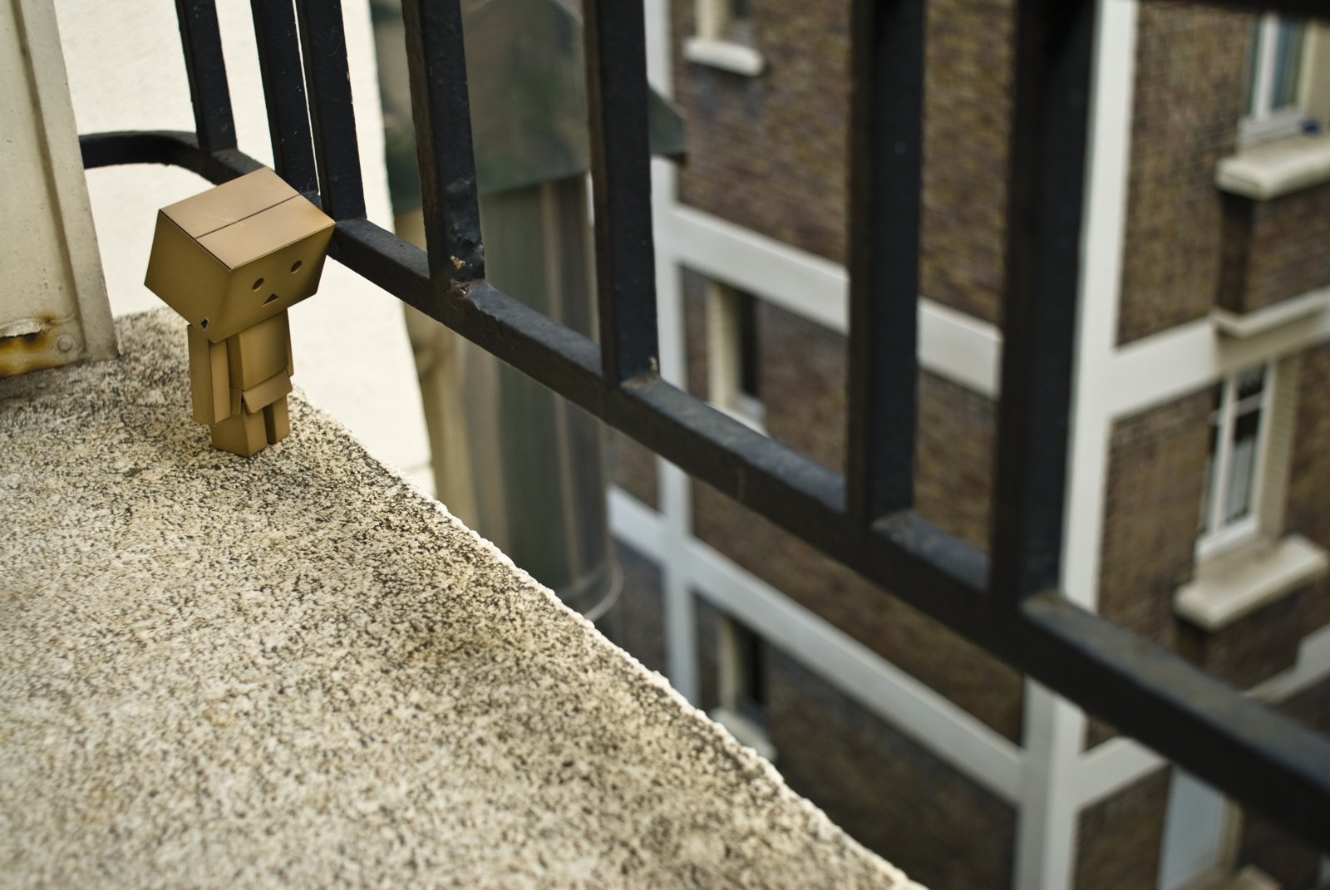
Sad

Slide 37

What to do?

Slide 38
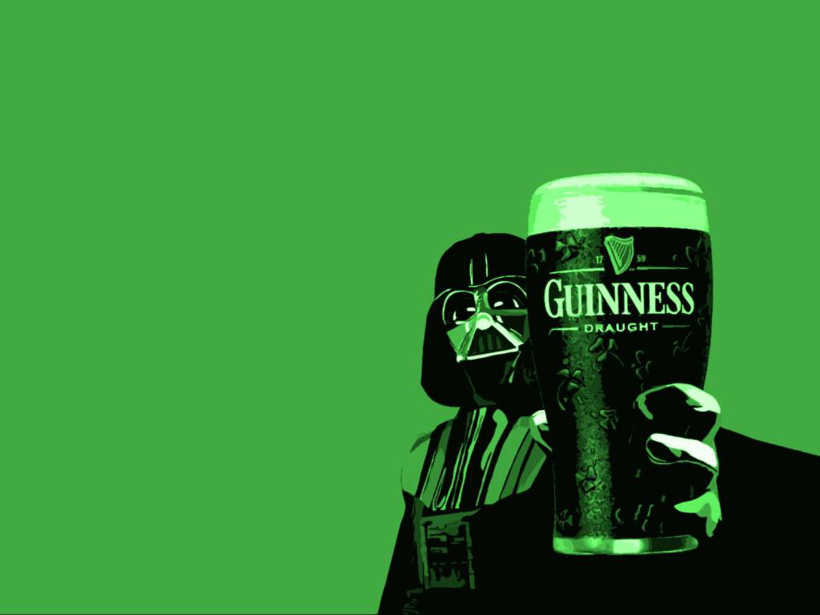
Questions?
Lets discuss over a beer!
Awesome graphics found via wallbase.net/4chan.
Code by jeff bryner
p0wnlabs.com
Use @ your own risk
no midgets were harmed in
the making of this presentation

