Slide 1
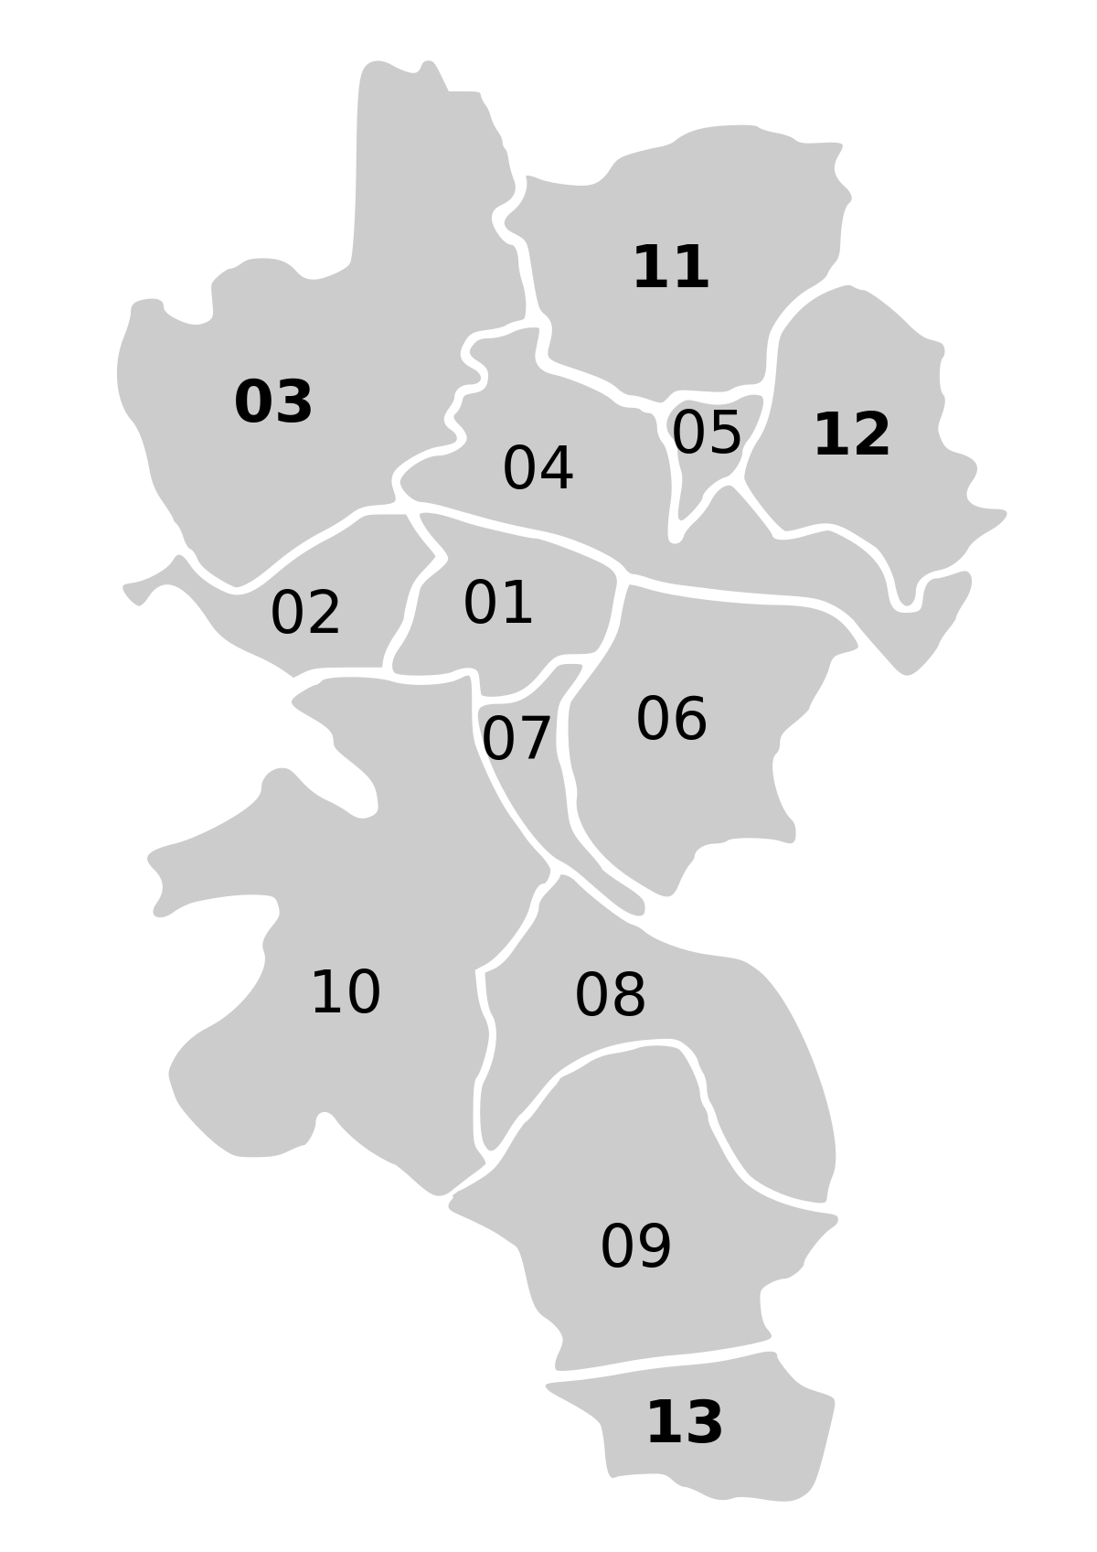

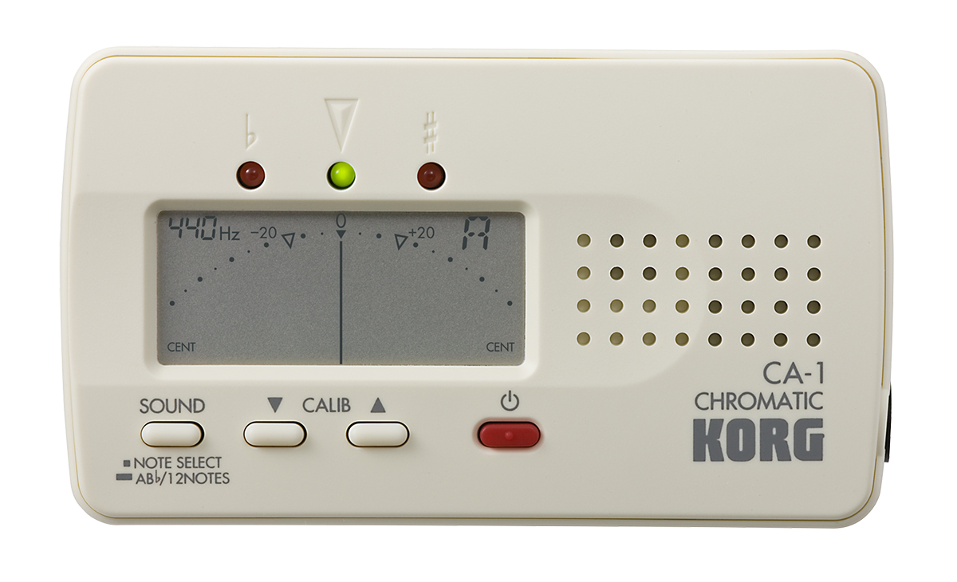
Würzburg TUNER
Mamad and Kimia
Mir project

Slide 2

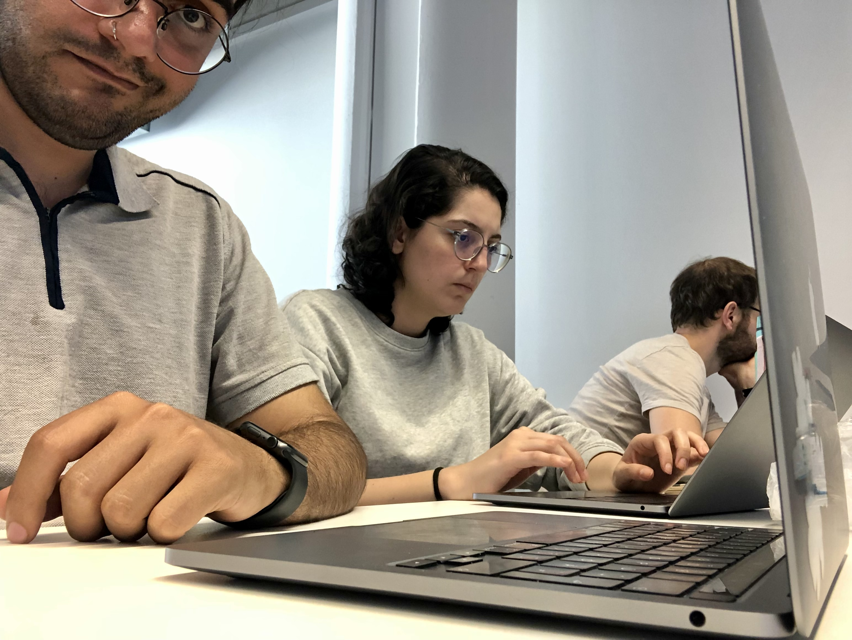
Who we are?
Kimia AI Student 👩🏻‍💻
Mamad AI Student 🧑🏻‍💻
Christof Weiß 👨🏻‍🏫

Slide 3
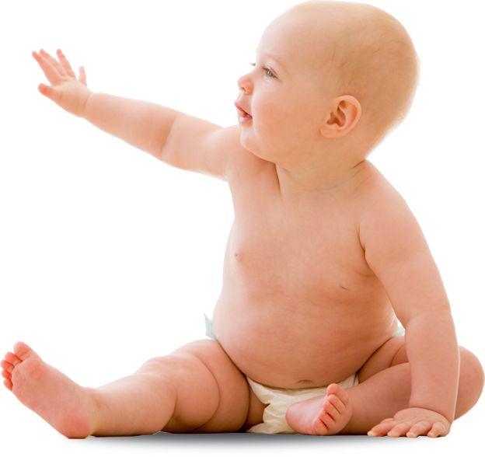


The project
Digital Tuner
A baby tuner though! 🐣

Slide 4


Libraries

Slide 5

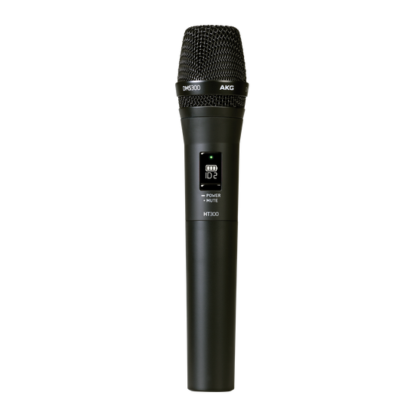
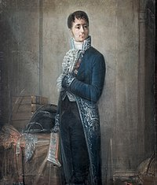
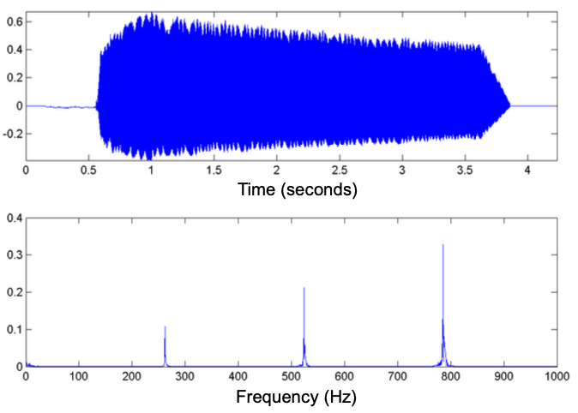


Project architecture
Harmonic Product Spectrum
Multiplication of integers
Pull out max
magnitude
Detect the note
and compare with the ideal frequency

Slide 6
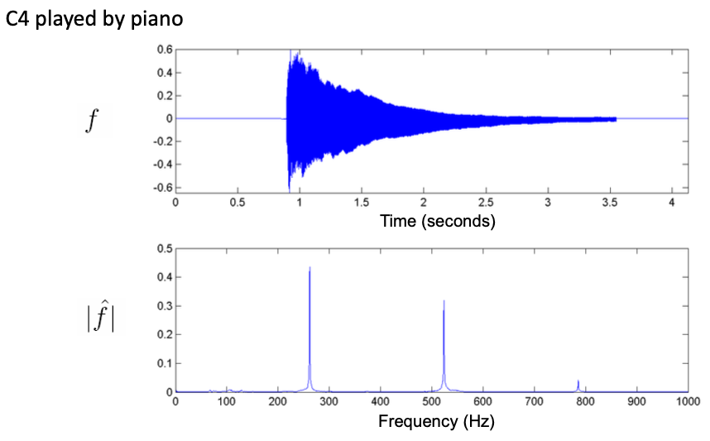
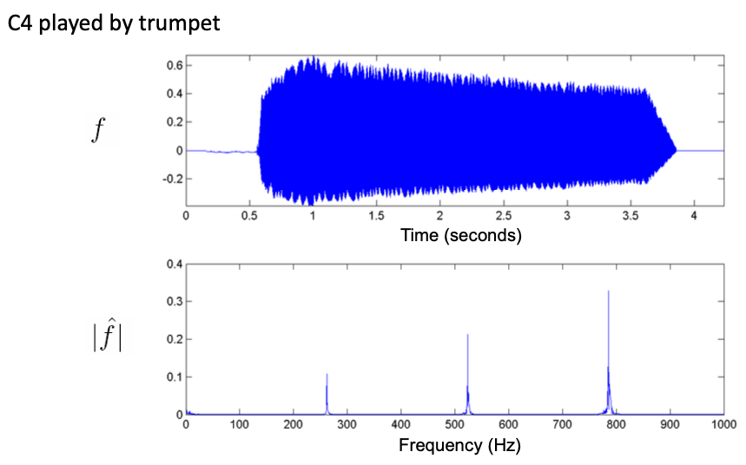
What we learned?
Harmonic Product Spectrum
Creadit of plots is for Christof Weiß

Slide 7


Don’t talk! show the results!

