Slide 1
Cyclistic Bike-Share Analysis
How Casual Riders and Annual Members Use Cyclistic Bikes Differently
NAME: Mamadou Jawo | Google Data Analytics Capstone
DATE: 09/01/2026

Slide 2
Business Task
Analyze how casual riders and annual members use Cyclistic bikes differently and identify insights that can help convert casual riders into annual members.

Slide 3
Data and Methodology
Data: 12 months of Divvy bike-share trip data (April 2020–March 2021).
Preparation: Combined 12 months CSV files using Excel Power Query.
Cleaning: Checked data types and consistency, created ride-length/date-time fields, and removed rides with invalid durations (≤ 0).
Analysis: Analyzed the cleaned dataset of 3,478,810 rides using Excel summaries and PivotTables, then used Tableau for visualization.

Slide 4
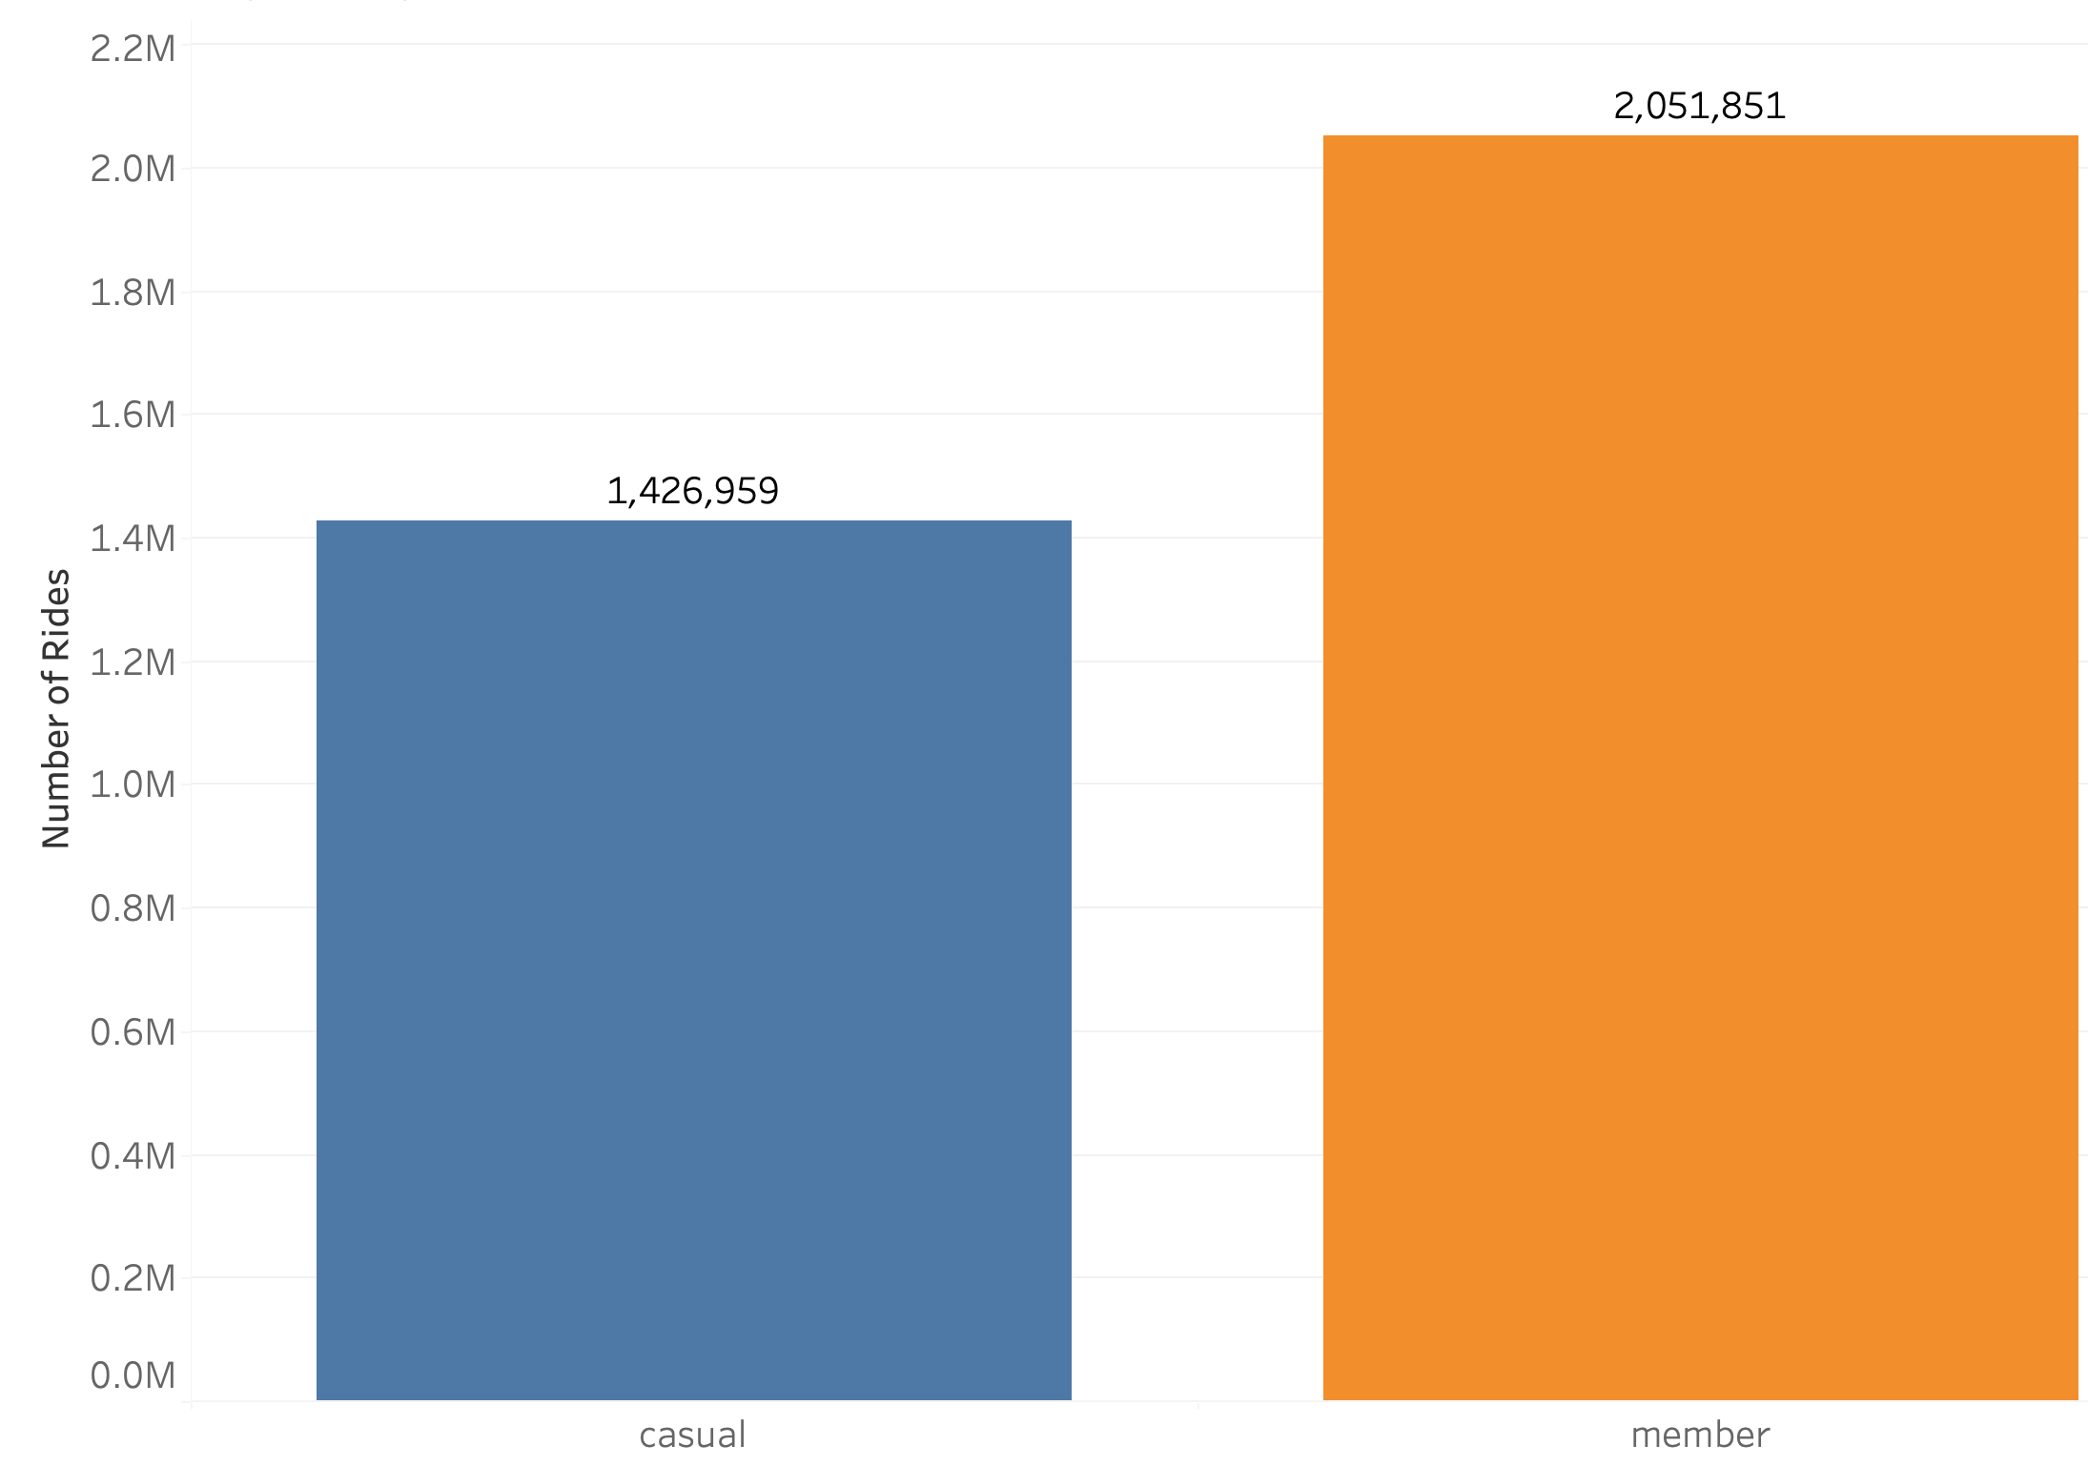
Total Rides by Rider Type
Members completed 2,051,851 rides, compared with 1,426,959 casual rides.
about 44% more rides by members.

Slide 5
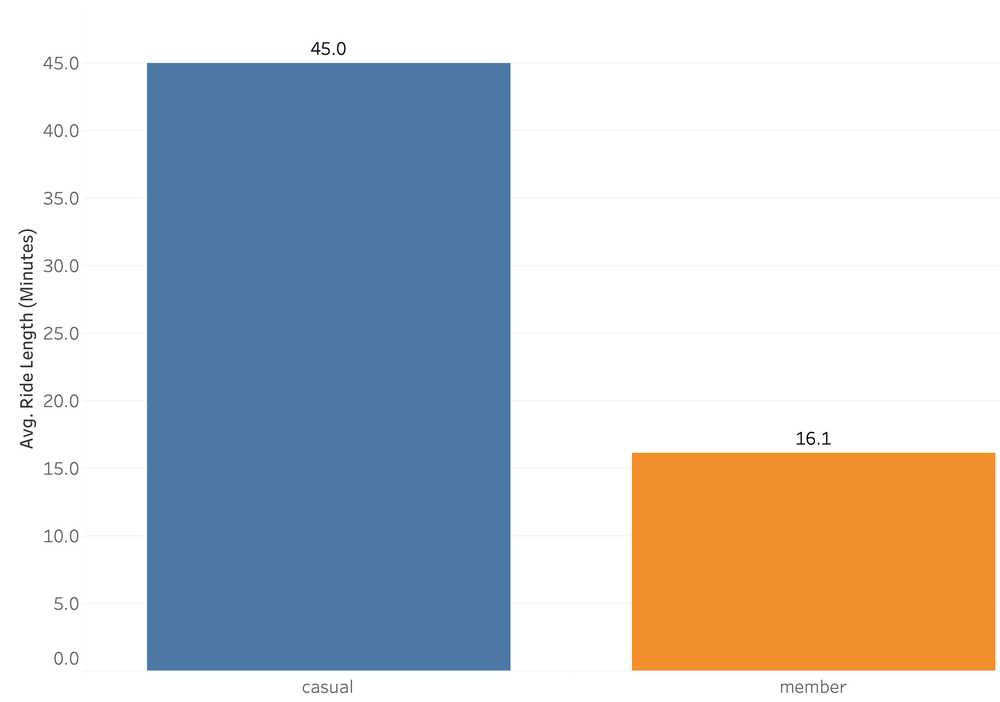
Average Ride Length by Rider Type
Casual riders averaged 45.0 minutes per ride, compared with 16.1 minutes for members.
Casual rides were nearly 3× longer on average.

Slide 6
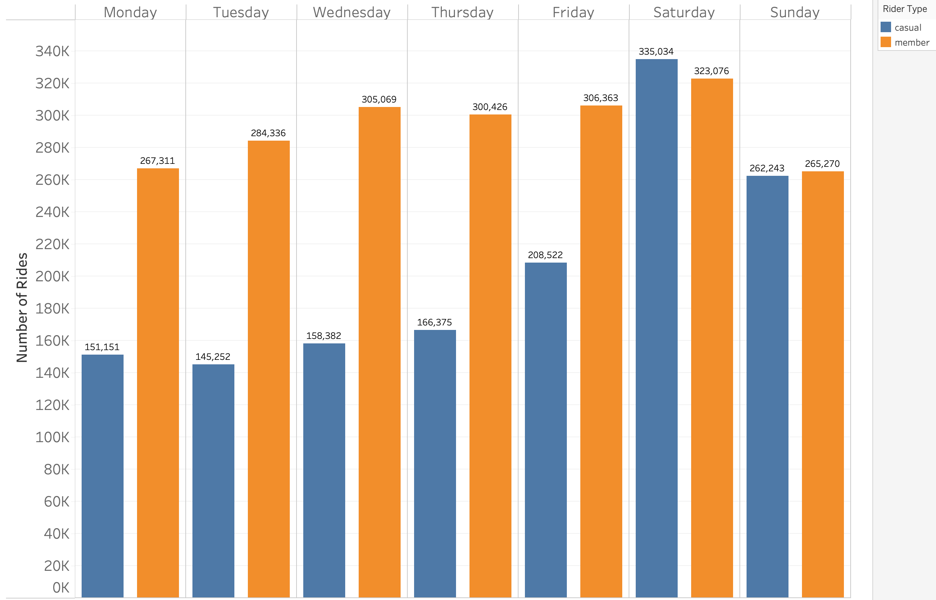
Rides by Day of Week and Rider Type
Members take substantially more rides than casual riders from Monday through Friday.
Saturday is the only day casual riders exceed members, with 335,034 casual rides vs. 323,076 member rides.
Casual rides are strongly concentrated on the weekend.

Slide 7
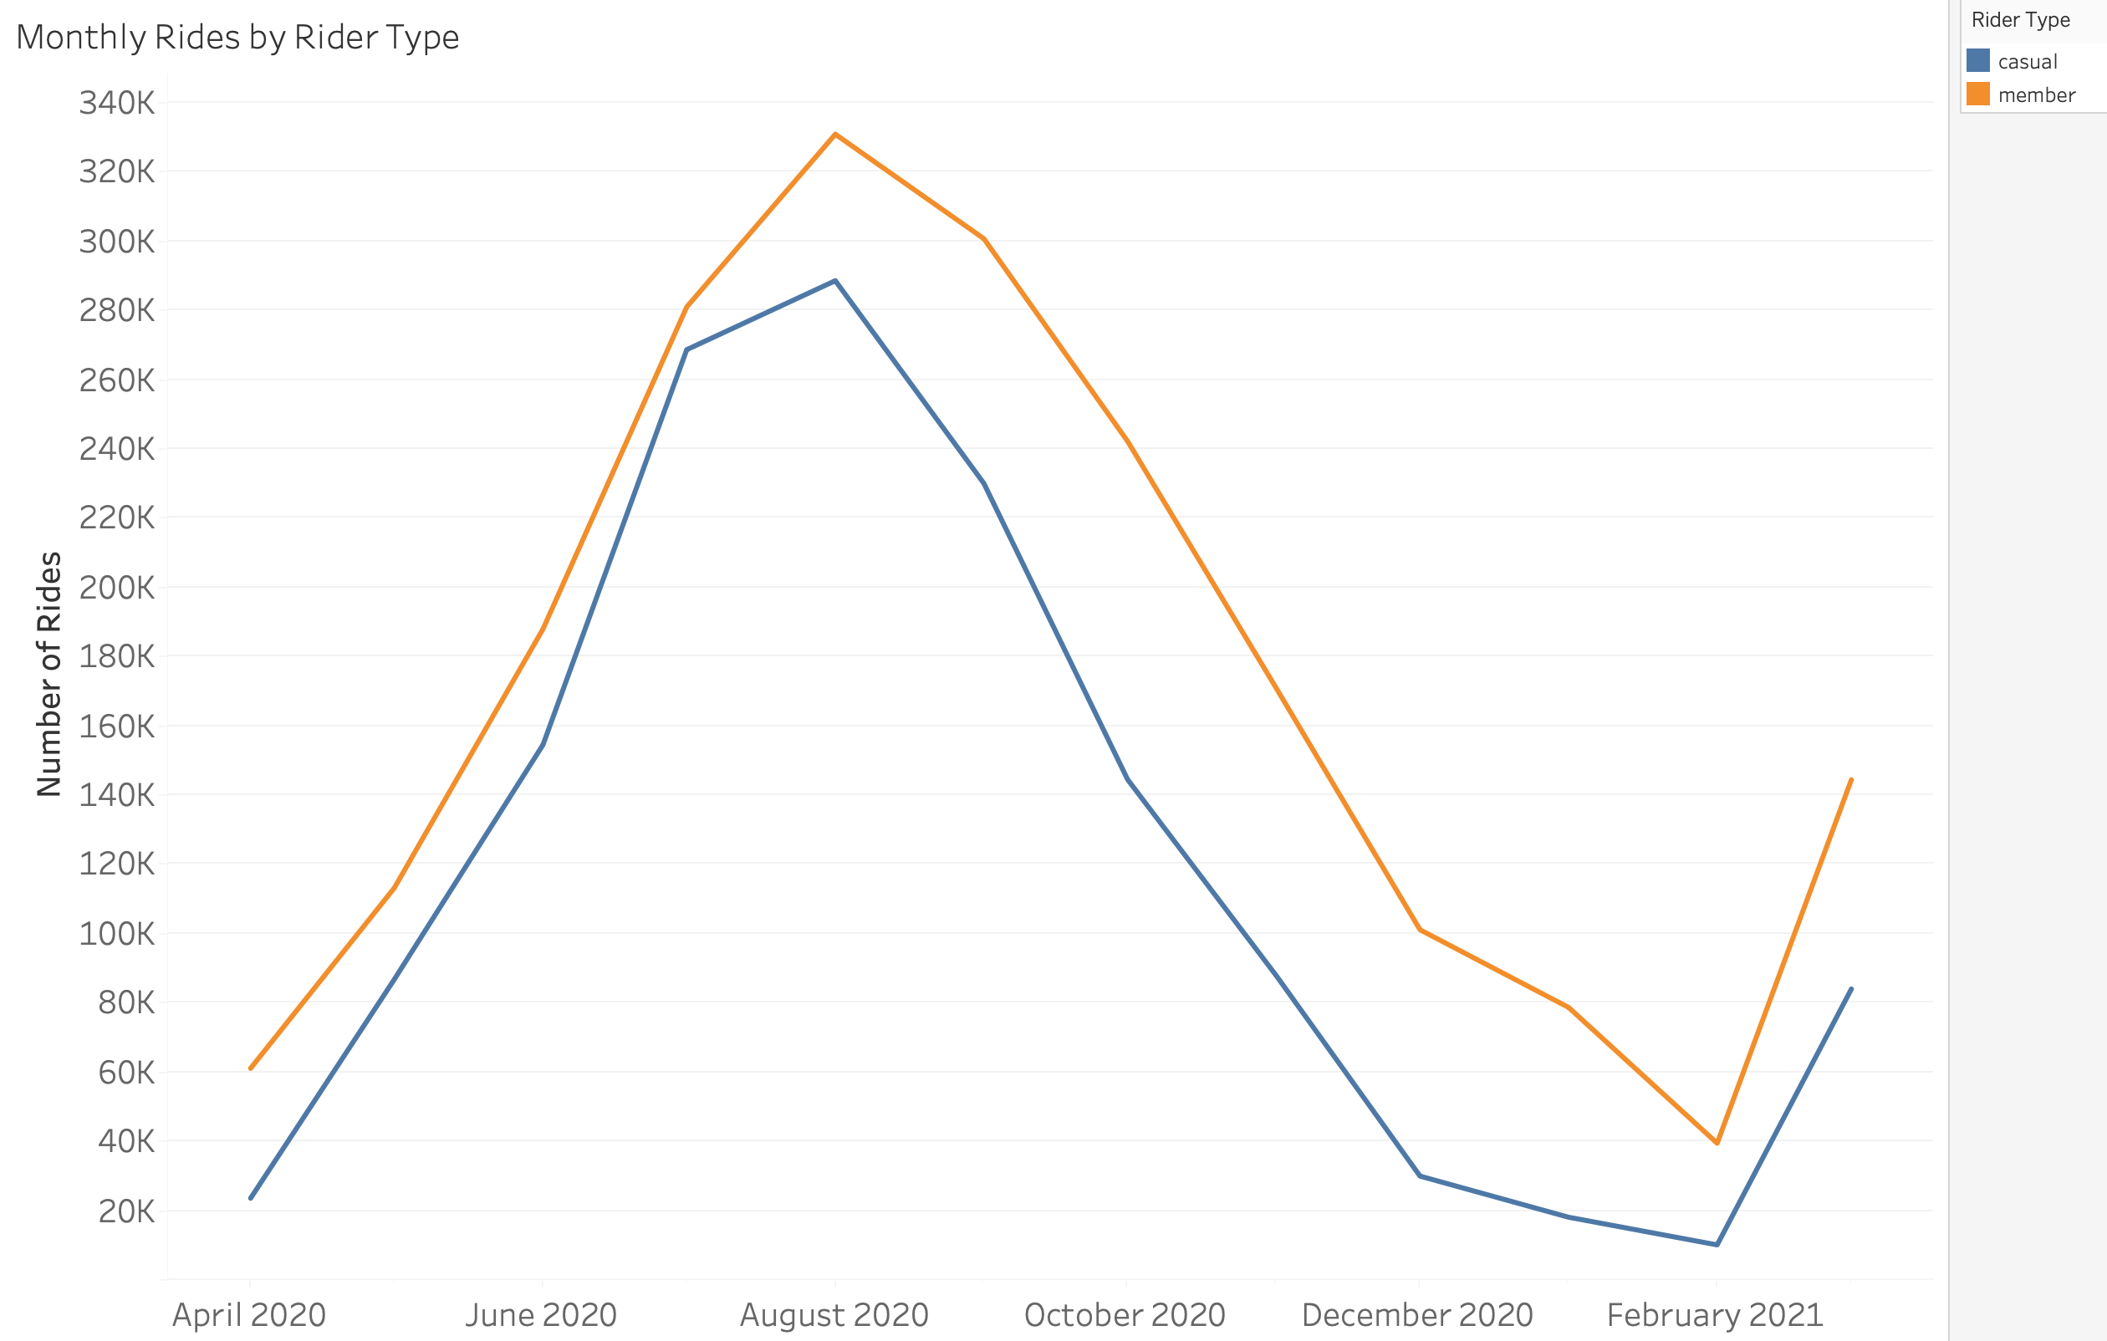
Monthly Rides by Rider Type
Both rider types show strong seasonal patterns, with rides increasing through spring and summer and declining during winter.
Ridership for both groups peaked in August 2020 — about 289K casual rides and 331K member rides.
Members recorded more rides than casual riders in every month, while both groups reached their lowest levels in February 2021.

Slide 8
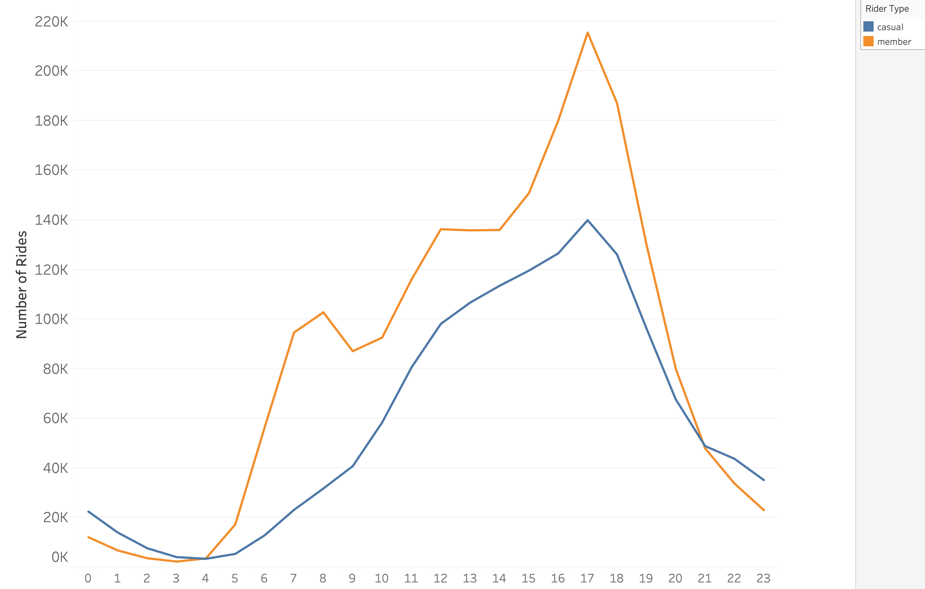
Rides by Hour and Rider Type
Member rides show a pronounced late-afternoon peak, reaching their highest level around 5 PM (17).
Casual rides increase more gradually throughout the day, peaking around 5 PM, but at a much lower level than member rides.
Member rides show a noticeable morning peak around 7–8 AM, while casual ridership remains much lower during those hours.

Slide 9
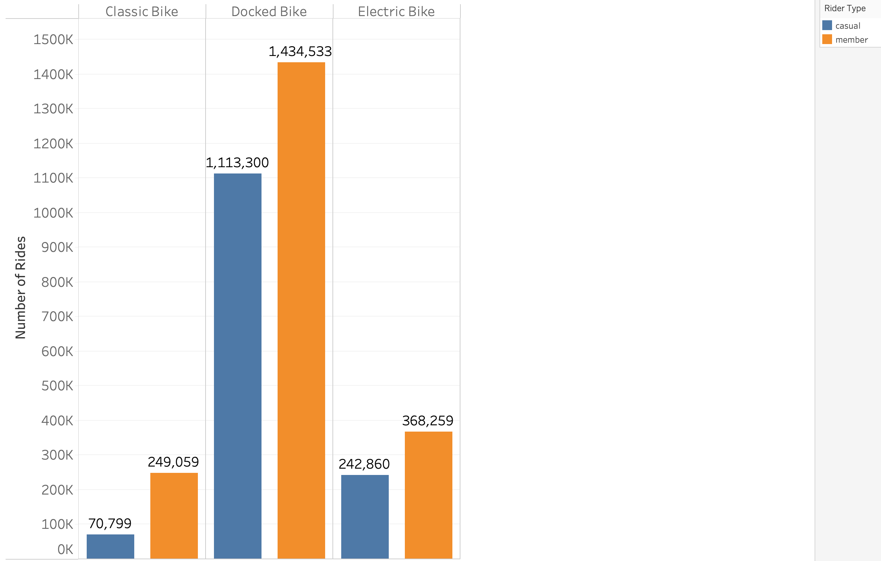
Rides by Bike Type and Rider Type
Docked bikes dominate ridership for both groups, accounting for about 1.11M casual rides and 1.43M member rides.
Members recorded more rides across every bike type, with the largest numerical difference occurring for docked bikes.
Electric bikes are the second-most-used bike type for both groups, while classic bikes account for the fewest rides.

Slide 10
Key Findings
Members ride more frequently overall, completing about 44% more rides than casual riders.
Casual riders take much longer trips, averaging 45.0 minutes compared with 16.1 minutes for members.
Casual riding is more leisure-oriented, with much stronger weekend activity, while member riding is stronger during weekdays and commuting hours.
Both groups are highly seasonal, with ridership strongest in the warmer months and substantially lower during winter.

Slide 11
Recommendations
Target casual riders during weekends and warmer months. Run membership campaigns when casual ridership is highest, especially on Saturdays and during spring and summer.
Promote membership around the value of frequent riding. Use targeted offers to show casual riders how an annual membership could benefit them if they begin using Cyclistic more regularly.
Encourage casual riders to use Cyclistic beyond recreation. Promote membership for weekday and commuting use, emphasizing Cyclistic as an option for routine transportation rather than only leisure trips.

