Slide 1



Mega project
(Healthcare AI Assistant website)
SoftwareTestingTeam
Get Started
https://teamdepi.github.io/mega

Slide 2

ProjectTeamMembers
01
Febrionya Ibrahim Zakaria Awadalla (Leader)
02
Abanob Ebrahim Sobhy Sedrak
03
Nourhan Mohamed Mohamed Amin
04
Esraa Mohamed Abdelrahim Mohamed
05
Ahmed Youssef Abdullah Mohammed
06
Mario Wageh Flem Samuel
Software Testing

Slide 3

Our Testing Arsenal: Tools & Technologies
Excel for structured test planning and documentation
Postman for comprehensive API testing and automation
Eclipse for developing robust automation frameworks
Selenium for scalable web application testing
Software Testing

Slide 4
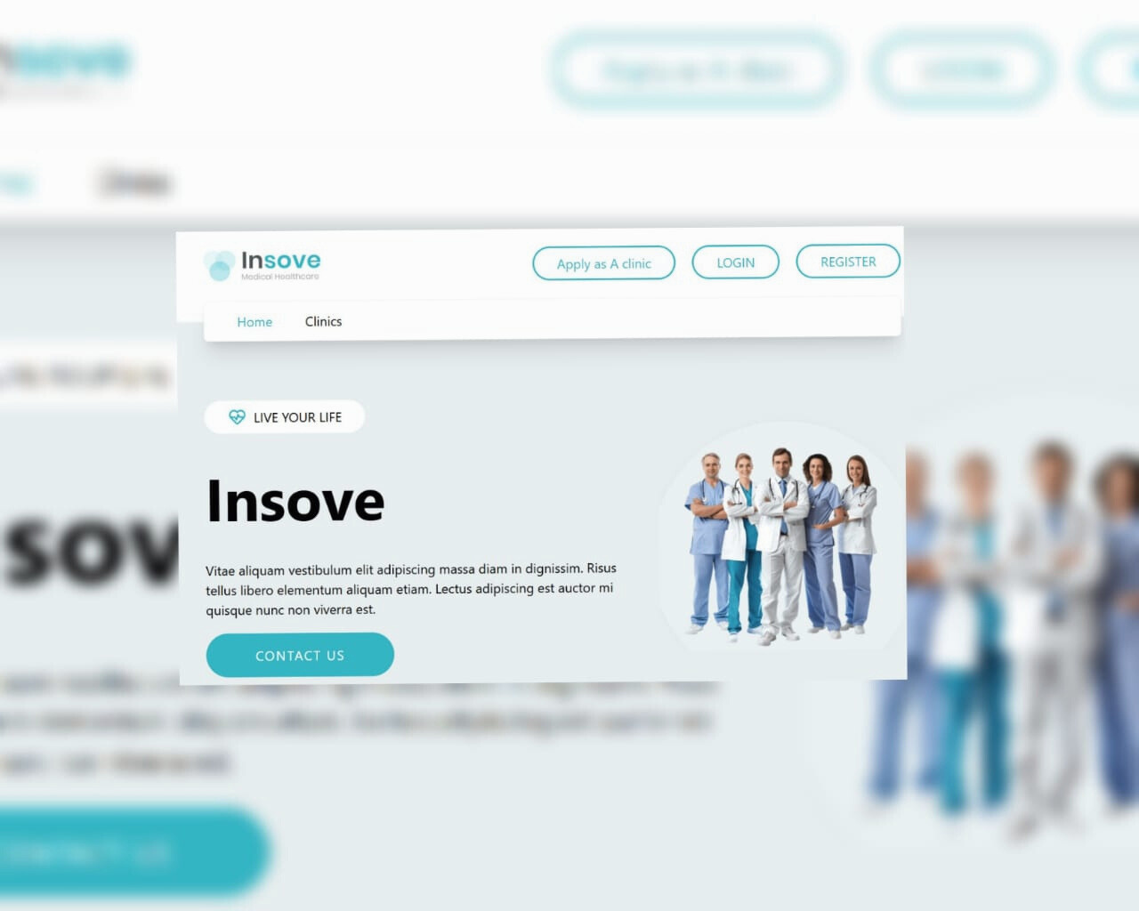

Introduction to Healthcare AI Assistant website
The platform is built to manage a complete clinic ecosystem.
From a business perspective, the goal of the system is to:
Improve the patient experience
Reduce operational costs for clinics
Organize medical data and appointments
Increase the efficiency of doctors and staff
Support management with accurate reports and analytics
This system is meant to handle large amounts of data and serve multiple roles (patients, doctors, reception, admins), so quality, reliability, and performance are critical for business success.
Software Testing

Slide 5
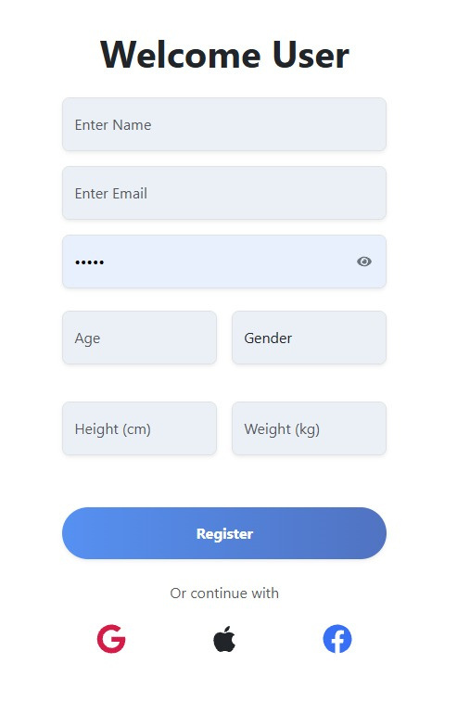
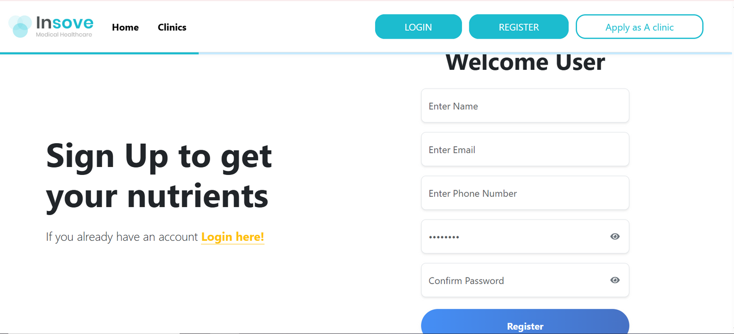
Old version
New version

Slide 6
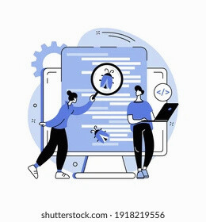
Manual Testing
Before the data comes the diligence. Manual testing is where our team's critical thinking and user empathy ensure the product not only functions, but feels right. These screenshots capture the evidence of that essential human verification.

Slide 7
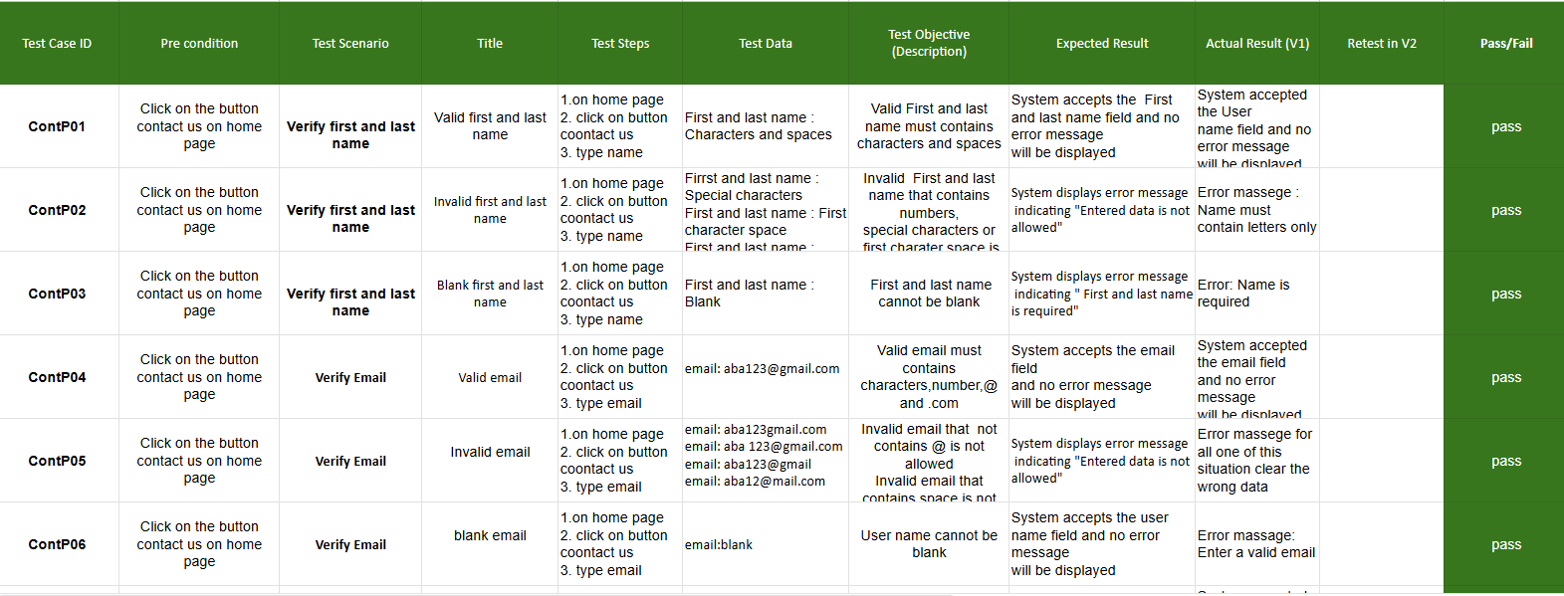
Contact Page

Slide 8

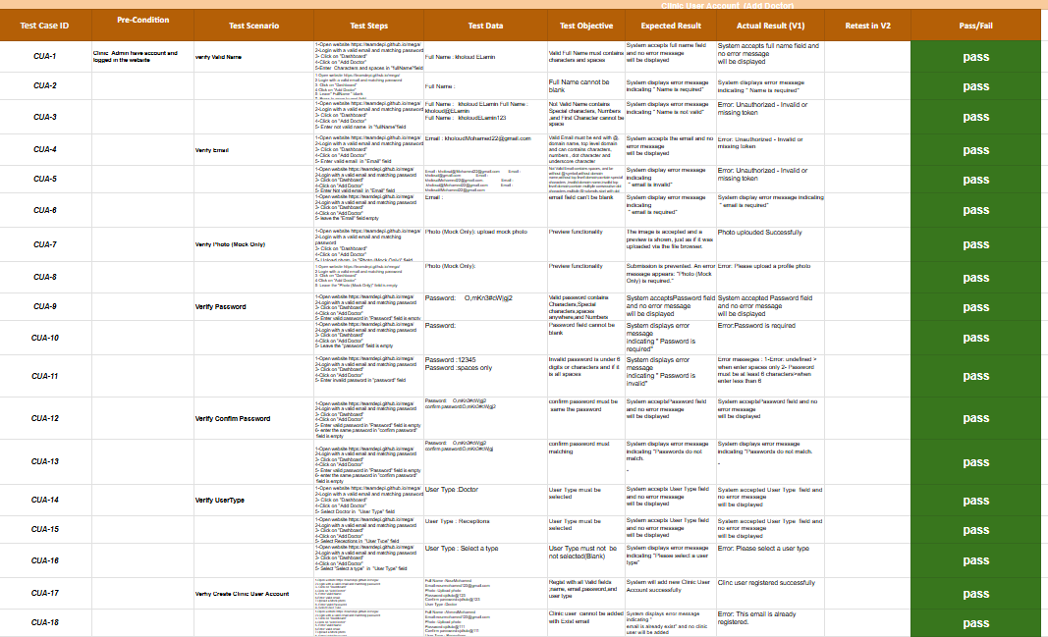

Add Doctor

Slide 9
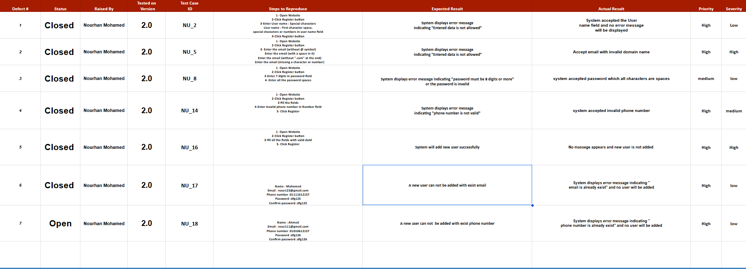
Bug Report
1-New User

Slide 10
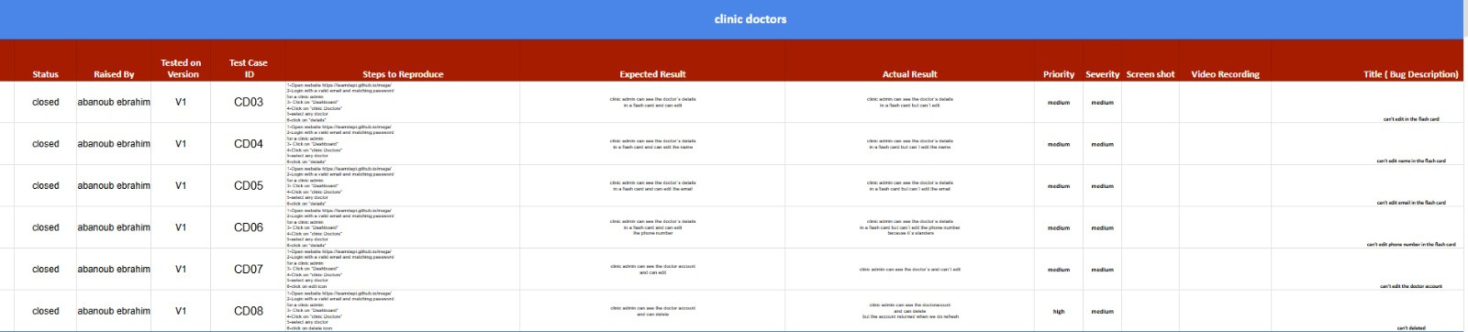
Bug Report
2-Clinic doctors

Slide 11
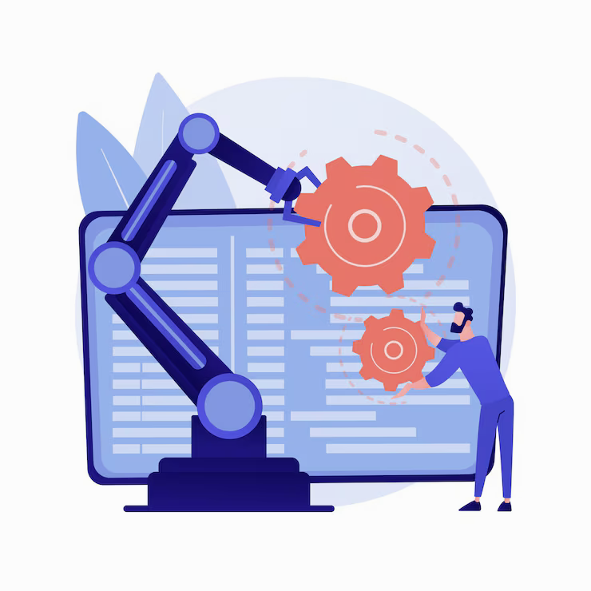
Fauget
To complement our exploratory manual testing, we employ strategic test automation. It serves as our force multiplier—handling repetitive checks with speed and precision. This allows us to:
Protect existing functionality through reliable regression suites.
Validate builds instantly with automated smoke tests.
Execute data-driven tests at a scale impossible to do manually.
Automation is the engine that gives us repeatability, speed, and data, ensuring we can deliver quality consistently at pace.
Automation: Scaling Our Quality Safeguards

Slide 12
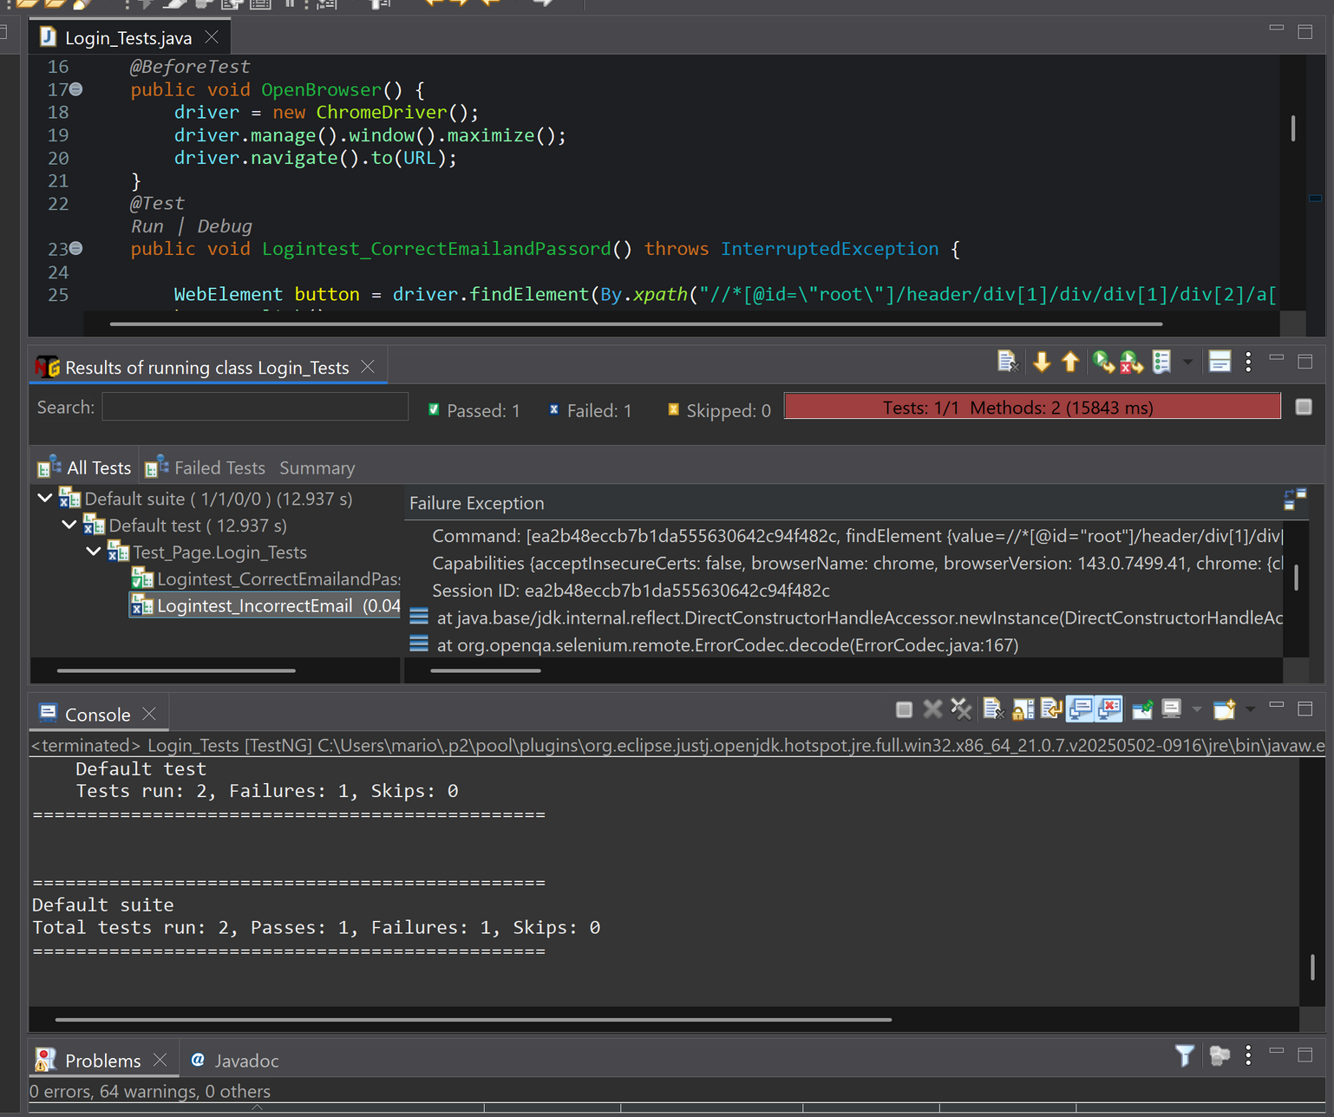

Automated Login Testing: Architecture & Implementation
Objective: To validate the core login functionality with speed, accuracy, and data-driven precision, ensuring a secure and reliable user entry point.
AUTOMATION TESTING

Slide 13
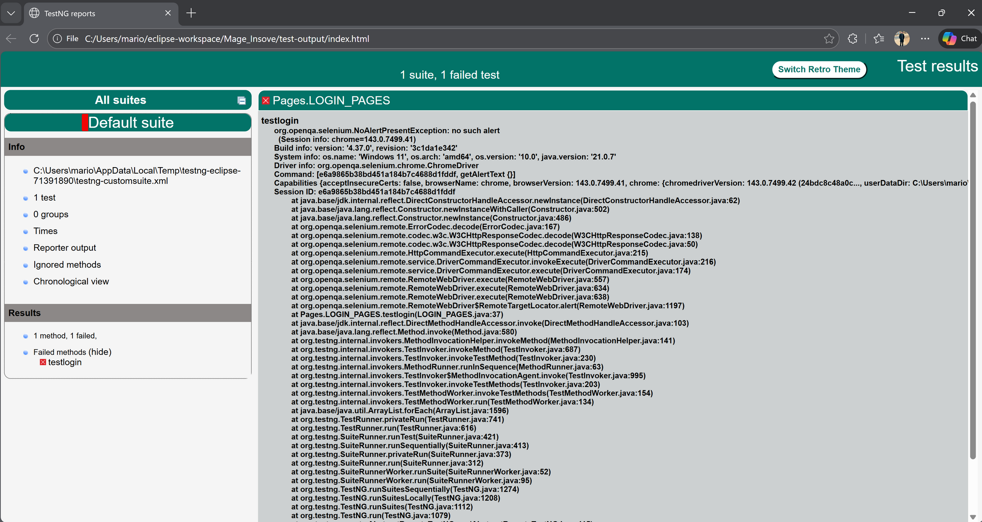
Automated Login Test Report: Insights & Analysis
AUTOMATION TESTING

Slide 14
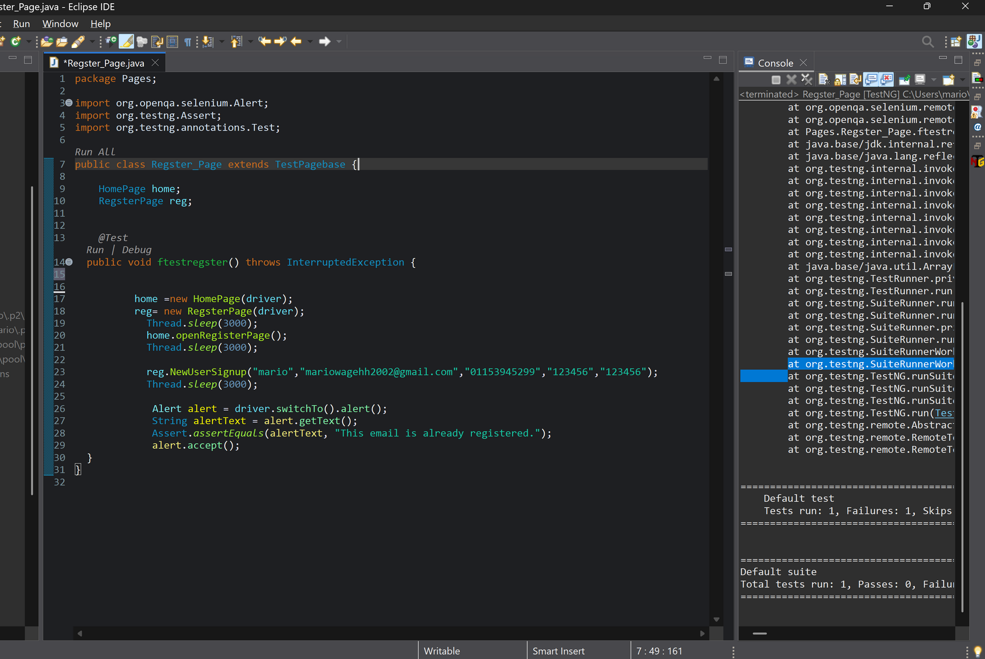
Automated Registration Testing: Comprehensive Validation Suite
Objective & Scope
To automate end-to-end validation of user registration workflows, ensuring data integrity, business rule compliance, and optimal user experience across all registration scenarios.
AUTOMATION TESTING

Slide 15
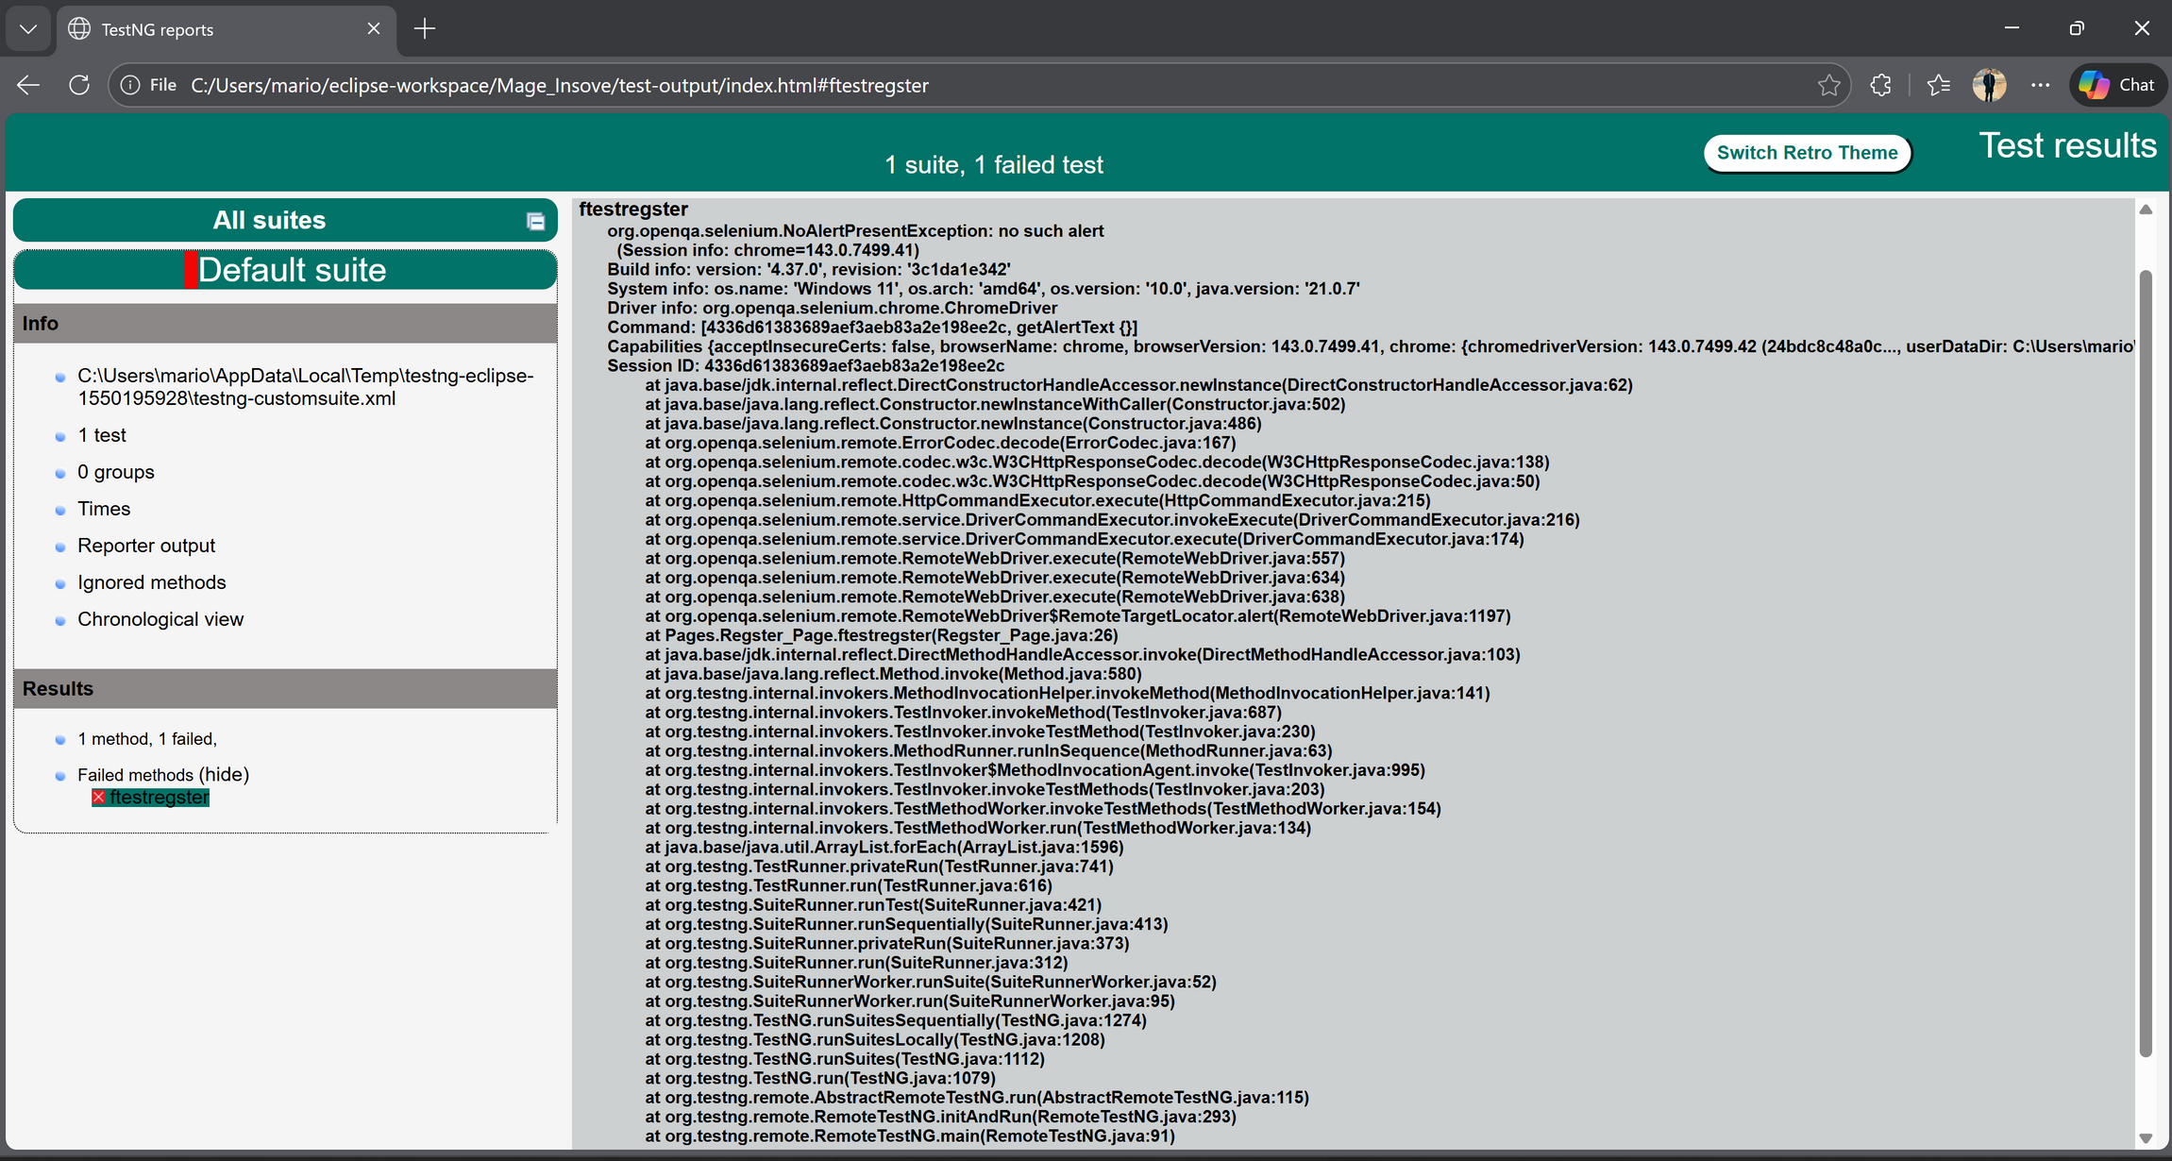
Automated Registration Test Report: Comprehensive Quality Analysis
AUTOMATION TESTING

Slide 16
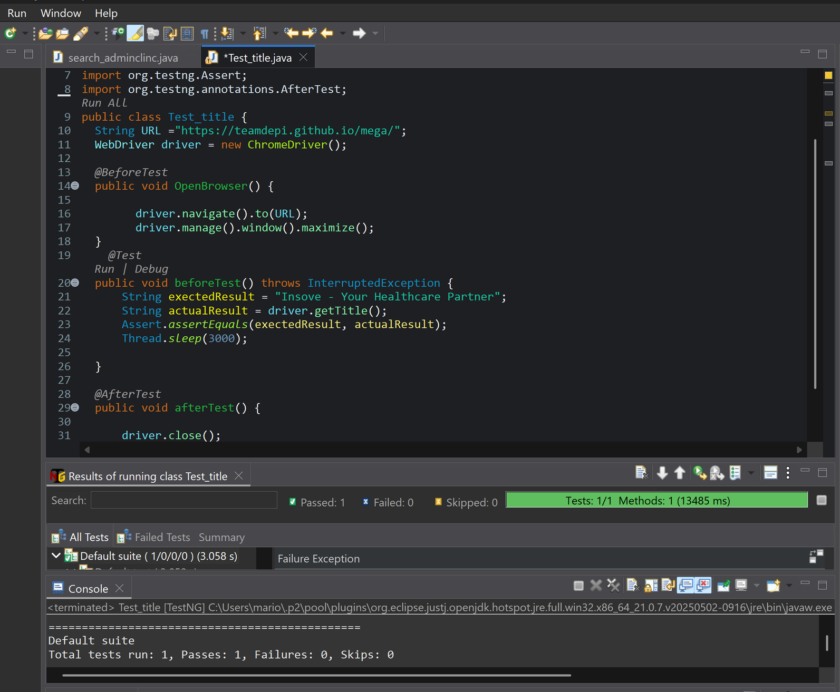
Automated Title Validation Testing Framework
Title Validation Testing ensures that web pages display correct, dynamic, and contextually appropriate titles across the entire application. Our automated framework validates:
Page title accuracy per business requirements
Dynamic title updates (based on user actions/content)
SEO compliance and formatting standards
Multi-language title rendering
Browsertab/window title consistency
AUTOMATION TESTING

Slide 17
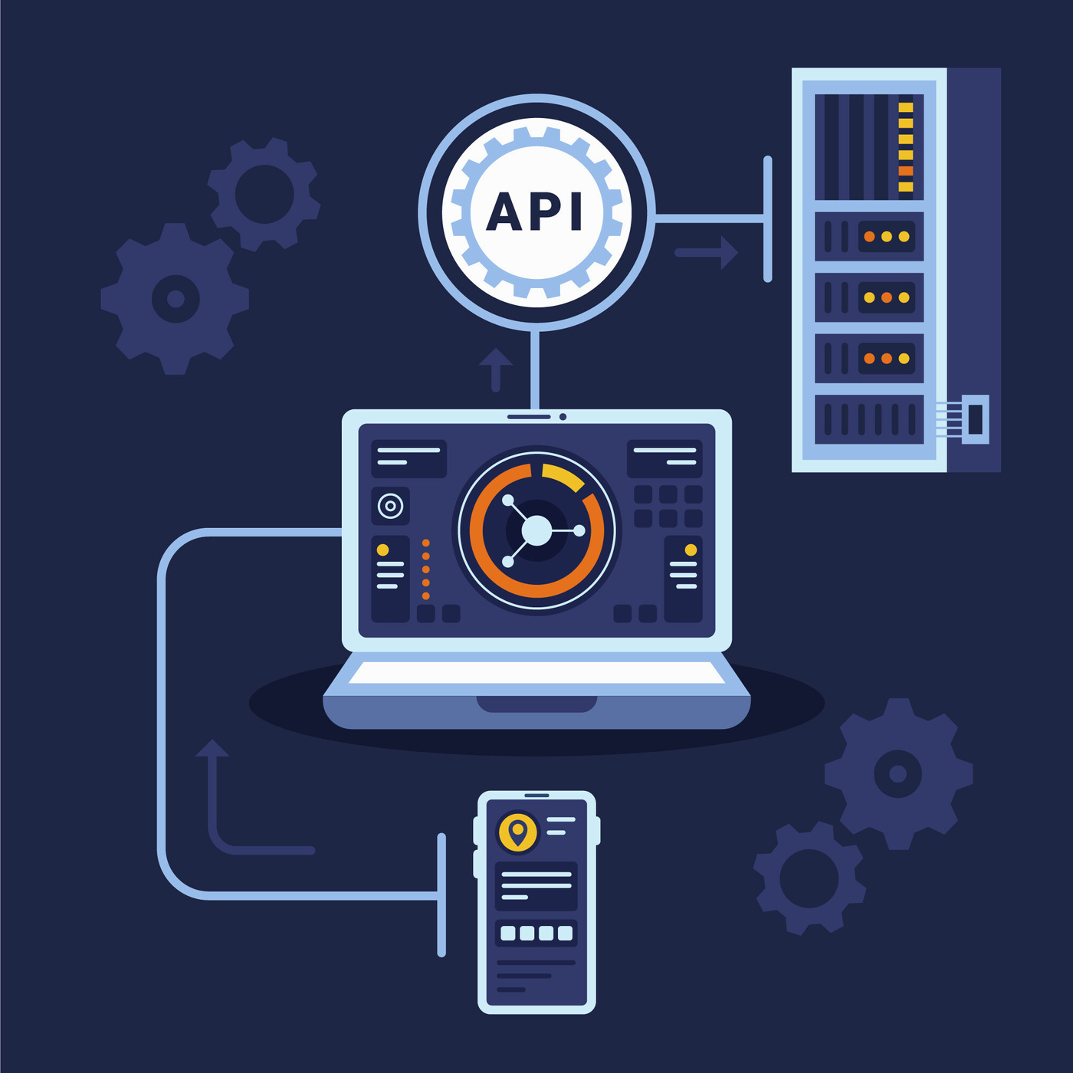
API Testing: The Backbone of Digital Reliability
API Testing is the critical discipline of validating these hidden engines of functionality. It's where we ensure that:
Services communicate flawlessly—sending the right data, to the right place, at the right time
Business rules are enforced at the system's core, not just the surface
Performance and security are baked into the foundational architecture
Third-party integrations work reliably, extending our capabilities

Slide 18
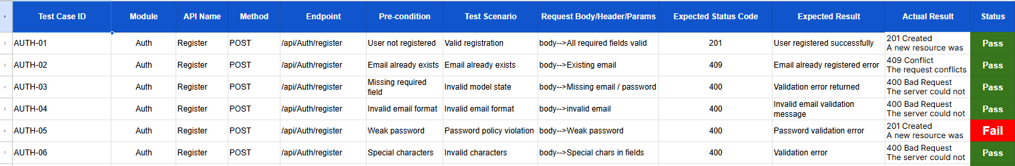
API Testing: The Registration Engine
1. Test Case Design & Documentation
API TESTING

Slide 19
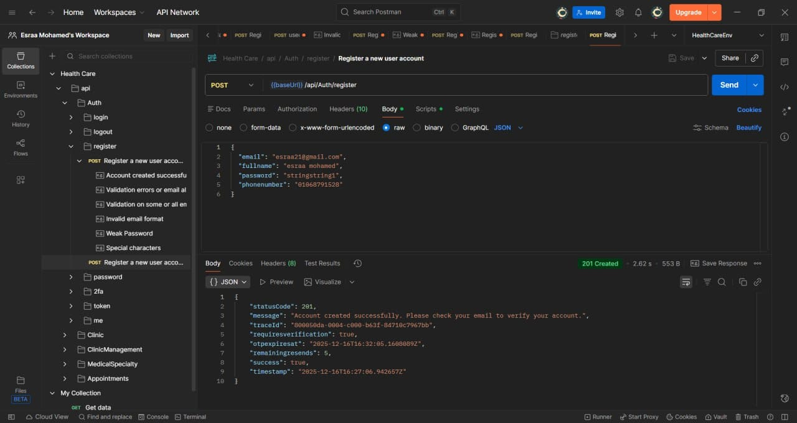
API TESTING
API Testing: The Registration Engine
2. Request & Response Validation in Postman

Slide 20
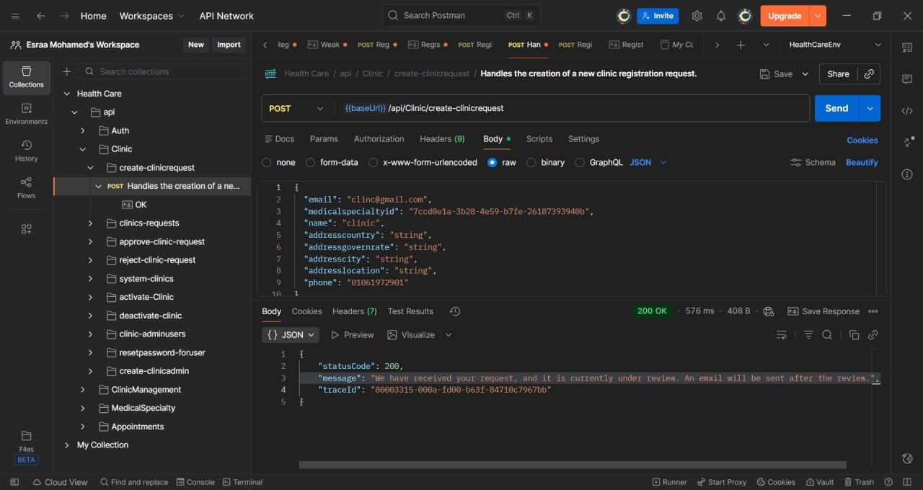
API TESTING

Slide 21
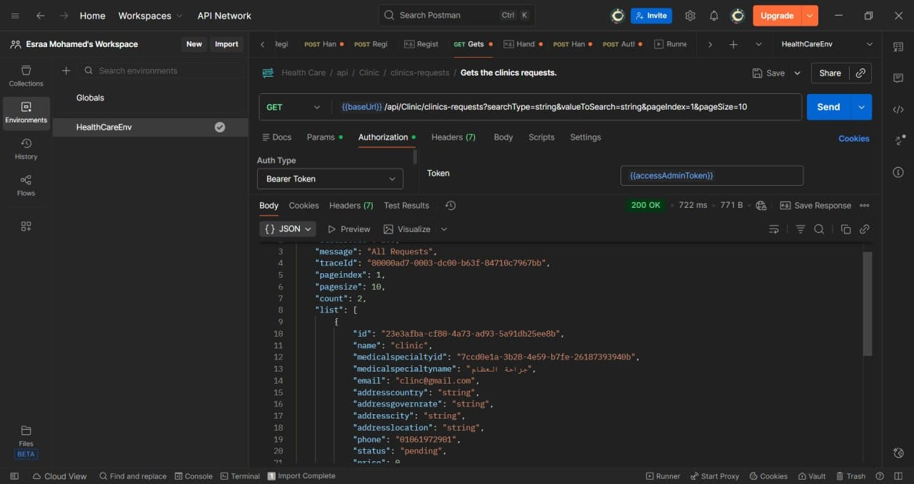
API TESTING

Slide 22


Thank
You
Software Testing Team
https://teamdepi.github.io/mega

