Slide 1
Welcome! Advanced Java
Introduction

Slide 2
Chapter 6: Persisting Data Using Databases
Essential Java

Slide 3
Chapter Concepts
Working with databases
Connecting to a database
Executing a SQL statement
Parsing results of a SQL statement
Working effectively and securely with databases
Preventing SQL injection attacks
Taking advantage of connection pools
Managing transactions
Isolation levels
Pessimistic vs. Optimistic Locking

Slide 4
Persisting Data Using Databases
JDBC
Efficient, Secure Database Access
Java Persistence API
Chapter Summary

Slide 5
java.sql
Java provides a portable means of accessing databases
Java Database Connectivity, supplied by java.sql
Standard SQL-92 syntax
The same Java code can access Oracle, MySQL or Sybase database
The database vendors provide drivers that hook into java.sql
Notes:
The stuff in com.mysql extends/implements the interfaces and classes in java.sql
DriverManager in java.sql uses those classes and returns them to client code

Slide 6

Best Practice: Data Access Object
Better to centralize your database code in a few classes
Rather than pollute your entire code base with SQL queries
All other code should use these data accessor objects (DAOs)
The DAO interface should fit the business case
The DAO implementation uses SQL, but rest of code base is shielded
Can also allow for different implementations later

Slide 7
Connecting and Executing Queries
To connect to a database and execute queries, the application has to:
Load up the database driver
Create a connection to the database
Create a statement to execute SQL queries
Parse the returned results of database call
Close results and connections

Slide 8
1. Loading and Registering the Driver
The client code has to:
Load up the database vendor’s driver
The driver will then register itself with java.sql.DriverManager
Needs to be done only once
If using Oracle, would register Oracle driver instead:
If using IBM DB2, could use an IBM driver:
Class.forName("com.mysql.jdbc.Driver");
Class.forName("oracle.jdbc.driver.OracleDriver");
Class.forName("com.ibm.db2.jcc.DB2Driver");

Slide 9
2. Creating Connection to Database
Use the DriverManager to create a connection to database
Keep a connection around within a data access object as a field
Creating a new connection is expensive
Alternately, can use connection pools
class MemberDAODBImpl implements MemberDAO {
private Connection conn;
public MemberDAO(){
Class.forName("com.mysql.jdbc.Driver");
conn = DriverManager.getConnection(
"jdbc:mysql://localhost/m_430", // dburl
"museumstaff", // username
"javamuseum" // password
);
}
// other methods
}
// if using Oracle:
DriverManager.getConnection(
"jdbc:oracle:thin:@javamuseum.com:1521:leapt1", //dburl
"museumstaff", "javamuseum");

Slide 10
3. Create and Use a Statement
SQL calls are executed by a Statement
Use the connection to create a Statement
class MemberDAODBImpl implements MemberDAO {
private Connection conn;
public MemberDAODBImpl(){
Class.forName("com.mysql.jdbc.Driver");
conn = DriverManager.getConnection(
"jdbc:mysql://localhost/test_crs430", // dburl
"museumstaff", // username
"javamuseum" // password
);
}
public void addNewMember(String name, int id){
String sql = "INSERT into Members VALUES ('" +
name + "','" + id + "')";
Statement stmt = conn.createStatement();
stmt.executeUpdate(sql);
}
}

Slide 11
Statement
There are different types of Statement available
CallableStatement
For stored procedures
PreparedStatement
For precompiled queries
Where users can insert parameters later
We’ll look at this in a few minutes
When executing a Statement, consider:
Will the SQL statement return results?
If no (example: INSERT, UPDATE, DELETE statements)
Use executeUpdate()
If yes (example: SELECT statements)
Use executeQuery()

Slide 12
4. Parsing Results From Statements
SQL select statements return a subset of the table
rs.next() moves to the next row of result set
Starts out before the first row
rs.getInt(), rs.getString() etc. retrieve fields from current row
Either by column number of result set starting at 1 (1,2,3 …,N)
Or by column name (case insensitive)
List<Customer> customers = …;
Statement stmt = conn.createStatement();
String sql = "SELECT name,id from Customers WHERE id < 1000";
ResultSet rs = stmt.executeQuery(sql);
while (rs.next()){
String name = "id"); // or rs.getInt(2)
Customer customer = new Customer(name, id);
customers.add(customer);
}

Slide 13

5. Close Results and Connections
When done with a ResultSet, Statement, or Connection, close it
Closing a Statement automatically closes its ResultSet
If not closed explicitly, garbage collection will ultimately close it
When would you close a Statement?
When would you close a Connection?
Remember that it is a field of the DAO
stmt.close();
conn.close();
Notes:
(a) As soon as you have iterated through the result set
(b) Provide an explicit close method (next slide)

Slide 14
Explicit close() Method
Garbage collection is only for memory
Other resources have to be explicitly disposed off
Finalizers are not recommended
No control over when they will be called (if ever)
Provide an explicit close() method
Clients of the DAO should call close() when they are done with it
// In DAO
void close(){
try {
conn.close();
} catch (SQLException e){
// ok: what are you going to do?
}
}
Notes:
Joshua Bloch (Effective Java) one of the designers of the J2SE core packages recommends against finalizers.
Main problem is that no control over when finalizers will be called, if ever

Slide 15
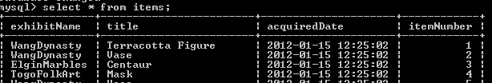
Exercise: Database Access
20 min
On the ROI Java VM, there is a database with these settings:
That database has a table with these entries:
write a Java program to print out the titles of all the items
Note: you will need the database driver JAR file in your classpath
db.url=jdbc:mysql://localhost/test_crs445
db.driver=com.mysql.jdbc.Driver
db.username=
db.password=

Slide 16
Solution: Database Access
Suggested solution
See src/com.roi.db/DatabaseDemo.java for full error handling
ResultSet rs = null;
Statement stmt = null;
Connection conn = null;
Class.forName("com.mysql.jdbc.Driver");
conn = DriverManager.getConnection("jdbc:mysql://localhost/test_crs445");
stmt = conn.createStatement();
rs = stmt.executeQuery("select title from items");
while (rs.next()){
System.out.println(rs.getString("title"));
}

Slide 17
Persisting Data Using Databases
JDBC
Efficient, Secure Database Access
Chapter Summary

Slide 18
Properties for JDBC Strings
Different database vendors have different String syntax for their drivers and database URLs
Don’t hardcode the names into Java code
Read the information from an external properties file
db.properties (MySQL)
DBURL=jdbc:mysql://localhost/test_museum
DRIVER=com.mysql.jdbc.Driver
USER=museumstaff
PASSWORD=javamuseum
db.properties (Oracle)
DBURL= jdbc:oracle:thin:@javamuseum.com:1521:leapt1
DRIVER=oracle.jdbc.driver.OracleDriver
USER=museumstaff
PASSWORD=javamuseum

Slide 19
Using Properties
Place the properties file in the application’s classpath and read it in
Use the settings in the JDBC calls
Connection conn;
Properties properties = new Properties();
properties.load(this.getClass().getClassLoader().
getResourceAsStream("db.properties"));
String driver = properties.getProperty("DRIVER");
String dburl = properties.getProperty("DBURL");
String user = properties.getProperty("USER");
String password = properties.getProperty("PASSWORD");
Class.forName(driver);
conn = DriverManager.getConnection(dburl, user, password);

Slide 20
Exception Handling
Many of the lines of code throw Exceptions
Class.forName() throws a ClassNotFoundException
DriverManager.getConnection() throws a SQLException
As does rs.next(), rs.close(), etc.
Few database-driven applications can work if the database is inaccessible
Simply catch the exception and re-throw as a RuntimeException
The GUI layer should catch and deal with exception gracefully
try{
// all the DB code
} catch (SQLException e){
// a RuntimeException
throw new DatabaseUnavailableException(e);
}

Slide 21
DataSource
Getting a new connection is expensive
Better to reuse connections to the same database
DAOs for different types of objects should use same pool of connections
Many database vendors implement javax.sql.DataSource
To provide pooled connections
Optionally, distributed transactions
Requires a Java Naming and Directory (JNDI) service
Available in J2EE environments such as servlets and application managers
Where JNDI is available, use DataSource instead of DriverManager
InitialContext ctx = new InitialContext();
DataSource ds = (DataSource)
ctx.lookup("java:comp/env/jdbc/test_db");
Connection conn = ds.getConnection();

Slide 22

User Inputs into SQL Queries
Directly embedding user inputs into SQL queries is dangerous
// In DAO
Member getMember(String name){
try{
String sql = "SELECT name,id from Members WHERE name='"+ name + "'";
ResultSet rs = conn.createStatement().executeQuery(sql);
// do stuff
} catch (SQLException e){
throw new DatabaseUnavailableException(e);
}
}

Slide 23
SQL Injection
Code that directly embeds user inputs lays itself open to SQL injection attacks
What if the user input was the following String?
String sql = "SELECT name,id from Members WHERE name='+ name + "'";
John Millions’; DROP TABLE Exhibits; SELECT name,id from Members WHERE id=`John Millions

Slide 24
Preventing SQL Injection
Preventing SQL injection is simple
Never create a SQL query by concatenating strings
Use PreparedStatement to insert the values into the query
// In DAO
Member getMember(String name){
try{
String sql = "SELECT name,id from Members WHERE name=?";
PreparedStatement stmt = conn.prepareStatement(sql);
stmt.setString(1, name);
ResultSet rs = stmt.executeQuery();
// do stuff as before
} catch (SQLException e){
throw new DatabaseUnavailableException(e);
}
}

Slide 25
Batch Updates
Can use PreparedStatement to do batch updates
String sql = "UPDATE exhibits SET permanent = ? WHERE name = ?";
PreparedStatement statement = connection.prepareStatement(sql);
statement.setInt(1, 0);
statement.setString(2, "Okeefe");
statement.addBatch();
statement.setInt(1, 1);
statement.setString(2, "Elgin Marbles");
statement.addBatch();
statement.setInt(1, 0);
statement.setString(2, "Remington");
statement.addBatch();
statement.executeBatch();

Slide 26
Stored Procedures
Use CallableStatement to invoke stored procedures
String sql = "{call changeExhibitStatus(?, ?)}";
CallableStatement statement = con.prepareCall(sql);
statement.setInt(1, 0);
statement.setString(2, "Okeefe");
statement.addBatch();
statement.setInt(1, 1);
statement.setString(2, "Elgin Marbles");
statement.addBatch();
statement.setInt(1, 0);
statement.setString(2, "Remington");
statement.addBatch();
statement.executeBatch();

Slide 27
In and Out Parameters
Output parameters need to be registered before update is executed
CallableStatement cstmt = con.prepareCall(
"{call reviseStatus(?)}");
cstmt.setByte(1, (byte) 13);
cstmt.registerOutParameter(1, java.sql.Types.TINYINT);
cstmt.executeUpdate();
byte newstatus = cstmt.getByte(1);

Slide 28
Exercise: Persisting Data Using Databases
45 min
Create a database table to store High-Low temperature data in a city
Use database’s command-line client to create this table
Using a Java program, populate this table with made-up data values
Perhaps 100 rows with data obtained by calls to Random
Using a Java program, query the database table for all high temperatures above 80F that are accompanied by low temperatures below 40F
Ideally convert the results of the query into objects and use the object‘s toString() method to print

Slide 29

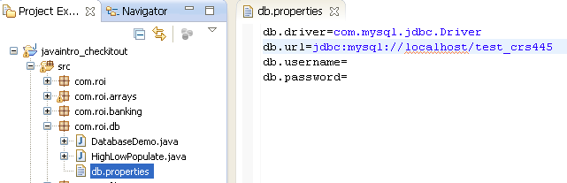
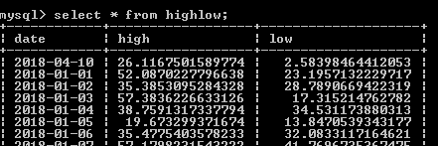
Solution: Persisting Data Using Databases (1/3)
Create database table using MySQL Command Line Client:
Create properties file:
After second step (next slide), verify that rows are inserted:
Notes:
Po

Slide 30
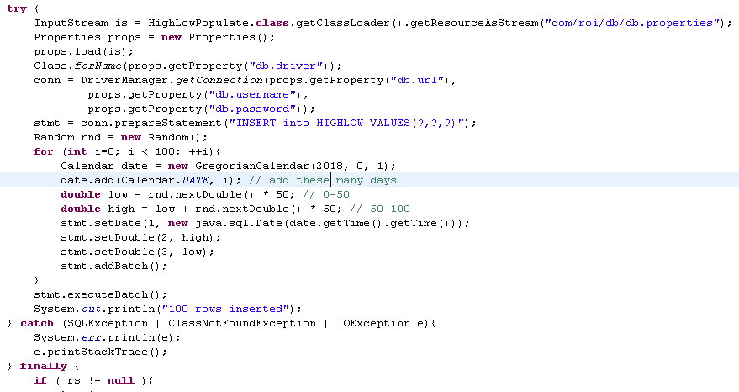
Solution: Persisting Data Using Databases (2/3)
Populating database table

Slide 31
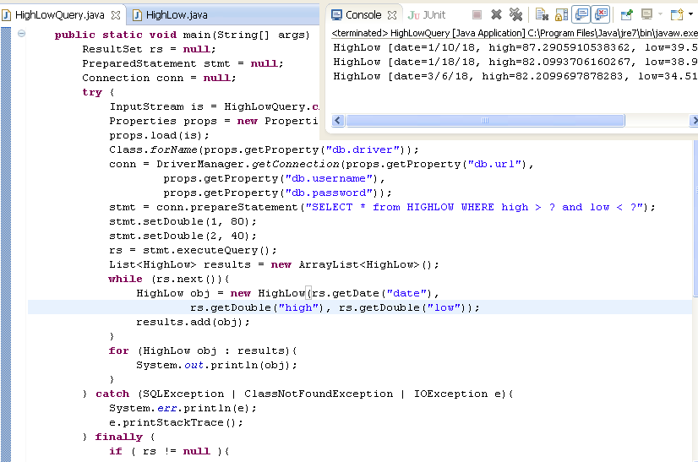
Solution: Persisting Data Using Databases (3/3)
Querying database table

Slide 32
Auto Commit
By default, the JDBC connection is in auto-commit mode
Every statement is committed immediately
What if you need to combine statements so that they execute as a block?
Not similar statements, like a batch
Notes:
Need a transaction

Slide 33
What Are Transactions?
Transactions are a series of operations that should either all succeed or be all rolled back
For example: an account transfer: if deposit to an account fails, money should not be debited from originating account
Transactions need to be:
Atomic
All succeed or all fail
Consistent
After transaction, data should not be corrupted
Isolated
The same data should not be concurrently updated by separate transactions
Durable
After a transaction is complete, it can not be lost in the event of a system crash

Slide 34
Running Statements in a Transaction
To run multiple statements within a transaction:
Turn off Connection’s autoCommit
Execute the various statements
React to a failure by rolling back
Commit if all statements succeed
In either case, set the auto-commit back to the default
public void doSomethingAsTransaction(){
try {
conn.setAutoCommit(false); // 1
stmt1.executeUpdate(…); // 2
stmt2.executeUpdate(…);
conn.commit(); // 3
} catch (Exception e){
conn.rollback(); // 4
} finally {
conn.setAutoCommit(true); // 5
}
}

Slide 35
Isolation Level
Can set the isolation level before starting a transaction
If underlying driver and database support that isolation level
The isolation levels supported are shown below
The safer levels are also slower
conn.setTransactionIsolation( Connection.TRANSACTION_SERIALIZABLE );
TRANSACTION_SERIALIZABLE | The safest level
TRANSACTION_REPEATABLE_READ | Phantom reads are possible (may see rows inserted after transaction was started)
TRANSACTION_READ_COMMITTED | Non-repeatable reads possible (may see data changed after transaction was started)
TRANSACTION_READ_UNCOMMITTED | Both phantom and non-repeatable reads are possible

Slide 36
Long-Lived Transactions
Transactions that map to a single user-request are short-lived
Not all transactions are short-lived
Consider airline booking
Consists of multiple round-trips between user and website
Two strategies for long-lived transactions
Optimistic locking, used when collisions are unlikely
Add version number to database
Read version number along with data
When updated data is saved, check version number in database
If version number has changed, then fail operation and tell user to retry
Pessimistic locking, used when collisions are very likely
Use database locking mechanisms

Slide 37
Persisting Data Using Databases
JDBC
Efficient, Secure Database Access
Chapter Summary

Slide 38
To Sum Up
Working effectively and securely with databases
Create a data accessor object that rest of code base will use
Load database properties from configuration file
Get a connection in constructor of DAO
Using Class.forName and DriverManager
DataSource in server environments
Use connection in methods of DAO
Should map to business use cases
Provide explicit close() methods
Never concatenate user inputs directly to SQL queries
Use PreparedStatement to avoid SQL injection attacks

