Slide 1

Git is a distributed version control system that tracks versions of files.
GIT =GLOBAL INFORMATION TRACKER
It is often used to control source code by programmers collaboratively developing software.
Git tracks changes not versions
Git was originally authored by Linus Torvalds in 2005 for the development of the Linux kernel, with other kernel developers contributing to its initial development.

Slide 2
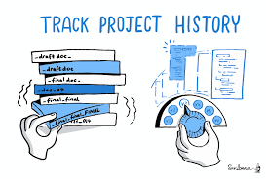
What is version control system?
A way to manage files & directories
It tracks the changes of any file
Recalls previous versions

Slide 3
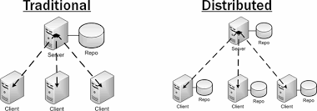

Slide 4
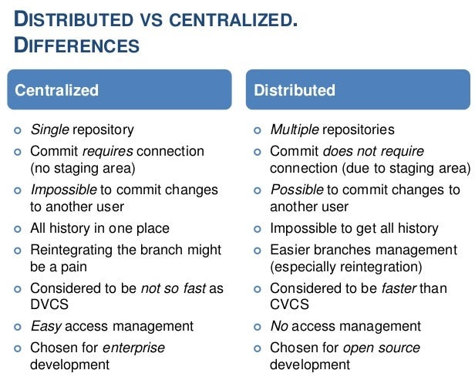

Slide 5
Most popular languages supported with Git
HTML
JAVA SCRIPT
PYTHON
SHELL SCRIPT
RUBY
JAVA
C++

Slide 6
TO Install Git on linux http://git-scm.com
#yum install update –y
#yum install git –y
#git --version

Slide 7
what is REPOSITORY ?
REPO =REPOSITORY
Usually used to organize a single project
Repos can contains any files , folders , images , document , spreadsheets required for the project .

Slide 8
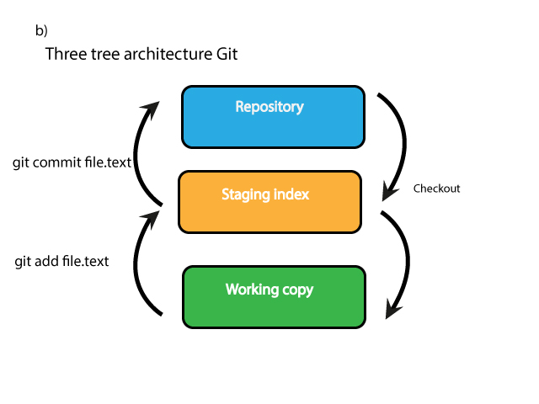
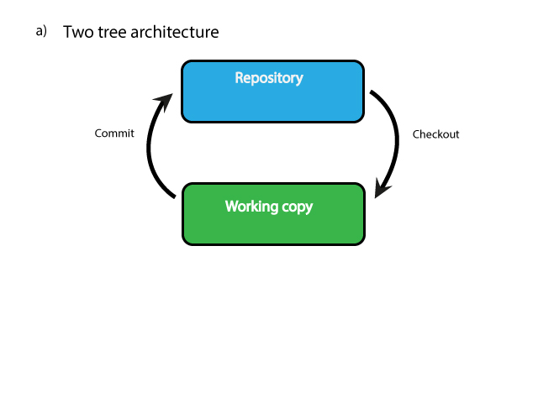
Git uses three tree architecture

Slide 9
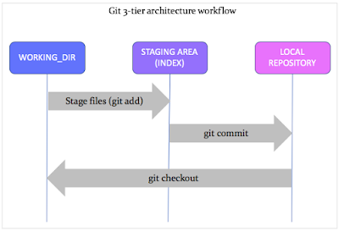
Working

