Slide 1
Bootstrap
By Mamatha Kunisetty

Slide 2

Agenda
What is Bootstrap?
Why Bootstrap?
Bootstrap Features
Grid System
Forms
Components
Layout

Slide 3

What is Bootstrap?
Bootstrap is a free front-end framework(HTML and CSS) for faster and easier web development.
Bootstrap is famous for being developed with components that have ability to follow the property of responsive designs.

Slide 4

Why Bootstrap?
Bootstrap makes responsive web design a reality. It makes possible for a web page or app to detect the visitors screen and orientation and automatically adapt the screen accordingly.

Slide 5
Bootstrap Features
Theme Support
Responsive
Grid
Great Visual Studio Support
Components

Slide 6
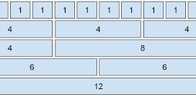
Grid System
Bootstrap’s grid system uses a series of containers, rows, and columns to layout and align content. It’s built with flexbox and is fully responsive.
Bootstrap's grid system is built with flexbox and allows up to 12 columns across the page.
If you do not want to use all 12 columns individually, you can group the columns together to create wider columns:

Slide 7
Grid Classes
The Bootstrap 5 grid system has six classes:
.col- (extra small devices - screen width less than 576px)
.col-sm- (small devices - screen width equal to or greater than 576px)
.col-md- (medium devices - screen width equal to or greater than 768px)
.col-lg- (large devices - screen width equal to or greater than 992px)
.col-xl- (xlarge devices - screen width equal to or greater than 1200px)
.col-xxl- (xxlarge devices - screen width equal to or greater than 1400px)

Slide 8
Forms
Form Control
Floating labels
Layout
Validation
Checks & Radios

Slide 9
Components
Buttons
Alerts
Dropdowns
Navbar
Card
Modal

Slide 10
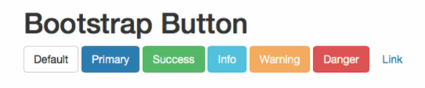
Bootstrap Button Styles
Bootstrap provides seven styles of buttons.
To achieve the button styles, bootstrap has different contextual classes as below:
btn-default
btn-primary
btn-success
btn-info
btn-warning
btn-danger
btn-link

Slide 11
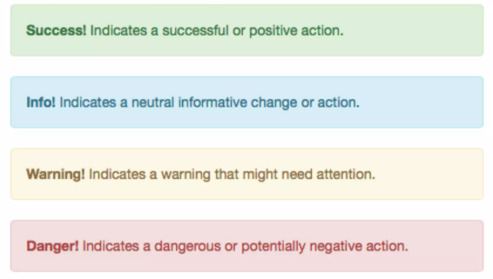
Bootstrap Alerts
Bootstrap provides an easy way to create predefined alert messages.
Alerts are created with .alert class, followed by one of the four contextual classes.
.alert-success
.alert-info
.alert-warning
.alert-danger

Slide 12
Layout
Breakpoints
Containers
Columns
CSS grid
Utilities

Slide 13


