Slide 1
SUPERSTORE SALES PERFORMANCE DASHBOARD
Prepared by: Julius Musau
AnalystLab Africa Internship – Week 4

Slide 2
Business Problem
Businesses generate large volumes of sales data daily. This project analyzes sales performance, profitability, customer behavior, and regional trends to support data-driven decision-making.

Slide 3
Dataset Overview
Dataset: Superstore Sales Dataset
Period: 2014–2017
Fields include Orders, Customers, Products, Categories, Regions, Sales, Profit, Quantity, and Discounts.
Tool Used: Microsoft Power BI

Slide 4
KPIs Defined
Total Sales: $2.30M
Total Profit: $286.40K
Total Orders: 5K
Total Quantity Sold: 38K
Profit Margin: 12.47%
Average Order Value: $458.61

Slide 5
Dashboard Overview
Interactive Features: Region, Category, Segment and Date filters.
Visuals: Sales Trend, Profit by Region, Sales by Segment, Sales by Category, Top Products and Top Customers.

Slide 6
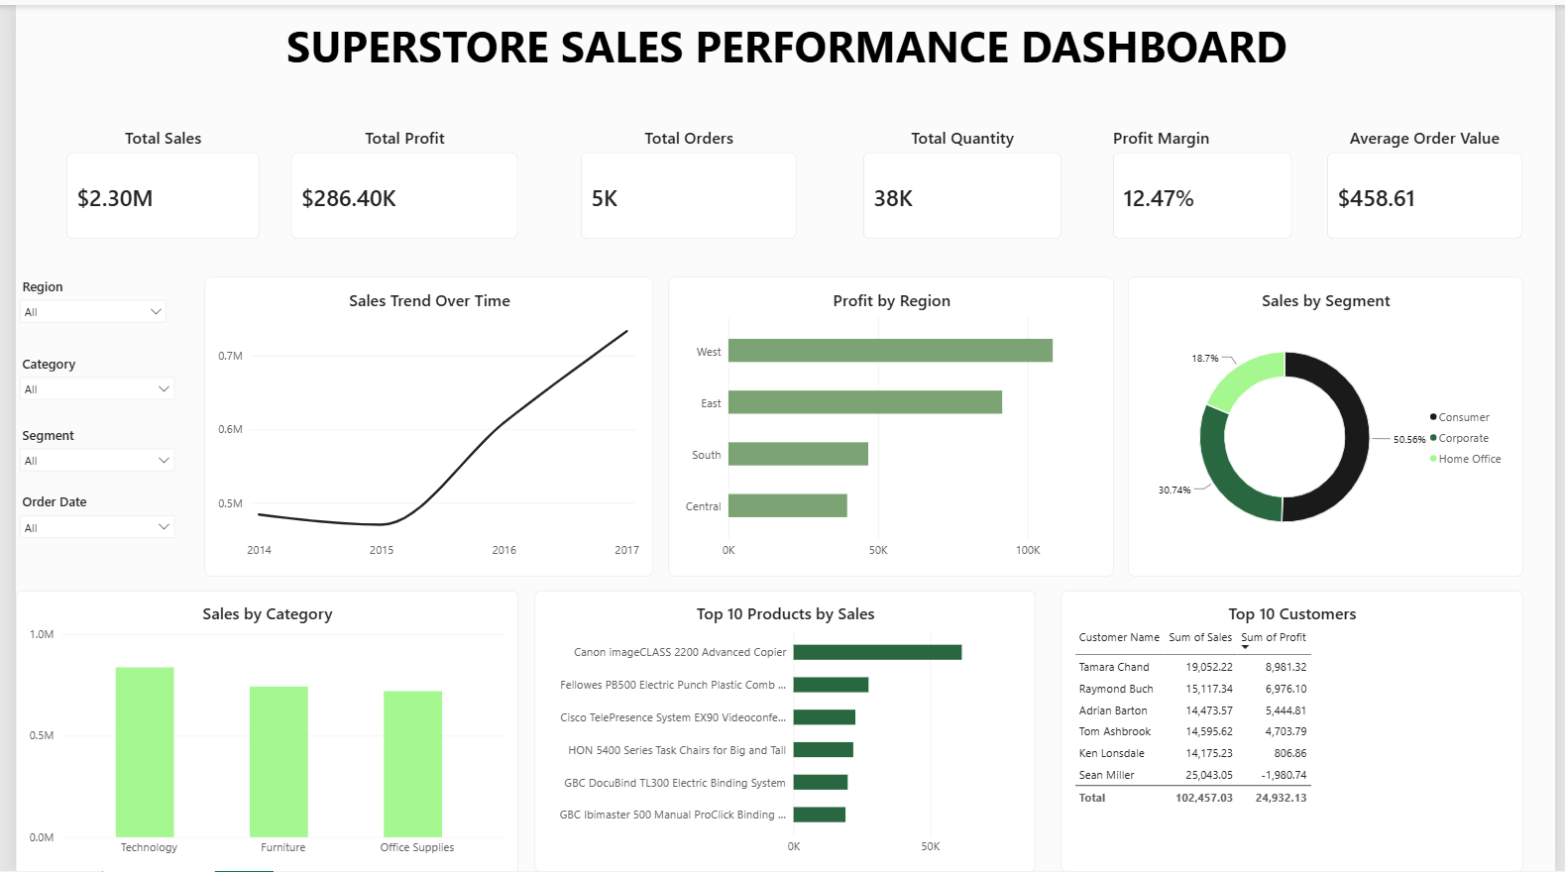
FULL DASHBOARD

Slide 7
Key Insights
1. Total sales reached $2.30M while generating $286.4K profit.
2. West region recorded the highest profit.
3. Technology was the top-performing category.
4. Consumer customers contributed over 50% of sales.
5. Sales grew consistently from 2014 to 2017.

Slide 8
Recommendations
Increase investment in Technology products.
Replicate successful strategies from the West region.
Retain high-value customers.
Improve lower-performing regions.
Target Corporate and Home Office segments for growth.

Slide 9
Challenges Faced
Data preparation and validation.
KPI selection.
Dashboard design.
Communicating insights effectively.

Slide 10
Conclusion
The dashboard transformed raw sales data into actionable insights and supports data-driven business decisions.

