Slide 1


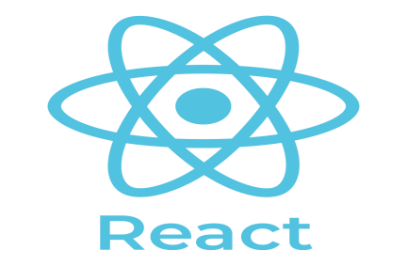


React Js Online Training
03
By: Ajeet Kumar

Slide 2
How to Setup React JS Project using CDN Links
03

Slide 3
How to Setup React JS Project using CDN Links
Using React JS from CDN
To start working with react, we need to first install reactjs. You can easily get started to use reactjs by using the CDN javascript files, as shown below.
Go to the official site of reactjs to get the CDN links, i.e., https://reactjs.org/docs/cdn- links.html and you will get the required files to explain the following image.
03

Slide 4
Basic Requirement to setup development environment
03

Slide 5
Basic Requirement to setup development environment
setup development environment
Text Editor/Source Code Editor
Visual Studio Code
Atom
Notepad++
subline etc
Web Brower
Google chrome
Firefox
safari
internet explorer etc
React Developer tool
React Developer Tools is a Chrome DevTools extension for the open-source React JavaScript library. It allows you to inspect the React component hierarchies in the Chrome Developer Tools.
03

Slide 6
Basic Requirement to setup development environment
setup development environment
NPM
npm (originally short for Node Package Manager) is a package manager for the JavaScript programming language. It is the default package manager for the JavaScript runtime environment Node.
Webpack
webpack is a module bundler. Its main purpose is to bundle JavaScript files for usage in a browser, yet it is also capable of transforming, bundling, or packaging just about any resource or asset.
Babel
Babel is a free and open-source JavaScript transcompiler that is mainly used to
convert ECMAScript 2015+ (ES6+) code into a backwards compatible version of JavaScript that can be run by older JavaScript engines. Babel is a popular tool for using the newest features of the JavaScript programming language
03

Slide 7
NPM
03

Slide 8
NPM
NPM (Node Package Manager)
NPM (Node Package Manager) is the default package manager for Node.js and is written entirely in Javascript. Developed by Isaac Z. Schlueter.
It was initially released in January 12, 2010. NPM manages all the packages and modules for Node.js and consists of command line client npm. It gets installed into the system with installation of Node.js.
npm is free to use.
You can download all npm public software packages without any registration or logon.
All npm packages are defined in files called package.json.
The content of package.json must be written in JSON.
At least two fields must be present in the definition file: name and version.
npm is the world's largest Software Registry.
The registry contains over 800,000 code packages.
Open-source developers use npm to share software.
Many organizations also use npm to manage private development
03

Slide 9
Install React Developer tool
03

Slide 10
Install React Developer tool
Download the new devtools from the Chrome Web Store, Firefox Add-ons for Firefox, and Microsoft Edge Addons for Edge. If you’re developing using React, we highly recommend installing these devtools.
If you use the standalone shell (e.g. in React Native or Safari), you can install the new
version from NPM:
npm install -g react-devtools@^4
03

Slide 11
How to Setup React JS Project using NPM
03

Slide 12
How to Setup React JS Project using NPM
Ways to setup ReactJS
There are two ways to set up an environment for successful ReactJS application. They are given below.
Using the create-react-app command
Using the npm command (Using webpack and babel)
03

Slide 13
How to Setup React JS Project using NPM
Using the create-react-app command
Install NodeJS and NPM
NodeJS and NPM are the platforms need to develop any ReactJS application. You have to install NodeJS here (NPM package manager will automatically install whenever Nodejs installed).
Make sure you have nodejs installed. If not installed. To verify NodeJS and NPM, use the command as shown below.
C:\Users\username>node -v
v12.13.0
C:\Users\username>npm -v
6.13.6
03

Slide 14
How to Setup React JS Project using NPM
create-react-app
You’ll need to have Node 8.16.0 or Node 10.16.0 or later version on your local development machine (but it’s not required on the server).
In order to learn and test React, you should set up a React Environment on your computer. The create-react-app is an officially supported way to create React applications.
Create React App is a tool, built by developers at Facebook that gives you a massive head start when building React apps. It saves you from time consuming setup and configuration. You simply run one command and Create React App sets up the tools you need to start your React project.
Syntax:
npx create-react-app my-app
03

Slide 15
How to Setup React JS Project using NPM
create-react-app
Installs the latest version of React, React-DOM and react-scripts.
React, JSX, ES6, TypeScript and Flow syntax support.
Autoprefixed CSS, so you don't need -webkit- or other prefixes.
Installs the dependencies needed to build project
Zero Setup and Configuration Required
Webpack — It configuring Webpack to bundle your project assets.
Babel — It transpile JSX into browser-ready code.
Creates the initial project structure
Development Server
Built-in Testing - Jest testing framework
Create React App provides helpful runtime error messages in the browser
03

Slide 16
How to Setup React JS Project using NPM
create-react-app
To create a new app, you may choose one of the following methods:
npx
npx create-react-app my-app
Note:
(npx is a package runner tool that comes with npm 5.2+ and higher)
npm
npm init react-app my-app
Note:
npm init <initializer> is available in npm 6+
03

Slide 17
How to Setup React JS Project using NPM
Using the npm command
You need to create a package.json file
npm init
You need to install react and its DOM packages
npm install react react-dom --save
You can also use the above command separately
npm install react --save
npm install react-dom --save
You need to Install Webpack
npm install webpack webpack-dev-server webpack-cli --save You can also use the above command separately
npm install webpack --save
npm install webpack-dev-server --save npm install webpack-cli --save
03

Slide 18
How to Setup React JS Project using NPM
Using the npm command
4.You need to Install Babel
npm install babel-core babel-loader babel-preset-env babel-preset-react babel-webpack-
plugin --save-dev
You can also use the above command separately npm install babel-core --save-dev
npm install babel-loader --save-dev
npm install babel-preset-env --save-dev npm install babel-preset-react --save-dev
npm install babel-webpack-plugin --save-dev
03

Slide 19
How to Setup React JS Project using NPM
Using the npm command
5.You need to Create Files
To complete the installation process, you need to add the following files in your project
folder.
These files are index.html, App.js, main.js, webpack.config.js and, .babelrc.
You can create these files by manually, or by using the command prompt. code index.html
code App.js code main.js
code webpack.config.js code .babelrc
03

Slide 20
React JS Folder Structure
03

Slide 21
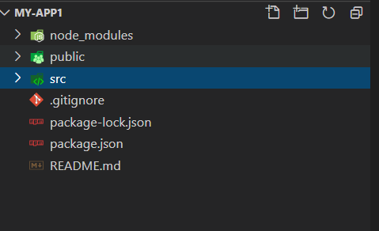
React JS Folder Structure
Whenever we create an react application with create-react-app command
It automatically creates required folders. Means in React application, there are several files and folders in the root directory. As shown below
03

