Slide 1



React Js Training
11
By: Rakesh Kumar Srivastaw

Slide 2

Fragments in React Js
11

Slide 3
Fragments in React Js
Fragment is used to group a list of children without adding extra nodes to the DOM.
We know that we make use of render method inside a component whenever we want to render something to the screen. We may render a single element or multiple elements, though rendering multiple elements will require a ‘div’ tag around the content as the render method will only render a single root node inside it at a time.
When we render more than one root element we have to put the entire content inside the ‘div’ tag which is not loved by many developers. So in React 16.2 version, Fragments were introduced and we use them instead of the extraneous ‘div’ tag.
the main reason of using is that it is a tiny bit faster as when compared to the one with the ‘div’ tag inside it, as we didn’t create any DOM node. Also, it takes less memory.
Another shorthand also exists for the Fragment in which we make use of ‘<>’ and ‘</>’ instead of the ‘React.Fragment’.
11

Slide 4
State in React Js
11

Slide 5
State in React Js
The state is a built-in React object that is used to contain data or information about the component. A component’s state can change over time; whenever it changes, the component re- renders. The change in state can happen as a response to user action or system-generated events and these changes determine the behaviour of the component and how it will render.
the State of a component is an object that holds some information that may change over the lifetime of the component.
React components has a built-in state object. We can create state only in class component. It is possible to update the state/Modify the state. The state object can contain as many properties.
State is similar to props but unlike props, it is private to a component and is controlled solely by the said component. those components that receive the props have no control over them because props are read-only.
11

Slide 6
State in React Js
The state object is where you store property values that belongs to the component.When the state object changes, the component re-renders.
Creating the state Object
There are two way to initialize state in React Component: -
Directly inside class (Without Constructor)
Inside the constructor (With Constructor)
Using the state Object
Refer to the state object anywhere in the component by using the this.state.propertyname
syntax.
11

Slide 7
State in React Js
Changing the state Object
To change a value in the state object, use the this.setState() method. The setState() Method
State can be updated in response to event handlers, server responses, or prop changes. This is done using the setState() method. The setState() method enqueues all of the updates made to the component state and instructs React to re-render the component and its children with the updated state.
Always use the setState() method to change the state object, since it will ensure that the
component knows it’s been updated and calls the render() method.
When a value in the state object changes, the component will re-render, meaning that the output will change according to the new value(s).
11

Slide 8
State in React Js
12

Slide 9
State in React Js
The state is a built-in React object that is used to contain data or information about the component. A component’s state can change over time; whenever it changes, the component re- renders. The change in state can happen as a response to user action or system-generated events and these changes determine the behaviour of the component and how it will render.
the State of a component is an object that holds some information that may change over the lifetime of the component.
React components has a built-in state object. We can create state only in class component. It is possible to update the state/Modify the state. The state object can contain as many properties.
State is similar to props but unlike props, it is private to a component and is controlled solely by the said component. those components that receive the props have no control over them because props are read-only.
12

Slide 10
State in React Js
The state object is where you store property values that belongs to the component.When the state object changes, the component re-renders.
Creating the state Object
There are two way to initialize state in React Component: -
Directly inside class (Without Constructor)
Inside the constructor (With Constructor)
Using the state Object
Refer to the state object anywhere in the component by using the this.state.propertyname
syntax.
12

Slide 11
State in React Js
Changing the state Object
To change a value in the state object, use the this.setState() method. The setState() Method
State can be updated in response to event handlers, server responses, or prop changes. This is done using the setState() method. The setState() method enqueues all of the updates made to the component state and instructs React to re-render the component and its children with the updated state.
Always use the setState() method to change the state object, since it will ensure that the
component knows it’s been updated and calls the render() method.
When a value in the state object changes, the component will re-render, meaning that the output will change according to the new value(s).
12

Slide 12
State in React Js
setState accepts a function as its parameter
If you pass a function as the first argument of setState, React will call it with the at-call-time- current state and expect you to return an Object to merge into state.
For Example:
// assuming this.state = { value: 0 }; this.setState((state,props) => ({ value: state.value + 1}));
Or
this.setState(function(state, props) { return };
It accepts a function rather than an object. • It receives the previous state as the first argument,
The props at the time the update is applied as the second argument.
12

Slide 13
State in React Js
setState accepts a callback
setState takes a callback as its second argument. When this callback fires, this.state is the updated state.
Note:
The react docs recommend that you use the lifecycle events instead of use the callback.
Point to note
A state can be modified based on user action or any events.
Every time the state of an object changes, React re-renders the component to the browser
The state object is initialized in the constructor
12
The state object can store multiple properties
this.setState() is used to change the value of the state object
setState() function performs a shallow merge between the new and the previous state

Slide 14
State in React Js
setState is asynchronous (*)
The fact that setState causes reconciliation(the process of re-rendering the components tree) is base of the next property — setState is asynchronous. This allows us to have multiple calls to setState in a single scope and not trigger not needed re-renders of the whole tree.
This is why you don’t see the new values in state right after you updated it React will also try to group or batch setState calls into a single call.
12

Slide 15
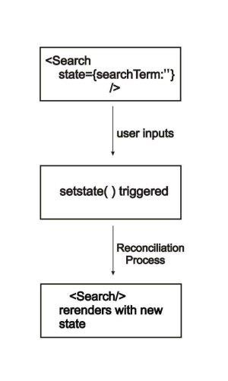
State in React Js
reconciliation process
This is basically kicking off a process that React calls reconciliation.
The reconciliation process is the way React updates the DOM, by making changes to the component based on the change in state. When the request to setState() is triggered, React creates a new tree containing the reactive elements in the component (along with the updated state). This tree is used to figure out how the Search component’s UI should change in response to the state change by comparing it with the elements of the previous tree. React knows
12
which changes to implement and will only update the parts of the
DOM where necessary. This is why React is fast.

Slide 16
Never call setState() inside constructor()
12

Slide 17
Never call setState() inside constructor()
The constructor of your component is the perfect place to set the initial state of your component. Instead of using setState() like you would do in other methods in your class, you will need to set the initial state directly:
constructor(props) { super(props); this.state = {
name: 'Ajeet',
email: 'ajeetsingha@gmail.com',
};
}
The constructor is the only place that you should assign the local state directly like that. Any place else in our component, you should rely on setState() instead.
12

Slide 18
Difference between State and Props
12

Slide 19
Difference between State and Props
SN | Props | State
1. | Props are read-only. | State changes can be asynchronous.
2. | Props are immutable. | State is mutable.
3. | Props allow you to pass data from one component to other components as an argument. | State holds information about the components.
4. | Props can be accessed by the child component. | State cannot be accessed by child components.
5. | Props are used to communicate between components. | States can be used for rendering dynamic changes with the component.
6. | Stateless component can have Props. | Stateless components cannot have State.
7. | Props make components reusable. | State cannot make components reusable.
8. | Props are external and controlled by whatever renders the component. | The State is internal and controlled by the React Component itself.
12

Slide 20
React Events
12

Slide 21
React Events
An event is an action that could be triggered as a result of the user action or system generated event. For example, a mouse click, loading of a web page, pressing a key, window resizes, and other interactions are called events.
React has its own event handling system which is very similar to handling events on DOM
elements.
Just like HTML, React can perform actions based on user events.
React has the same events as HTML: click, change, mouseover etc.
Adding Events
React events are written in camelCase syntax means React events are named as camelCase instead of lowercase.
onClick instead of onclick.
React event handlers are written inside curly braces:
onClick={shoot} instead of onclick="shoot()".
12

Slide 22
React Events
Event Handlers
With JSX, a function is passed as the event handler instead of a string. For example:
Event declaration in plain HTML:
<button onclick="showMsg()"> Hello Sahosoft
</button>
Event declaration in React:
<button onClick={showMsg}> Hello Sahosoft
</button> //IN FUNCTION COMPONENT
<button onClick={this.showMsg}> Hello Sahosoft </button> //IN CLASS COMPONENT
12

Slide 23
React Events
Prevent the default behavior
In react, we cannot return false to prevent the default behavior. We must
call preventDefault event explicitly to prevent the default behavior. For example:
In plain HTML, to prevent the default link behavior of opening a new page, we can write:
<a href="#" onclick="console.log('You had clicked a Link.'); return false"> Click_Me
</a>
12

Slide 24
React Events
In React, we can write it as:
function ActionLink() {
function handleClick(e) {
e.preventDefault();
console.log('You had clicked a Link.');
}
return (
<a href="#" onClick={handleClick}> Click_Me
12
</a>
);
}

Slide 25
React Events
13

Slide 26
React Events
Bind this
If your functions don't require access to the state of your component, then sure, you don't need to bind them.
this.handler.bind(something) returns a new function (Bind creates a new function!), in which references to this will refer to something. This is a way of saving the current value of this, which is in scope during the call to the constructor, so that it can be used later when the function is called.
Passing Arguments
If you want to send parameters into an event handler, you have two options:
1. Make an anonymous arrow function.
13
2. Bind the event handler to this.
Note that the first argument has to be this.

Slide 27
React Events
React Event Object
Event handlers have access to the React event that triggered the function.
With the arrow function you have to send the event argument manually:
Without arrow function, the React event object is sent automatically as the last argument when using the bind() method.
With the bind() method, the event object is sent as the last argument.
13

Slide 28
Why we need to bind() event handlers in Class Components in React
13

Slide 29
Why we need to bind() event handlers in Class Components in React
While working on React, you must have come across controlled components and event handlers. We need to bind these methods to the component instance using .bind() in our custom component’s constructor.
Blame JavaScript, Not React
Well, laying blame sounds a bit harsh. This is not something we need to do because of the way React works or because of JSX. This is because of the way the this binding works in JavaScript.
13

Slide 30
Using Arrow Functions to avoid binding `this` in React
13

Slide 31
Using Arrow Functions to avoid binding `this` in React
We will specifically focus on arrow functions and their usage with this in React. Arrow functions make your code look cleaner and more presentable but on top of that there are more reasons to use them in React.
To begin I’ll give a quick definition of what this is in React. this in general refers to a JavaScript element depending on the scope or context of its use. So in React, when we define classes we use methods inside those classes to refer to attributes such as state and props. For our methods to have access to this.state and this.props we need to bind the React component this context to those methods. Binding this to the class methods enables us to access props and state for the component with this.props and this.state. A benefit of using arrow functions is that this is already bound to that function so we don’t need to specify that anywhere else.
13

Slide 32
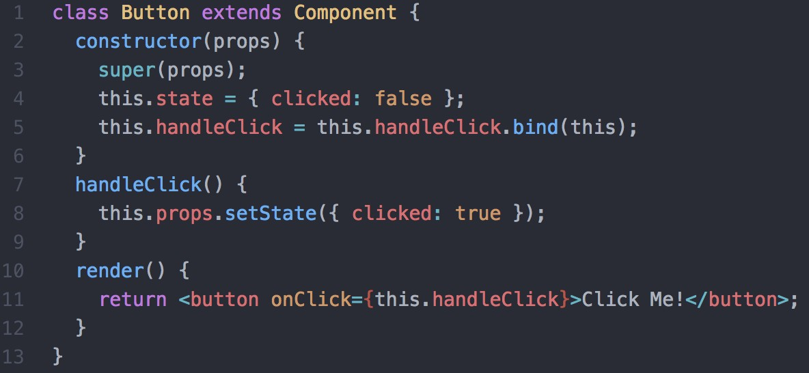
Using Arrow Functions to avoid binding `this` in React
Use arrow functions to avoid binding `this` to methods:
Usually when you want to access this inside a class method you would need to bind it to your method like so:
Without an arrow function
13

Slide 33
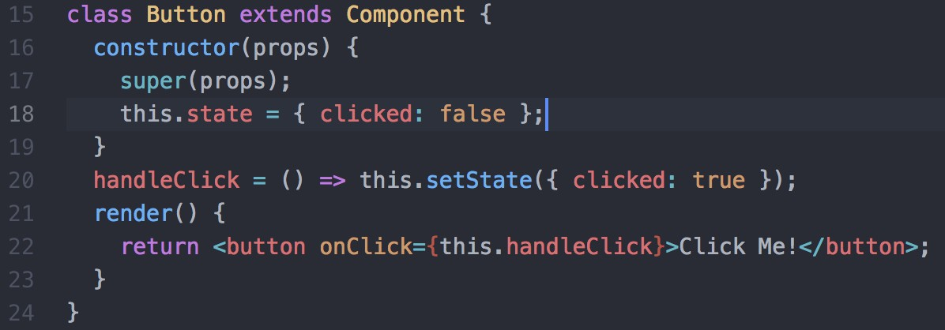
Using Arrow Functions to avoid binding `this` in React
Binding this to handleClick in the constructor allows us to
use this.setState from Component inside handleClick. Without this binding, this is re-scoped for handleClick and therefore cannot be used with the setState method.
However using arrow functions makes this whole process unnecessary and leaves your code
looking much nicer:
With an arrow function
13

Slide 34
Using Arrow Functions to avoid binding `this` in React
Here you can see 3 lines of code have been cut out just from changing that one function. It may not seem like a huge deal for this example but in a huge app with many components it will definitely make a difference. The great thing about an arrow function is that this means the same thing within the function body as it does outside of it. Which means that if you use arrow functions within your component’s render, they can access this and this.setState. Doing this I can
call handleClick in just one line.
As you can see using arrow functions in class components can end up saving you lines of code and time which is a win situation. Properly understanding and knowing how to use arrow functions can make your life easier when dealing with this.
13

Slide 35
Supported Events in React JS
13

Slide 36
Supported Events in React JS
Clipboard Events
onCopy onCut onPaste
Composition Events
onCompositionEnd onCompositionStart onCompositionUpdate
Keyboard Events
onKeyDown onKeyPress onKeyUp
Focus Events
onFocus onBlur
Form Events
onChange onInput onInvalid onReset onSubmit
Generic Events
onError onLoad
Mouse Events
onClick onContextMenu onDoubleClick onDrag onDragEnd onDragEnter onDragExit onDragLeave onDragOver onDragStart onDrop onMouseDown onMouseEnter onMouseLeave onMouseMove onMouseOut onMouseOver onMouseUp
Pointer Events
onPointerDown onPointerMove onPointerUp onPointerCancel onGotPointerCapture onLostPointerCapture onPointerEnter onPointerLeave onPointerOver onPointerOut
Selection Events
onSelect
Touch Events
onTouchCancel onTouchEnd onTouchMove onTouchStart
UI Events
onScroll
Wheel Events
onWheel
Media Events
onAbort onCanPlay onCanPlayThrough onDurationChange onEmptied onEncrypted onEnded onError onLoadedData onLoadedMetadata onLoadStart onPause onPlay onPlaying onProgress onRateChange onSeeked onSeeking onStalled onSuspend onTimeUpdate onVolumeChange onWaiting
Image Events
onLoad onError
Animation Events
onAnimationStart onAnimationEnd onAnimationIteration
Transition Events
onTransitionEnd
Other Events
onToggle

