Slide 1



React Js Online Training
13
By: Ajeet Kumar

Slide 2
React Events
13

Slide 3
React Events
Bind this
If your functions don't require access to the state of your component, then sure, you don't need to bind them.
this.handler.bind(something) returns a new function (Bind creates a new function!), in which references to this will refer to something. This is a way of saving the current value of this, which is in scope during the call to the constructor, so that it can be used later when the function is called.
Passing Arguments
If you want to send parameters into an event handler, you have two options:
1. Make an anonymous arrow function.
13
2. Bind the event handler to this.
Note that the first argument has to be this.

Slide 4
React Events
React Event Object
Event handlers have access to the React event that triggered the function.
With the arrow function you have to send the event argument manually:
Without arrow function, the React event object is sent automatically as the last argument when using the bind() method.
With the bind() method, the event object is sent as the last argument.
13

Slide 5
Why we need to bind() event handlers in Class Components in React
13

Slide 6
Why we need to bind() event handlers in Class Components in React
While working on React, you must have come across controlled components and event handlers. We need to bind these methods to the component instance using .bind() in our custom component’s constructor.
Blame JavaScript, Not React
Well, laying blame sounds a bit harsh. This is not something we need to do because of the way React works or because of JSX. This is because of the way the this binding works in JavaScript.
13

Slide 7
Using Arrow Functions to avoid binding `this` in React
13

Slide 8
Using Arrow Functions to avoid binding `this` in React
We will specifically focus on arrow functions and their usage with this in React. Arrow functions make your code look cleaner and more presentable but on top of that there are more reasons to use them in React.
To begin I’ll give a quick definition of what this is in React. this in general refers to a JavaScript element depending on the scope or context of its use. So in React, when we define classes we use methods inside those classes to refer to attributes such as state and props. For our methods to have access to this.state and this.props we need to bind the React component this context to those methods. Binding this to the class methods enables us to access props and state for the component with this.props and this.state. A benefit of using arrow functions is that this is already bound to that function so we don’t need to specify that anywhere else.
13

Slide 9
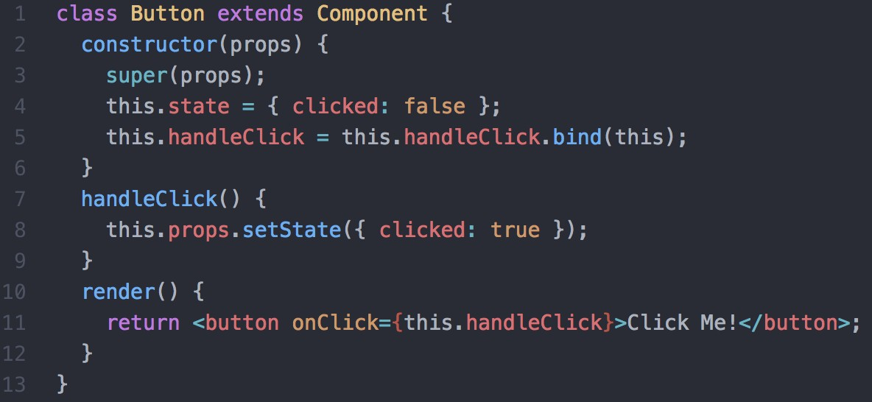
Using Arrow Functions to avoid binding `this` in React
Use arrow functions to avoid binding `this` to methods:
Usually when you want to access this inside a class method you would need to bind it to your method like so:
Without an arrow function
13

Slide 10
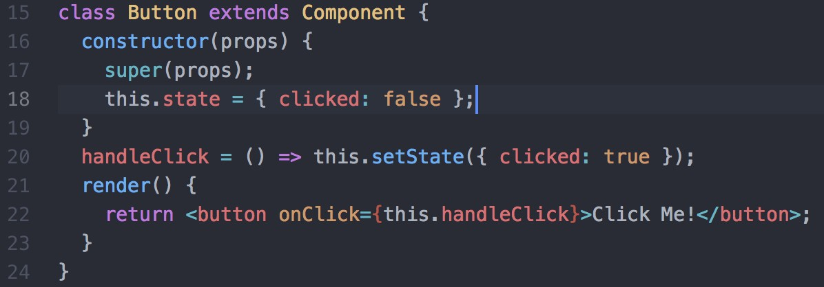
Using Arrow Functions to avoid binding `this` in React
Binding this to handleClick in the constructor allows us to
use this.setState from Component inside handleClick. Without this binding, this is re-scoped for handleClick and therefore cannot be used with the setState method.
However using arrow functions makes this whole process unnecessary and leaves your code
looking much nicer:
With an arrow function
13

Slide 11
Using Arrow Functions to avoid binding `this` in React
Here you can see 3 lines of code have been cut out just from changing that one function. It may not seem like a huge deal for this example but in a huge app with many components it will definitely make a difference. The great thing about an arrow function is that this means the same thing within the function body as it does outside of it. Which means that if you use arrow functions within your component’s render, they can access this and this.setState. Doing this I can
call handleClick in just one line.
As you can see using arrow functions in class components can end up saving you lines of code and time which is a win situation. Properly understanding and knowing how to use arrow functions can make your life easier when dealing with this.
13

Slide 12
Supported Events in React JS
13

