Slide 1



React Js Online Training
19
By: Ajeet Kumar

Slide 2
How to use Material UI in React App
19

Slide 3
How to Type Emoji in VS Code in 2020 | VS Code Emoji Extension
19

Slide 4
How to Type Emoji in VS Code in 2020 | VS Code Emoji Extension
Step by Step on How to type emoji on VS Code
1: Open VS Code IDE
2: Click on the Extension Tab
3: search for :emojisense
4: Instal it
Now, you have to edit the .json file to make it work perfectly
5: Go to setting
6: click on the extension tab
19
7: click on :emojisense
8: now on the right side of the screen, click on Edit in setting.json file
then add some code in settings.json

Slide 5
Phase of Component
19

Slide 6
Phase of Component
Everything you see in a React application is a component or part of a component. In React, components are designed to follow the natural cycle of life. They are born (creation), grow (updating), and finally die (deletion). This is called the component lifecycle.
For each phase of a component’s life, React provides access to certain built-in events/methods called lifecycle hooks or lifecycle methods. These methods give you opportunities to control and manipulate how a component reacts to changes in the application.
Phase of Component
Mounting - Mounting is the process of creating an element and inserting it in a DOM tree.
Updating - Updating is the process of changing state or props of component and update changes to nodes already in the DOM.
19
Unmounting - Unmounting is the process of removing components from the DOM.
Error Handling - These are used when there is error during rendering, in lifecycle method or in the constructor of any child component.

Slide 7
Component lifecycle hooks or lifecycle methods
19

Slide 8
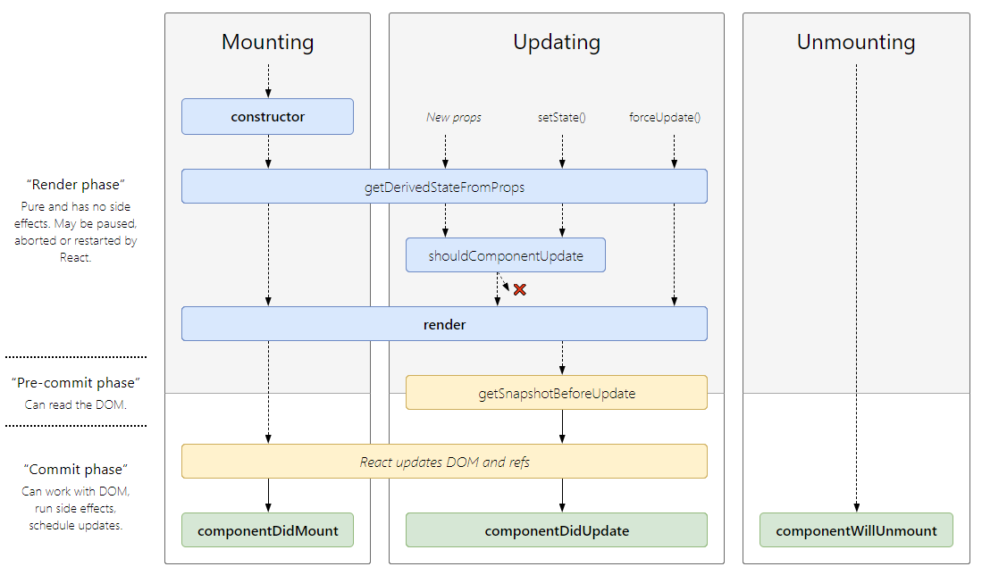
Component lifecycle hooks or lifecycle methods
For each phase of a component’s life, React provides access to certain built-in events/methods called lifecycle hooks or lifecycle methods. These methods give you opportunities to control and manipulate how a component reacts to changes in the application.
Every React component has it own lifecycle. The lifecycle of the component is defined by the
sequence of methods executed in different stages of the component’s existence.
19

Slide 9
Mounting
19

Slide 10
Mounting
This is the very first stage where component is created with props and state.
This all is done within constructor. After getting ready with state and props, our component is ready to mount on the DOM and it is rendered for the first time on the web page.
Mounting means putting elements into the DOM.
React has four built-in methods that gets called, in this order, when mounting a component means this phase has 4 methods in it:
constructor()
getDerivedStateFromProps()
render()
19
componentDidMount()
The render() method is required and will always be called, the others are optional and will be called if you define them.

Slide 11
Mounting
constructor
The constructor() method is called before anything else, when the component is initiated, and it is the natural place to set up the initial state and other initial values.
The constructor of component method is called before every other method is called.
The main purpose of this method is to initialize props and state and to bind event handlers to the instance.
Syntax - constructor(props)
The constructor() method is called with the props, as arguments, and you should always start by calling the super(props) before anything else, this will initiate the parent's constructor method and allows the component to inherit methods from its parent (React.Component).
19

Slide 12
Mounting
getDerivedStateFromProps
This method is called just before render() method is called. This method is used when the state of the component depends on props. This method is called just before render method both on initial mount or subsequent requests. In this method we can set the state.
Syntax - static getDerivedStateFromProps(props,state)
This method enables a component to update its internal state as a result of changes in props. This
method is used in very rare cases as the method does not have access to class instance.
This is the natural place to set the state object based on the initial props.
It takes state and props as an argument, and returns an object with changes to the state.
19

Slide 13
Mounting
render()
The render() method is required, and is the method that actually outputs the HTML to the DOM. This method is the only required method in the class component. The render() function does not
modify state component. It returns the same result each time its invoked, but this method does
not directly interact with the browser.
Syntax - render()
While calling this method it observes this.props() and this.state() value and returns one of the following types like: React elements, array, fragments, string and numbers, booleans or null.
19

