Slide 1



React Js Online Training
22
By: Ajeet Kumar

Slide 2
Custom Hook in React JS
22

Slide 3
Custom Hook in React JS
A custom Hook is a JavaScript function, when we want to share logic between two JavaScript functions, we extract it to a third function.
Building your own Hooks lets you extract component logic into reusable functions.
You can write custom Hooks that cover a wide range of use cases like form handling, animation, declarative subscriptions, timers, and many more.
A custom Hook is a JavaScript function whose name starts with "use" and that may call other Hooks.
Ex:- const data = useSomething( );
22

Slide 4
Higher order components or HOC in React JS
22

Slide 5
Higher order components or HOC in React JS
A Higher-Order Component (HOC) is an advanced technique in React for reusing component logic. HOCs are common in third-party React libraries.
A HOC is a function that takes a component as a parameter and returns a new component. Syntax: -
const EnhancedComponent = higherOrderComponent(WrappedComponent);
22

Slide 6
Context in React JS (Context API)
22

Slide 7
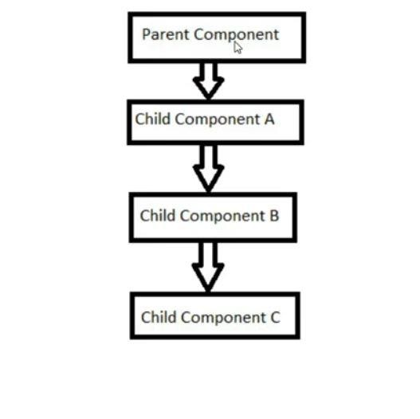
Context in React JS (Context API)
The React context api is safe to use in production with the version 16.3 or latest. The reason for adding context api is to avoid the passing of props if there is a chain of children components.
Without the use of context api, we have components. The other alternative solution maintaining a central store.
to pass the props through all the intermediate
is to use third party library such as Redux for
React hooks provides a concept call Context.
React Context API allows you to easily access
data at different levels of the component tree,
without passing prop to every level.
22

Slide 8

Context in React JS (Context API)
22

Slide 9
useContext hook and multiple context in React JS
22

Slide 10
useContext hook and multiple context in React JS
it’s a way to pass data deeply throughout your app without having to manually pass props down through multiple levels. It can be a good alternative to tools like Redux when all you need to do is pass data around.
useContext hook allows passing data to children elements without using redux.
useContext is a named export in react so we can import in functional components like below −
import {useContext} from ‘react’;
It’s an easy alternative to Redux if we just need to pass the data to the children elements.
The createContext hooks gives us provider and consumer.
Provider is used to pass the values to child components and child components access the value using consumer.
22

