Slide 1





React Js Online Training
35
By: Ajeet Kumar

Slide 2
Introduction to redux
35

Slide 3
Introduction to redux
Redux is an open-source JavaScript library used to manage application state.
Redux is quite an excellent State Managment Framework usually used with React.js library. In Single Page Application, data management at client side is far more complicated than just imagine. Now, you are familiar that, ReactJS is depends on the State of the application. However,
In React.js state management is possible, but when the application gets bigger and bigger, unwanted errors and data changes are detected, and which module has changed which state and
which view is updated, all these matters get complex, and we feel like, we trapped in our application.
Facebook gives the solution. Its developer has created one State management pattern called Flux.
35

Slide 4
Introduction to redux
What is React Redux
React Redux is the official React binding for Redux. It allows React components to read data from a Redux Store, and dispatch Actions to the Store to update data. Redux helps apps to scale by providing a sensible way to manage state through a unidirectional data flow model. React Redux is conceptually simple. It subscribes to the Redux store, checks to see if the data which your component wants have changed, and re-renders your component.
Redux was inspired by Flux. Redux studied the Flux architecture and omitted unnecessary complexity.
Redux does not have Dispatcher concept.
Redux has an only Store whereas Flux has many Stores.
The Action objects will be received and handled directly by Store.
35

Slide 5
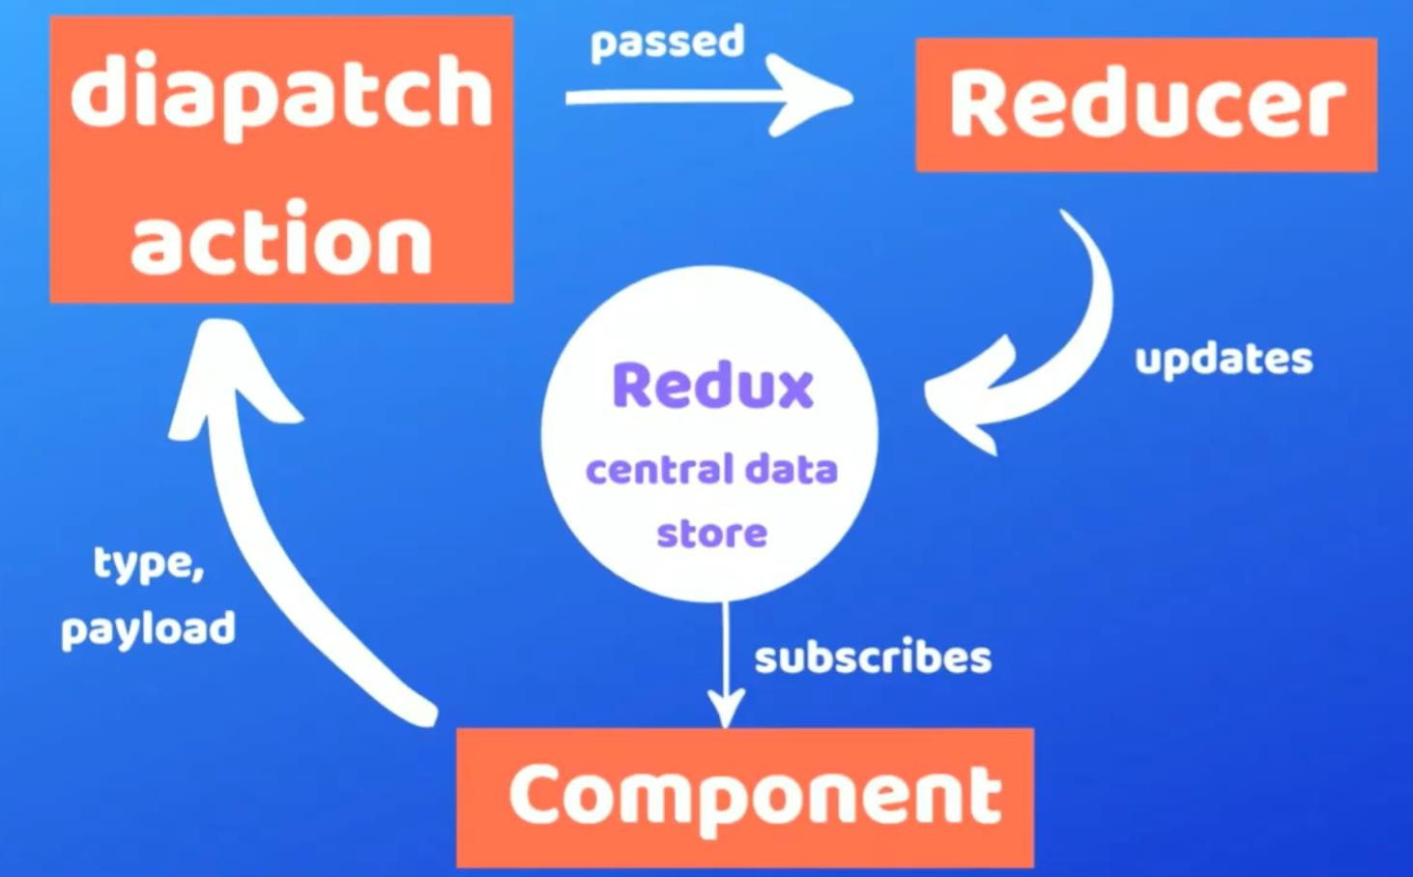
Introduction to redux
35

Slide 6
Introduction to redux
Redux is the predictable state container for JavaScript applications. Redux entirely different from Flux.
Flux has multiple stores.
Redux has a Single Store.
Redux cannot have multiple stores. The store is divided into various state objects. So, all we need is to maintain the single store, or we can say the only source of truth.
Flux has so many stores, and each store is using different small part of the state or data of our
application. In other words, each different module has its store.
Three Principles Of Redux
▪
▪
▪
Single source of truth. The state is read-only.
Changes are made with pure functions.
35

Slide 7
Introduction to redux
It is the state of our whole application is stored in an object within a single store. There is an only way to change the state is to emit an action, an object describing what happened. To specify how actions transform the state, you write pure reducers.
We will learn about all the definitions just to get exposure and an idea of them in your head first.
Actions
Reducers
Store
Dispatch
Connect
35

Slide 8
Introduction to redux
Actions
An action sends data from your application to the Redux store. An action is conventionally an object with two properties: type and (optional) payload. The type is generally an uppercase string (assigned to a constant) that describes the action. The payload is additional data that may be passed.
Actions are payloads of information that send data from your application to your store. Actions are plain JavaScript objects.
Action is sent or dispatched from the view which are payloads that can be read by Reducers.
35

Slide 9
Introduction to redux
Action Type
const DELETE_TODO = 'DELETE_TODO'
Action
{
type: DELETE_TODO,
payload: id,
}
35

Slide 10
Introduction to redux
Action creators
An action creator is a function that returns an action.
Action Creator
const deleteTodo = (id) => ({type: DELETE_TODO, payload: id})
35

Slide 11
Introduction to redux
Reducers
A reducer is a function that takes two parameters: state and action. A reducer is immutable and always returns a copy of the entire state.
Actions describe the fact that something happened but don’t specify how the application’s state changes in response. That is the job of reducers
Reducer read the payloads from the actions and then updates the store via the state accordingly. It
is a pure function to return a new state from the initial state..
A reducer typically consists of a switch statement that goes through all the possible action types.
35

Slide 12
Introduction to redux
Reducers
Reducer
const initialState = { todos: [
{id: 1, text: 'Eat'},
{id: 2, text: 'Sleep'},
],
loading: false, hasErrors: false,
}
function todoReducer(state = initialState, action) { switch (action.type) {
case DELETE_TODO:
return {
...state,
todos: state.todos.filter((todo) => todo.id !== action.payload),
}
default: return state
35
}
}

Slide 13
Introduction to redux
Store
The Redux application state lives in the store, which is initialized with a reducer. When used with React, a <Provider> exists to wrap the application, and anything within the Provider can have access to Redux.
A store is an object that brings them together. A Store is a place where the entire state of your application lists. It manages the status of the application and has a dispatch(action) function. It is like a brain responsible for all moving parts in Redux.
A store has the following responsibilities:
Holds application state;
Allows access to state via getState();
Allows state to be updated via dispatch(action);
35

Slide 14
Introduction to redux
Store
Index.js
import {createStore} from 'redux' import {Provider} from 'react-redux' import reducer from './reducers'
const store = createStore(reducer)
render(
<Provider store={store}>
<App />
</Provider>, document.getElementById('root'),
35
)

Slide 15
Introduction to redux
Store
Note:
it is important to note that you will only have a single store in a Redux application. If you want to split your data handling logic, you will use reducer composition instead of many stores.
import { createStore } from 'redux' import todoApp from './reducers' let store = createStore(todoApp)
35

Slide 16
Introduction to redux
Dispatch
dispatch is a method available on the store object that accepts an object which is used to update the Redux state. Usually, this object is the result of invoking an action creator.
const Component = ({dispatch}) => { useEffect(() => {
dispatch(deleteTodo())
}, [dispatch])
}
35

Slide 17
Introduction to redux
Connect
The connect() function is one typical way to connect React to Redux. A connected component is sometimes referred to as a container.
35

Slide 18
Why should I use Redux?
35

Slide 19
Why should I use Redux?
Easily manage global state - access or update any part of the state from any Redux-connected component
Easily keep track of changes with Redux DevTools - any action or state change is tracked and easy to follow with Redux. The fact that the entire state of the application is tracked with each change means you can easily do time-travel debugging to move back and forth between changes.
The downside to Redux is that there's a lot of initial boilerplate to set up and maintain (especially if you use plain Redux without Redux Toolkit). A smaller application may not need Redux and may instead benefit from simply using the Context API for global state needs.
In my personal experience, I set up an application with Context alone, and later needed to convert everything over to Redux to make it more maintainable and organized.
35

Slide 20
Redux dependencies
35

Slide 21
Redux dependencies
Redux requires a few dependencies.
Redux - Core library
React Redux - React bindings for Redux
Redux Thunk - Async middleware for Redux
Redux DevTools Extension - Connects Redux app to Redux DevTools
35

Slide 22
Installation
35

Slide 23
Installation
To use React Redux with your React app:
npm install react-redux
You'll also need to install Redux and set up a Redux store in your app.
npm install redux
OR
npm install redux react-redux
35

Slide 24
Installation
Provider
React Redux provides <Provider />, which makes the Redux store available to the rest of your app:
Index.js
import React from 'react'
import ReactDOM from 'react-dom' import App from './App'
import { Provider } from 'react-redux'
const rootElement = document.getElementById('root') ReactDOM.render(
35
<Provider>
<App />
</Provider>, rootElement
)

Slide 25
Installation
Creating the store
First, let's look at the original index.js file in which we created our store: import React from 'react'
import { render } from 'react-dom' import { Provider } from 'react-redux'
import { createStore } from 'redux'
import App from './App'
const store = createStore()
render(
<Provider store={store}>
35
<App />
</Provider>,
document.getElementById('root')
)

Slide 26
Installation
Set Reducer
First, let's look at the original index.js file in which we created our store: import React from 'react'
import { render } from 'react-dom'
import { Provider } from 'react-redux' import { createStore } from 'redux'
import rootReducer from './reducers'
import App from './App'
const store = createStore(rootReducer) render(
<Provider store={store}>
35
<App />
</Provider>,
document.getElementById('root')
)

Slide 27
Installation
In this code, we pass our reducers to the Redux createStore function, which returns a store object. We then pass this object to the react-redux Provider component, which is rendered at the top of our component tree.
This ensures that any time we connect to Redux in our app via react-redux connect, the store is available to our components.
35

Slide 28
Installation
connect()
React Redux provides a connect function for you to connect your component to the store.
Normally, you’ll call connect in this way:
import { connect } from 'react-redux’
Class Counter extends Component {
35
}
export default connect()(Counter)

Slide 29
Installation
connect()
import { connect } from 'react-redux'
import { increment, decrement, reset } from './actionCreators'
// const Counter = ...
const mapStateToProps = (state /*, ownProps*/) => { return {
counter: state.counter
}
}
const mapDispatchToProps = { increment, decrement, reset }
35
export default connect(
mapStateToProps,
mapDispatchToProps
)(Counter)

Slide 30
redux thunk
35

Slide 31
redux thunk
Extending Redux functionality
Most apps extend the functionality of their Redux store by adding middleware or store enhancers (note: middleware is common, enhancers are less common). Middleware adds extra functionality to the Redux dispatch function; enhancers add extra functionality to the Redux store.
The redux-thunk middleware, which allows simple asynchronous use of dispatch.
Install redux-thunk
npm install redux-thunk
35

Slide 32
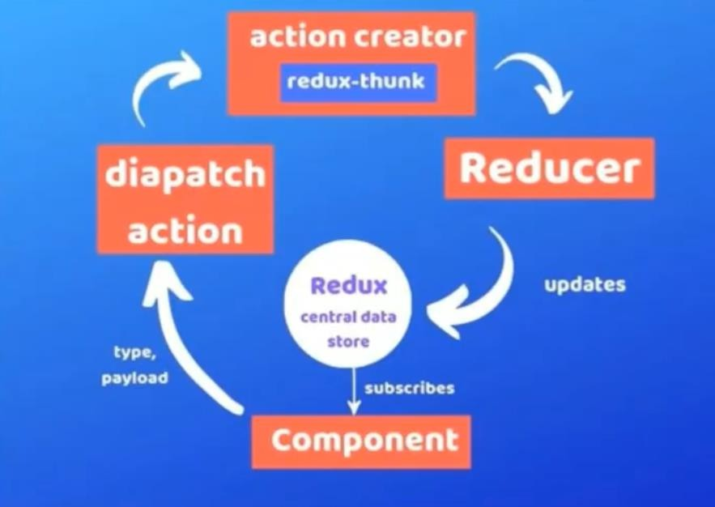
redux thunk
35

Slide 33
Combine more than one reducer in redux
35

Slide 34
useSelector and useDispatch hooks in react redux
35

Slide 35
useSelector and useDispatch hooks in react redux
The traditional approach, as we just learned, is to use mapStateToProps with the connect() function. This is still common in codebases and therefore worth learning. The newer, React Hooks way of going about it is to use useDispatch and useSelector from react-redux. This approach requires less code overall as well.
useDispatch and useSelector lunched in react-reduct 7.1.0 version.
35

