Slide 1





React Js Online Training
04
By: Ajeet Kumar

Slide 2
Module Import - Export in React
04

Slide 3
Module Import - Export in React
Module Import - Export
A module is just a file. One script is one module.
Modules can load each other and use special directives export and import to interchange
functionality, call functions of one module from another one:
export keyword labels variables and functions that should be accessible from outside the current module.
import allows the import of functionality from other modules.
04

Slide 4
Module Import - Export in React
Module - Export
The export statement is used in Javascript modules to export functions, objects, or primitive values from one module so that they can be used in other programs (using the 'import' statement).
A module encapsulates related code into a single unit of code. All functions related to a single module are contained in a file.
Two Types of Export:
Default Export
Named Export
Note: You can have multiple named export per module but only one default export
04

Slide 5
Module Import - Export in React
Module - Default Export
You can have only one default export per module.
Company.js
Export default function project(){
Export default class employee {
Property
Methods
}
class employee {
Property Methods
}
Export default employee;
}
function project(){
}
Export default project;
const a=10;
Export default a;
04

Slide 6
Module Import - Export in React
Module - Named Export
You can have multiple named export per module.
Company.js
Export class employee {
Property Methods
}
Export
{ employee, project };
Export function project(){
}
Export const a=10;
04

Slide 7
Module Import - Export in React
Module - Import
The static import statement is used to import bindings which are exported by another module. Imported modules are in strict mode whether you declare them as such or not.
Module - Importing Default
You can have only one default export per module. Default export can be imported by any name
Company.js
app.js
Export default class employee { Property
Methods
}
Import employee from ‘./company.js’
04

Slide 8
Module Import - Export in React
Module - Importing Named
You can have multiple named export per module. During import , it is mandatory to use the same name of respective objects.
Company.js
Export class employee {
Property Methods
}
app.js
Import {employee} from ‘./company.js’
Import {employee , Project } from ‘./company.js’
function project(){
04
}
Export project;

Slide 9
Module Import - Export in React
Module - Importing All
You can have multiple named export per module. During import , it is mandatory to use the same name of respective objects.
Company.js
app.js
Export class employee {
Property Methods
}
Import * as comp from ‘./company.js’
Comp.employee Comp.project Comp.a
function project(){
04
}
Export project;

Slide 10
Module Import - Export in React
Module - Importing default & named
You can have multiple named export per module. During import , it is mandatory to use the same name of respective objects.
Company.js
app.js
Export class employee {
Property Methods
}
Import employee , {project } from ‘./company.js’
function project(){
04
}
Export project;

Slide 11
DOM VS Virtual DOM
04

Slide 12
DOM VS Virtual DOM
DOM
Just to get things straight - DOM stands for Document Object Model and is an abstraction of a structured text. For web developers, this text is an HTML code, and the DOM is simply called HTML DOM. Elements of HTML become nodes in the DOM.
So, while HTML is a text, the DOM is an in-memory representation of this text.
The HTML DOM provides an interface (API) to traverse and modify the nodes. It contains methods like getElementById or removeChild. We usually use JavaScript language to work with the DOM.
So, whenever we want to dynamicly change the content of the web page, we modify the DOM:
Javascript
var item = document.getElementById("myLI");
item.parentNode.removeChild(item);
04
document is an abstraction of the root node,
while getElementById, parentNode and removeChild are methods from HTML DOM API.

Slide 13
DOM VS Virtual DOM
DOM Issues
The DOM in simple words represents the UI of your application. Every time there is a change in the state of your application UI, the DOM gets updated to represent that change. Now the catch is frequently manipulating the DOM affects performance, making it slow.
The HTML DOM is always tree-structured - which is allowed by the structure of HTML document. This is cool because we can traverse trees fairly easily. Unfortunately, easily doesn’t mean quickly here.
The DOM trees are huge nowadays. Since we are more and more pushed towards dynamic web apps (Single Page Applications - SPAs), we need to modify the DOM
tree incessantly and a lot. And this is a real performance and development pain.
04

Slide 14
DOM VS Virtual DOM
Virtual DOM
First of all - the Virtual DOM was not invented by React, but React uses it and provides it for free.
That’s where the concept of virtual DOM comes in and performs significantly better than the real DOM. The virtual DOM is only a virtual representation of the DOM. Every time the state of our application changes, the virtual DOM gets updated instead of the real DOM.
Well, you may ask” Isn’t the virtual DOM doing the same thing as the real DOM, this sounds
like double work? How can this be faster than just updating the real DOM?”
The answer is virtual DOM is much faster and efficient, here is why.
04

Slide 15
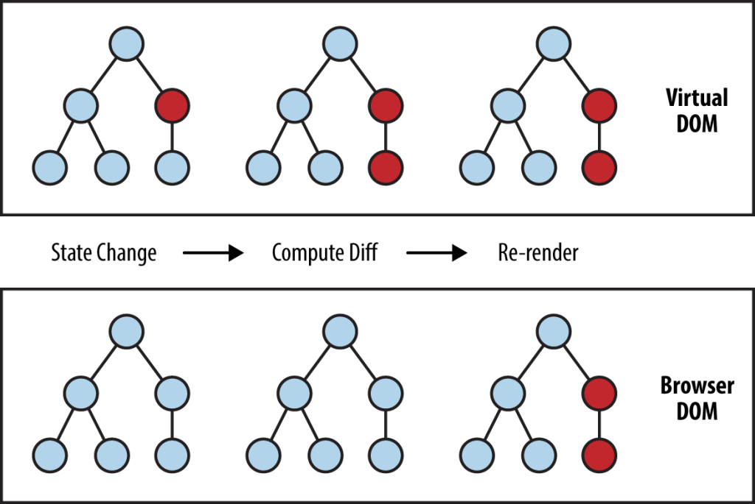
DOM VS Virtual DOM
How is Virtual DOM faster?
When new elements are added to the UI, a virtual DOM, which is represented as a tree is created. Each element is a node on this tree. If the state of any of these elements changes, a new virtual DOM tree is created. This tree is then compared or “diffed” with the previous virtual DOM tree.
Once this is done, the virtual DOM calculates the best possible method to make these changes to the real DOM. This ensures that there are minimal operations on the real DOM. Hence, reducing the performance cost of updating the real DOM.
04

Slide 16
DOM VS Virtual DOM
How does React use Virtual DOM
Now that you have a fair understanding of what a Virtual DOM is, and how it can help with performance of your app, let’s look into how React leverages the virtual DOM.
In React every UI piece is a component, and each component has a state. React follows the observable pattern and listens for state changes. When the state of a component changes, react updates the virtual DOM tree. Once the virtual DOM has been updated, react then compares the current version of the virtual DOM with the previous version of the virtual DOM. This process is called “diffing”.
Once React knows which virtual DOM objects have changed, then React
updates only those objects, in the real DOM. This makes the performance far better when compared to manipulating the real DOM directly. This makes React standout as a high- performance JavaScript library.
In simple words, you tell React what state you want the UI to be in, and it makes sure that the DOM matches that state. The great benefit here is that as a developer, you would not need to know how the attribute manipulation, event handling or the manual DOM updates happen behind the scenes.
04

Slide 17
DOM VS Virtual DOM
How does React use Virtual DOM
All of these details are abstracted away from React developers. All you need to do is update the states of your component as and when needed and React takes care of the rest. This ensures a superior developer experience when using React.
Batch Update
React follows a batch update mechanism to update the real DOM. Hence, leading to increased performance. This means that updates to the real DOM are sent in batches, instead of sending updates for every single change in state.
The repainting of the UI is the most expensive part, and React efficiently ensures that the real DOM receives only batched updates to repaint the UI.
04

