Slide 1



React Js Online Training
07
By: Ajeet Kumar

Slide 2
Webpack
07

Slide 3
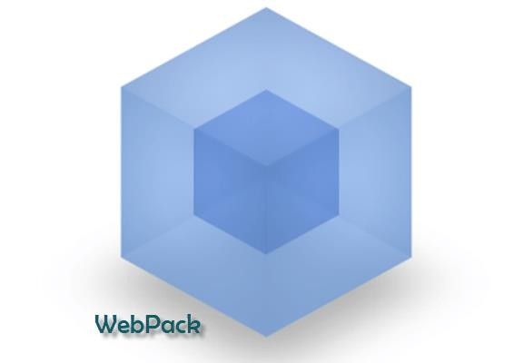
Webpack
Webpack is module bundler that takes your modules with dependencies and generates static assets representing those modules. If we are working with a website, then it is possible that it contains the large numbers of JS and CSS files. For a general scenario, if our application contains 10 JavaScript files and 3 CSS files, then 13 requests will be sent to the server for all these files, which makes the process slow.
Webpack is a build tool but it does more than that. It manages our code and handles the dependencies.
07

Slide 4
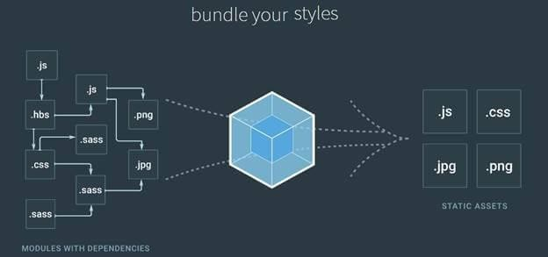
Webpack
The best practice is to make the bundle of all these files and provide a single package for JS and a single package for CSS; that means now only minmum requests will be sent to the Server to load all the required resources. This, definitely, reduces the time and increases the performance of our application.
07

Slide 5
Webpack
Webpack not only bundles our resources like JS and CSS but it also transforms them and allows us to write our code in ES6 (ECMA Script 6). In current time, all the technologies like Angular2+, React etc. use ES6 for the development. But every browser doesn’t necessarily understand the ES6, so Webpack compiles the code into ES5 (with the help of babel) such that the browser can understand the code.
07

