Slide 1

©mamed/rifqy
Personal Project
Name: Peta Isochrone Terminal-Terminal di Jakarta
Kota | Terminal
Jakarta Pusat | Pasar Senen
Jakarta Barat | Grogol · Kalideres
Jakarta Selatan | Blok M · Lebak Bulus · Manggarai · Pasar Minggu · Ragunan
Jakarta Timur | Cililitan · Kampung Melayu · Kampung Rambutan · Klender · Pinang Ranti · Pulo Gadung · Pulo Gebang · Rawamangun
Jakarta Utara | Tanjung Priok · Muara Angke
Terminal Tipe A: melayani kendaraan penumpang umum untuk angkutan antar kota antar propinsi (AKAP), dan angkutan lintas batas antar negara, angkutan antar kota dalam propinasi (AKDP), angkutan kota (AK) serta angkutan pedesaan (ADES).
Terminal Tipe B: melayani kendaraan penumpang umum untuk angkutan antar kota dalam propinasi (AKDP), angkutan kota (AK) serta angkutan pedesaan (ADES).

Slide 2
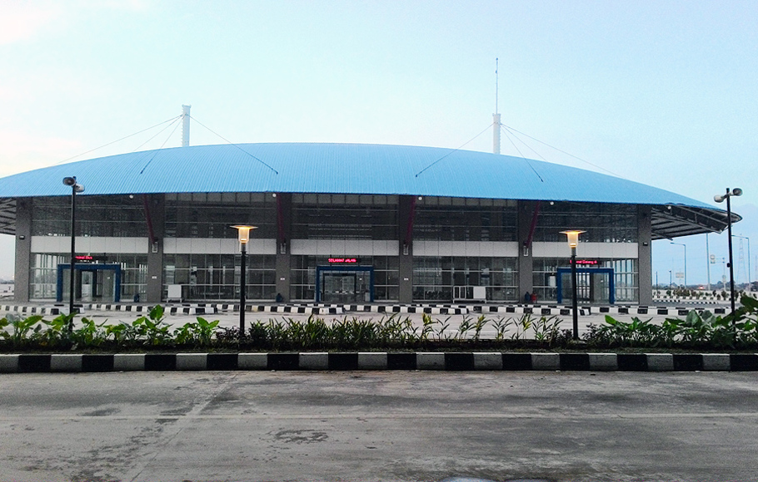
©mamed/rifqy
Personal Project
Name: Peta Isochrone Terminal-Terminal di Jakarta
/Terminal Pulo Gebang/
Location: Jl Sejajar Sisi Tol Timur KM 2 Pulo Gebang Cakung Kota Administrasi Jakarta Timur.
Operation Date: 28 Desember 2016.
Type: Terminal Type A
Image: BeritaSatu

Slide 3
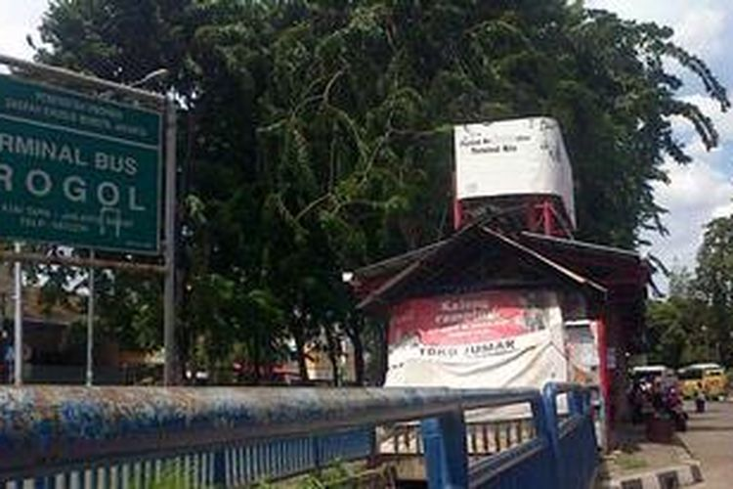
©mamed/rifqy
Personal Project
Name: Peta Isochrone Terminal-Terminal di Jakarta
/Terminal Grogol/
Location: Jalan Kyai Tapa 1 11450 Grogol, Petamburan, Jakarta Barat, Daerah Khusus Ibukota Jakarta.
Type: Terminal Type A
Image: Kompas

Slide 4
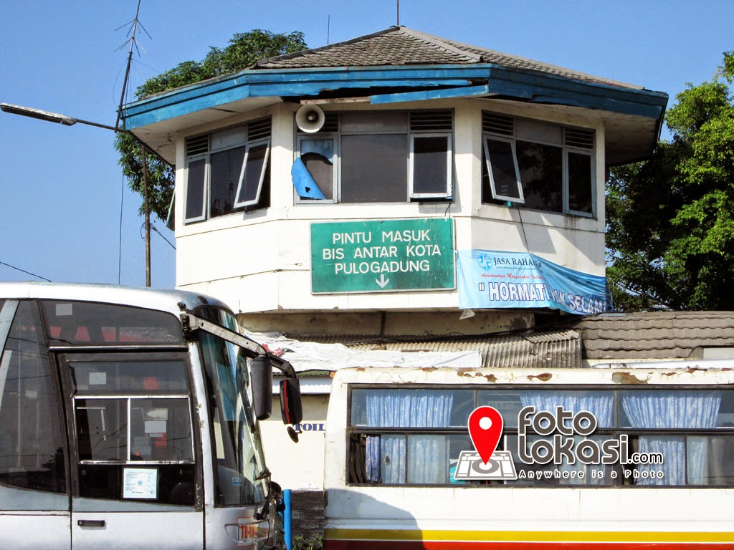
©mamed/rifqy
Personal Project
Name: Peta Isochrone Terminal-Terminal di Jakarta
/Terminal Pulogadung/
Location: Jl. Perintis Kemerdekaan Jl. Bekasi Timur Raya, RW.2, Pulo Gadung, Kec. Klp. Gading, Kota Jakarta Timur.
Type: Terminal Type B
Image: fotolokasi.com

Slide 5
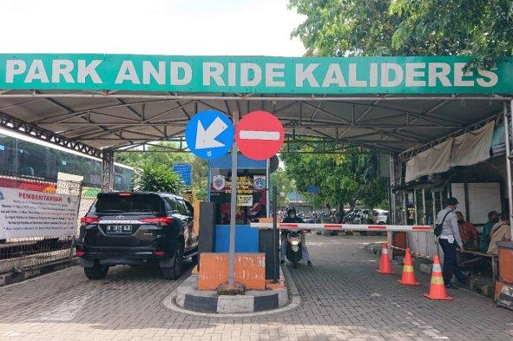
©mamed/rifqy
Personal Project
Name: Peta Isochrone Terminal-Terminal di Jakarta
/Terminal Kalideres/
Location: Jalan Raya Daan Mogot, Kalideres, Kalideres, Kota Jakarta Barat.
Type: Terminal Type A
Image: Tribunnews

Slide 6
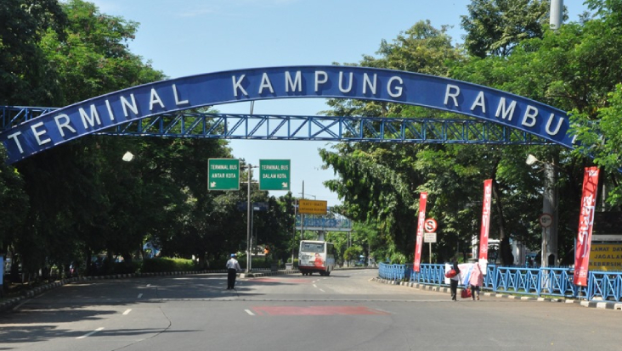
©mamed/rifqy
Personal Project
Name: Peta Isochrone Terminal-Terminal di Jakarta
/Terminal Kampung Rambutan/
Location: Rambutan, Ciracas, Jakarta Timur.
Operation Date: 1986
Type: Terminal Type A
Image: iNews

Slide 7
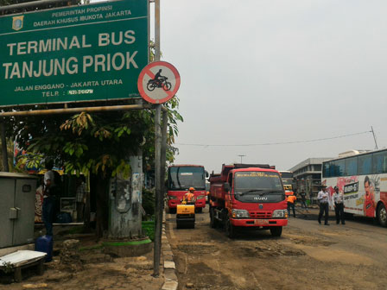
©mamed/rifqy
Personal Project
Name: Peta Isochrone Terminal-Terminal di Jakarta
/Terminal Tanjung Priok/
Location: Stasiun, Tj. Priok, Kec. Tj. Priok, Jakarta Utara.
Type: Terminal Type A
Image: beritajakarta.id

Slide 8
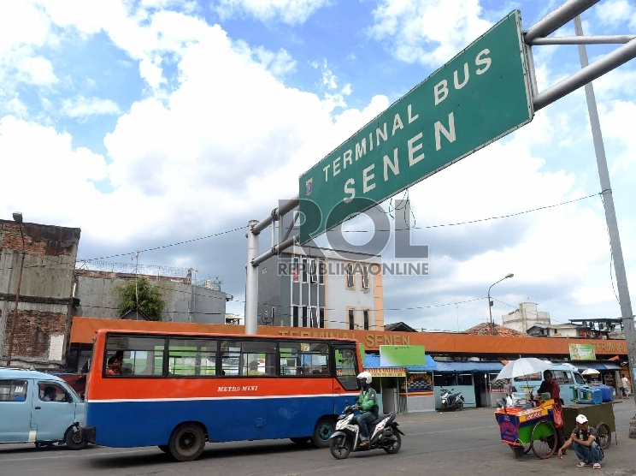
©mamed/rifqy
Personal Project
Name: Peta Isochrone Terminal-Terminal di Jakarta
/Terminal Senen/
Location: Senen, Senen, Kota Jakarta Pusat.
Type: Terminal Type B
Image: Republika Online

Slide 9
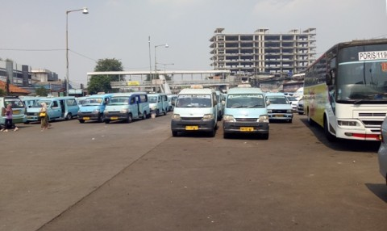
©mamed/rifqy
Personal Project
Name: Peta Isochrone Terminal-Terminal di Jakarta
/Terminal Kampung Melayu/
Location: Jalan Jatinegara Barat Raya RT.5/RW.3 Bidara Cina, RT.2/RW.1, Bali Mester, Kecamatan Jatinegara, Kota Jakarta Timur.
Type: Terminal Type B
Image: medcom.id

Slide 10
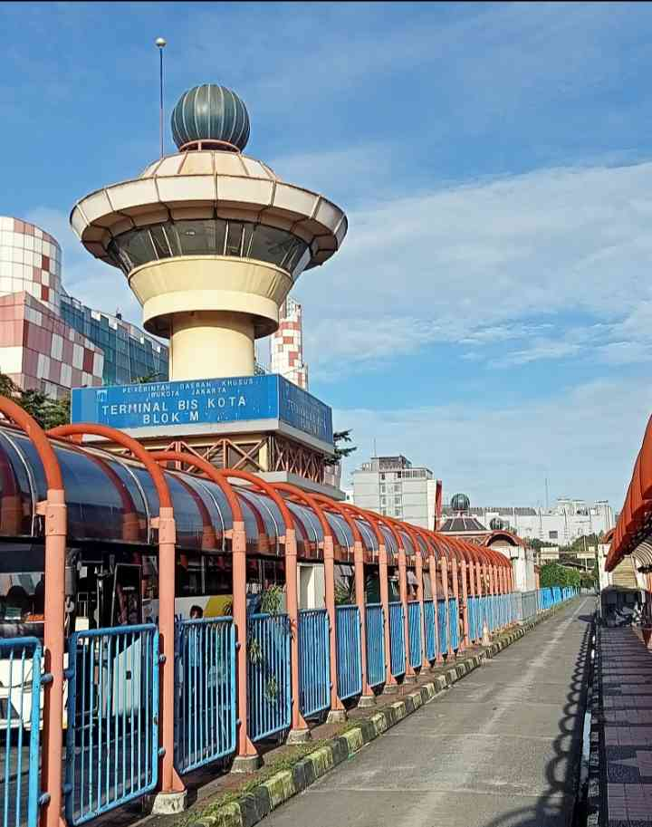
©mamed/rifqy
Personal Project
Name: Peta Isochrone Terminal-Terminal di Jakarta
/Terminal Blok M/
Location: Melawai, Kebayoran Baru, Jakarta Selatan.
Type: Terminal Type B
Image: Kompasiana

Slide 11
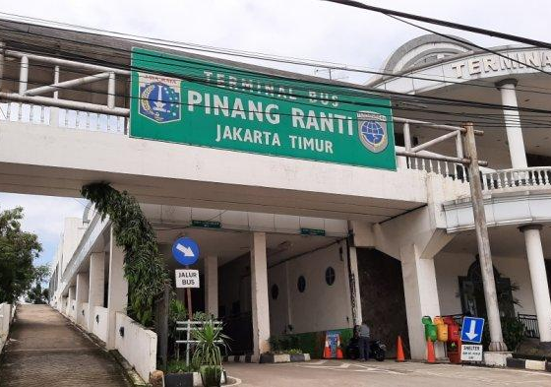
©mamed/rifqy
Personal Project
Name: Peta Isochrone Terminal-Terminal di Jakarta
/Terminal Kampung Melayu/
Location: Jl. Raya Pd. Gede No.18, Pinang Ranti, Kec. Makasar, Kota Jakarta Timur.
Type: Terminal Type B
Image: Tribun Jakarta

Slide 12
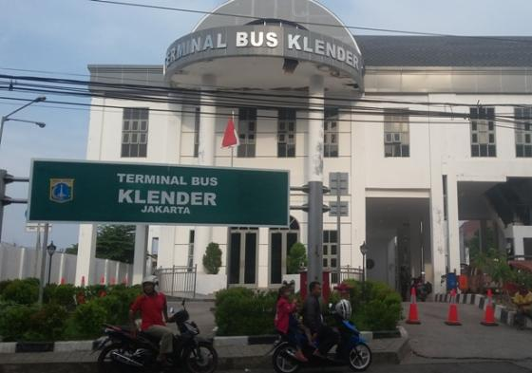
©mamed/rifqy
Personal Project
Name: Peta Isochrone Terminal-Terminal di Jakarta
/Terminal Klender/
Location: l. Raya Pd. Gede No.18, Pinang Ranti, Kec. Makasar, Kota Jakarta Timur.
Type: Terminal Type B
Image: Wartakota

Slide 13
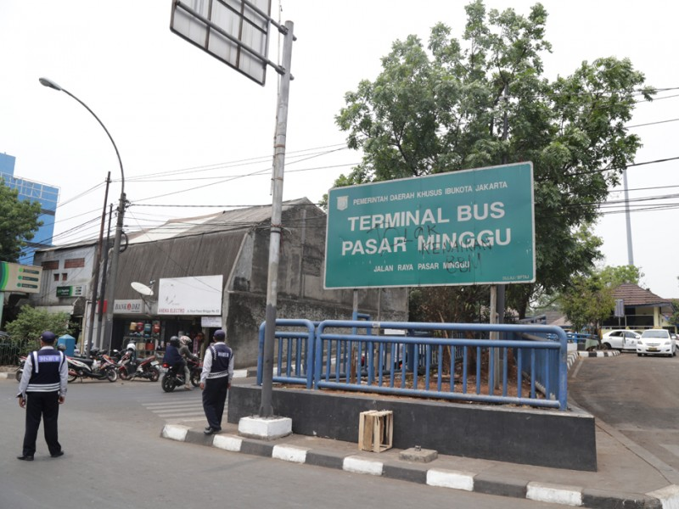
©mamed/rifqy
Personal Project
Name: Peta Isochrone Terminal-Terminal di Jakarta
/Terminal Pasar Minggu/
Location: RT.4/RW.1, Ps. Minggu, Kec. Ps. Minggu, Kota Jakarta Selatan.
Type: Terminal Type B
Image: beritajakarta.id

Slide 14
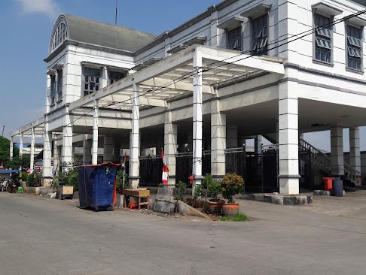
©mamed/rifqy
Personal Project
Name: Peta Isochrone Terminal-Terminal di Jakarta
/Terminal Muara Angke/
Location: Pluit, Kec. Penjaringan, Kota Jakarta Utara.
Type: Terminal Type B
Image: ApaBuka.com

Slide 15
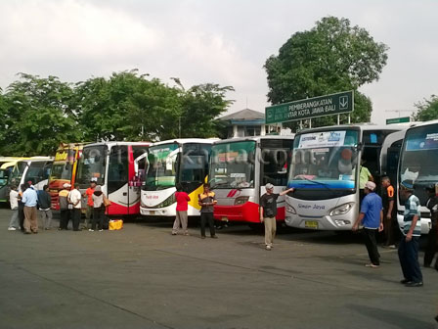
©mamed/rifqy
Personal Project
Name: Peta Isochrone Terminal-Terminal di Jakarta
/Terminal Rawa Buaya/
Location: Komplek Terminal Rawa Buaya, Kalideres, Kec. Kalideres, Jakarta Barat.
Type: Terminal Type B
Image: beritajakarta.id

Slide 16
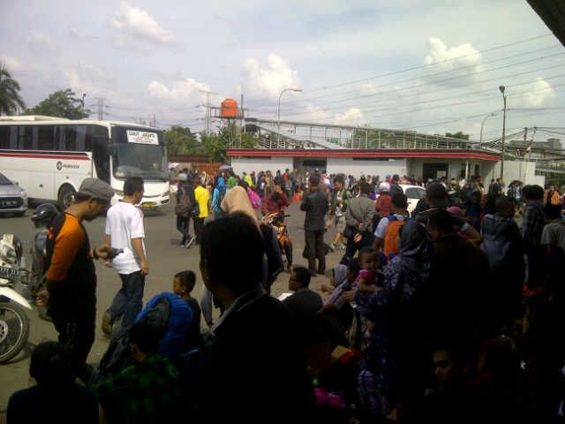
©mamed/rifqy
Personal Project
Name: Peta Isochrone Terminal-Terminal di Jakarta
/Terminal Cililitan/
Location: Cililitan, RW.3, Kramat Jati, Kec. Kramat jati, Kota Jakarta Timur.
Type: Terminal Type B
Image: DetikNews

Slide 17
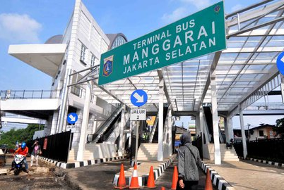
©mamed/rifqy
Personal Project
Name: Peta Isochrone Terminal-Terminal di Jakarta
/Terminal Manggarai/
Location: Pasar Manggis, Kota Jakarta Selatan.
Type: Terminal Type B
Image: Merdeka.com

Slide 18
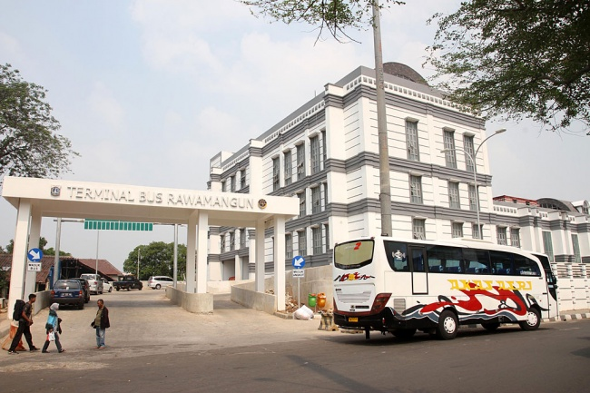
©mamed/rifqy
Personal Project
Name: Peta Isochrone Terminal-Terminal di Jakarta
/Terminal Manggarai/
Location: Jl. Pegambiran No.31A, Jati, Kec. Pulo Gadung, Kota Jakarta Timur.
Type: Terminal Type B
Image: Tempo.co

Slide 19
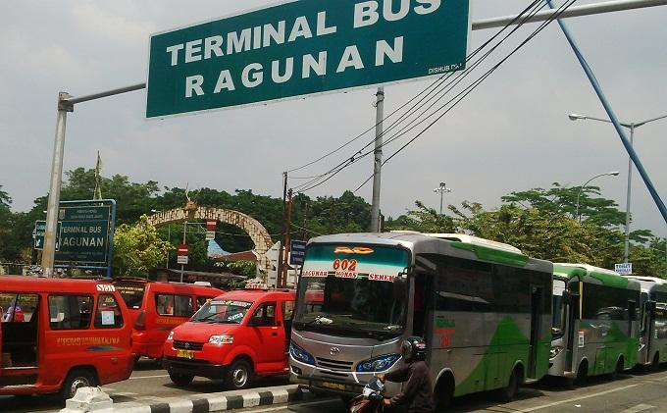
©mamed/rifqy
Personal Project
Name: Peta Isochrone Terminal-Terminal di Jakarta
/Terminal Ragunan/
Location: Jl. Saco No.54, Ragunan, Ps. Minggu, Kota Jakarta Selatan.
Type: Terminal Type B
Image: Wartakota

