Slide 1
Adjustments: Household Composition

Slide 2
When expenditure is utility consistent
If the following conditions are satisfied, expenditure is utility consistent:
All individuals have the same utility function
Prices are identical to all individuals
All household and individual characteristics are the same
All individuals have exactly the same goods that are not transacted in markets
If not, you need to do some adjustments to make expenditures comparable across individuals

Slide 3
What to do when HH characteristics vary?
Goal: construct a money-metric wealth indicator for each person
Such as:
Price indexes → different cost-of-living
Equivalence of scales → different demographic compositions
General practice: per capita terms
Limitation:
Different individuals may have different “needs”
The cost per person of reaching a certain welfare level may be lower in large households than small ones.

Slide 4
Equivalence of scales Limitation
Different individuals may have different needs
A child may no need the same food consumption expenditure as an adult member → understate welfare of people in households with large fraction of children (…but not forget about non-food)
Where do adult equivalence scales come from?
Nutritional scales: derived from health studies
Used to deflate food expenditure
Behavioral scales: major difficulties with identification
Example: if we observe that females and children get less. Do they need less? Or is it that they are systematically discriminated against?

Slide 5
Equivalence of scales Headcount
Type of Household | Equivalence of scales
 | (1,1,1) | (1,1,0.6) | (1,0.8,0.6) | (1,0.7,0.4)
All households | 63.4 | 63.2 | 62.9 | 63.8
Male-Headed | 63.8 | 63.6 | 63.5 | 64.5
Female-Headed | 57.7 | 57.4 | 54.3 | 52.7
Widow-Headed | 58.3 | 61.9 | 58.2 | 58.6
Extended male-headed | 68.2 | 69.5 | 67.6 | 67.4
Source: Dreze and Srinivasan (1997), Table 3
Note: The equivalence of scales are written as triplets indicating the weights for “adult male”, “adult female”, “Child” in that order.

Slide 6
Equivalence of scales Headcount
Poverty profiles do not change much as a result of equivalence of scales
The use of per capita welfare measure may not be too misleading
But…this is an empirical question that needs to be checked on a case-by-case basis

Slide 7
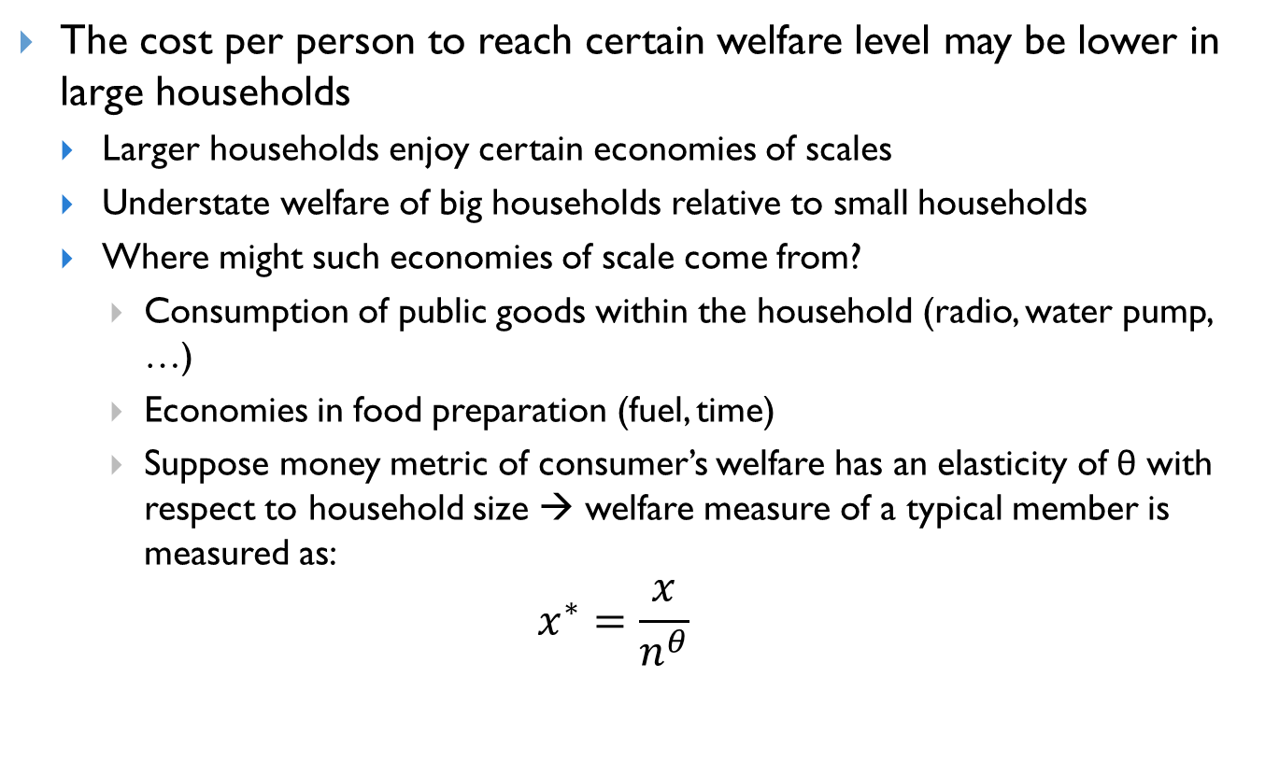
Equivalence of scales Limitation – Economies of scale
The cost per person to reach certain welfare level may be lower in large households
Larger households enjoy certain economies of scales
Understate welfare of big households relative to small households
Where might such economies of scale come from?
Consumption of public goods within the household (radio, water pump, …)
Economies in food preparation (fuel, time)
Suppose money metric of consumer’s welfare has an elasticity of θ with respect to household size → welfare measure of a typical member is measured as:
$$x^{∗}=\frac{x}{n^{θ}}$$

Slide 8
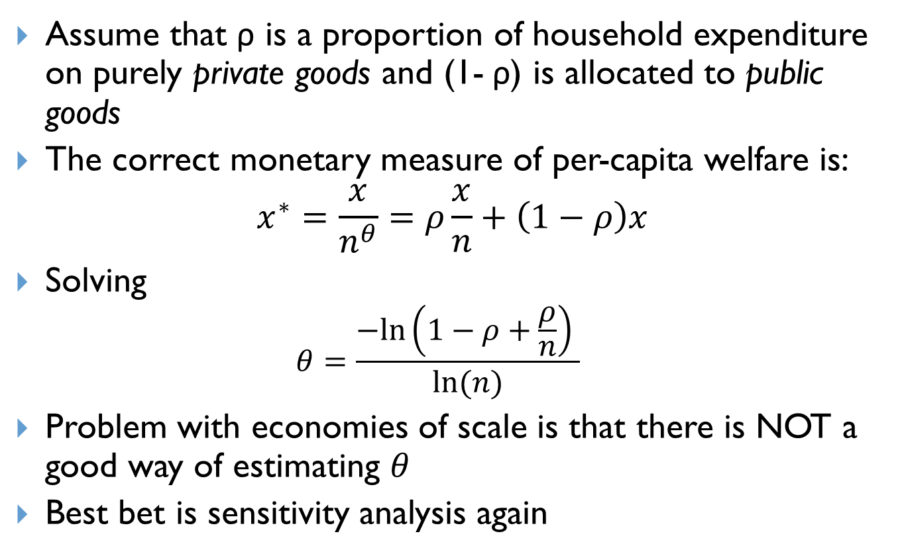
Equivalence of scales Limitation – Economies of scale
Assume that ρ is a proportion of household expenditure on purely private goods and (1- ρ) is allocated to public goods
The correct monetary measure of per-capita welfare is:
$$x^{∗}=\frac{x}{n^{θ}}=ρ\frac{x}{n}+\left(1−ρ\right)x$$
Solving
$$θ=\frac{−ln⁡\left(1−ρ+\frac{ρ}{n}\right) }{ln⁡(n)}$$
Problem with economies of scale is that there is NOT a good way of estimating $θ$
Best bet is sensitivity analysis again

Slide 9
Economies of scale Headcount
Type of Household | Mean size | Economies of scale
 |  | 1 | 0.8 | 0.6 | 0.4
All households | 5.35 | 63.4 | 59.6 | 54.5 | 49.5
Male-Headed | 5.56 | 63.8 | 59.4 | 53.9 | 48.6
Female-Headed | 3.60 | 57.7 | 61.6 | 62.0 | 62.6
Widow-Headed | 3.32 | 58.3 | 63.8 | 65.1 | 66.2
Extended male-headed | 6.78 | 68.2 | 60.3 | 51.0 | 43.5
Source: Dreze and Srinivasan (1997), Table 4

Slide 10
Equivalence of scales
This may affect direction of policy
But … there are no accepted methods for calculating equivalence of scales.

Slide 11
Equivalence of scales
Behavioral approach
One idea seems correct
Two types of goods within the household:
Private goods
Public goods
Support the intuition that in:
Economies with high food shares of the budget → economies of scales are likely to be small
Economies where housing is important → economies of scales are likely to be larger

Slide 12
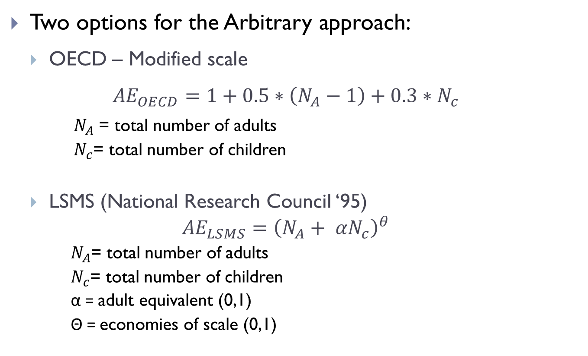
Equivalence of scales
Two options for the Arbitrary approach:
OECD – Modified scale
$${AE}_{OECD}=1+0.5∗\left(N_{A}−1\right)+0.3∗N_{c}$$
$N_{A}$ = total number of adults
$N_{c}$= total number of children
LSMS (National Research Council ‘95)
$${AE}_{LSMS}={\left(N_{A}+ αN_{c}\right)}^{θ}$$
$N_{A}$= total number of adults
$N_{c}$= total number of children
α = adult equivalent (0,1)
Θ = economies of scale (0,1)

Slide 13
Equivalence of scales
Traditionally
We do not know
α = adult equivalent
Θ = economies of scale
To perform the sensitivity analysis for the LSMS case
We can not simply change the parameters and leave poverty rate unchanged
α = 1 & Θ changes 1 to 0.5 → poverty decline given constant poverty line
Alter the relative standing of large households relative to small households
 | Adult Equivalent = α | Economies of scale = Θ
Poor | 0.25-0.33 | 0.9 - 1
Richer | 0.50-0.75 | 0.25-0.75

Slide 14
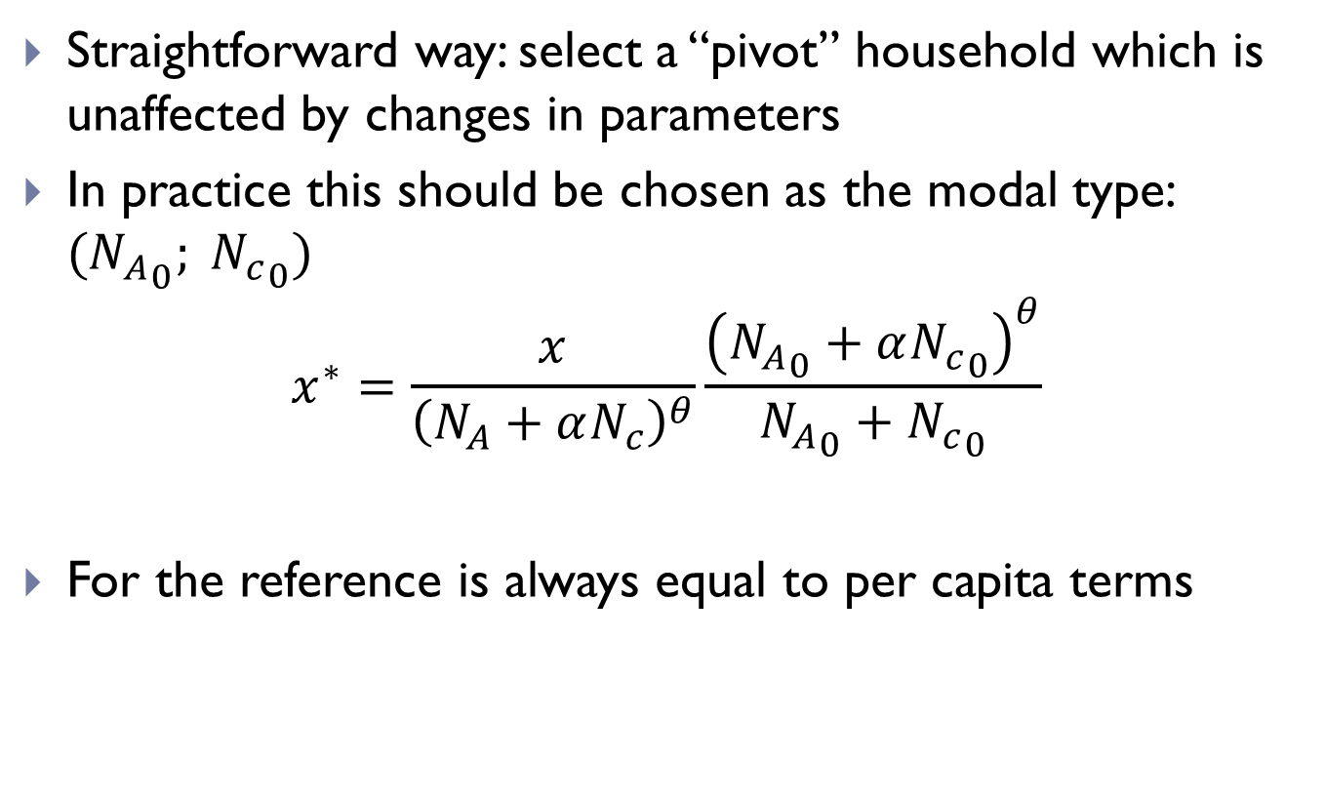
Equivalence of scales
Straightforward way: select a “pivot” household which is unaffected by changes in parameters
In practice this should be chosen as the modal type: ${{(N}_{A}}_{0}; {N_{c}}_{0})$
$$x^{∗}=\frac{x}{{\left(N_{A}+αN_{c}\right)}^{θ}}\frac{{\left({N_{A}}_{0}+α{N_{c}}_{0}\right)}^{θ}}{{N_{A}}_{0}+{N_{c}}_{0}}$$
For the reference is always equal to per capita terms

