Slide 1
Adjustments: Prices Concepts and Practical Issues

Slide 2
Today’s lecture
Learning basics of price adjustment
Utility consistency and price index
Paasche, Laspayres, and Fisher
Practical considerations
This lecture focuses on Deaton and Zaidi (2002) materials
Debate on price adjustment is still active
Debate on Purchasing Power Parity (PPP) is one of them
This lecture will not discuss these issues of PPPs

Slide 3
Let’s go back to EC101
X
X’
Y
Y’

Slide 4
Let’s go back to EC101
X
Budget
Line
X’
U’
Y
Y’

Slide 5
If prices are the same …
X
… Expenditure increases if and only if utility increases
X’
U’’
U’
Y
Y’

Slide 6
If prices differ …
X
… Person R and Person J spent exactly the same amount ($100) but they face difference prices
ER=EJ(=$100 say)
but UR<UJ
EJ
ER
UJ
UR
Y

Slide 7
A simple example: who is better off?
 | Consumption |  | Price ($/kg) |  | Nominal Expenditure ($)
 | Rice (kg) | Meat (kg) | Rice | Meat
Ringo | 2 | 2.5 | 10 | 32 | 100
John | 4 | 2.8 | 4 | 30 | 100
Paul | 4.4 | 3.0 | 5 | 26 | 100
George | 15 | 7.0 | 2 | 10 | 100
Nominal expenditures are not directly useful because prices faced by each are different.
Whose prices are higher? How to answer this question for a comparison between John and Paul?

Slide 8
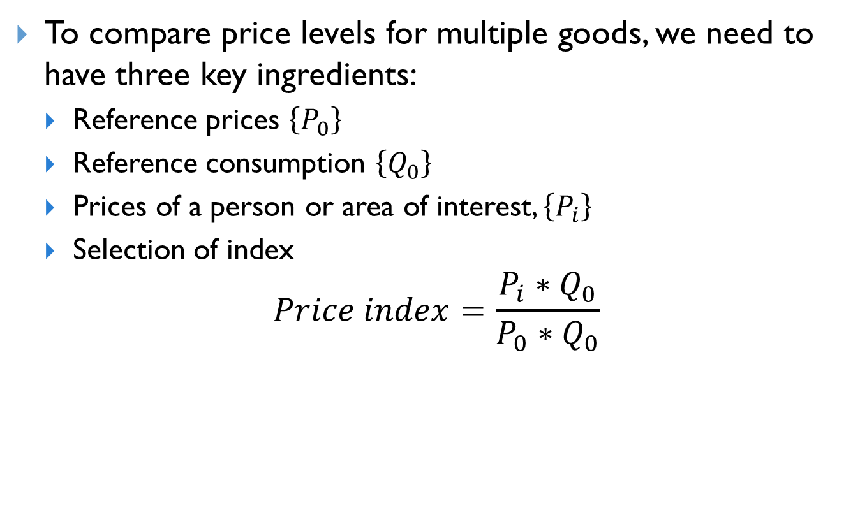
Price index
To compare price levels for multiple goods, we need to have three key ingredients:
Reference prices $\left\{P_{0}\right\}$
Reference consumption $\left\{Q_{0}\right\}$
Prices of a person or area of interest, $\left\{P_{i}\right\}$
Selection of index
$$Price index=\frac{P_{i}{∗Q}_{0}}{P_{0}{∗Q}_{0}}$$

Slide 9
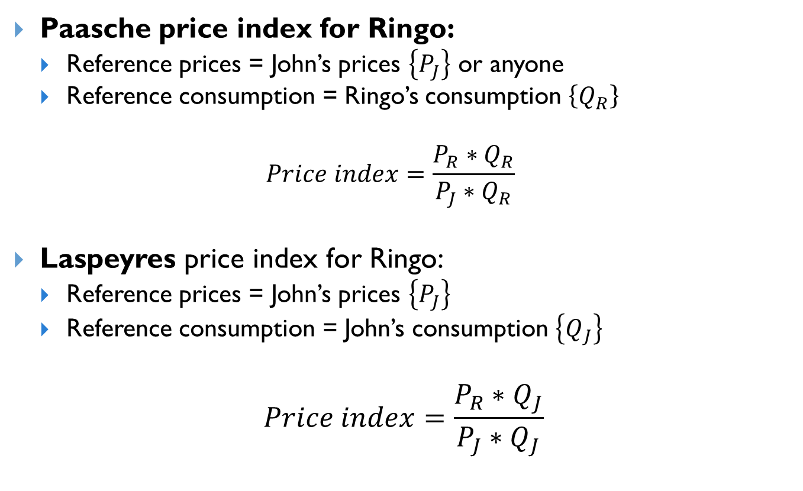
Paasche vs. Laspeyres
Paasche price index for Ringo:
Reference prices = John’s prices $\left\{P_{J}\right\}$ or anyone
Reference consumption = Ringo’s consumption $\left\{Q_{R}\right\}$
$$Price index=\frac{P_{R}{∗Q}_{R}}{P_{J}{∗Q}_{R}}$$
Laspeyres price index for Ringo:
Reference prices = John’s prices $\left\{P_{J}\right\}$
Reference consumption = John’s consumption $\left\{Q_{J}\right\}$
$$Price index=\frac{P_{R}{∗Q}_{J}}{P_{J}{∗Q}_{J}}$$

Slide 10
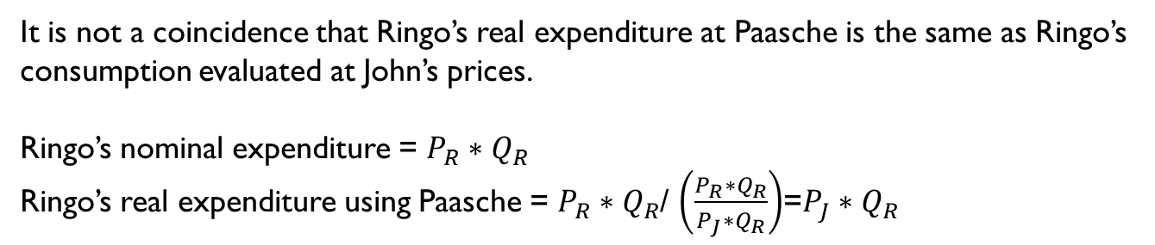
Calculating Ringo’s real expenditure (with John’s prices as reference)
Calculating real expenditure for Ringo
Price Index | John’s prices (1) | Ringo's prices (2) | Price index = (2)/(1) | Ringo’s real expenditure (100/Price Index) | Notes
Paasche | 83 | 100 | 1.205 | 83 | Using Ringo’s consumption
Laspeyres | 100 | 130 | 1.30 | 76.9 | Using John’s consumption
It is not a coincidence that Ringo’s real expenditure at Paasche is the same as Ringo’s consumption evaluated at John’s prices.
Ringo’s nominal expenditure = $P_{R}{∗Q}_{R}$
Ringo’s real expenditure using Paasche = $P_{R}{∗Q}_{R}$/ $\left(\frac{P_{R}{∗Q}_{R}}{P_{J}{∗Q}_{R}}\right)$=$P_{J}{∗Q}_{R}$

Slide 11
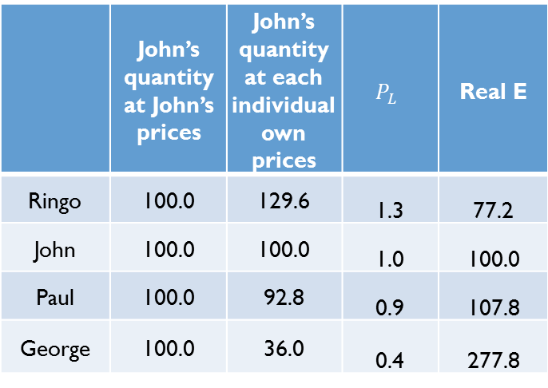
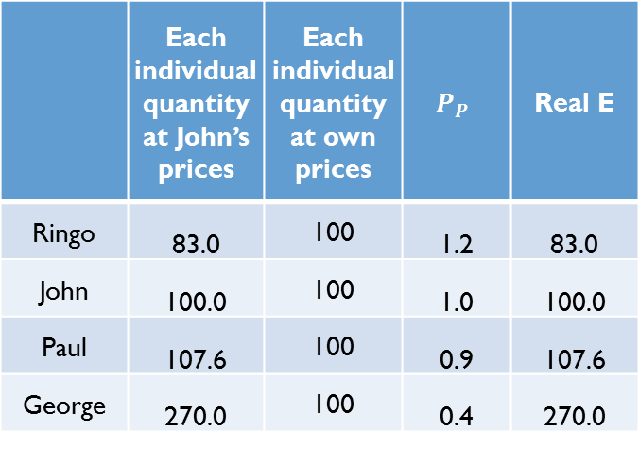
Comparison of all four players (Reference=John’s prices)
Paasche Price Index
Laspeyres Price Index
 | Each individual quantity at John’s prices | Each individual quantity at own prices | $$P_{P}$$ | Real E
Ringo | 83.0 | 100 | 1.2 | 83.0
John | 100.0 | 100 | 1.0 | 100.0
Paul | 107.6 | 100 | 0.9 | 107.6
George | 270.0 | 100 | 0.4 | 270.0
 | John’s quantity at John’s prices | John’s quantity at each individual own prices | $$P_{L}$$ | Real E
Ringo | 100.0 | 129.6 | 1.3 | 77.2
John | 100.0 | 100.0 | 1.0 | 100.0
Paul | 100.0 | 92.8 | 0.9 | 107.8
George | 100.0 | 36.0 | 0.4 | 277.8
Both indicators show that John faces higher prices than Paul.

Slide 12













Illustration of price adjustments with Paasche Index
X
Adjustment with Paasche
X
Fully utility consistent
Expenditures adjusted by Paasche index are the first order approximation of the ideal adjustment
Ideal price adjustment (given change in prices, R changes consumption bundle to maximize his utility)
$$E_{J}$$
$$E_{J}$$
$$E_{R}=83$$
$$X_{R}′$$
$$X_{R}$$
$$X_{R}$$
$$U_{J}$$
$$U_{J}$$
$$U_{R}$$
$$U_{R}$$
Y
Y
$$Y_{R}$$
$Y_{R}$’
$$Y_{R}$$

Slide 13
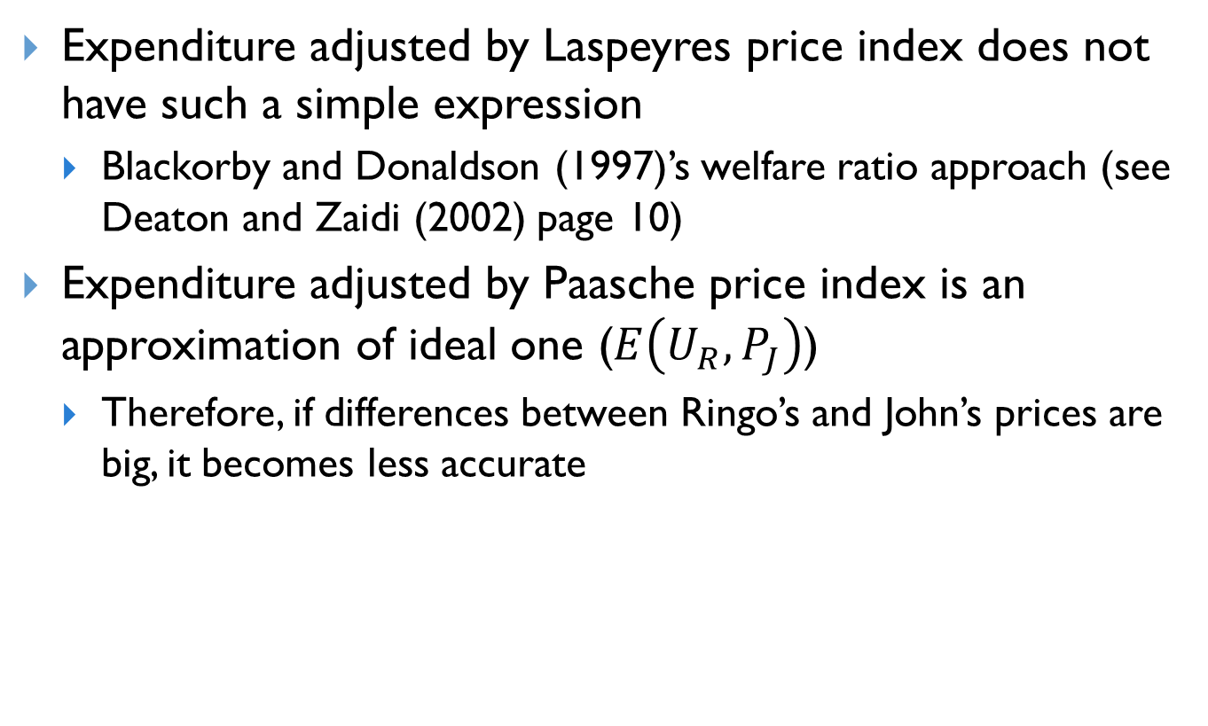
Discussions
Expenditure adjusted by Laspeyres price index does not have such a simple expression
Blackorby and Donaldson (1997)’s welfare ratio approach (see Deaton and Zaidi (2002) page 10)
Expenditure adjusted by Paasche price index is an approximation of ideal one ($E\left(U_{R},P_{J}\right)$)
Therefore, if differences between Ringo’s and John’s prices are big, it becomes less accurate

Slide 14
Practical issues

Slide 15
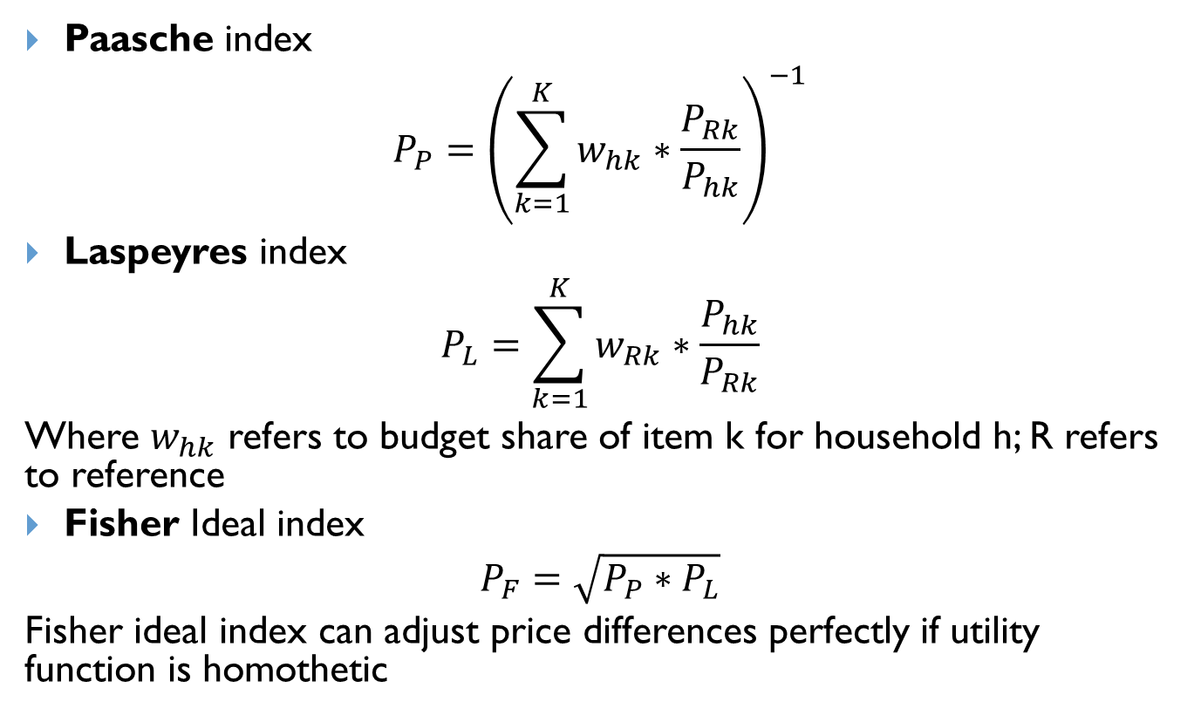
Typical formula for Paasche and Laspeyres index
Paasche index
$$P_{P}={\left(\sum_{k=1}^{K}{w_{hk}∗\frac{P_{Rk}}{P_{hk}}}\right)}^{−1}$$
Laspeyres index
$$P_{L}=\sum_{k=1}^{K}{w_{Rk}∗\frac{P_{hk}}{P_{Rk}}}$$
Where $w_{hk}$ refers to budget share of item k for household h; R refers to reference
Fisher Ideal index
$$P_{F}=\sqrt{P_{P}∗P_{L}}$$
Fisher ideal index can adjust price differences perfectly if utility function is homothetic

Slide 16
Intertemporal price adjustment
In the context of intertemporal price adjustments
Paasche index uses budget shares of the current period
Laspeyres index uses budget shares of the reference year
Most often used for CPI
Fisher index is used in some countries
Considered ideal

Slide 17
Unit values vs. Prices
Price data are collected from markets.
Usually identification of quality is quite rigorous but price data might not be comparable across areas
Often price data are collected only from capital city or urban areas
Relatively reliable
Price data usually include both nonfood and food items
Unit value is a ratio of expenditure to quantity
Different qualities might be included in the same item
Unit values can be representative at sub-national level
Due to misreporting of units, it is often very noisy
Unit values are usually available only from food items.

Slide 18
Level of geographic disaggregation
Price index can be constructed at different level of aggregations (province, district, even household)
Deaton and Zaidi (2002) recommend Paasche price index at the household level
Inflation rates are usually at the national level only

Slide 19
Coverage of goods
Unit values are often available only for food items
Price index from unit values are often constructed with only unit values from food items only
Prices are available for both non-food and food
But, as discussed, availability of price data are often restricted to urban areas

Slide 20
CPI price data vs. ICP price data
International Comparison Program (ICP) produces Purchasing Power Parity (PPP) by collecting price data comparable across and within countries
CPI price data are comparable over time within an area but not necessarily comparable across areas

Slide 21
Coverage of goods and selection of price index
 | Consumption |  | Unit value ($/kg)
 | Rice (kg) | Meat (kg) | Rice | Meat
Ringo | 2 | . | 10 | .
John | 4 | 2.8 | 4 | 30
We need to impute unit value for Ringo’s meat if we want to create Laspeyres price index evaluated at John’s prices, but there is no problem with Paasche price index.

Slide 22







A system of price adjustments (inter-temporal and spatial adjustments)
Spatial variation
Time
$$P_{T1}$$
$$P_{T2}$$
$$P_{T3}$$
$$P_{T1}^{S}$$
$$P_{T2}^{S}$$
$$P_{T3}^{S}$$
Use a combination of inter-temporal index and spatial index
For example, for Period T1 and Area S, a full price index is
$P_{T1}^{S}$* $P_{T1}$

Slide 23

Transitivity and Purchasing Power Parity (PPP)
If a Paasche, Laspayres, or Fisher index is used
$$P_{AB}≠P_{AC}∗P_{CB}$$
A
B
C
PPP uses a multilateral price index such as EKS index to obtain transitivity

Slide 24
Recommendations
Deaton and Zahidi (2002) recommend Paasche price index at the household level for spatial price adjustment
For intertemporal price adjustment, if CPI is reliable, use inflation rates constructed from CPI
If not, need to construct intertemportal price index using unit values
Be careful about the coverage of items if you use price index based on unit values

Slide 25
Annex – Theoretical foundation

Slide 26
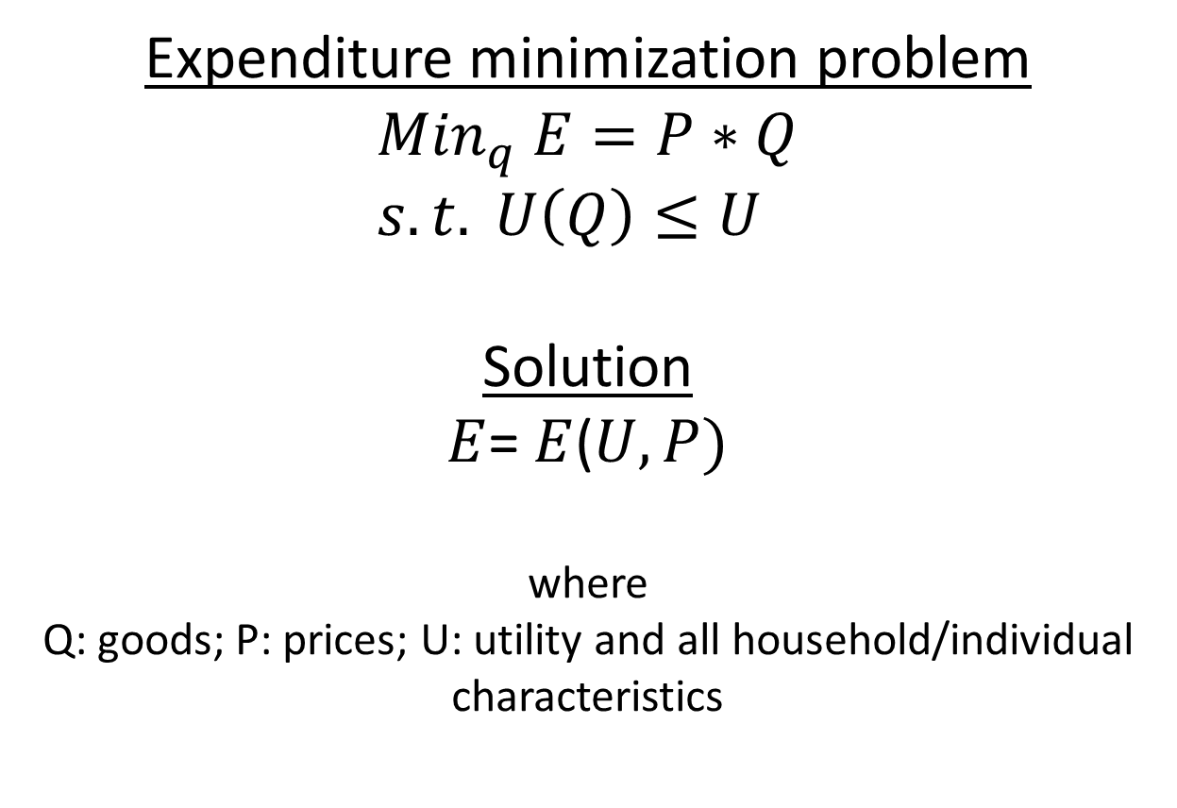
A little more formal discussion using a duality theory
Expenditure minimization problem
$${Min}_{q} E=P∗Q \\ s.t. U\left(Q\right)≤U$$
Solution
$E$= $E$($U,P)$
where
Q: goods; P: prices; U: utility and all household/individual characteristics

Slide 27
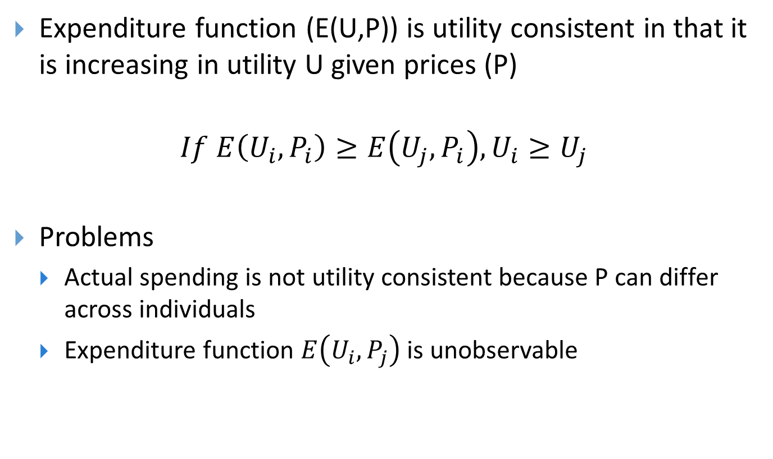
Expenditure function (E(U,P))
Expenditure function (E(U,P)) is utility consistent in that it is increasing in utility U given prices (P)
$$If E\left(U_{i},P_{i}\right)≥E\left(U_{j},P_{i}\right), U_{i}≥U_{j}$$
Problems
Actual spending is not utility consistent because P can differ across individuals
Expenditure function $E\left(U_{i},P_{j}\right)$ is unobservable

Slide 28
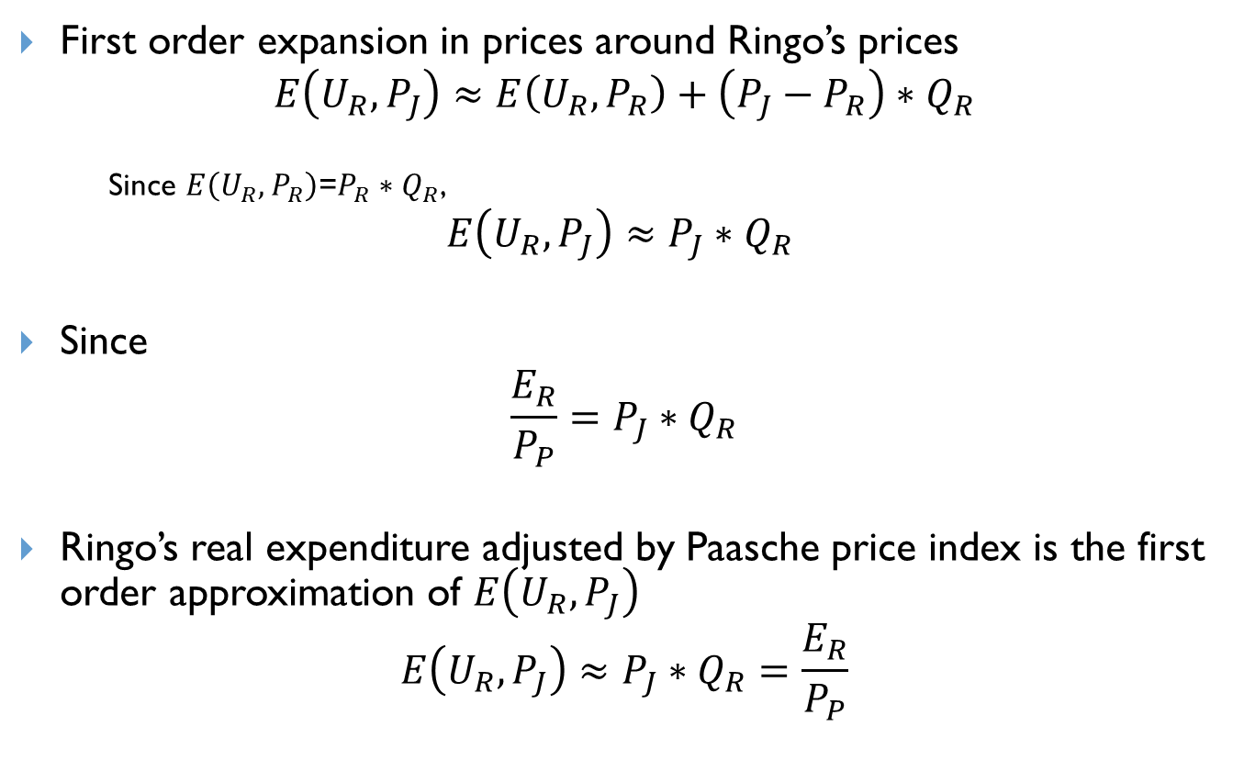
Theoretical consideration
First order expansion in prices around Ringo’s prices
$$E\left(U_{R},P_{J}\right)≈E\left(U_{R},P_{R}\right)+\left(P_{J}−P_{R}\right)∗Q_{R}$$
Since $E\left(U_{R},P_{R}\right)$=$P_{R}∗Q_{R}$,
$$E\left(U_{R},P_{J}\right)≈P_{J}∗Q_{R}$$
Since
$$\frac{E_{R}}{P_{P}}=P_{J}∗Q_{R}$$
Ringo’s real expenditure adjusted by Paasche price index is the first order approximation of $E\left(U_{R},P_{J}\right)$
$$E\left(U_{R},P_{J}\right)≈P_{J}∗Q_{R}=\frac{E_{R}}{P_{P}}$$

Slide 29
Plutocratic vs. Democratic
 | Rice | Beef | Total Spending | Rice share | Beef share
Poor household | 40 | 60 | 100 | 40% | 60%
Rich household | 60 | 240 | 300 | 20% | 80%
Total | 100 | 300
Share of total | 25% | 75%
Average Shares |  |  |  | 30% | 70%
Plutocratic
Democratic
Source: Gibson (2007)

