Slide 1
CodeSensei
Nomination: Nomination I — Virtual university location
Team CodeSensei
Igor Sikorsky Kyiv Polytechnic Institute
Team members:
Mark Mamenko, Kateryna Shozda, Denys Ilienko, Sviatoslav Pavlenko, Dmytro Poshytyniuk

Slide 2
Our Team
Mark Mamenko
Igor Sikorsky KPI
Role in the project:
Team lead. Backend API, Gemini proxy, Render hosting.
Kateryna Shozda
Igor Sikorsky KPI
Role in the project:
Learning design. OOP presets and mentor prompts.
Denys Ilienko
Igor Sikorsky KPI
Role in the project:
Quality assurance. Tests, API contract, demo checklist.
Note: Continued on the next slide.

Slide 3
Our Team (continued)
Sviatoslav Pavlenko
Igor Sikorsky KPI
Role in the project:
VRChat client. UdonSharp terminal, GET-only networking, prefab.
Dmytro Poshytyniuk
Igor Sikorsky KPI
Role in the project:
World integration. MetaLab assembly, VRChat SDK, scene placement.
Five authors
Igor Sikorsky KPI
Role in the project:
Artefacts stay with the five authors. NEXT may use them for teaching.
Note: Five people. Artefacts stay with the team.

Slide 4
Selected Location
SELECTED LOCATION
Multimedia Laboratory (MetaLab), Igor Sikorsky KPI
Our MetaLab hall at Igor Sikorsky KPI, a VRChat twin of MacPaw AI Lab. CodeSensei is the mentor in this room: UdonSharp on the client, a .NET 10 proxy on Render, Google Gemini behind it.
MODELLED SCOPE
In this hall: 24 OOP topics, a five-character review ticket, the /paste page, and one shared screen for the group.

Slide 5
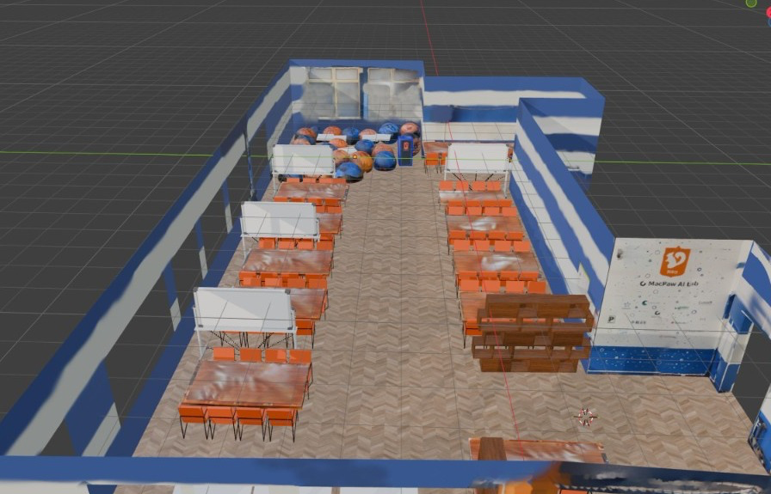
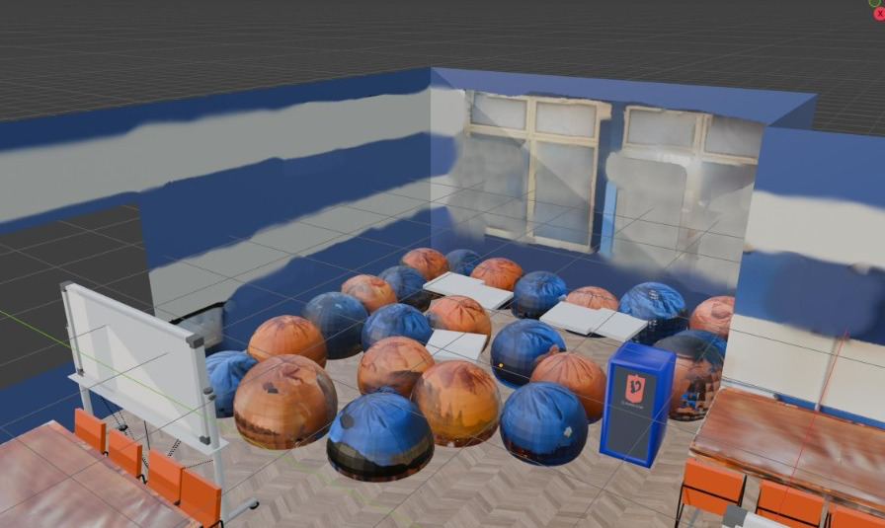
Selected Location
MetaLab overview — our laboratory
MetaLab lounge — virtual classroom

Slide 6
Virtual Model
MetaLab virtual laboratory
Workstations in the MetaLab world

Slide 7
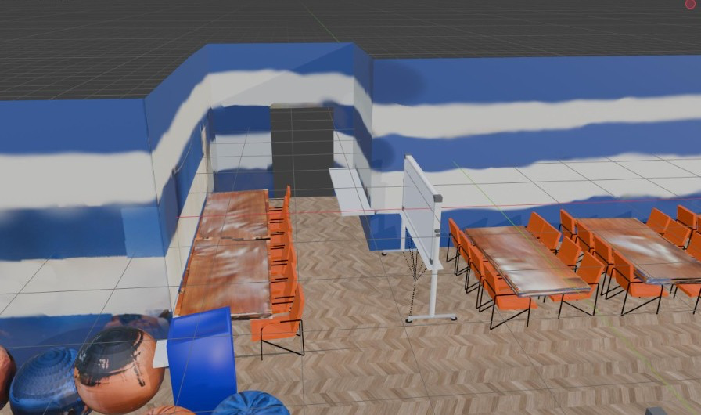
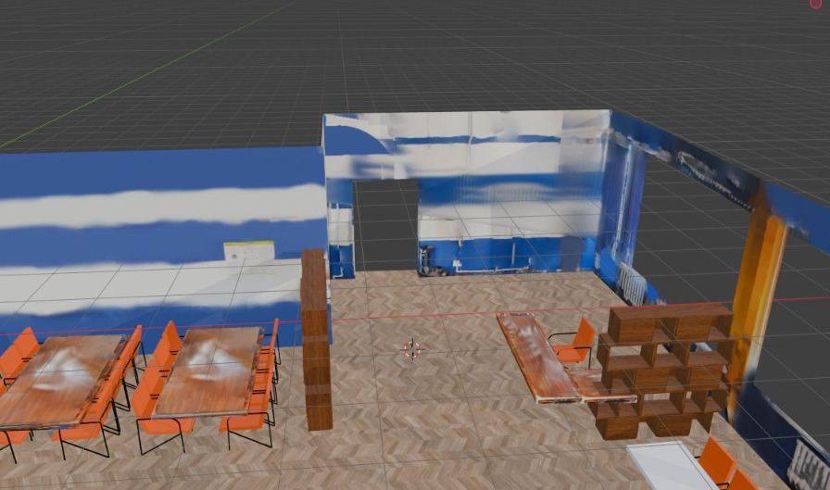
Digital Artefacts
CodeSensei Terminal
OOP preset catalogue
AI code-review inbox
UdonSharp prefab in MetaLab. The answer syncs, so the group reads the same lines.
Twenty-four short OOP explanations, from encapsulation to class versus object.
A five-character code, a C# snippet on /paste, then the Gemini review on the VR screen.

Slide 8
Technical Implementation
Tools and software
Unity, VRChat SDK3, UdonSharp, C# / .NET 10, ASP.NET Minimal APIs, Docker, Render, Google Gemini, GitHub, NUnit.
Development process
1) Align the HTTP contract with VRChat GET-only limits. 2) Build the .NET proxy and 24 presets. 3) Package the UdonSharp terminal. 4) Deploy to Render and verify the live inbox.
VRChat integration
The prefab uses VRCStringDownloader only. URLs are baked to https://codesensei-d5zi.onrender.com. Players must enable Allow Untrusted URLs. Polling respects the 5.5 s VRChat limit.
Technical challenges
Udon cannot POST, so review is a ticket plus /paste. VRChat blocks our host until Allow Untrusted URLs is on. Render Free sleeps. Tickets stay in memory. Lines wrap at 55 characters.
Note: Assets follow VRChat SDK3 / UdonSharp and are ready for the NEXT MetaLab world.

Slide 9
Integration into NEXT-Study Metaverse
Educational use
In the MetaLab hall a student opens an OOP preset or starts a review. The teacher and the group see the same synced text.
User experience
Visitors read 24 short explanations, take a review ticket, paste a snippet, and read a mentor reply fitted to the VR screen.
Further development
Next: a ticket store that survives restarts, more languages, a host that stays awake, extra topics, and a public listing once the prefab stays in MetaLab.

Slide 10
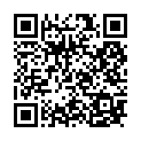
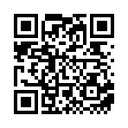
Demo and Project Materials
Project demo
Live demo: https://codesensei-d5zi.onrender.com/paste Health: https://codesensei-d5zi.onrender.com/health
Project materials
GitHub: https://github.com/mamenkomarkus-creator/CodeSensei Prefab: client/CodeSensei.unitypackage API: docs/api.md
Additional resources
VRChat: https://hello.vrchat.com/ NEXT: https://nextstudy.eu/ Docs: presentation-materials/documentation/DOCUMENTATION.md
Note: All links are public. Authorship of artefacts remains with the team.

Slide 11
Thank you!
Questions?

