Slide 1
Benders decomposition

Slide 2
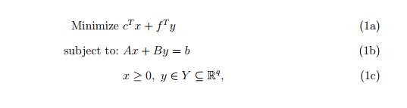
Benders decomposition
we describe Benders decomposition algorithm for linear programs. Consider the following problem

Slide 3

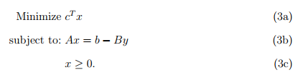
Benders decomposition
Benders decomposition partitions problem into two problems:
(i) a master problem that contains the y-variables, and (ii) a subproblem that contains the x-variables.
master problem
subproblem

Slide 4
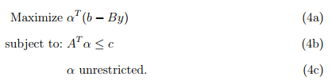
Benders decomposition
master problem
We calculate q(y) by solving its dual. The dual of subproblem is
subproblem
Dual of subproblem

Slide 5
Benders decomposition
subproblem
Dual of subproblem
feasible region of the dual formulation does not depend on the value of y.
if the dual feasible region (4b)(4c) is empty, then either the subproblem is unbounded for some y (in which case the original problem is unbounded), or the subproblem feasible region (3b)(3c) is also empty for all y (in which case (1) is also infeasible.)
if the dual feasible region is not empty…

Slide 6
Benders decomposition
subproblem
Dual of subproblem
Assuming that the feasible region defined by (4b)(4c) is not empty,
we can enumerate all extreme points and extreme rays of the feasible region, where I and J are the numbers of extreme points and extreme rays of (4b)(4c), respectively.
for a given y vector, the dual problem can be solved by checking
(i)whether for an extreme ray , in which case the dual formulation is unbounded and the primal formulation is infeasible,
and (ii) finding an extreme point that maximizes the value of the objective function , in which case both primal and dual formulations have finite optimal solutions

Slide 7
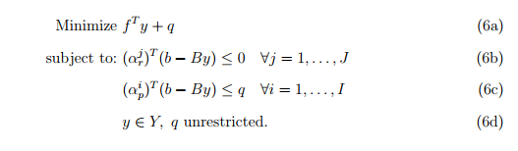
Benders decomposition
Here comes a reformulation of the original problem in terms of q and y-variables:
Since there is typically an exponential number of extreme points and extreme rays of the dual formulation(the dual of subproblem), generating all constraints of type (6b) and (6c) is not practical.
So?

Slide 8
Benders decomposition
Benders decomposition starts with a subset of these constraints, and solves a relaxed master problem," which yields a candidate optimal solution (y*,q*). It then solves the dual subproblem to calculate q(y*).
If the subproblem has an optimal solution having q(y*) = q*, then the algorithm stops.
Otherwise, if the dual subproblem is unbounded, then a constraint(Benders feasibility cut) is generated and
and added to the relaxed master problem, which is then re-solved.
Similarly, if the subproblem has an optimal solution having q(y*) > q*, then a constraint (Benders optimality cut)is added to the relaxed master problem, and the relaxed master problem is re-solved.
Since I and J are finite, and new feasibility or optimality cuts are generated in each iteration, this method converges to an optimal solution in a finite number of iterations

Slide 9

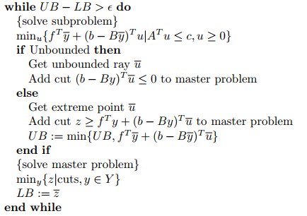
Benders decomposition
The Benders’ Decomposition algorithm can be stated as:

Slide 10


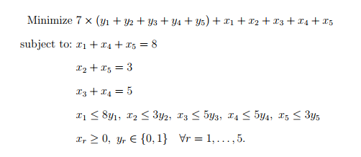
Numerical example

Slide 11

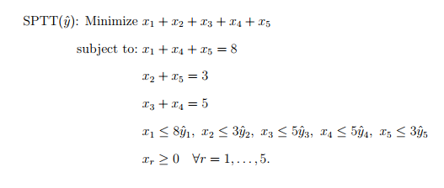
Numerical example

Slide 12
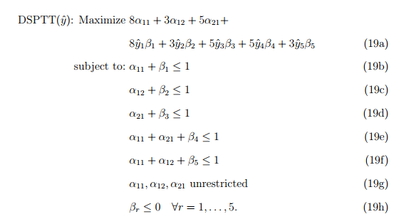
Numerical example

Slide 13
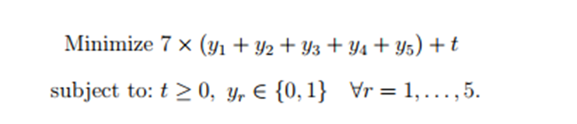
Numerical example
Iteration 1: We first relax all Benders cuts in the master problem, and solve
The optimal solution is y = [0,0,0,0,0]; t = 0. In order to solve the subproblem
corresponding to y, we solve DSPTT (y). DSPTT(y) is unbounded having an extreme ray α11 = 2; α12 = −1; α21 =−1; β1 = −2; β2 = 0; β3 = 0; β4 = −1; β5 = −1, which yields the Benders feasibility cut 8 − 16y1 − 5y4 − 3y5 ≤ 0.

Slide 14
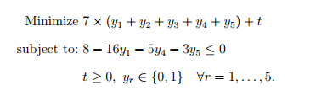
Numerical example
Iteration 2: We add the generated Benders feasibility cut to our relaxed master problem,
and solve
An optimal solution is y = [1, 0, 0, 0, 0], t= 0. We solve DSPTT( y). DSPTT( y) is, again, unbounded. An extreme ray is α11 = 0; α12 = 0; α21 = 1; β1 = 0; β2 = 0; β3 = −1; β4 = −1; β5 = 0, which yields the following Benders feasibility cut: 5 − 5y3 − 5y4 ≤ 0.

Slide 15
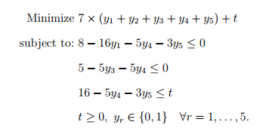
Numerical example
Iteration 4: The updated relaxed Benders master problem is:
An optimal solution is y = [0, 0, 0, 1, 1], t = 8. Note that y is equal to the solution
generated in the previous iteration, and therefore t* = 8. Since t* = t, optimality has been
reached and we stop.

