Slide 1


AI at Jack Henry
How we use it. How we build it. How we bring it to you. 17 Aug 2026 Mike Ames data@jackhenry.com
Mike Ames
data@jackhenry.com
Notes:
Option 2 – Slide Cover

Slide 2


Our Story in Four Beats
01
02
03
04
We use it
We build it
You get it
You get the playbook
Accelerating internal adoption with a team of AI coaches.
Helping product teams embed AI for better customer experiences.
Enabling clients to leverage AI through our products and supporting initiatives.
Bringing our best practices to customers through adoption and coaching.
Jack Henry Confidential

Slide 3

AI @ Jack Henry
OUR STORY
Inside-out: coaches → products → clients → coaching
People
Products
Clients

Slide 4
From Curious to Fluent to Market Leader
AI Literacy
Start small, build a sandbox
AI Proficiency
AI gives you 1 free day a week
AI Native
AI is your operating system
1
2
3

Slide 5

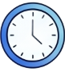



1,500 HOURS automated
AI-driven consolidation of weekly reports across seven layers in Bank.
AI Transformation Program Impact
1323 ASSOCIATES
working with the 8 recently hired AI Coaches
3,200 HOURS saved
AI-assisted clean up of Basecamp eliminated the need for extra help.
Teams in progress
34
37 HOURS regained weekly
AI-optimized Service Desk triage added a new team member to the team.
Teams completed
29
30 HOURS backlog capacity
AI acted as a virtual team member allowing the team to absorb more work.
Teams increased AI maturity by 2 levels
21
75% faster code completion
AI helped developers show significant savings performing complex log analysis.
Teams that are 20% or more productive
22

Slide 6
Beat Apathy by Solving One Passionate Problem this Week
Prep
AI Innovation Week
End
Learning & Setup
Day 1
Day 2
Day 3
Day 4
Day 5
The Showcase
Share what works & doesn’t
Find at least one annoying bottleneck
Paired Learning with Current Work:
Give a team 5 days of hands-on-coaching with their real work, not abstract tutorials.
This is offered as an engagement to our clients

Slide 7



Accelerating Internal AI Adoption
Beat 2 — We build it
Building AI into our Products
Empowering Client AI Usage
Coaches help teams use AI tools to increase productivity and engagement with AI.
Help our product teams build GenAI into our products to make better experiences for our clients.
Enable our clients to leverage AI effectively through our products and supporting initiatives.

Slide 8

Where Is Jack Henry Taking Our Products?

Slide 9
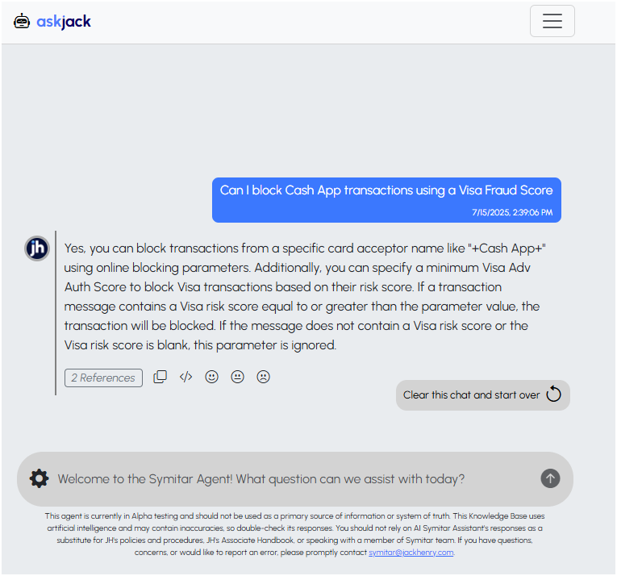
Internal Trials: Service Advisor Agents – Step 1
WHO
Jack Henry technical support reps
GUARDRAIL
Internal only — until accuracy is high
FEEDBACK LOOP
Reps update the knowledge base when the answer isn’t sufficient

Slide 10
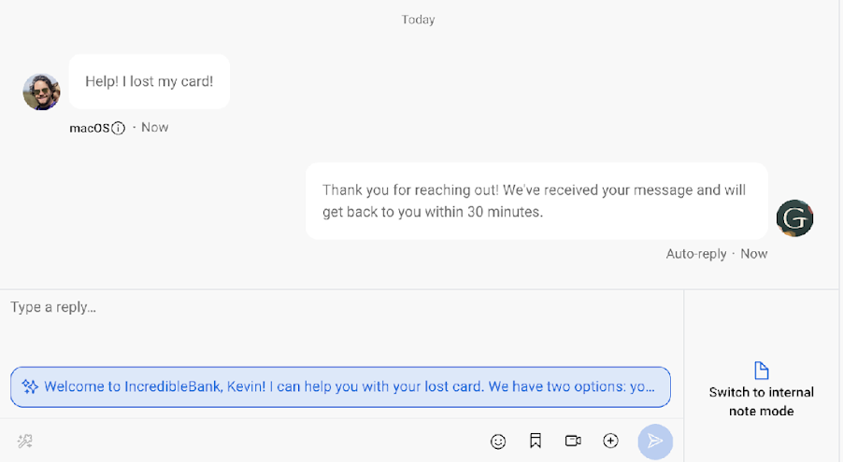
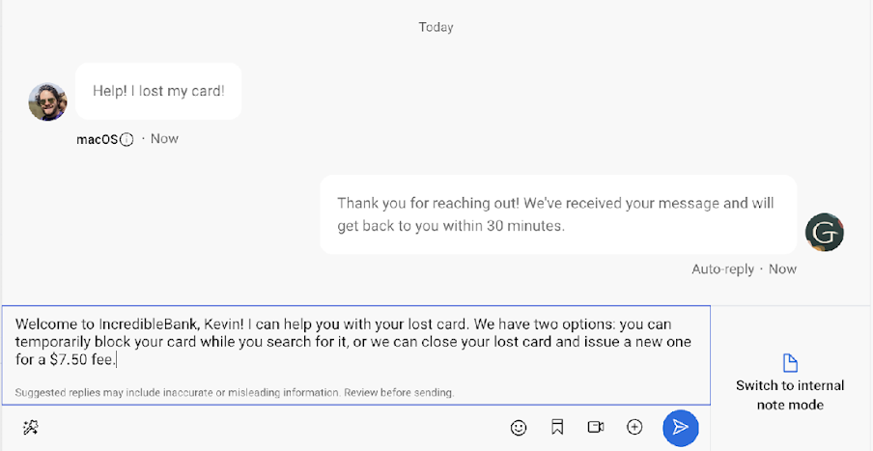
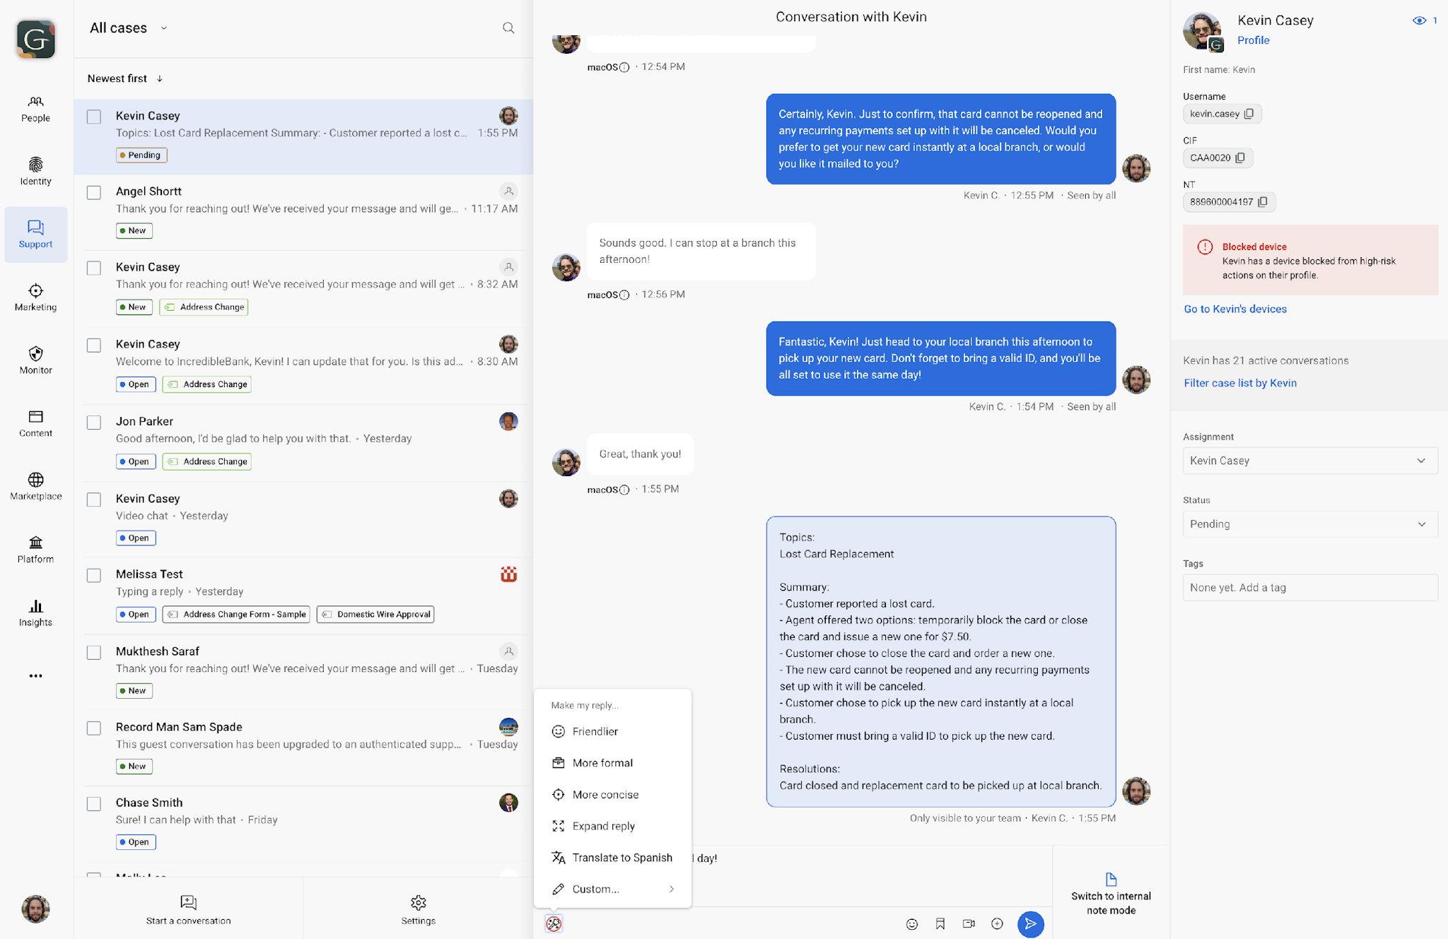
Closed Beta: Auto-suggested Replies - Banno Conversations
The customer asks a question in the Conversation
AI considers the question, consults its database of bank policies, and suggests a response
With one click the rep can accept that response and make more edits

Slide 11
Accelerating Internal AI Adoption
Beat 3 — You get it in the product
Building AI into our Products
Empowering Client AI Usage
Coaches help teams use AI tools to increase productivity and engagement with AI.
Help our product teams build GenAI into our products to make better experiences for our clients.
Enable our clients to leverage AI effectively through our products and supporting initiatives.

Slide 12

You’re Still in Control
Not every client is the same
01
02
Which capabilities
How fast you move
Adopt first, on your timeline
Crawl, walk, or run — you choose
03
04
What guardrails
Which data & tools
Controls matched to your risk
AI only sees what you allow

Slide 13








AI Fabric: Flexible, Secure Foundation for AI
Customized for your needs, your rules, your data
Identity & Access
Client Institution
AI Fabric
Orchestration
Guardrails
Logging
Mix &
Match
Your Models
Cloud and/or
Local LLMs
Your Data
Knowledge Bases & Documents
Your Tools
MCP access to
external systems
Your Way
Custom Agents, Prompts & Instructions

Slide 14
How We Can Help
Three integrated service areas across your AI journey.
1
2
3
Adoption & Coaching
Governance & Policy
Agents & AI Fabric
Building AI-literate cultures through workshops and hands-on enablement.
Establishing guardrails and enterprise AI risk mitigation.
Seamless environmental integration with the AI Fabric.

Slide 15
How We Partner: The Strategic POD
High-impact delivery pairing a Strategic Consultant with a dedicated SME.
Consultant
One accountable pod.
Owns commercial alignment, stakeholder management, and value realization.
AI coaches and engineering working side by side — so adoption sticks and value is realized.
Coach or Engineer
Owns technical execution, architecture, and team enablement.

Slide 16
Sample Flexible Roadmap
Focused engagement - from first experiment to measurable value.
Week 0: Assessment - Figure out what you need and how long it will take.
Determine your maturity level, enroll in training, onboard the team.
WEEK 1
WEEK 2
WEEK 3
WEEK 4–5
WEEK 6
Innovation Week
Adv. Prompting
AI
Accelerator
Optional
Close
Prep → Day 1 → Day 5 → Showcase. Every person solves one real bottleneck.
Level up prompting skills and kick off the AI Accelerator on a priority use case.
Build, iterate, and apply — turning use cases into working tools.
Custom agents, or governance or enhanced engagement.
Showcase results, measure impact.

Slide 17
The flywheel
Coaches build capability → Products embed AI → Clients adopt in product → Coaching scales best practices
RECAP
03 Clients
01 Coaches
02 Products
04 Coaching

Slide 18

Questions
Mike Ames · data@jackhenry.com
Notes:
First – as with any strategy - you must understand what you’re trying to accomplish.
Responsible – Have strong ethics, avoid harming anyone, Comply with laws and regs, maintain our reputation.
Bold – Our customers look to us to position them to compete with other institutions, many of which have almost limitless resources. That means we must position them to be ready for the future, to solve their customers problems, and to always be driving toward excellence.
Balanced – There is a lot of complexity, many options, being balanced gives us optionality, flexibility and adaptability. As with so many other things in life, balance promotes long-term sustainability.

