Slide 1
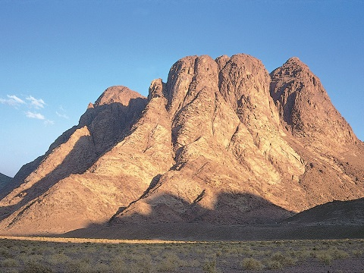
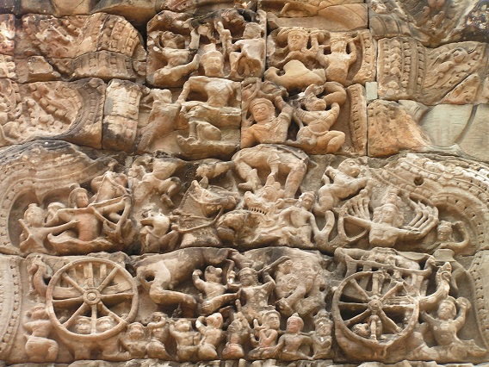
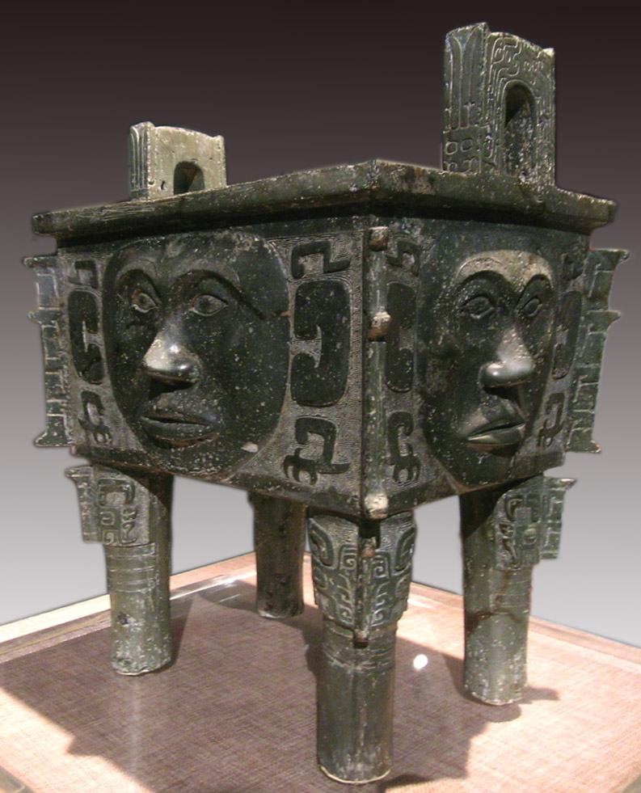
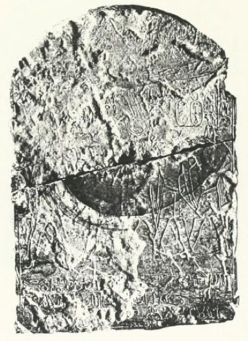
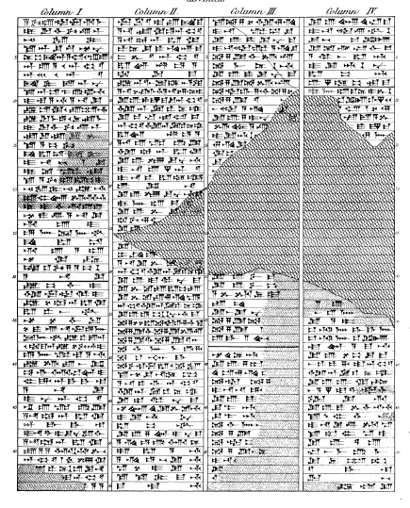
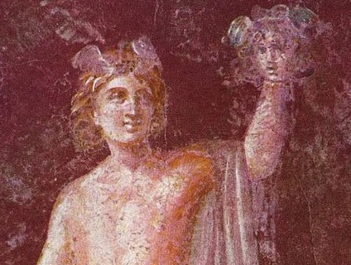
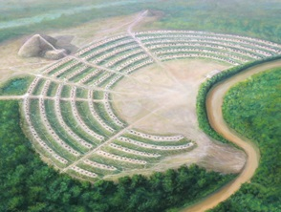
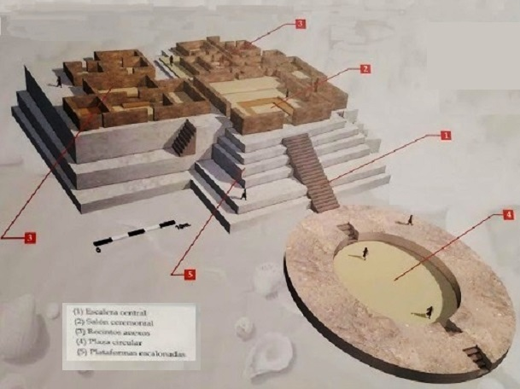
Global Times: -1500 B.C.
Using HAMICE
Hebrew: After the Exodus, God leads Moses to Sinai to declare the law
Africa: Egyptian pharaoh Dedumose 2 subdued by Asiatics; "Megiddo Battle" fought in Kadesh?
Mesopotamia: Babylon king Agum 2 Kakrime offers tax exemptions for idol makers
AmericaNorth: Poverty Point mounds & earthworks complex
India: Battle of the 10 Kings: TritsuBharata king Sudas defeats alliance of 10 kings
China: 100 years after the MingTiao Battle, Shang king ZuXin moves the capital for the 6th time to Bi
Europe: Mycenaeans form the 1st major Greek culture under the Perseid Dynasty; Athens Erechtheid dynasty
AmericaSouth: NorteChico /Caral pyramid civilization declines

Slide 2
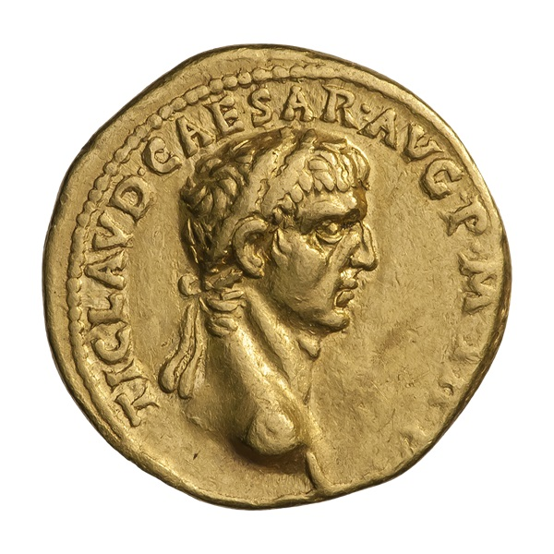
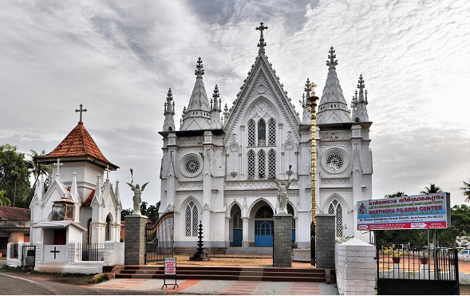
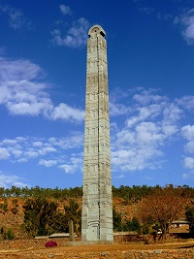
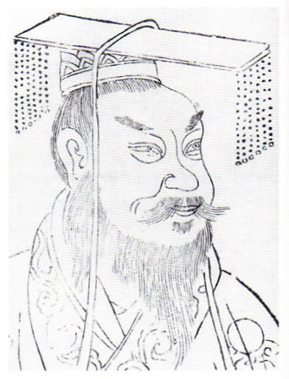
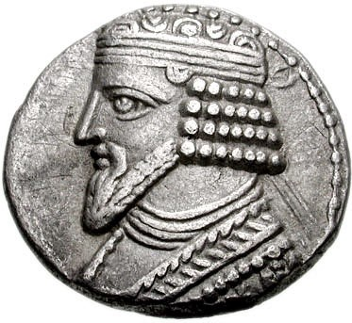
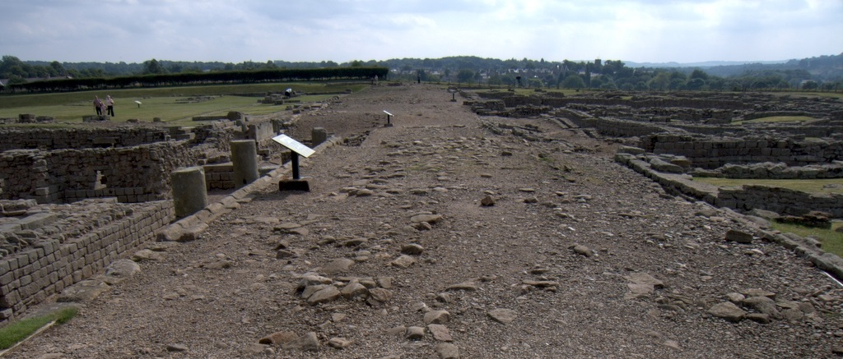
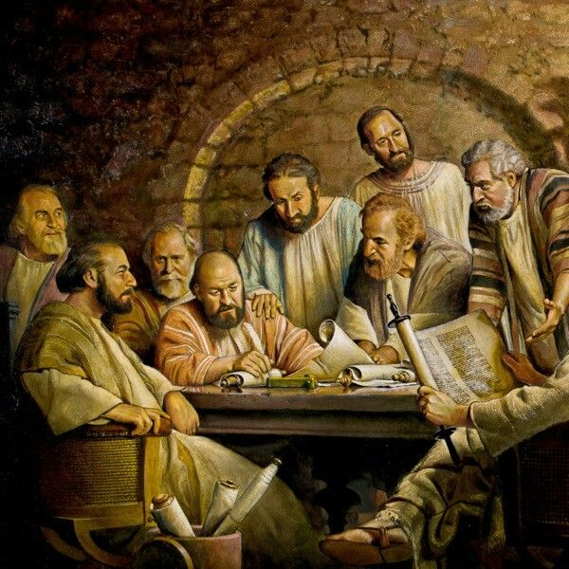
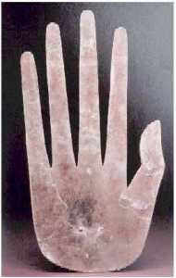
Global Times: 50 A.D.
Using HAMICE
Hebrews: Jerusalem high priest Ananias accused of violence but acquitted by emperor Claudius
Africa: West Nok & East Axum cultures still thriving
Mesopotamia: Parthia dynasty Arsacid king Gotarzes 2 rules Parthian Empire
Christians: Apostles hold 1st Council of Jerusalem; Paul&Silas 2nd mission
India: Kerala state Kodungallur city allows Saint Thomas to build 7 churches
China: East Han emperor #1 Guangwu regains control of kingdom thru strategic military leadership
Europe: Rome emperor Claudius begins conquest of Britain; conflicts with Parthians continue
Americas: Ohio Hopewell culture superseded older Adena

