Slide 1
Flowmon
Overview for MAMI Management and Measurement Summit
Pavel Minarik, Chief Technology Officer

Slide 2




























Customer references
is an international vendor devoted to innovative network traffic & performance & security monitoring
700+ customers 30+ countries
First 100G probes in the world
Strong R&D background
European origin
Notes:
Flowmon equals ultimate technology that no one can compete with, satisfied customers across all verticals, scales and continents including 5 minitistries of defense, 5 of top 10 Telcos in the world, the biggest financial institutions and manufacturers. We are 100% channel oriented vendor who invest all our technology in development and partner support.

Slide 3





How was Flowmon Started?
2005
2007
2010
2015
First 10GE NetFlow monitoring Probe
NIC of own design using FPGA
Non-sampled flow data on 10Gbps speed
Company started under INVEA-TECH name
University/CESNET spin-off
Network Behavior Analysis introduce
Security & anomaly detection use-cases
Doing business outside of Czech Republic
Strong focus on performance monitoring
Network/Application Performance

Slide 4



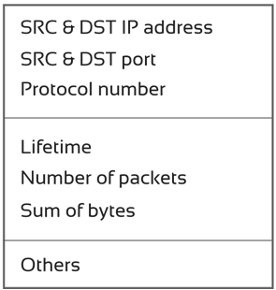




Flow Monitoring Principle
Flow Export
Start Duration Proto Src IP:Port Dst IP:Port Packets Bytes …
9:35:24.8 0.1 TCP 192.168.1.1:10111 -> 10.10.10.10:80 2 80 …
9:35:24.8 0 TCP 192.168.1.1:10111 -> 10.10.10.10:80 1 40 …
9:35:25.0 0 TCP 10.10.10.10:80 -> 192.168.1.1:10111 1 40 …
9:35:25.0 0.9 TCP 10.10.10.10:80 -> 192.168.1.1:10111 5 1231 …
9:35:25.0 0.7 TCP 10.10.10.10:80 -> 192.168.1.1:10111 4 862 …
9:35:25.0 0.5 TCP 10.10.10.10:80 -> 192.168.1.1:10111 3 362 …
9:35:25.0 0.3 TCP 10.10.10.10:80 -> 192.168.1.1:10111 2 156 …

Slide 5
Flow vs. Packet Analysis
 | Strong aspects | Weak aspects
Flow data | Works in high-speed networks Resistant to encrypted traffic Visibility and reporting Network behavior analysis | No application layer data Sometimes not enough details Sampling (routers, switches)
Packet analysis | Full network traffic Enough details for troubleshooting Supports forensic analysis Signature based detection | Useless for encrypted traffic Usually too much details Very resource consuming
Solution?
Take advantage of strong aspects in one solution
Versatile and flexible Probes for visibility into all network layers – Flowmon long-term strategy

Slide 6

Flowmon Probes
Versatile and flexible network appliances
Monitoring ports convert packets to flows
Un-sampled export in NetFlow v5/v9 or IPFIX
Wire-speed, L2-L7 visibility, PCAPs when needed
L2
L3/L4
L7
MAC
VLAN
MPLS
GRE tunnel
OTV
Standard items
NPM metrics
RTT, SRT, …
TTL, SYN size, …
VxLAN
ASN (BGP)
Geolocation
NBAR2
HTTP
SNI
DNS
DHCP
SMB/CIFS
VoIP (SIP)
Email
SQL

Slide 7

NPM Principles
Client
TCP handshake
Client request
Server response
Syn
Ack
Req
Probe
Server
Syn,
Ack
Ack
Data
Data
Data
Data
RTT
SRT
Delay
Round Trip Time – delay introduced by network
Server Response Time – delay introduced by server/application
Delay (min, max, avg, deviation) – delays between packets
Jitter (min, max, avg, deviation) – variance of delays between packets

Slide 8



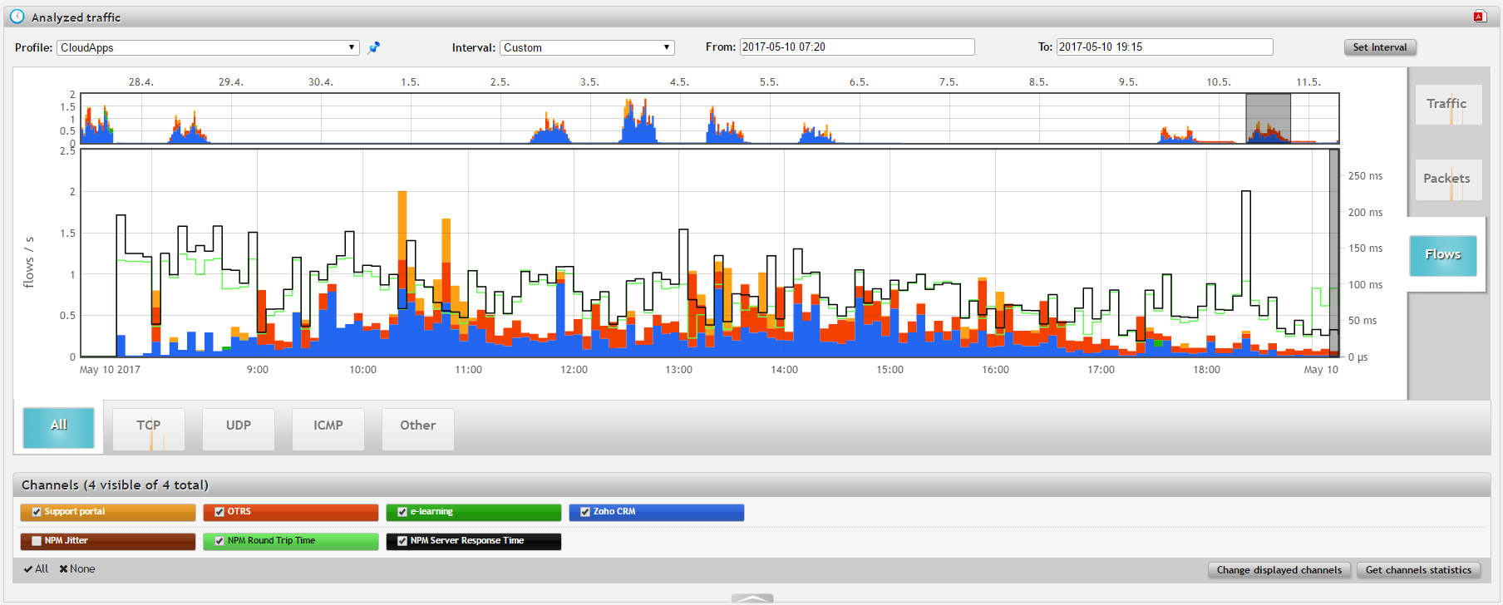
CLOUD APPs PERFORMANCE
Get quick insight, understand deviations
NPM metrics (RTT, SRT, Jitter)
In time visualizations per application
Time axis on the right side of traffic chart
Selection of current view/application

Slide 9
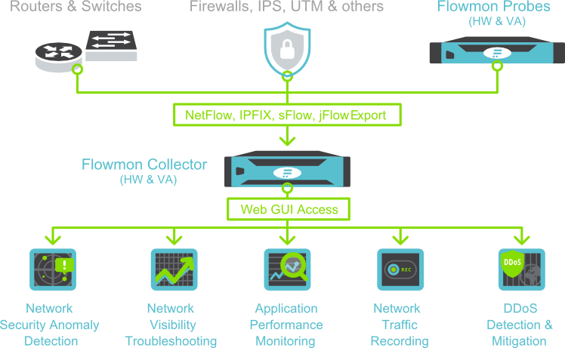
Architecture
Flow export from already deployed devices
Flow data export + L7 monitoring
Flow data collection, reporting, analysis
Flowmon modules for advanced flow data analysis

Slide 10
Performance monitoring, visibility and security with a single solution
Pavel Minarik
pavel.minarik@flowmon.com

