Slide 1
Path Transparency Observatory
Demo of the Web User Interface
Stephan Neuhaus and Mirja Kühlewind
Brussels, Oct 21, 2016

Slide 2
Path Transparency Observatory - PTO
Store
raw data and
computed conditions
that relate to path transparency, enabling
exploration and
analysis
with a special focus on
easing replication and
providing insights to the general public

Slide 3
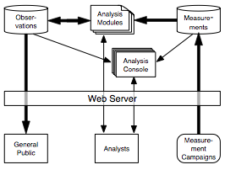
PTO - Architecture
Raw measurement storage
manual or automated upload per measurement campaign
Analyzers
generate observations from measurements
Jupyterhub for interactive analysis and analysis development
Web UI for general public
access to selected observations from vetted analysis modules
Notes:
arrows thickness represents the volume of the data flow
webserver nginx
general public: limited access as some data can contain personally identifiable information

Slide 4
PTO - Measurements
Raw data stored from measurement campaigns
Data format most appropriate to the tool/campaign
IPFIX, tracebox, json, mPlane results …
Stored in HDFS for easy clustering
metadata stored in MongoDB

Slide 5
PTO - Observations
Path Transparency Observation {P, t, c, v}
path designator P: sequence of identifiers for path along which the observation was taken (initiator, target, and other point on along path between them, as e.g. network-layer addresses, prefixes, or AS numbers)
temporal scope t: when a observation was taken and is considered valid
condition c: condition observed along the path (e.g. whether ECN causes connectivity failure, whether a TFO cookie request succeeds); inherently boolean, but may contain associated values v.
Conditions have symbolic names, arranged in hierarchy, e.g.,
ecn.connectivity.works
ecn.negotiation_attempt.succeeded
Stored in MongoDB for ease of clustering and querying

Slide 6
PTO - Analyzers
Analyzers produce Observations
based on measurements in the raw data or other Observations
Observations contain the name of the analyzer…
…and the commit identifier of the exact analyzer version
This enables reproducibility and also easier filtering:
“Give me all observations from analyser x, excluding (buggy) commit 1a2b3c4d”
Analysis console is Jupyterhub, enables easy exploratory analysis of measurements and observations

Slide 7
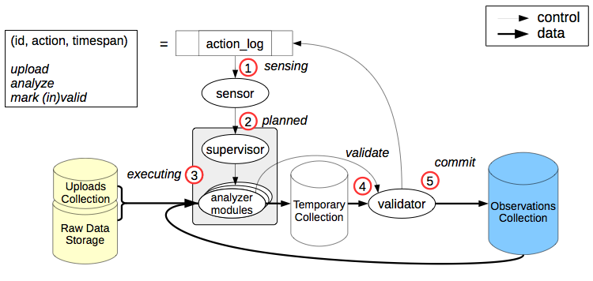
Automatic Analysis and Reanalysis
Research is inherently exploratory, but requires immutable raw data for repeatability.
Observations contain all information required to regenerate them.
Sensors trigger on new data uploads, rerun analysis on data replacement.
Observations marked deprecated due to invalidated raw data remain available.

Slide 8
PTO - State of Development
PTO backend infrastructure up since ~March
PTO measurement upload software since ~April
PTO condition-querying REST service since ~May
PTO query API working since ~June
…but being constantly optimised
PTO Web UI in active development since ~July
…now in Beta testing inside MAMI
…about to go live in December

Slide 9
Example measurement study (1):
ECN connectivity testing
Explicit Congestion Notification (ECN): TCP extension to signal congestion before dropping packets
Negotiation between both endpoints and network support needed
ECNspider: A/B testing using PATHspider for ECN connectivity testing:
list of target IP
addresses
TCP connection w/o ECN
vantage
point
(running
ECNspider)
target
endpoint
(public
webserver)
Internet
TCP connection w/ ECN
observations

Slide 10
Example measurement study (1):
ECN observations
ECN.connectivity.{works, broken, transient, offline}
works: all TCP w/o ECN connections and all TCP connections w/ ECN worked
broken: all TCP w/o ECN connections and no TCP connections w/ ECN worked
transient: TCP connections w/ ECN did not work
offline: no TCP connections could be established at all
ECN.negotiation_attempt.{succeeded, failed}
succeeded: ECN was successfully negotiated
failed: target host did not support ECN

Slide 11
Example measurement study (3):
ECN path transparency
Measuring path-dependency based on different vantage points
Vantage Points
Alexa top 1M
websites
London
works
works
Webserver
New York City
broken
Singapore
path-dependent
TCP w/o ECN connection always work but TCP w/ ECN never

Slide 12
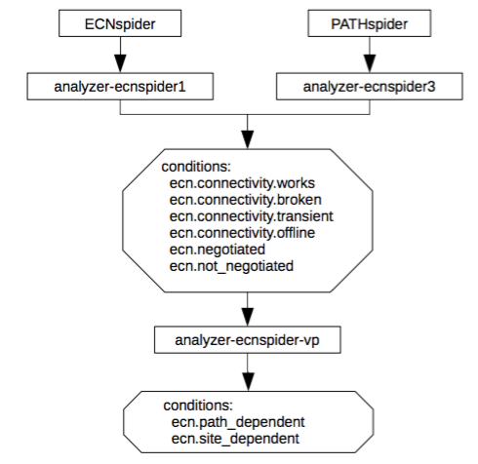
Example measurement study (4):
ECN path transparency analyses
Additional analysis tool in PTO (analyzer-ecnspider-vp) compares observations from different vantage points and derived a path-dependent observation:
ecn.path_dependent: from some vantage points ecn.connectivity.works and some ecn.connectivity.broken
ecn.site_dependent: from all vantage points ecn.connectivity.broken
ecn.negotiation_attempt.succeeded
ecn.negotiation_attempt.failed

Slide 13
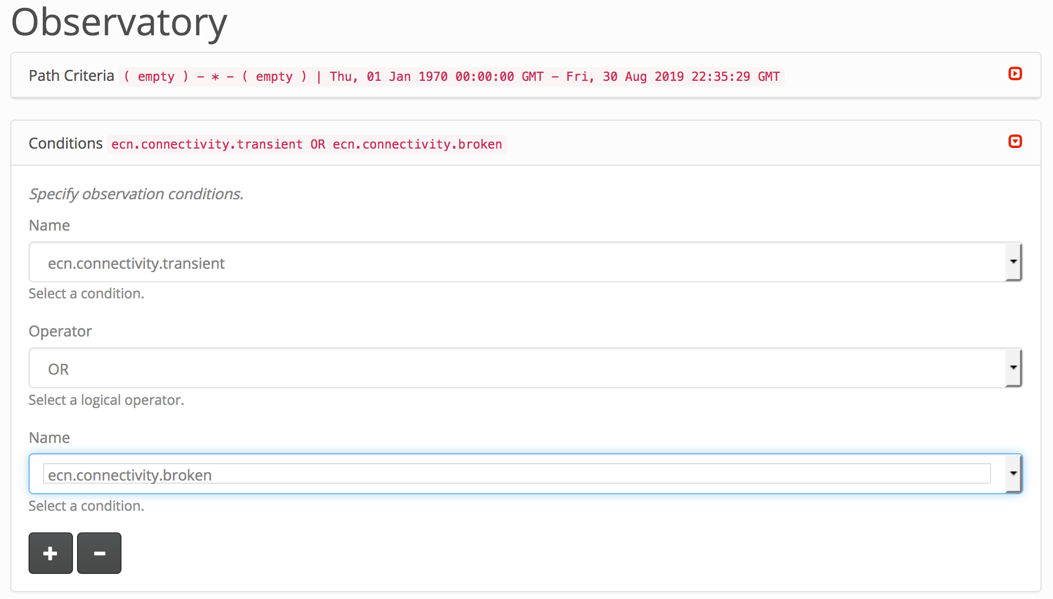
PTO Web UI: Query Parameters

Slide 14
PTO Web UI
User selects criteria in PTO UI:
Date and time
Path
Condition(s)
Submits query to PTO
PTO queries mongo database according to submission
PTO returns JSON to PTO UI
PTO UI renders JSON

Slide 15
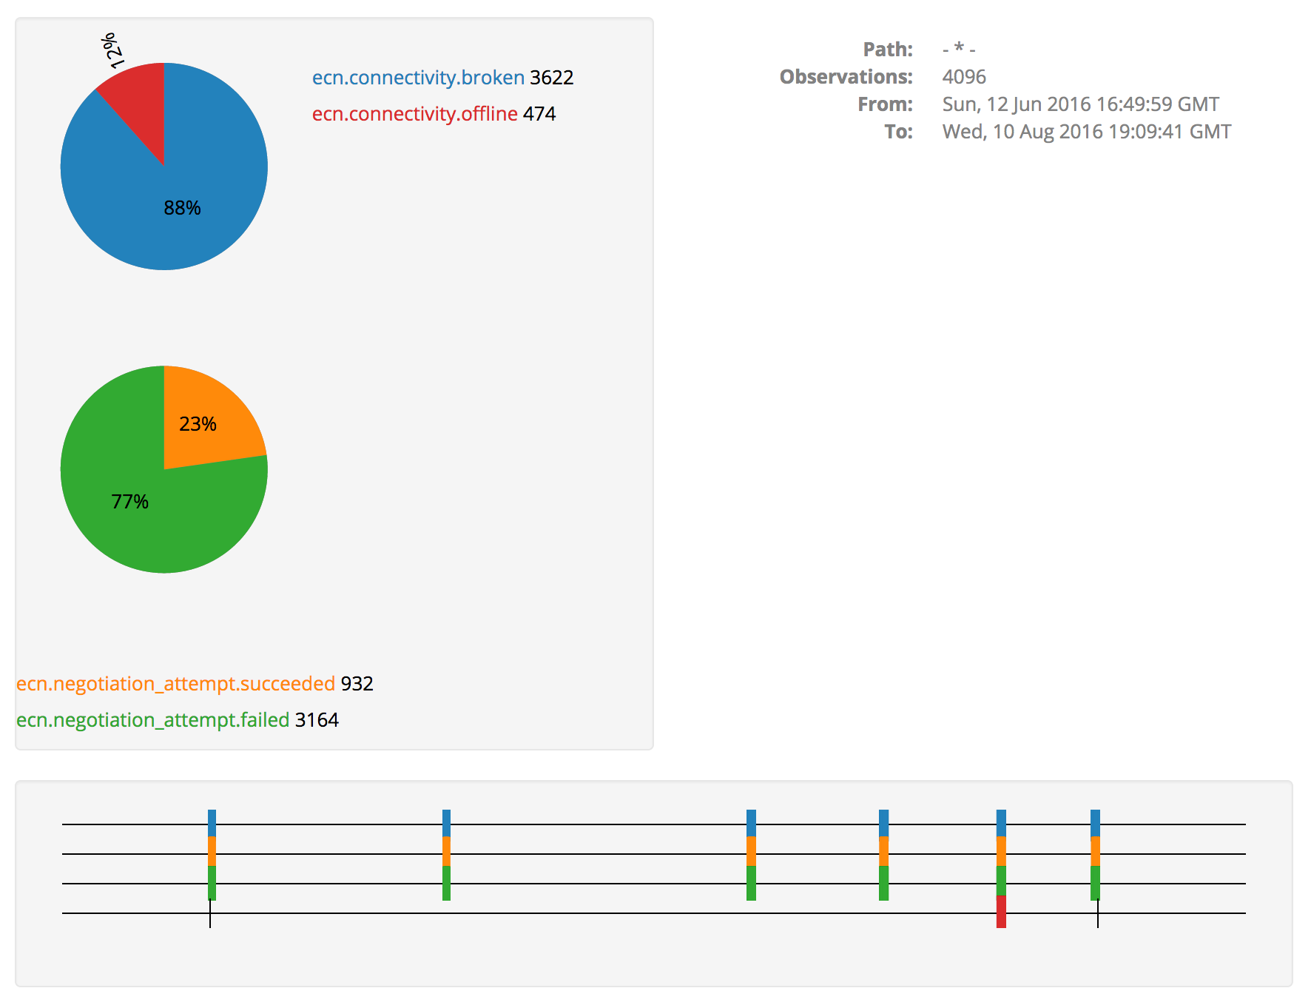
PTO Web UI: Rendering Results (1)
Percentages of mutually exclusive conditions
Clickable measurement
Timeline

Slide 16
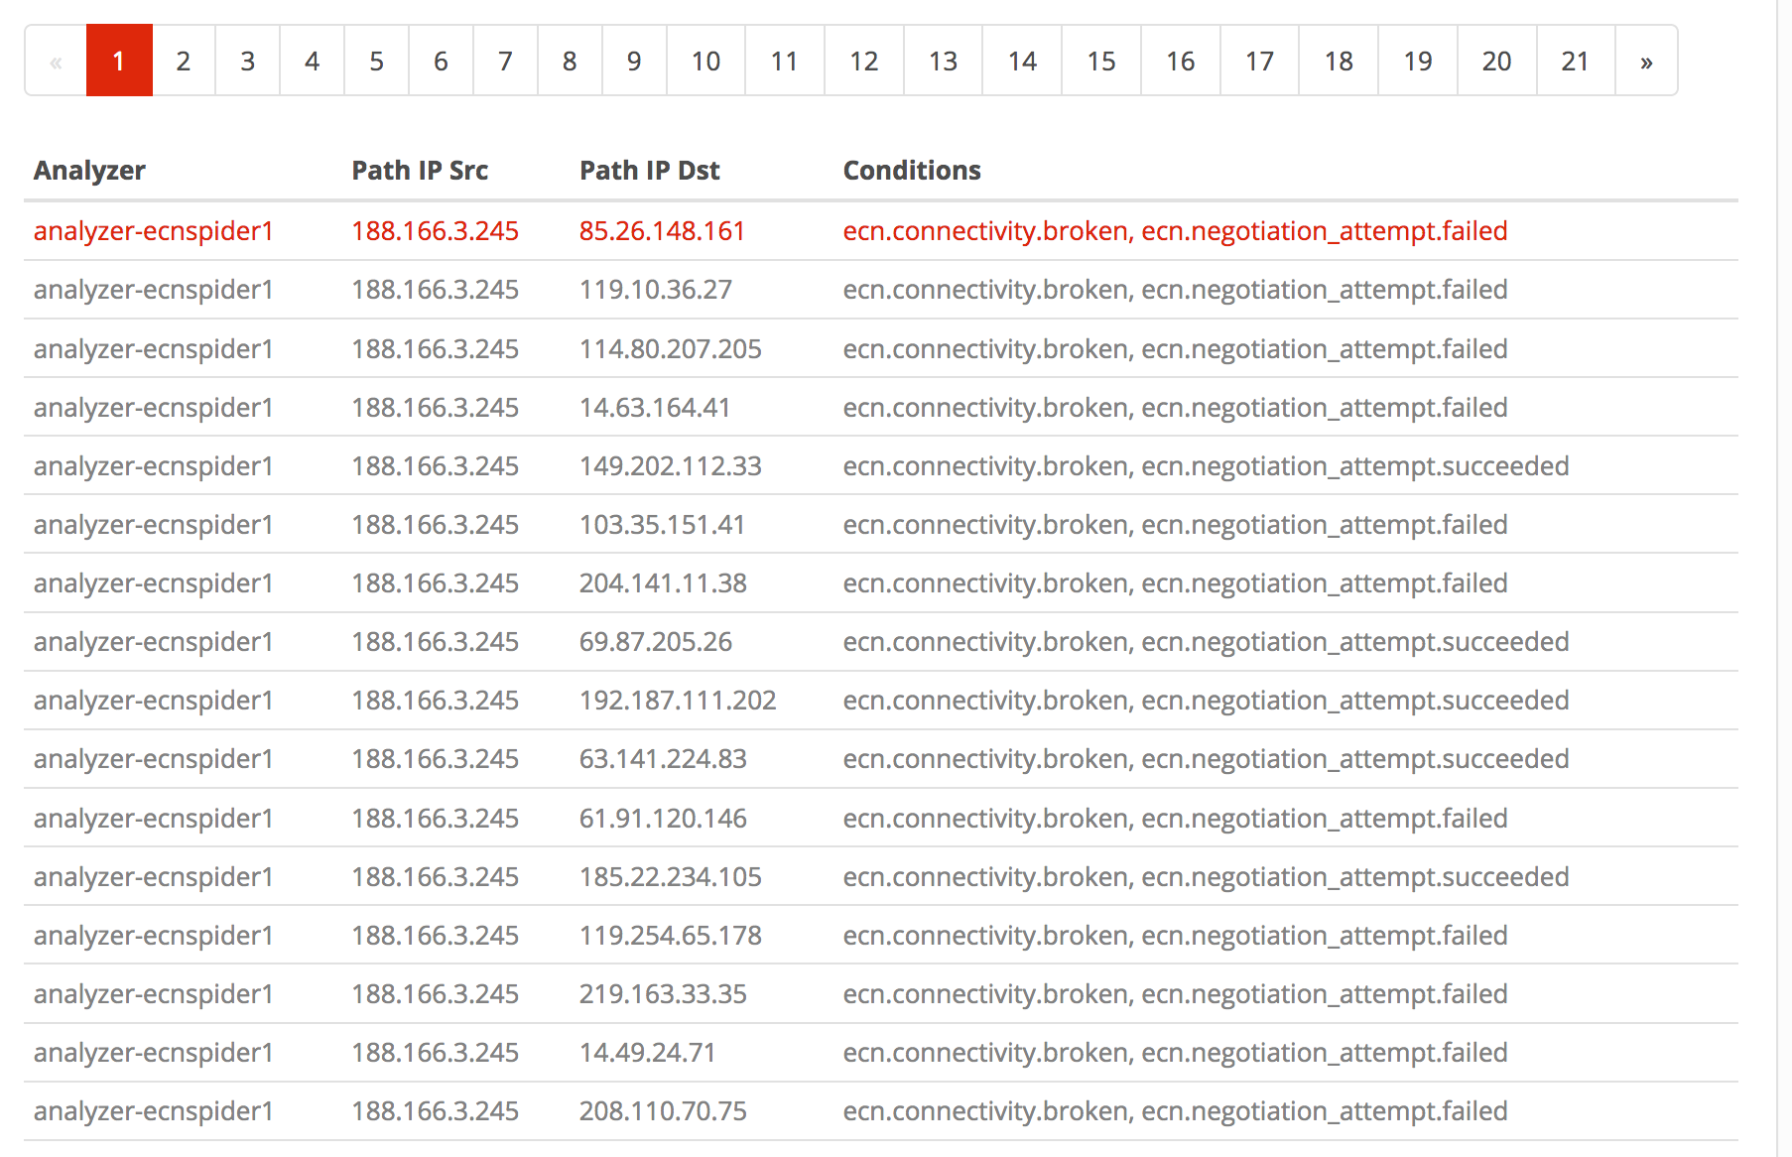
PTO Web UI: Rendering Results (2)
Clickable row
Table View

Slide 17
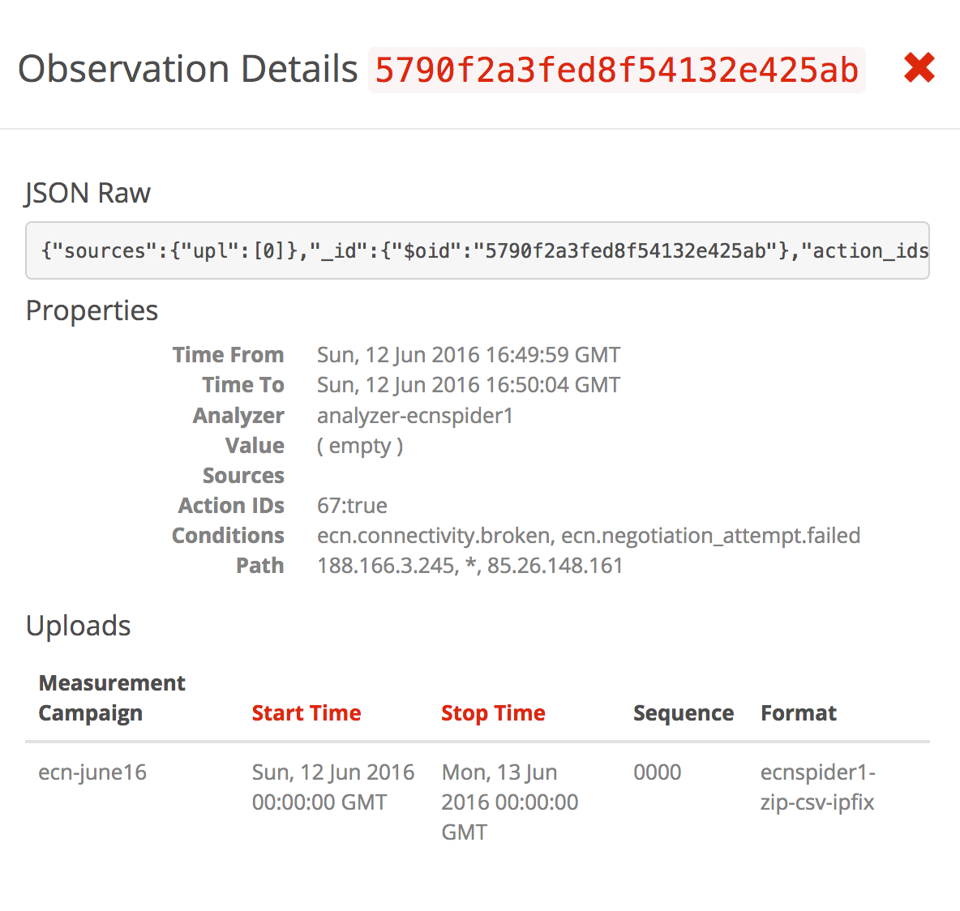
PTO Web UI: Rendering Results (3)

Slide 18
PTO on the web
Path Transparency Observatory web UI:
https://observatory.mami-project.eu/#/observatory
All sources on GitHub!
data upload: https://github.com/mami-project/observatory-upload
core: https://github.com/mami-project/pto-core
web interface: https://github.com/mami-project/pto-web

