Slide 1
WP4: Standardisation, Dissemination & Exploitation
Diego R. Lopez (TID)

Slide 2
A Few Remarks on the WP4 Tasks
Standardisation
Key aspect, taking into account project technical goals
Significant results from all the other WPs
Publications, Workshop and Conference Activities
Supported by previous encouraging results
Exploitation and Innovation Management
Connected with ongoing initiatives of the industrial partners
Academic Exploitation
Activity follow-up through the project collaboration mechanisms
Public Communication Activities
Steps taken even before the official start of the project
Middlebox Observatory Web Site Development and Maintenance
Data management and accessibility

Slide 3
WP4 Goals
Monitor standards and other relevant activities that can contribute to the project objectives
Identify opportunities for new work to provide contributions and publish/influence new standards
Support the standardisation of the MCP as a basis for large-scale deployment
Produce guidelines for vendors and operators on observed limitations to enhance future development and deployment processes
Contribute to open-source projects the produced results on measurement techniques, transport stack flexibility, as well as NFV-based implementation of the MCP
Build visibility of the project and its results among the research and scientific community
Maximise exploitation of the project outcomes, ensuring a successful market orientation of them
Ensure application of project results by industry

Slide 4
WP4 Deliverables
D4.1 - Data Management Plan. M4
Plan for managing the data generated by measurements and open access to that data
D4.2 - Initial Standardisation, Dissemination, and Exploitation Report. M6
D4.3 - Intermediate Standardisation, Dissemination, and Exploitation Report. M18
D4.4 - Final Standardisation, Dissemination, and Exploitation Report. M30
Summarise the achievements about standardisation, dissemination, and exploitation of MAMI results, including a report of the communication activities

Slide 5
WP4 Tasks
T4.1 Standardization
Focused on MCP and its ancillary support
NFV applications and implementations
T4.2 Publications, Workshop and Conference Activities
Journals, magazines, conferences, and workshops as well as operator conferences
T4.3 Exploitation and Innovation Management
Identify and collaborate with other organisations, key market players and potential users
Identify key application(s) of the project results and define the maturity of the technology
T4.4 Academic Exploitation
Integrate aspects of the research into advanced teaching modules of involved academic partners
PhD school on measurement infrastructure and datasets, and about middlebox (co-)operation
T4.5 Public Communication Activities
Visual and Internet identity: Website, social networking and general promotion material
T4.6 Middlebox Observatory Web Site Development and Maintenance
Making datasets accessible and usable

Slide 6
WP4 Tasks and Partners
Partner | PM | T4.1 Standardization | T4.2 Publications, Workshop and Conference Activities | T4.3 Exploitation and Innovation Management | T4.4 Academic Exploitation | T4.5 Public Communication Activities | T4.6 Middlebox Observatory Web Site Development and Maintenance
1. ETH | 10 | ✓ | ✓ |  | ✓ | ✓ | ✓
2. TID | 8 | ✓ | ✓ | ✓ |  | ✓
3. ULg | 2 |  | ✓ |  | ✓
4. UoA | 8 | ✓ | ✓ |  | ✓
5. ZHAW | 4 |  | ✓ |  | ✓ | ✓ | ✓
6. SRL | 2 |  | ✓ |  | ✓
7. Nokia | 8 | ✓ | ✓ | ✓

Slide 7
T4.1 - Standardisation Targets
IETF transport-related groups
TAPS, QUIC, tcpm, tsvwg as well as PLUS activity and IAB StackEvo Program
Other IETF groups
I2NSF: Interface for security function management
Multi-context trust and security: LURK and ACME
IRTF groups
MAPRG: Measurement collection, processing and access
NFVRG: VNF deployment. Trust models and network-application communication
ETSI
NFV IFA and EVE: Management and orchestration for MAMI-enhanced VNFs
NFV SEC: Multi-context trust and security mechanisms
MEC: MAMI-enhanced VNFs as part of mobile edge (fog computing) deployments
NGP: Middlebox-friendly transport, transport-friendly middleboxes
ONF: App-network interfaces as part of the intent NBI initiative
5G activities: As part of the network support for new applications

Slide 8
T4.1 - Standardisation Activities on MCP (up to M6)
Follow up of the ACCORD workshop at IETF 95 (April 2016)
Alternatives to Content Classification for Operator Resource Deployment
Preparation of the PLUS BoF for IETF 96 (July 2016)
Path Layer UDP Substrate
Collecting support from key players in the IETF transport arena
Coordination with the proponents of QUIC
Alignment with MCP goals
Co-chairing of the planned QUIC BoF at IETF 96
IETF related documents
draft-trammell-spud-req
draft-kuehlewind-spud-use-cases
Building awareness in ETSI NFV
Report on MCP goals at NFV#14 (May 2016)

Slide 9
T4.1 - Standardisation Activities on Measurement (up to M6)
HOPS RG reconstituted as the Measurement and Analysis for Protocols (MAP) RG
Slightly wider scope
Co-chaired by ETH
MAP RG expected to be confirmed at IETF 96
Measurement results presented at IETF 95 (April 2016)
IETF related documents
draft-trammell-mplane-protocol
Building awareness in ETSI NFV
Report on measurement results and plans at NFV#13 (February 2016)

Slide 10
T4.1 - Standardisation Activities on Transport Interfaces and Security (up to M6)
Exploring the interoperability of the MAMI FTL (Flexible Transport Layer) will strive to interoperate with the TAPS facility
Preparation of the LURK BoF for IETF 96 (July 2016)
Limited Use of Remote Keys
Related to multi-context security and trust
IETF related documents
draft-ietf-taps-transports
draft-mglt-lurk-tls-use-cases

Slide 11
T4.1 – Brief on Standardisation Activities beyond M6
Discussions on PLUS and LURK at IETF 96 (July 2016)
PLUS: “A transport-independent method to signal flow semantics under transport and application control”
Not chartered, mostly because of emotional arguments
Work to make it progress ongoing, connected to the IAB Stack Evolution Programme
LURK: “Scheduled with the objective of discussing approaches to mitigating security risks to TLS private keys”
Exploring the applicability of temporary certificates via the ACME interfaces
And the feasibility of crypto oracle functions
NFV#15
Initial discussions on LURK and the multi-context trust approaches at NFV SEC

Slide 12
T4.2 – Conferences and Workshops
Dagstuhl Seminar on Global Measurements: Practice and Experience, Schloss Dagstuhl (January 2016)
https://www.dagstuhl.de/en/program/calendar/semhp/?semnr=16012
CleanSky Workshop, Heidelberg (February 2016)
http://www.cleansky-itn.org/conference-series/heidelberg/
ICIN 2016, Paris (March 2016)
http://www.icin.co.uk/
Cisco/Ecole Polytechnique Networking Innovation and Research Symposium, Paris (March 2016)
http://www.cisco.com/web/FR/events/2016/ecole_polytechnique/index.html

Slide 13
T4.2 – Conferences and Workshops beyond M6
Applied Networking Research Workshop
https://irtf.org/anrw/2016/
1 full and 2 short papers
CoNEXT 2016
http://conferences2.sigcomm.org/co-next/2016/
1 full paper
Submissions
ACM Sigcomm Computer Communication Review
http://www.sigcomm.org/publications/computer-communication-review
1 technical paper with repeatable results, 1 technical paper
Passive and Active Measurement
https://research.csiro.au/pam2017/
1 full paper

Slide 14
T4.3 – Exploitation Plans
MCP-based signalling to be applied to the UNICA, Niji, and virtualised home environment initiatives
UNICA is Telefonica’s telco cloud, redefined to address NFV
Niji is a Telefonica anonymization and optimisation service currently deployed into the 3G/4G network
The virtualised home environment is the first commercial NFV pilot
Initial contacts with Telefonica’s corporate and business units dealing with technology and network planning
MAMI being considered for many different areas of Nokia’s product portfolio: mobile edge and core, Software Defined Networking (SDN), and Content Distribution Network (CDN)
The standardisation around from LURK expected to have a great impact on the CDN product

Slide 15
T4.3 – Exploitation Through Industrial Contacts
Active collaboration with GSMA
In the framework of GSMA’s POP project
“Identifying differences and possible impacts between mobile network implementations and IETF Protocols (and discovering methods to improve these.”
Alignment of observatory data collection and access
Coordination on MCP-related approaches
RIPE 72, Copenghagen (May 2016)
https://ripe72.ripe.net/
EC 1st Stakeholder Consultation Workshop, Brussels (June 2016)
https://www.broadbandmapping.eu/wp-content/uploads/2016/07/Agenda-Workshop_Mapping-Broadband-Services-in-Europe.pdf
Introducing MAMI at the SDN World Congress, The Hague (October 2016)

Slide 16
T4.4 – Academic Exploitation Plans
ETH Zurich
Two semesters’ thesis projects (to end July 2016) on MCP prototyping and measurement using Pathspider
One masters’ thesis project thesis project includes implementation and proof of concept operation of the observatory, together with ZHAW
Considering a potential doctoral thesis position
ZHAW
Offering a number of Bachelor and project theses on Linux kernel development and observatory operation (together with ETHZ)
Plans on offering more theses, depending on the project’s needs.
MCP will serve in teaching security and risk analysis, so that protocol users have a realistic sense of what kind of security they can expect
University of Aberdeen
MAMI results to contribute to its portfolio of research and standardisation activities
MAMI-focused research will also further the work of postgraduate students.
Simula Research Laboratory
Contributions to the PhD summer school that will be organised later in the project.
University of Liege
Master theses and research projects currently being proposed to students for next academic year, on implementing the middlebox simulator, as well as analysing the observatory dataset
Leverage the knowledge and experience acquired within MAMI in advanced networking courses

Slide 17




T4.5 – Communication Actions
The MAMI visual identity
Logos (and stickers…)
The MAMI domain and website
The mami-project.eu domain name has been secured: web site, observatory and project repository
https://mami-project.eu/ on-line since September 2015
In January 2016, the MAMI webpage was according to the project structure and goals
Main means for communication and dissemination
The MAMI Twitter profile
The profile https://twitter.com/mamiproject was created in March 2015
Stats by the end of June 2016: 47 followers, 108 tweets that got 52 likes
By mid October: 85 followers, 424 tweets that got 67 likes
Active coordination with the FIRE Dissemination WG

Slide 18
T4.5 – Public Repositories
MAMI organization hosted on github.com
https://github.com/mamiproject
Contains several repositories for open-source software and public information created by the project
Up to 12 by June 2016
MAMI intends to publish several open source releases
Plans to distribute software via software distribution systems
Debian Operating System - https://www.debian.org/
Python Package Index2 - https://pypi.python.org/
The project will keep contributing packages to these and other systems

Slide 19
T4.6 – The Goals of Data Management
Managing the data generated by measurements
Open access to that data
“Data Management Plan” has a specific meaning in H2020 projects
What types of data will the project generate/collect?
What standards will be used?
How will this data be exploited and/or shared/made accessible for verification and re-use?
How will this data be curated and preserved?
And in addition: How will this data contribute to the project innovation impact?
Considering Management of
Raw data derived from MAMI measurements (stored at the MAMI observatory)
Data generated through the query interface (dynamically generated by the MAMI observatory)
MAMI software (stored at Github)

Slide 20
T4.6 – Data Management Plan
Initial discussion of the Observatory architecture and software
Description of the Observatory datasets
Structured around raw data and observations derived from them
Access open to observations, not to raw data
Commitments on archiving and preservation
Description of data produced by the different sources considered to date
PathSpider, a generalized tool for A/B functionality tests
Tracebox, based on accessing remote servers from vantage points
Copycat, to detect differential treatment of UDP and TCP traffic
Revelio, detecting IPv4 network address translation on access networks

Slide 21
T4.6 - Data Access Policy
Anyone can query data in the MAMI observatory
MAMI-created raw data in the observatory are "all rights reserved” and will be given out to researchers on a contractual basis
Query results are CC BY
ND and NC are not essential – Even could hamper further exploitation, especially NC
Anyone can (try to) combine data sets obtained through MAMI queries with other data
Host data not originating in MAMI on a best-effort basis
Data not available online elsewhere
Data available but nice to have close to MAMI
Do not host if foreign data is not compatible with MAMI’s data access policy
But open to specific agreements with third parties
MAMI data has priority

Slide 22
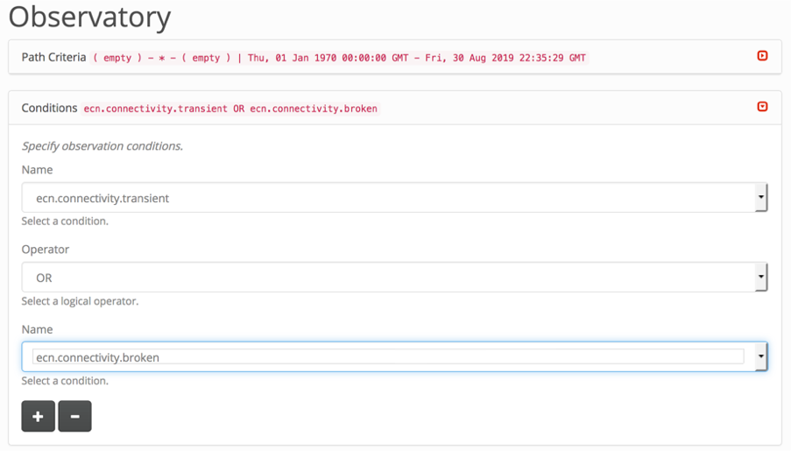
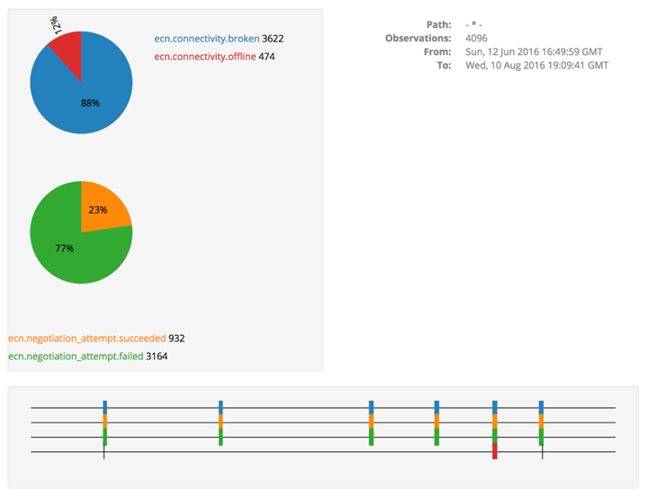
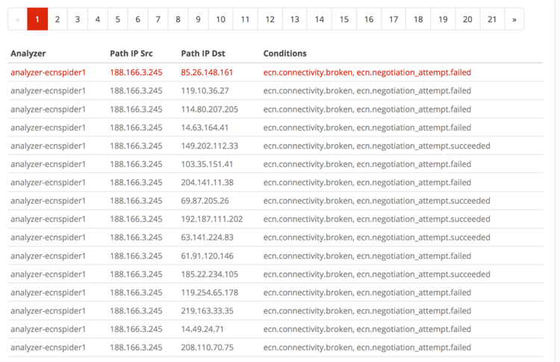
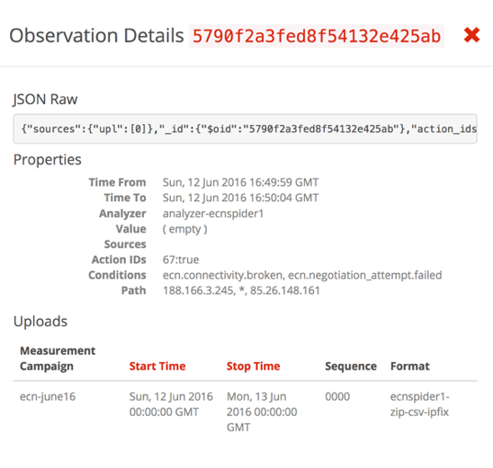
T4.6 – PTO UI Design https://observatory.mami-project.eu/#/observatory
User selects criteria: {t,p,c}
Query is submitted to PTO
PTO queries database
PTO returns JSON to PTO UI
PTO UI renders JSON
Sources on GitHub
https://github.com/mami-project/pto-web

