Slide 1

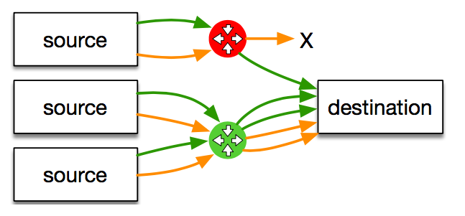



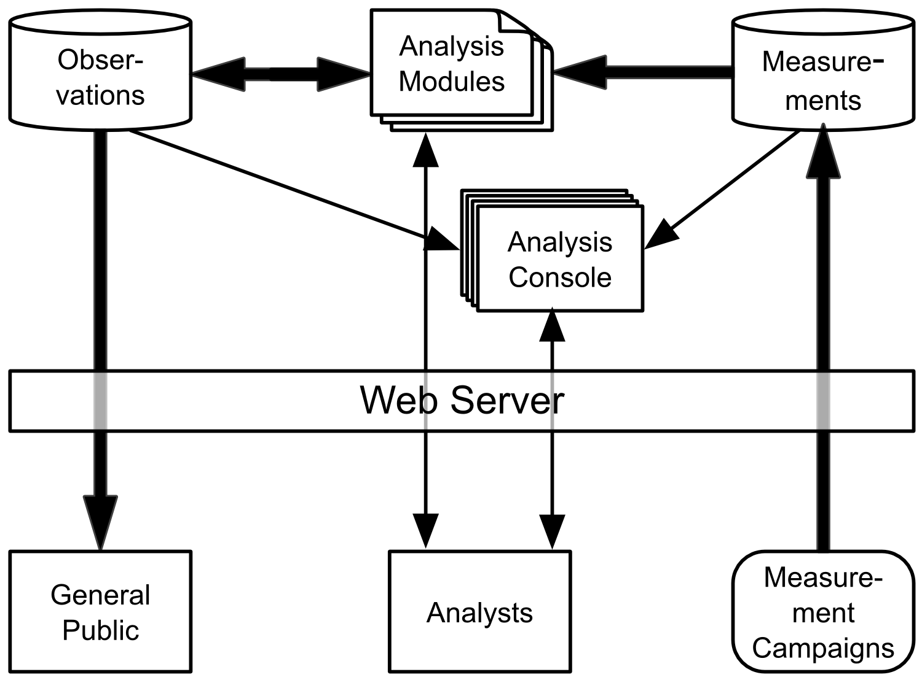

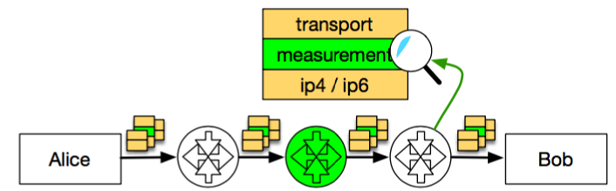
Measurement-based Protocol Design
Gorry Fairhurst (University of Aberdeen), Mirja Kuühlewind (Networked Systems Group, ETH Zurich), and Diego Lopez (Telefonica I+D)
IN-NETWORK FUNCTIONS AND
ENCRYPTION
Many middleboxes in current generation mobile networks [1]
e.g. for NATs, firewall, or performance enhancing as transcoding
often based on clear text information in protocol headers/payload
e.g., TCP sequence and acknowledgement numbers to measure RTT for performances diagnostics
Three driving forces that presents a need for architectural changes:
This raises new questions on the design of transport protocols:
How does encryption impact existing deployed infrastructure?
What options may exist to design new protocols with explicit support for certain in-network function?
What form of operational support would need to be offered when these new protocols are deployed?
[1] Z. Wang, Z. Qian, Q. Xu, Z. M. Mao, and M. Zhang, “An untold story of middleboxes in cellular networks,” in ACM SIGCOMM, 2011.
MEASUREMENT
AS PART OF THE DESIGN PROCESS
Using PATHspider to measure Internet path transparency, publicly available on GitHub https://pathspider.net/
Experimental evaluation focusing on Mobile Broadband network, using MONROE nodes connected to up to 3 providers and WiFi: https://www.monroe-project.eu/
Complemented measurement of the path with tools such as Tracebox: http://www.tracebox.org/
Large-scale data collection from diverse sources in the Path Transperancy Observatory (PTO): http://observatory.mami-project.eu/
Observation: a given condition c was observed on a given path p at a given time t
e.g. that ECN was successfully negotiated, or TFO works
A/B-testing as performed by PATHspider
The end-to-end
ideal
Today’s middleboxed reality
Expanding deployment of encryption
to protect end-user privacy
Restoration of the
end-to-end principle
in the face of
increasing ossification
Dependency on
in-network functionality
to support
network operations
PROTOCOL DESIGN FOR MEASUREMENT
The availability of large scale measurement data enables a new approach to protocol design:
Maps of middlebox manipulation within the Internet provide background for design decisions about protocol engineering and evolution.
The Path Layer UDP Substrate (PLUS) proposes a framework for information exposure with a focus on measurements and diagnosability in a transport-protocol-independent way: see https://datatracker.ietf.org/doc/draft-trammell-plus-spec/
Goals
Increase the likelihood that new protocols will be deployable across the entire Internet, regarding the range of effects from middlebox manipulation on various packet headers
Build-in support for in-network performance measurement to be explicitly designed into next generation network protocol that by default encrypt all end-to-end protocol information
Design Principles
Information exposure has to happen under explicit endpoint control
Least exposure of minimum amount of information required by the proposed mechanism to solve the identified problem, in this case in-network measurement
Trust by verify under the assumption that two endpoints have a trust relation for integrity protection and encryption but there is no requirement for an explicit trust relationship with the network

