Slide 1

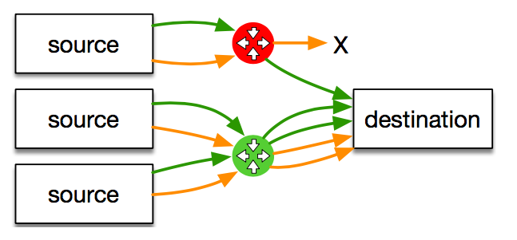




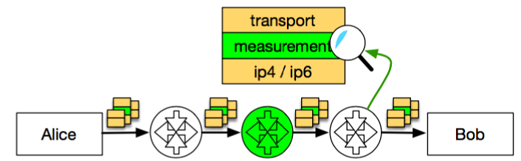
Measurement-based Protocol Design
Gorry Fairhurst (University of Aberdeen), Mirja Kühlewind (Networked Systems Group, ETH Zurich), and Diego Lopez (Telefónica I+D)
IN-NETWORK FUNCTIONS AND
ENCRYPTION
The current generation of mobile networks uses many middleboxes [1], e.g.
NATs, firewall, or performance enhancing proxies, transcoding devices. Often utilising clear text information in protocol headers/payload
TCP sequence and ack numbers. Visibility of the headers support diagnostics and also allow measurement of network performance (loss, RTT, etc.).
Three driving forces present a need for an architectural change:
How should transport protocols be designed for this new architecture?
Does use of encryption impact existing deployed infrastructure?
What operational support is needed to deploy new protocols?
Are there options for protocols to explicitly support specific in-network functions?
[1] Z. Wang, Z. Qian, Q. Xu, Z. M. Mao, and M. Zhang, “An untold story of middleboxes in cellular networks,” in ACM SIGCOMM, 2011.
MEASUREMENT
AS PART OF THE DESIGN PROCESS
The publicly available PATHspider tool can measure Internet path transparency (https://pathspider.net/)
PATHspider and tracebox (http://www.tracebox.org/) are being used to evaluate Mobile Broadband using the MONROE testbed. This is part of a large-scale campaign to understand the real obstacles to deploying new protocol mechanisms over actual network paths.
Data from measurements is being made available from diverse sources in the Path Transparency Observatory, PTO: http://observatory.mami-project.eu/
Observation: a given condition c was observed on a given path p at a given time t
e.g. that ECN was successfully negotiated, or TFO works
A/B-testing as performed by PATHspider
The end-to-end
ideal
Today’s middleboxed reality
Expanding deployment of encryption
to protect end-user privacy
Restoration of the
end-to-end principle
in the face of
increasing ossification
Dependency on
in-network functionality
to support
network operations
PROTOCOL DESIGN FOR MEASUREMENT
Large-scale measurement data is being used to map middlebox manipulation within the Internet.
This provides valuable background for design decisions to engineer new protocols.
The Path Layer UDP Substrate (PLUS) proposes a framework for information exposure with a focus on measurements and diagnosability in a transport-protocol-independent way: see https://datatracker.ietf.org/doc/draft-trammell-plus-spec/
Goals
Enable a protocol designer to query for evidence that a new protocol function would work as the protocol is designed.
Increase the likelihood of new protocols being deployable across the entire Internet.
Opportunities to explicitly design support for in-network performance measurement into next generation protocols that by default encrypt the end-to-end protocol information.
Design Principles
Rewriting the rules allowing the network to use transport information.
Information exposure as a design decision or only under explicit endpoint control
Trust by verify under the assumption that two endpoints have a trust relation for integrity protection and encryption, but generally no requirement for explicit trust relationship with network devices.

