Slide 1

MAMI
Roaming project
Ana Custura

Slide 2
Background
Roam like home- 15th June 2017
MONROE Experimental Setup already in place
Experiments to determine whether or not it really is “roam like home”?

Slide 3
Background
4G/ LTE brings us much higher data transmission rates
Challenge: the need for a seamless user experience when roaming in 4G/LTE (identical to what is received while on the home network?)
Sustainable high performance 4G roaming lies in:
1) The ability to signal as efficiently as possible and
2) Performing efficient signalling in a private, secure and managed environment (IPX environment?)
Notes:
Traditionally, voice traffic interconnection between different operators has utilized the international SS7/TDM networks. However, the all-IP paradigm with VoIP is being rapidly introduced by different operators. In order to minimize the number of conversions between packet-switched voice and circuit-switched voice there is a clear need to deploy an IP based NNI (Network-to-Network Interface) and therefore an IP based interconnection network.

Slide 4
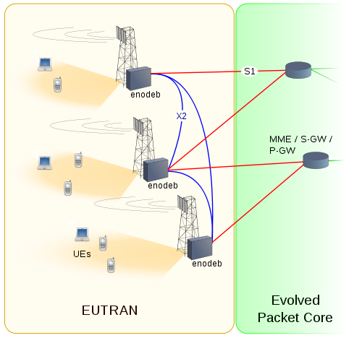
LTE 101
Radio access network
Base stations (Node Bs)
MME/SGW – mobility management entity
Serving gateway
Further into PGW, packet gateway
Services and functions (eg charging – not displayed)
Various protocol stacks bind these together

Slide 5
Roaming
Home routing
Break out from visited network:
-with Home operator application
-with Visited operator application

Slide 6
Experimental Setup
6 countries, 16 operators, each country has two MONROE node
Norway: Telia, Telenor
Sweden: Telenor, Tre, Telia
Spain: Orange, Vodafone, Movistar
Germany: Vodafone, O2, T-Mobile
UK: EE, Vodafone
Italy: Vodafone, TIM, WIND
+ One measurement server per country
Measure one operator at a time (all nodes have the SAME SIM at the same time)

Slide 7
Roaming – flow
In all MONROE nodes – same operator SIM cards active
For each roaming SIM card, we identify the visited network, and insert the corresponding SIM for measuring native performance
Aiming to collect all measurements by the end of February/March
Force the devices in 3G and make a comparison study with 4G

Slide 8
Roaming experiments
Focus: 4G vs 3G:
- Periodic traceroutes against measurements servers in both 3G and 4G
- Looking for type of routing (home or breakout)
- Looking for infrastructure differences between 3G and 4G
General network characteristics:
- Netalyzr
- Performs address-based tests (NAT detection), reachability tests (common ports), access link properties (latency, bandwidth, buffers),
HTTP (proxy detection, filtering, caching behaviour) and DNS tests.

Slide 9
Roaming Experiments- II
Network interference detection:
-ooniprobe targeted against global and geo lists
-looks at website accessibility and HTTP header manipulation
- are visitors subjected to the same censorship as natives?
DNS performance
- DNS manual tests
- looks at local DNS performance compared to OpenDNS and Google DNS when resolving a list of advertiser and tracker names;

Slide 10
Roaming Experiments- III
DSCPs:
- edgetrace against UoA server
- compare received DSCPs among different networks, correlate them with type of roaming routing- whose infrastructure do they depend?
- validate previous results
Traffic differentiation experiments
WebWorks container
  web performance testing

Slide 11
Next steps
Complete the experiments – 6 operators to go
Analyse the results- this has just started.
Disseminate the results

