Slide 1


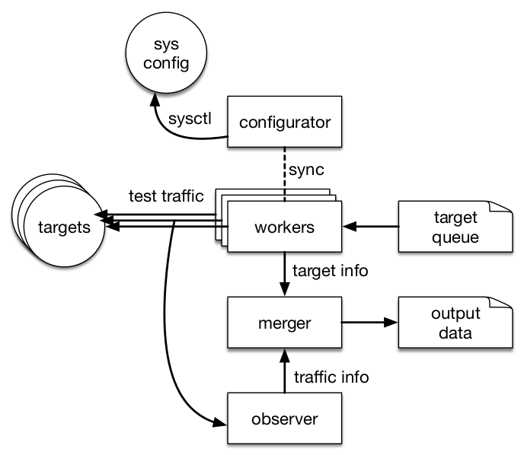
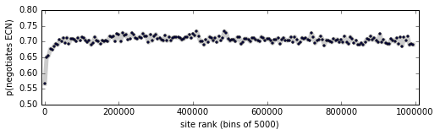
PATHspider: A tool for active measurement of path transparency
Iain Learmonth Brian Trammell Mirja Kühlewind Gorry Fairhurst
iain@erg.abdn.ac.uk trammell@tik.ee.ethz.ch mirja.kuelewind@tik.ee.ethz.ch gorry@erg.abdn.ac.uk
Introduction
PATHspider performs large-scale A/B testing between two different protocols or different protocol extensions to detect protocol-dependent connectivity problems as well as differential treatment. With PATHspider The actual A/B test can be easily customized via a plugin framework.
Connectivity problems can arise from the increasing number of middleboxes in the Internet where either accidental or intentional manipulation causes a connection to fail.
The end-to-end
ideal
Today’s middleboxed reality
Architecture
Results
Explicit Congestion Notification (ECN)
An ECN measurement from one vantage point at Digital Ocean near AMSIX (Amsterdam NL) on June 13, 2016:
Modify system configuration (e.g. set iptables rules, enable ECN) for a given test state
 | IPv4 | IPv6 | all
Connectivity indep. of ECN | 99.5% | 99.9% | 99.5%
ECN successfully negotiated | 70.0% | 82.8% | 70.5%
High worker concurrency, since most time is spent waiting on replies.
ECN negotiation by Alexa rank bin: note this is nearly uniform, but higher-ranked servers tend to disable ECN:
Passively observe generated traffic to determine network reaction to test
Each plugin consists of functions for generating test traffic, observing the resulting packets, and merging data into pre-analyzed observations. Each plugin handles a particular type of impairment (e.g. ECN, TFO, DSCP).
DiffServ Code Points (DSCP)
Getting Started
Initial study: 10006 out of 96978 (10.31%) of Alexa Top 100k websites had unexpected, non-zero DSCP values. More measurement is necessary to better characterize these anomalies.
PATHspider is available in debian unstable:
$ apt install pathspider
0.9.0 alpha was released shortly before ANRW!
Active development on new plugins (e.g. SCTP, UDP-Lite, MPTCP), enhancements, and integration with the MAMI Path Transparency Observatory continues.
TCP Fast Open (TFO)
Initial study: 330 IPv4 and 32 IPv6 addresses in Alexa Top 1M are TFO-capable (of which 278 and 28 are Google properties). DDoS prevention services, enterprise firewalls, and CPE tend to interfere with TFO. More measurement is necessary to analyze impairments.
Learn more at https://pathspider.mami-project.eu/

