Slide 1
WP 1: Measurements
Benoit Donnet, Brian Trammell, Stephan Neuhaus
Brussels, October 21st 2016

Slide 2
Agenda
Overview
Measurement Tools
Data Storage
Publications
Conclusion

Slide 3
Agenda
Overview
Measurement Tools
Data Storage
Publications
Conclusion

Slide 4
Overview - Goals
Large-scale measurements on the dynamics of the packet mangling by middleboxes
Measurement tools development
Data
storage
availability

Slide 5
Overview - What we are doing?
Methodology and Measurement Tool Design [1.1, in progress]
tracebox: middlebox detector, integration with scamper
PATHSpider: A/B path impairment testing, new plugins and framework improvements
copycat: UDP/TCP differential treatment detection
NAT Revelio: CGN detection
Measurements
Initial Measurements and Middlebox Detection [1.2, in progress]
atlas, copycat/tracebox on Ark, PathSpider ECN, TFO, DSCP runs.
large-scale measurements [1.3, from January 2017]
based on experience gained from 1.2
Data Model and Middlebox Observatory [1.4, in progress]

Slide 6

Overview - Timeline 2016 (Y1)
MS4
31.12.
Observatory
public release
PATHspider release
Berlin plenary
ANRW
First review
(we are here)
jan
feb
mar
apr
may
jun
jul
aug
sep
oct
nov
dec
RIPE, IRTF
presentations
on Atlas UDP/TCP
measurements
MS1
31.10.
Observatory
internal release
Initial Report
31.12.
D1.1
Notes:
MS1: Initial observatory can be accessed by all partners to retrieve or store measurement data

Slide 7
Overview - Timeline 2017 (Y2)
Middlebox
Observatory
Design and Data Model
31.12.
D1.2
MS6
june ‘17
MAMI/MONROE
Joint Workshop
TMA
2017
Second
review
jan
feb
mar
apr
may
jun
jul
aug
sep
oct
nov
dec
T1.3
transition to large-scale
measurements
IMC
2017
CoNEXT
2017
Notes:
MS1: Initial observatory can be accessed by all partners to retrieve or store measurement data

Slide 8
Overview - Who does what?
so far, this has been achieved or is ongoing
Partner | MM | Task 1.1 Methodology and Tools | Task 1.2 Initial Measurement | Task 1.3 Large-Scale Measurement | Task 1.4 Data Model and Observatory
ETH | 20 | ✓ pathspider (+mPlane SDK) | ✓ | ✓ Edit D1.3 (2018) | ✓ Edit D1.2 (2017)
ULg | 12 | ✓ tracebox + copycat | ✓ Edit D1.1 (Dec)
UoA | 15 | ✓ pathspider | ✓ | ✓
ZHAW | 8 |  |  |  | ✓
SRL | 6 | ✓ revelio |  | ✓

Slide 9
Agenda
Overview
Measurement Tools
tracebox
PATHSpider
copycat
NAT revelio
Data Storage
Publications
Conclusion

Slide 10
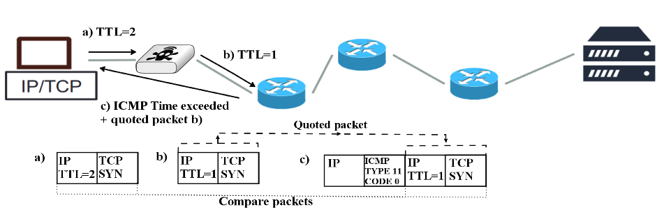
tracebox - Concept

Slide 11
tracebox - Data overview
Already collected
PlanetLab (Top 1M Alexa)
March 2016 → July 2016
1/4 of the dataset is already in the Observatory
Being collected
PlanetLab (Top 1M Alexa)
Archipelago (IPv6)
To-be collected
RIPE Atlas
Started collecting data
MONROE

Slide 12
tracebox - Mobile networks
Data collected with traceboxAndroid
Dataset
214 users, from 45 countries
80 carriers
252 wifi networks
mobile phones
cellular: 37 rooted, 70 unrooted
wifi: 61 rooted, 211 unrooted
Will be uploaded asap in the Observatory

Slide 13
tracebox - Mobile network algorithms
Among others
Proxies detection
NAT detection
Options feasibility tests

Slide 14
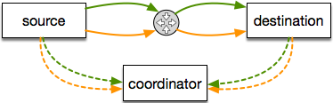
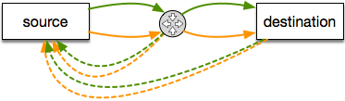
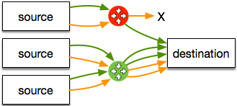
PATHSpider - Background
Active measurement of path transparency
Basic methodology
throw a bunch of packets at the Internet
see what happens.
Ideal: two-ended A/B testing
Scalable: one-ended A/B testing
Multiple sources: isolate on-path from near-target impairment
PATHspider provides a framework for generalizing and scaling the one-ended approach.
Details: see https://pathspider.net

Slide 15
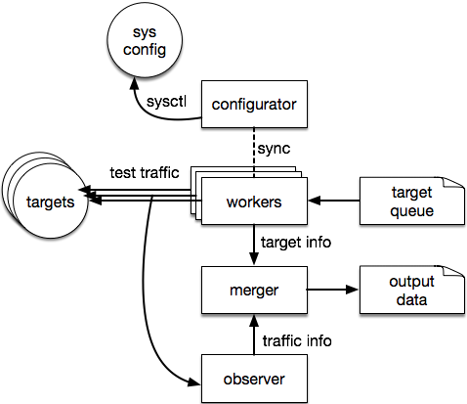
PATHSpider - Architecture
Configurator: puts system into configuration A or B (e.g., sysctl)
Workers: generate test traffic
Observer: passively observes test traffic
Merger: combine information about active measurement with passive observations.
Plugins allow for customizing traffic generation and observation for each kind of test (ECN, DSCP, TFO, etc.)
Output fed into Path Transparency Observatory
Notes:
sysctl => configure kernel parameters at runtime
DSCP: differentiate service code point

Slide 16
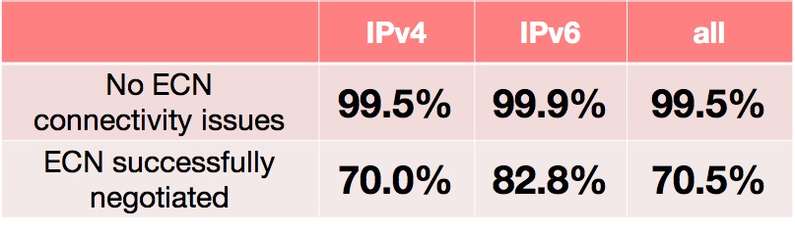
PATHSpider - Data overview
Explicit Congestion Notification (ECN) to Alexa top 1M websites:
Cited in June ‘16 Apple announcement to activate ECN by default.
Differentiated Services Codepoint (DSCP): ~10% of Alexa top 100k have unexpected DSCP values on downstream. Non-zero DSCP causes connection failure on up to 0.07% of paths.
TCP Fast Open (TFO): 0.1% of Alexa top 1M supports TFO (mostly Google). CPE, anti-DDoS sites impair TFO.
More detailed DSCP and TFO measurements under submission to PAM ‘17
Data being currently collected on MONROE
Notes:
8 millions of ECN observations already in the observatory

Slide 17
copycat - Basics
UDP encapsulation to circumvent middleboxes impairments (SCTP, QUIC, SPUD)
Does the path discriminate flows based on transport?
Study with copycat
differential treatment
connectivity, QoS, ...
is transport protocol X less ossified than Y?
e.g., TCP vs. UDP
Details at https://github.com/mami-project/udptun
Notes:
a new tool for comparing TCP loss, latency, and throughput with UDP by generating TCP-shaped traffic with UDP headers.

Slide 18
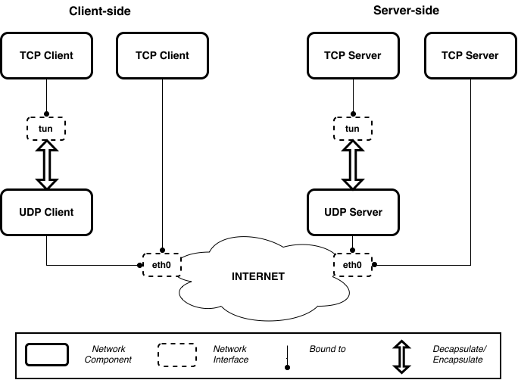
copycat - Architecture
runs pairs of flows between 2 end-points
one TCP flow
one TCP flow user UDP as outer transport
same 4-tuple between both flows
copycat uses a tun virtual network interface for encapsulating TCP within UDP
both ends are under control
Notes:
example for TCP vs. TCP-inside UPD => particular case than can be extended

Slide 19
copycat - Dataset
PlanetLab
full mesh measurements between 93 PL machines
March 6th, 2016 → April 23rd, 2016
already in the Observatory
DigitalOcean
full mesh measurements between 6 DO machines
May 2nd, 2016 → May, 12th, 2016
IPv4 and IPv6
already in the Observatory
+ RIPE Atlas pings

Slide 20
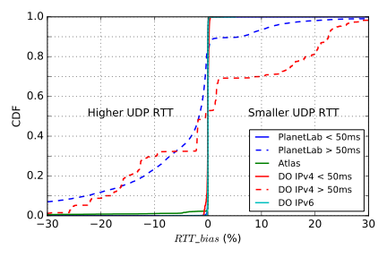
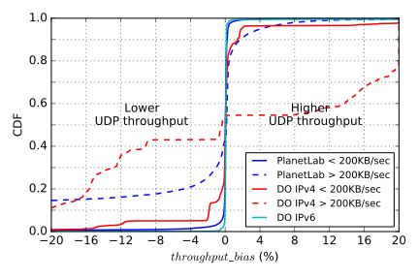
copycat - UDP vs. TCP results
UDP connectivity bias: -1% to -5% depending on ports

Slide 21
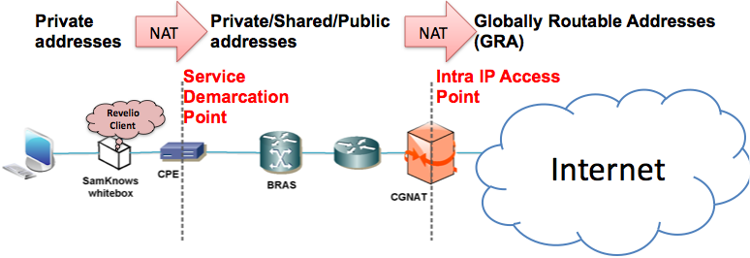
NAT Revelio - Basics
Detect the usage of private/shared address space beyond the service Demarcation device (CPE), in the ISP access network
Detection the location (home network or ISP access network) device doing the translation to the GRA of the subscriber
Notes:
CPE: Customer Premise Equipment => located in client site and connected to the ISP infrastructure in a PoP through a local loop.
BRAS: BRoadband Access Server => ensure interconnection between the DSLAM in the xDLS network and the ISP network
CGNAT: Carrier-Grade NAT => NAT444 (allows the ISP to reduce the amount of IPv4 addresses required for clients)
Details at https://github.com/alutu/revelio

Slide 22
NAT Revelio - Phases
The NAT revelio test suite includes 2 phases
environmental characterization
understand the environment hosting the device running the Revelio client
objective: avoid NAT444 false positives
NAT444 discovery
detection of signals that the ISP might deploy a NAT444 solution in the ISP access network
objective: access link detection
Notes:
NAT444 false positives:
- Diverse home network configurations, e.g. In-home cascaded NAT, with probe NOT connected directly to the CPE (that is the Service Demarcation device) - Diverse ISP configurations and deployments e.g. use of private IP addresses internally even if they don’t do NAT444

Slide 23
Agenda
Overview
Measurement Tools
Data Storage
Path Transparency Observatory
Publications
Conclusion

Slide 24
Path Transparency Observatory (PTO)
Make decisions about deployability with data
Active measurements made by the project
External measurements (e.g. traceroutes, BGP, traces)
Focus on easing replication and providing insight to Internet operations community and general public
More details, front-end demo this afternoon
active A/B test
(PathSpider)
observations
{t,p,c,v}
traceroute
preanalysis
preanalysis
looking glass
mod trace
(tracebox)
etc.

Slide 25
Agenda
Overview
Measurement Tools
Data Storage
Publications
Conclusion

Slide 26
Publications - Papers
S. Neuhaus, K. Edeline, B. Donnet, E. Gubser. Towards an Observatory for Network Transparency Research. In Proc. Applied Network Research Workshop (ANRW). July 2016
I. Learmonth, B. Trammell, M. Kühlewind, G. Fairhurst. PATHspider: A Tool for Active Measurement of Path Transparency. In Proc. Applied Network Research Workshop (ANRW). July 2016
M. Varvello, J. Blackburn, D. Naylor, K. Papagiannaki. EYEORG: A Platform for Crowdsourcing Web Quality of Experiment Measurements. In Proc. ACM CoNEXT. December 2016

Slide 27
Publications - Presentations
M. Kühlewind. What if We Designed Measurement as a First-order Service? RIPE 72 RACI, Copenhagen (Denmark), May 2016.
B. Trammell. Internet Path Transparency Measurements using RIPE Atlas. RIPE 72 MAT WG, Copenhagen (Denmark), May 2016.
B. Trammell, Can we run the Internet over UDP?, IRTF MAPRG, Buenos Aires (Argentina), April 2016.
B. Trammell, M. Kühlewind. On Explicit In-Band Measurement. Cisco - Ecole Polytechnique Network Innovation and Research Symposium, Paris (France). March 2016.
M. Kühlewind, B. Trammell. Middlebox Measurement and Cooperation. CleanSky Conference, Heidelberg (Germany). February 2016.
B. Trammell. A Path Transparency Observatory. Seminar on Global Measurements: Practice and Experience, Dagstuhl (Germany). January 2016.

Slide 28
Publications - Technical Reports
K. Edeline, M. Kühlewind, B. Trammell, E. Aben, B. Donnet. Using UDP for Internet Transport Evolution. To be published in arXiv

Slide 29
Agenda
Overview
Measurement Tools
Data Storage
Publications
Conclusion

Slide 30
Conclusion
Progress has been done, since the beginning of the work package, on all front lines
tools have been developed
tools have been deployed and a first dataset is already available
Work still to be done on those tools
Deliverable 1.2 will be provided on time

Slide 31
Conclusion - Next steps
Short term (end of 2016)
MS4
Observatory public release
Deliverable D1.1, report on initial measurements
Adapt traceboxAndroid algorithms to standard tracebox
Measurements on MONROE
tracebox
PATHSpider
Mid term (early 2017)
Task T1.3
more analyses modules to integrate all measurement data in the Observatory
Notes:
T1.3: large-scale measurements

