Slide 1
A Vision for Explicit
Path-Cooperative Transport
Mirja Kühlewind and Brian Trammell, ETH Zürich Joe Hildebrand, Cisco Systems
Innovations in Clouds, Internet, and Networks Paris, 1 March 2016

Slide 2



The MAMI Project
Measurement and Architecture for a Middleboxed Internet
Strong interaction with relevant standards organizations for impact on deployment
FIRE testbed (MONROE) support for measurement as well as experimentation, especially on mobile broadband access networks
Learn more at http://mami-project.eu/
of deployed middleboxes
for middlebox cooperation
of use case applicability and deployability

Slide 3
Overview
Why do we need explicit middlebox cooperation?
Why do we need a shim layer for this?
Is it deployable?
How do we have to design the protocol to make it deployable?

Slide 4
Why explicit middlebox cooperation?
Deployment problems of new protocols and protocol extension due to ossification in the Internet, e.g.
Multipath TCP
QUIC (over UDP)
Operation and management of in-network functionality hindered due to increasing deployment of encryption, e.g.
firewalls using port mapping or DPI
performance enhancements in mobile networks

Slide 5






Why a new shim layer?
Transport layer: end-to-end sockets
flow information
Internet layer: hop-by-hop handling
per-packet information
stateful and ‚smart‘ processing at the edge
Missing:
Per-flow information for
stateful in-network functions
stateless and simple processing in the middle
Path layer for explicit cooperation with middleboxes instead of implicit assumptions

Slide 6
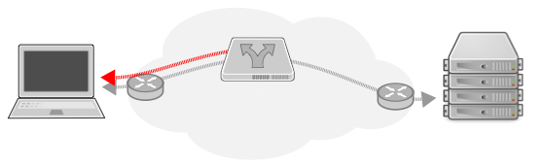
Path Layer: (Basic) Functional Requirements
Grouping of packets into flows
Extensibility to provide per-flow network information
Explicit feedback channel from middlebox to endpoint
magic
group/tube/flow id
resv
option space …
checksum

Slide 7
Why should I trust what you say about your flows?
Default: trust but verify
declarative signaling: no negotiation, no guarantees
the best way to prevent cheating is to make it useless to do so
minimize the information exposed!
Leverage existing trust relationships for higher-assurance declarations
e.g. your enterprise firewall, access network middleboxes, etc.

Slide 8
Example 1:
Firewall Traversal
Problem
UDP often blocked as it is hard to maintain state
Needed
group ID
start/stop signal and confirmation by receiver (‚SYN/ACK’)
Action
firewall can forward first packet and set up state based on confirmation from receiver
group ID must be large enough to not be guessable

Slide 9
Example 2:
Low Latency Support
Problem
Network service not optimized for latency sensitive traffic
Needed
Flag to signal loss sensitivity vs. latency sensitivity
Action
network device can treat latency sensitive traffic differently, e.g. in a separate smaller queue
trade-off between loss and latency gives no incentive to lie

Slide 10
Will it deploy?
Transport-layer encapsulation over UDP
Need ports for NAT
Impossible to deploy with new protocol number across the Internet
Userspace (and kernelspace) implementation possible
Magic number for easy recognition, protection against reflection
Flags for “SYN/ACK” condition for state decision delegation to endpoint
All traffic bidirectional
Data in first packet possible
Signals fit in a single packet (no segmentation or reliability)
Checksum for error detection, cryptographic integrity checks available

Slide 11
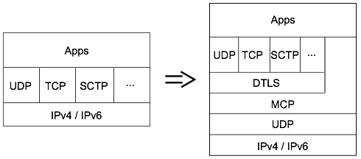
Implementing an Explicit Path Interface
Application can directly indicate requirements to path layer
Transport can use the path layer to expose parts of its functionality/intentions to the network
Middlebox Cooperation protocol (MCP) signals these information appropriately to on-path middleboxes
Minimize the information exposed!

Slide 12
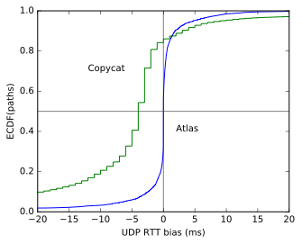
Is it possible to run the Internet over UDP? Preliminary Results
A/B testing for TCP/UDP connectivity
Copycat tool on 120 PlanetLab nodes
3,67% UDP blocking on port 33435
2,7% UDP blocking on all tested ports (33435,1228, 8008, 12345)
RIPE Atlas traceroute
3.661% UDP blocking based on existing traceroutes
We are currently running more measurements!
Use all existing testbeds available, e.g. CAIDA Ark, MONROE
Other impairment measurements: TCP Options, SCTP, …

Slide 13
Path Transparency Observatory
Observatory (public release end 2016) to derive common observations about conditions on a given path at a given time
Active measurements, made by the project
External measurements (e.g. traceroutes, BGP, traces)
Combining disparate measurements leads to better insight
How likely is it that a certain path impairment impacts my traffic?
Follow http://mami-project.eu for updates on data model & availability!
active A/B test
(PathSpider)
observations
{t,p,c,v}
traceroute
preanalysis
preanalysis
looking glass
mod trace
(tracebox)
etc.

Slide 14
References
Substrate Protocol for User Datagrams (SPUD) in the IETF: spud@ietf.org
draft-trammell-spud-req
draft-kuehlewind-spud-use-cases
draft-hildebrand-spud-prototype
IAB Stack Evolution Program
Workshop on Stack Evolution in a Middlebox Internet (SEMI) 2015 [RFC7663]
B. Trammell, J. Hildebrand: Evolving Transport in the Internet
IRTF research group on Measurement and Analysis for Protocols (MAPRG): maprg@irtf.org
MAMI webpage (mami-project.eu) or twitter (@mamiproject)

