Slide 1
WP2: Experimentation
Korian Edeline, Benoit Donnet (ULG)
MAMI Plenary, Berlin, Thursday 14 July 2016

Slide 2
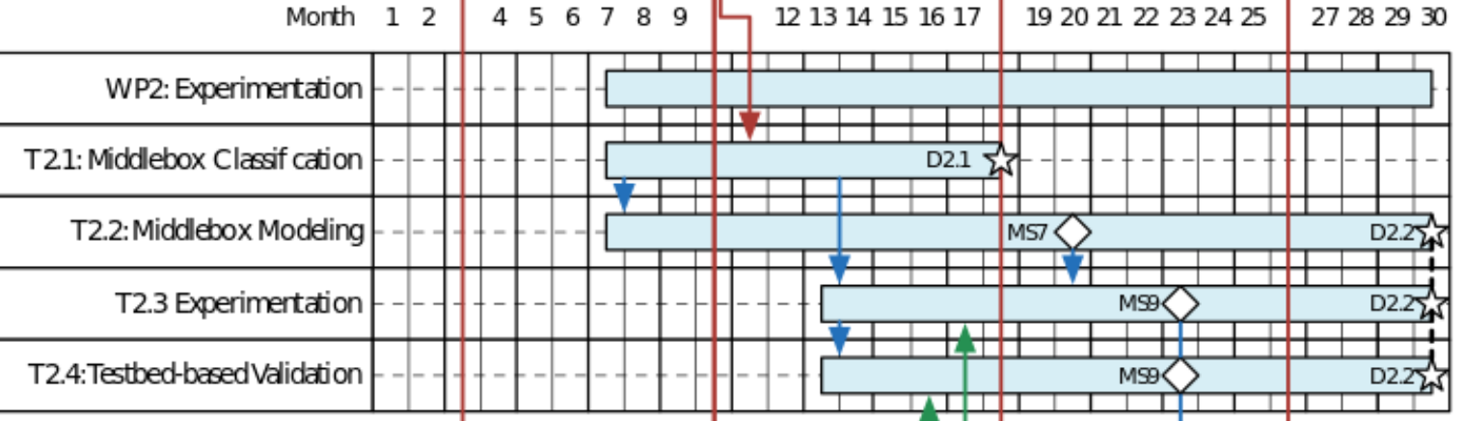
WP2 recap
Starts July 2016
  T2.1 Middlebox Classification (ULg, Aberdeen, SRL)
  T2.2 Middlebox Modeling (ULg, TID)
Starts January 2017
  T2.3: Model/NFV-based Experimentation (ETH, Aberdeen, SRL)
  T2.4: Testbed-based Validation Approach (ETH, Aberdeen, SRL)
Berlin Plenary

Slide 3
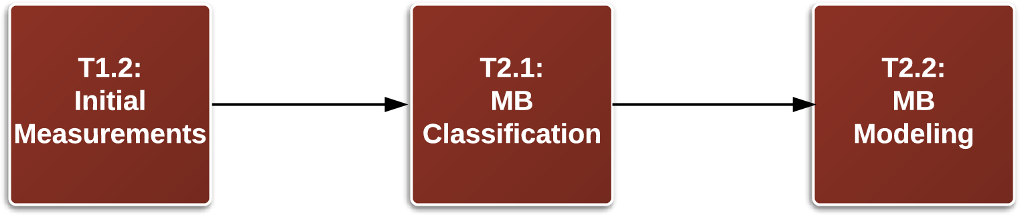
WP2 Early Plan
Data
Classification
Class models

Slide 4
Tracebox Datasets
Collected data:
  PlanetLab
Being-collected data:
  Ark (IPv6)
To-Be-Collected data:
  RIPE Atlas
Additional data (SRL ?):
  MONROE, NORNET
Berlin Plenary

Slide 5
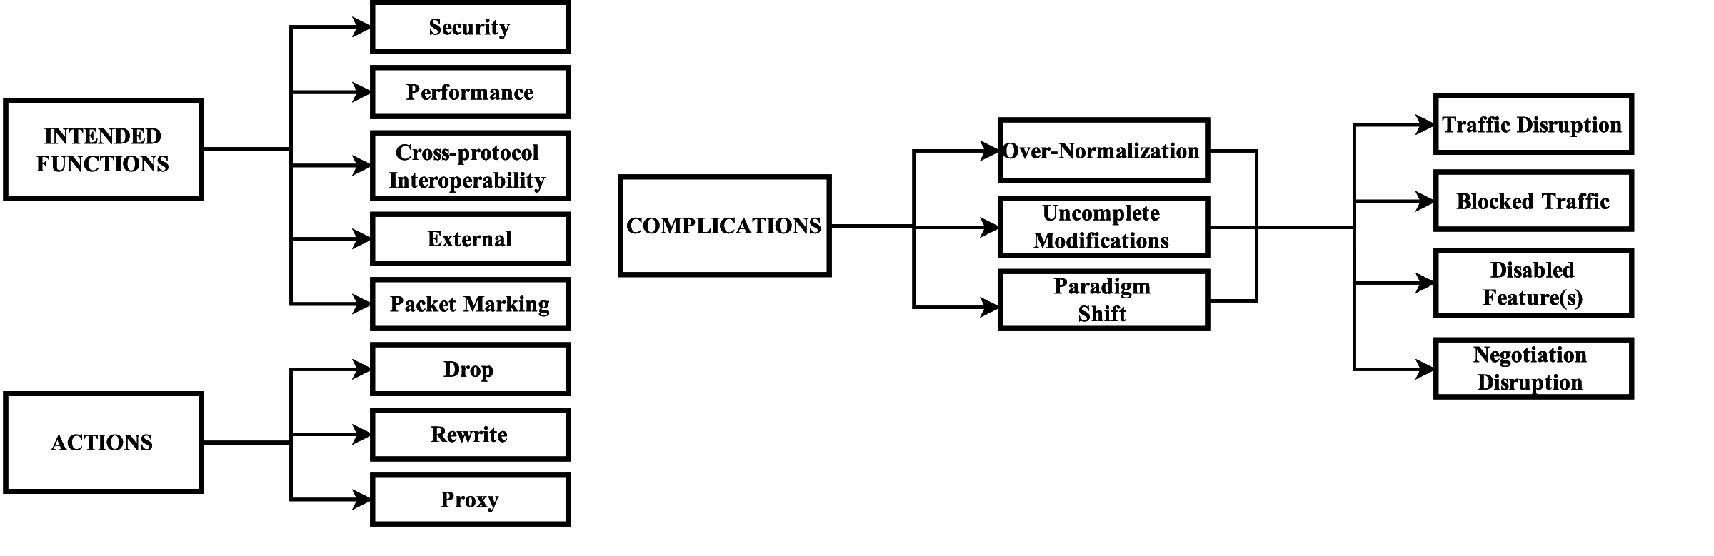
Classification
Taxonomy
Extend with:
Persistence (Temporal aspect)
Positionning (Location on the path)
Carpenter, B., & Brim, S. (2002). Middleboxes: Taxonomy and issues (No. RFC 3234).
Edeline, K., & Donnet, B. (2015, April). Towards a middlebox policy taxonomy: Path impairments. In 2015 IEEE Conference on Computer Communications Workshops (INFOCOM WKSHPS) (pp. 402-407). IEEE.
Berlin Plenary

Slide 6
Classification
Planned PAM16 submission
Berlin Plenary

Slide 7
Modeling
Simulator
Netkit
  http://wiki.netkit.org/index.php/Main_Page
Netkit + Click (MBTest)
  https://bitbucket.org/bhesmans/mbtest/src
Mininet (Any experienced user ?)
  http://mininet.org/
Berlin Plenary

